Slide 1
















Thanh Am Primary School
Welcome to English class
Teacher: Ngoc Khue
Notes:
Để nguyên trang bìa như này, chỉ thay đổi tên bài trong quá trình làm. Logo của sách Wonderful World

Slide 2







4
GO HOME
Notes:
Để nguyên trang bìa như này, chỉ thay đổi tên bài trong quá trình làm. Logo của sách Wonderful World

Slide 3



Unit 7 MY FAVOURITE SPORT
Lesson 3. Task 4,5,6

Slide 4
01
WARM UP
Listen to the song

Slide 5
PRESENTATION
02

Slide 6
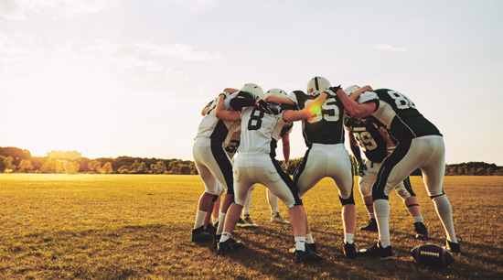
Are you playing with your team ?
- Yes, I am.

Slide 7

Is she running?
- No, she isn’t.

Slide 8
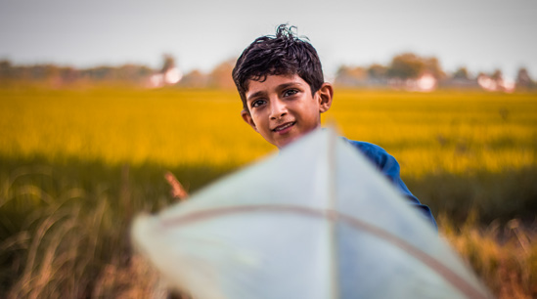
Is he flying a kite?
- Yes, he is.

Slide 9

Task 4. Listen and repeat.
Are you playing
with your team? - Yes, I am .
Is she running?
- No, she isn’t.
- Is he flying a kite ?
- Yes, he is.

Slide 10

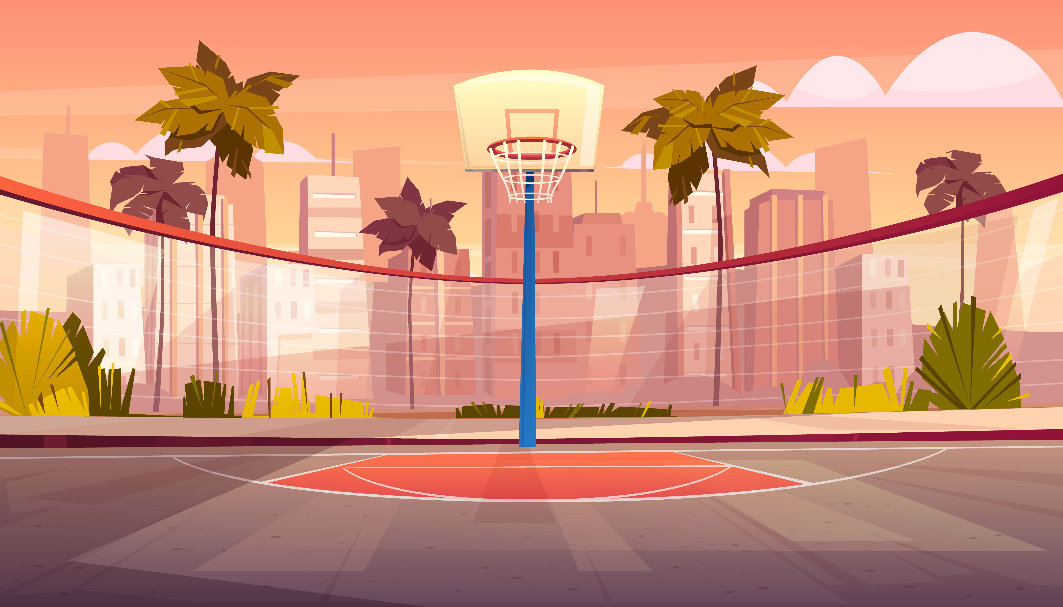

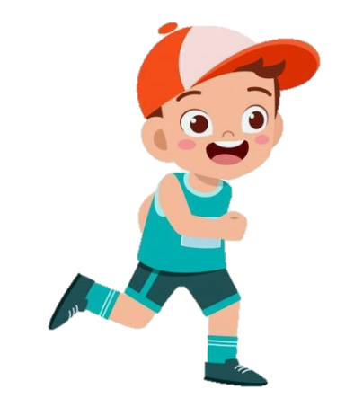


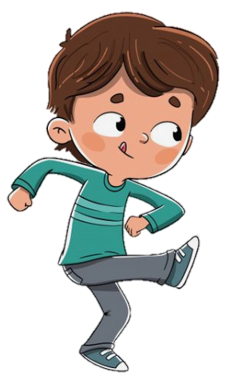
Checking Game
TPR GAME
Checking Game
Notes:
One student is doing the action what he likes . And student is standing in front of him so that he can’t see what other S is doing and then, guess and say the action. :
Is he …..? All the class has to answer yes/ no
And Sts can guese three times to find the correct action and get stars .

Slide 11

Is she running ?
No, she isn’t.

Slide 12

03
PRACTICE

Slide 13
04 PRODUCTION

Slide 14
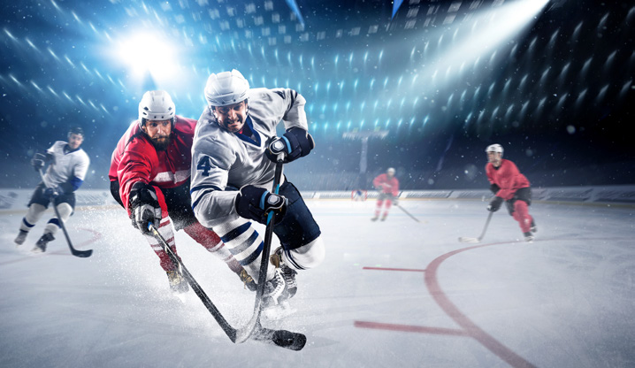
HOCKEY

Slide 15


Is he playing hockey ?
Is he hitting and running?

Slide 16
Hockey is cool! Hockey is great! Look at us now, we’re playing hockey! We’re hitting and running. We aren’t catching or jumping. Come on, play hockey with us!
Task 6. Listen and sing

Slide 17
05
ASSESSMENT

Slide 18
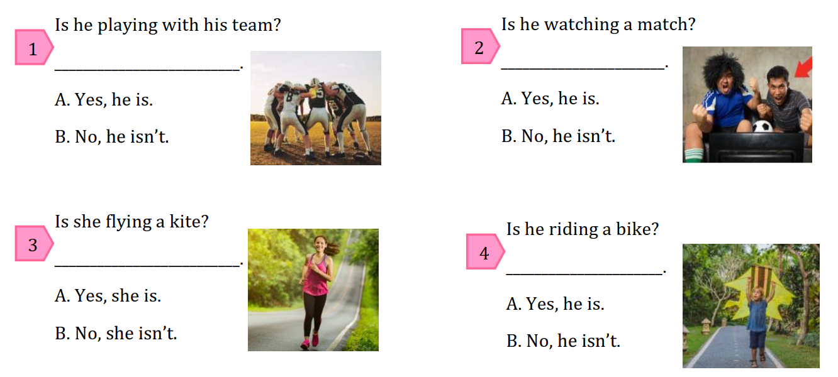
Look and circle the correct answers.
Notes:
HOẠT ĐỘNG TƯƠNG TÁC : THE BALL AND MUSIC , Sts pass the ball when the music plays. And when music stops, Sts is holding the ball who will answer the question and take the stars .

Slide 19

THANK YOU

