Slide 1
















Thanh Am Primary School
Welcome to English class
Teacher: Ngoc Khue
Notes:
Để nguyên trang bìa như này, chỉ thay đổi tên bài trong quá trình làm. Logo của sách Wonderful World

Slide 2



Unit 7:
My Favorite sport
Lesson 1-Task 1,2,3

Slide 3

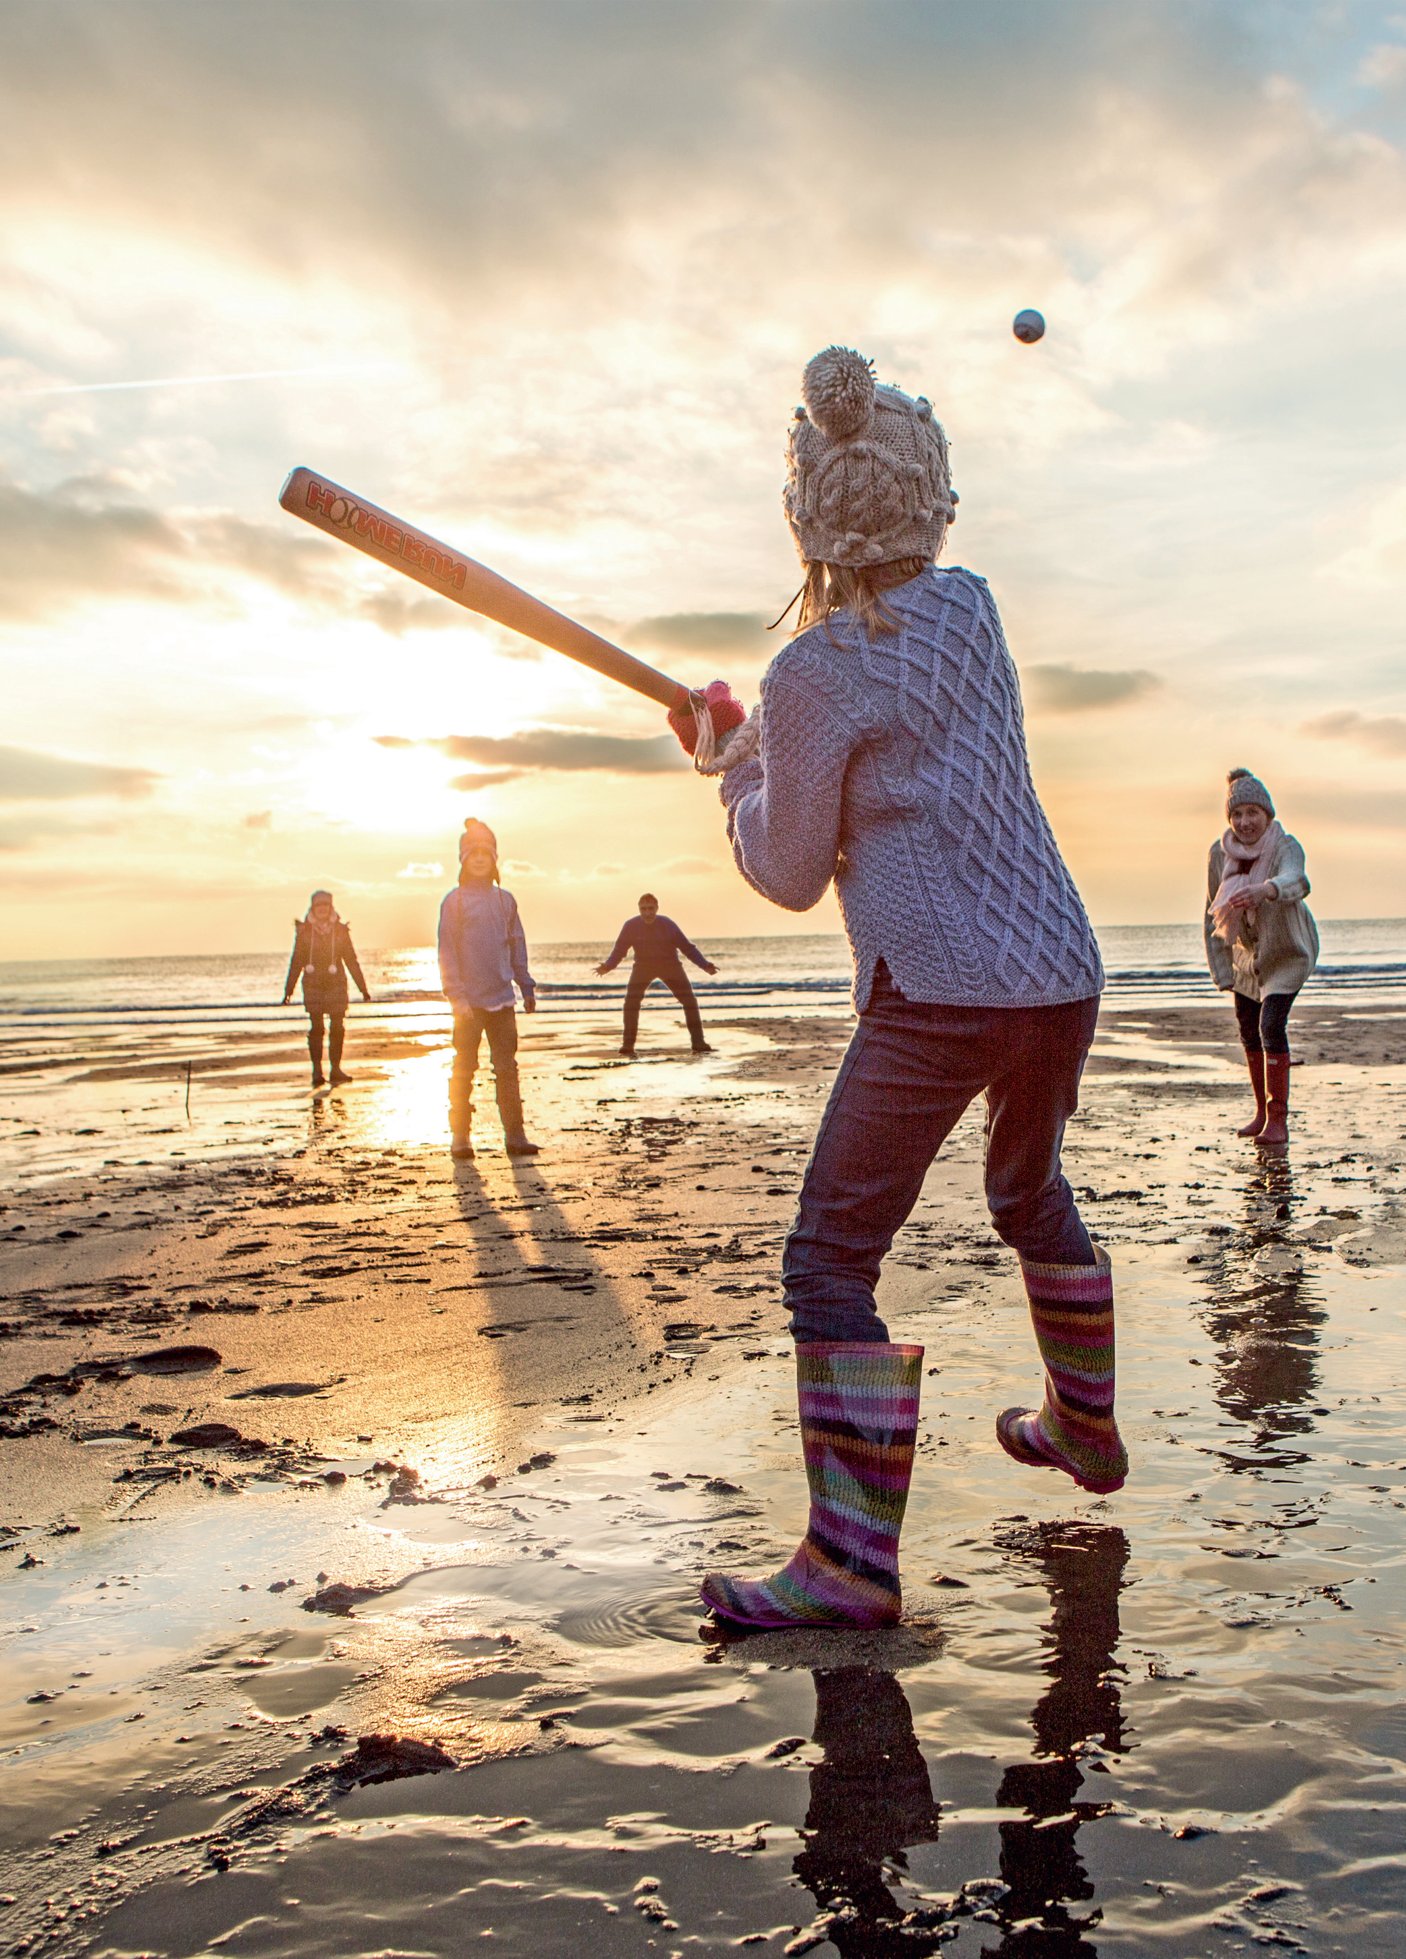
Look and tick what you see
✓
boots
dress
✓
✓
hat
coat
Family on the beach

Slide 4


Presentation

Slide 5



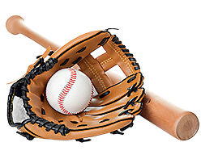

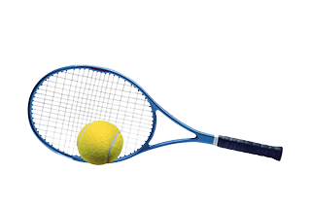
baseball
basketball
football
hockey
tennis
Notes:
Click at the words to listen the sounds.

Slide 6

VOCABULARY CHECKING
Mini game
Notes:
Ask 5 students to hold the flashcards . T stand behind and point to one st
Ask class to say the word aloud, the st holding the picture with that word will raise the picture.

Slide 7




Slide 8




1. Listen and point. Repeat

Slide 9


Slide 10
Practice

Slide 11

2. Listen and tick

Slide 12
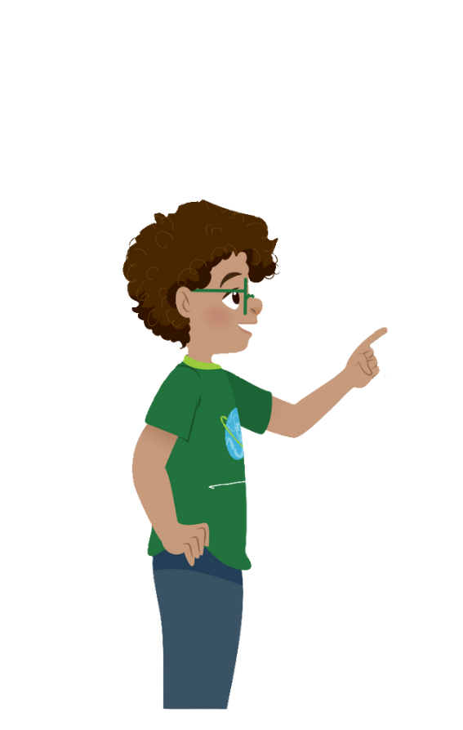
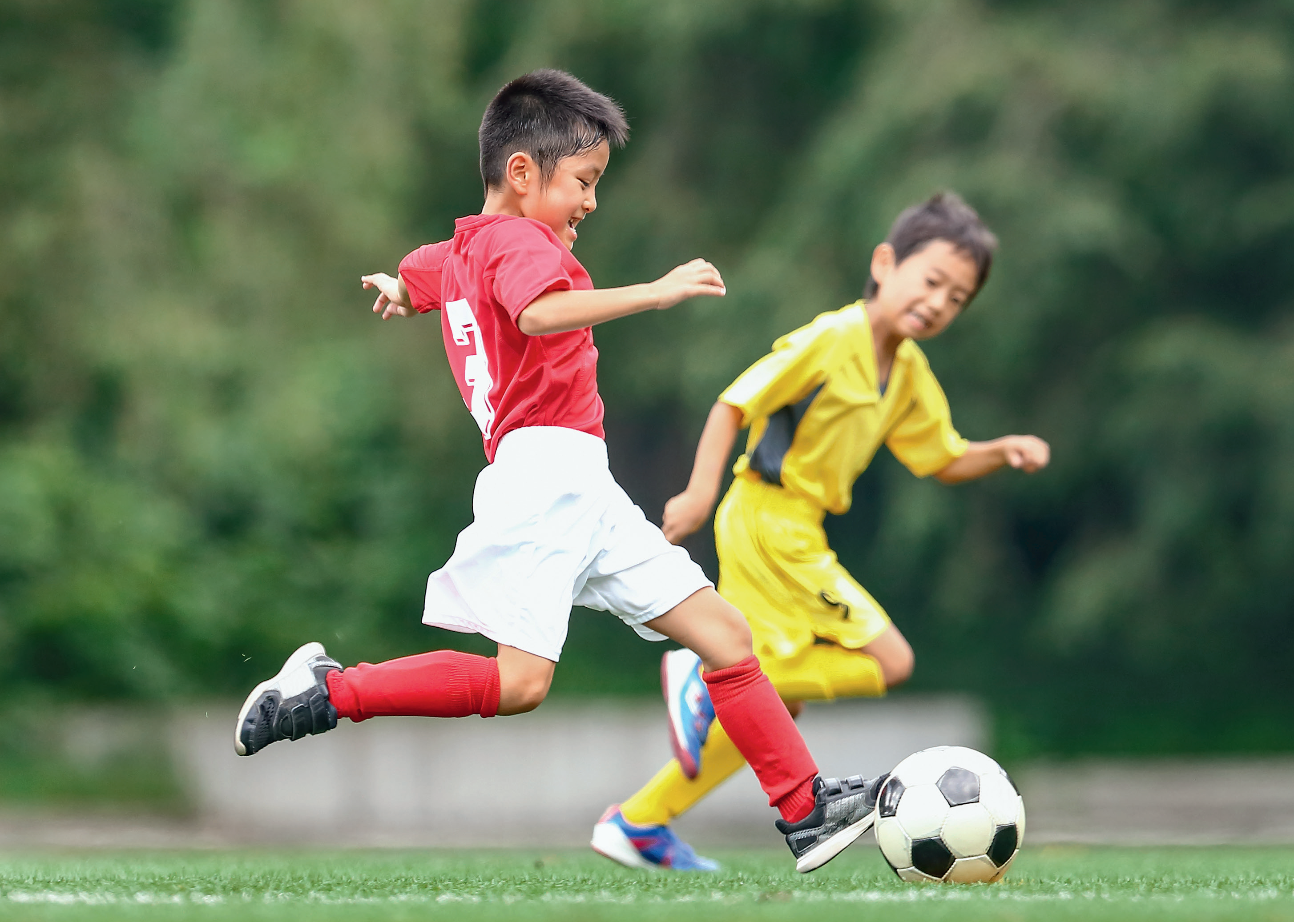

That is my brother, Phan . He’s playing football.
Can you play football , Tim ?
I can play football, too. Come play with my brother !
Yes, I can .
That’s fun
Cool !
✓
Can Tim play football ? Yes, he can. No, he can’t.
Tim

