Slide 1




















Notes:
Để nguyên trang bìa như này, chỉ thay đổi tên bài trong quá trình làm. Logo của sách Wonderful World

Slide 2

01 Warm-up

Slide 3
02 Presentation Task 4-Listen and repeat

Slide 4
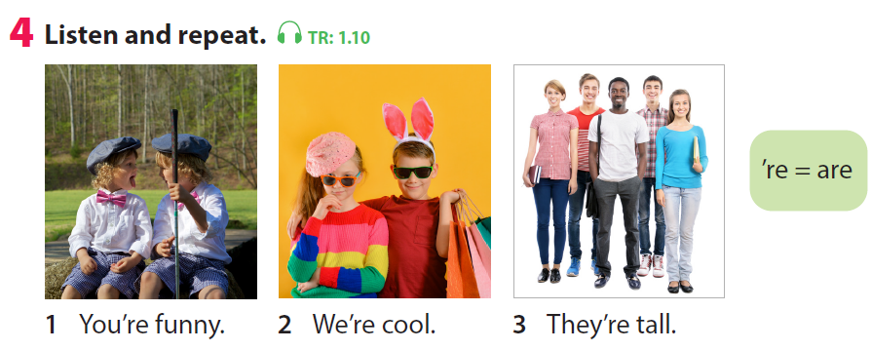
Notes:
Let the sts listen and repeat 2 times

Slide 5
03. Practice Task 2-Look and say

Slide 6
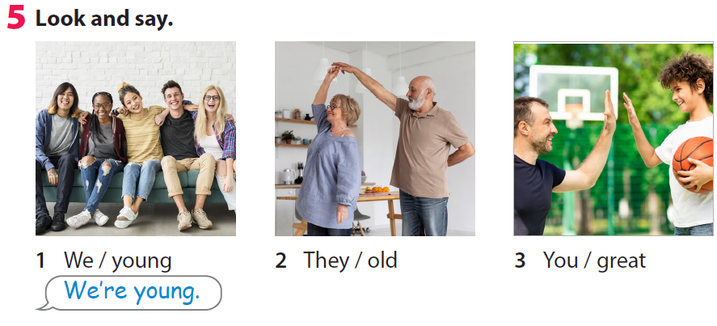
Notes:
-Ask the sts about the pictures
EX: Pic 1) How many people are there?
Pic 2) Are they young or old?
Pic 3) What are they doing?
-Make example for picture 1: “We’re young”
-Let some sts make sentences with pic 2, 3

Slide 7

Notes:
Game: LUCKY WHEEL
Divide class into 2 teams-Boys and Girls.
Spin the round to get points.
Choose a number to have a question.
The ones who can answer True/false will get points.

Slide 8




LUCKY WHEEL
30
20
1
2
40
10
3
SPIN
50
80
4
5
6
60
70
7
8
9
Next activity
Notes:
Game: LUCKY WHEEL
Divide class into 2 teams-Boys and Girls.
Spin the round to get points.
Choose a number to have a question.
The ones who can answer True/false will get points.

Slide 9


Game: TRUE OR FALSE?
True
They’re tall.
False

Slide 10

Game: TRUE OR FALSE?
True
We’re old.
False

Slide 11
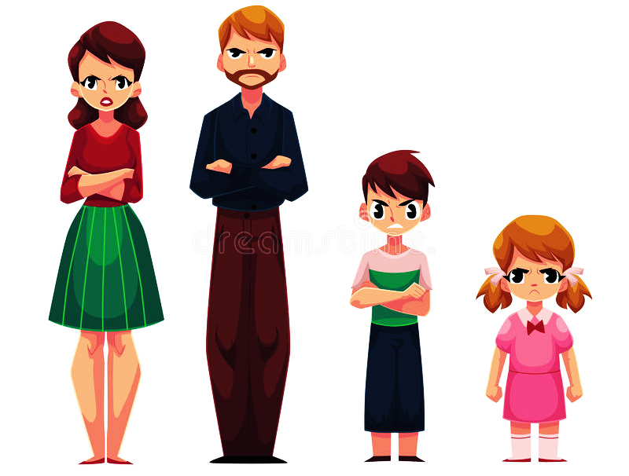
Game: TRUE OR FALSE?
True
They’re funny.
False

Slide 12
Game: TRUE OR FALSE?
True
He’s short.
False

Slide 13
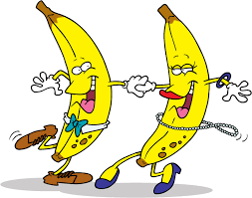
Game: TRUE OR FALSE?
True
They’re funny.
False

Slide 14
Game: TRUE OR FALSE?
True
We’re young.
False

Slide 15
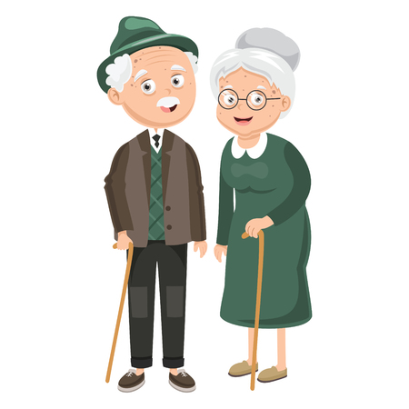
Game: TRUE OR FALSE?
True
They’re old.
False

Slide 16
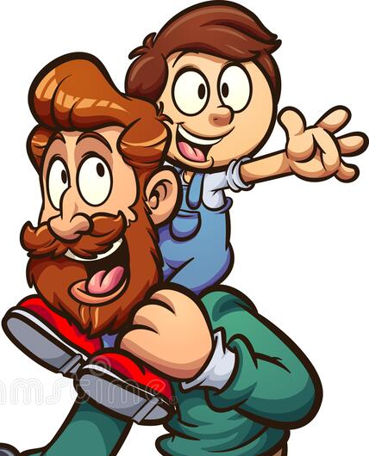
Game: TRUE OR FALSE?
True
My dad is great.
False

Slide 17

Game: TRUE OR FALSE?
True
They’re young.
False

Slide 18
03 Practice Task 6-Listen and sing

Slide 19
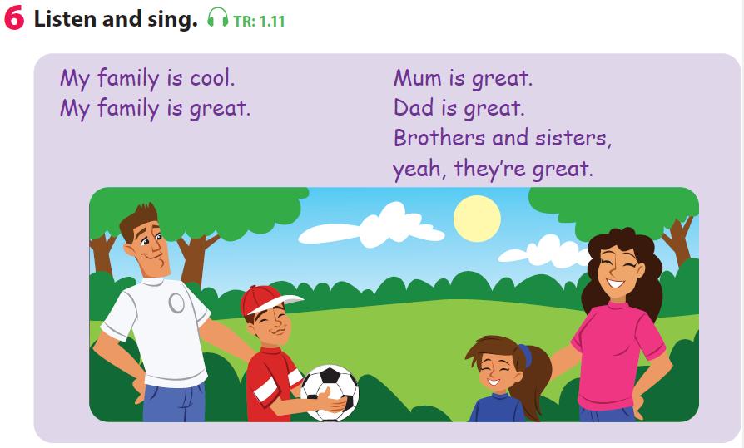
Notes:
-Let the sts listen and sing along-whole class
-Let the sts sing along in teams-4 teams

Slide 20
4. Production Draw a picture, write the name and talk about family

Slide 21
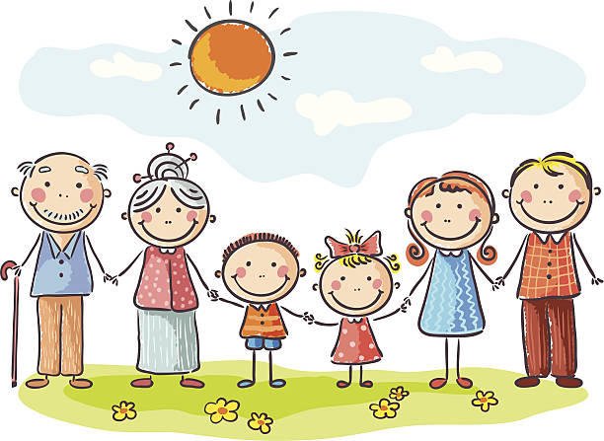
My grandpa is cool.
My grandma is old.
……………………..
………………………..

Slide 22
05
Assessment

Slide 23
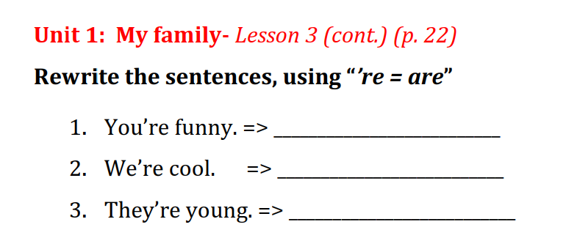

Slide 24
Goodbye

