Slide 1


Unit 2 - My Home
Lesson 2 – Period 2

Slide 2
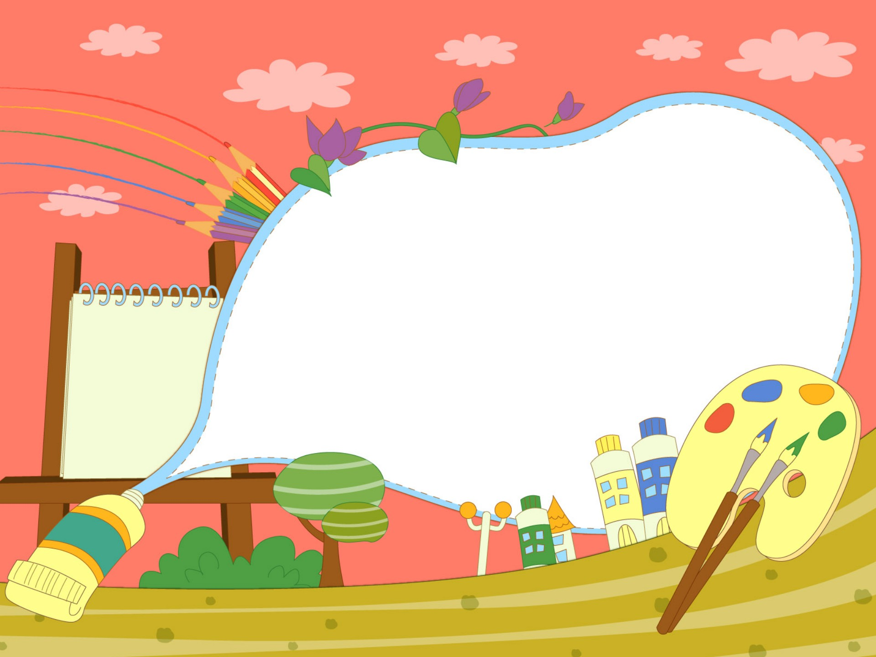

1.Warm up
Matching Time

Slide 3


Presentation
4
Listen and repeat.

Slide 4

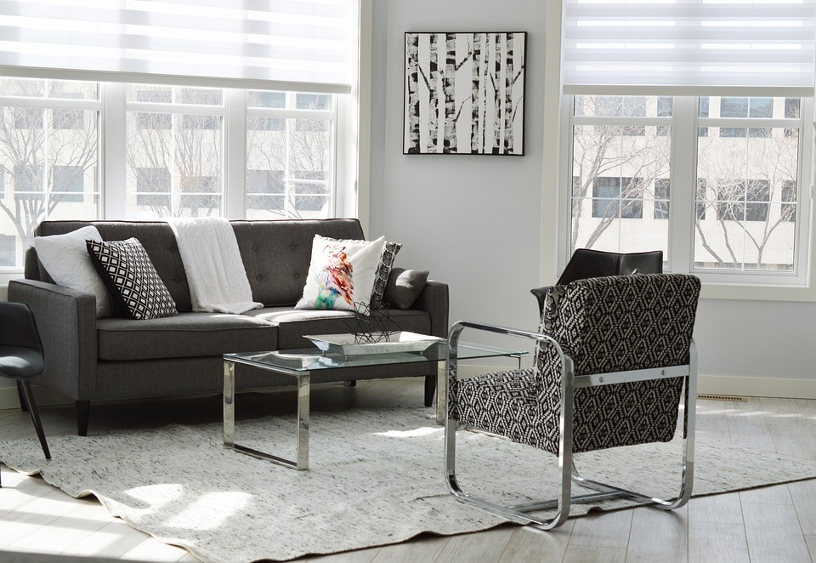
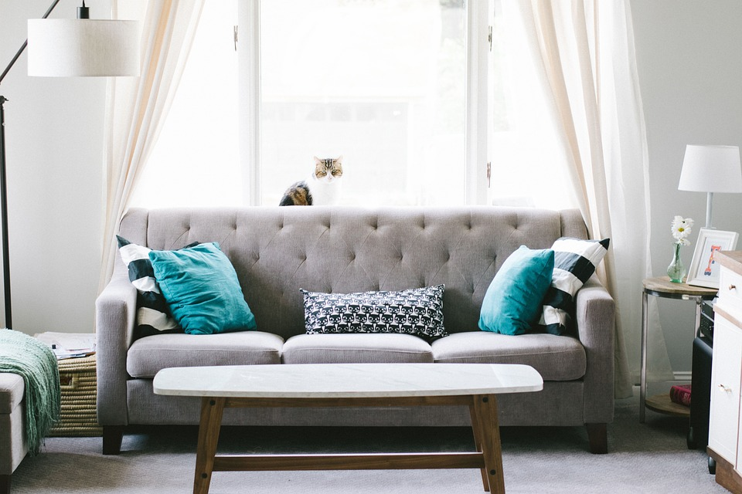
4
Listen and repeat.
2. Where is the sofa?
-It’s between two lamps.
1. Where is the rug?
-It’s in front of the sofa.

Slide 5
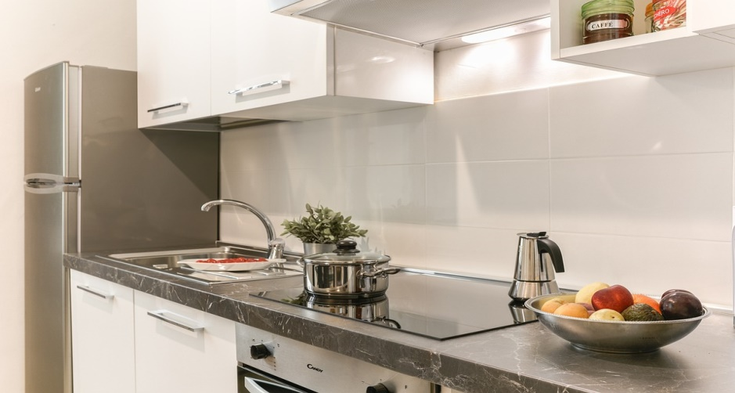
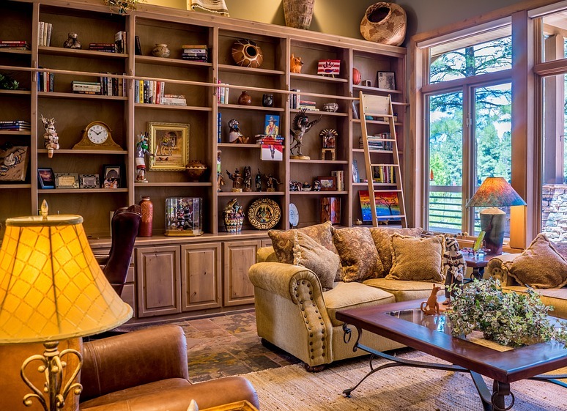
3. Where is the fridge?
4. Where are the books?
-It’s next to the sink.
- They’re behind the sofa.

Slide 6

Practice
5
Look and say.

Slide 7


Yes or No

Slide 8
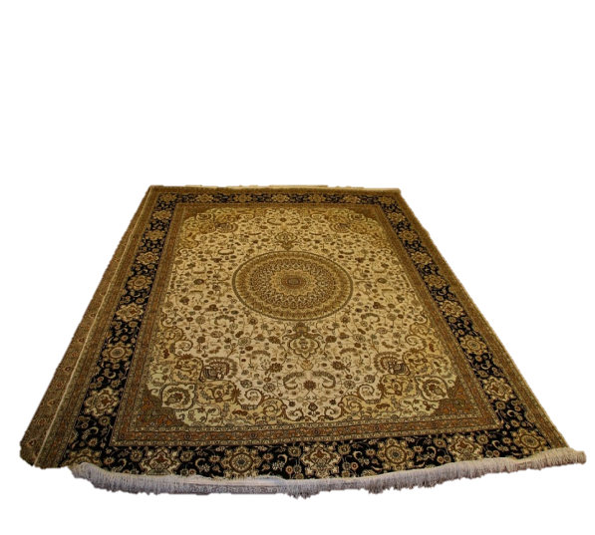
1. Is this a rug?
2. Is the rug behind the table?
Yes
No
Yes
No
No, it isn’t.
It’s under the table.

Slide 9
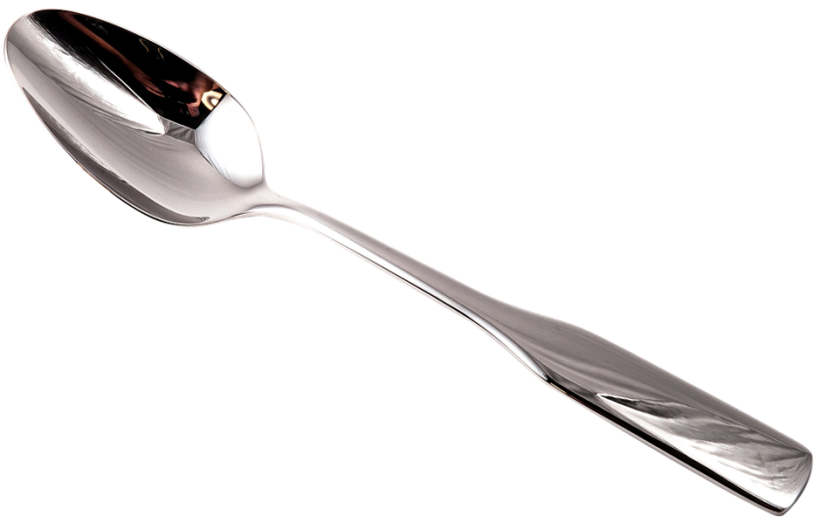
3. Are they two plates?
4. Is the sofa behind the table?
Yes
No
Yes
No
No, they aren’t.
They are spoons.

Slide 10

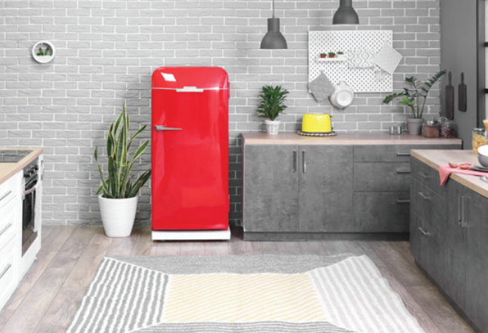


5
Look and say.
The rug/ in front of/ the fridge
Where is the rug?
It’s in front of the fridge.

Slide 11
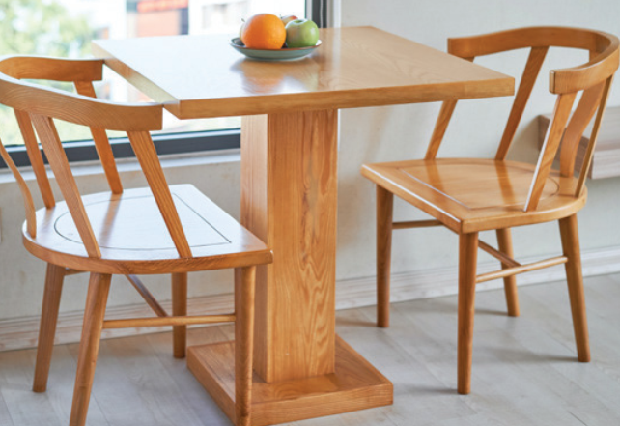
The table/ between/ two chairs
Where is the table?
The table is between two chairs.

Slide 12

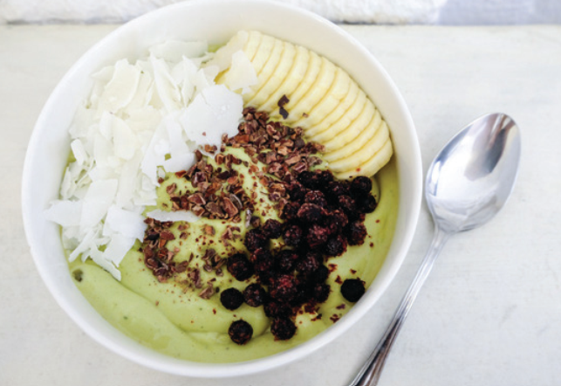
The bowl/ next to/ the spoon
Where is the bowl?
It’s next to the spoon.

Slide 13

Production
6
Listen and chant.

Slide 14

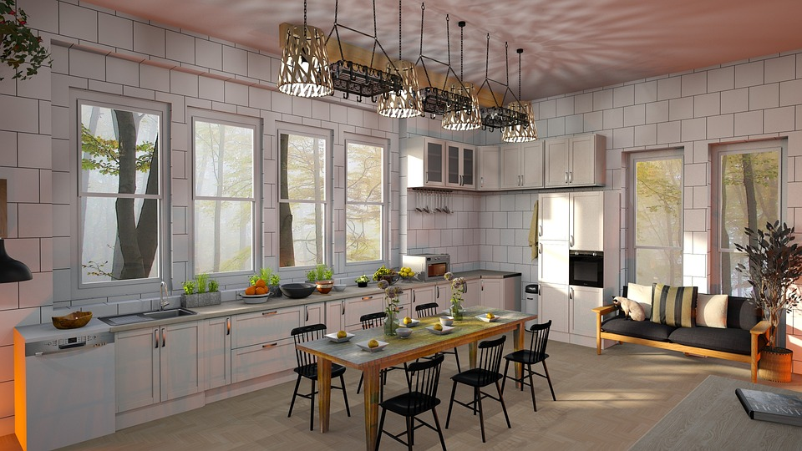
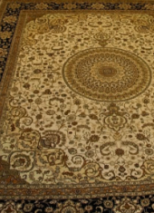
What do you see in the picture?
big fridge
small sink
brown table
black chairs
colorful rug
some bowls
………………

Slide 15

Assessment

Slide 16
Order the words to make complete sentences
1. This/ our/ is/ kitchen/ lovely.
This is our lovely kitchen.
__________________
2. The/ between/ is/ table/ chairs/ two.
The table is between two chairs.
_________________________
3. Three/ next to/ are/ bowls/ plate/ the.
Three bowls are next to the plate.
_________________________
4. Where/ the/ rug/ is/ ?
Where is the rug?
_____________

Slide 17

Wrap up
Notes:
Đây k phải là extra, đây là hđ 3 của bài

Slide 18
REMEMBER
VOCABULARY:
Behind
Under
Next to
Between
In front of
STRUCTURE:
Where is the rug?
- It’s in front of the fridge.
18

Slide 19

Thank you & goodbye!

