Slide 1










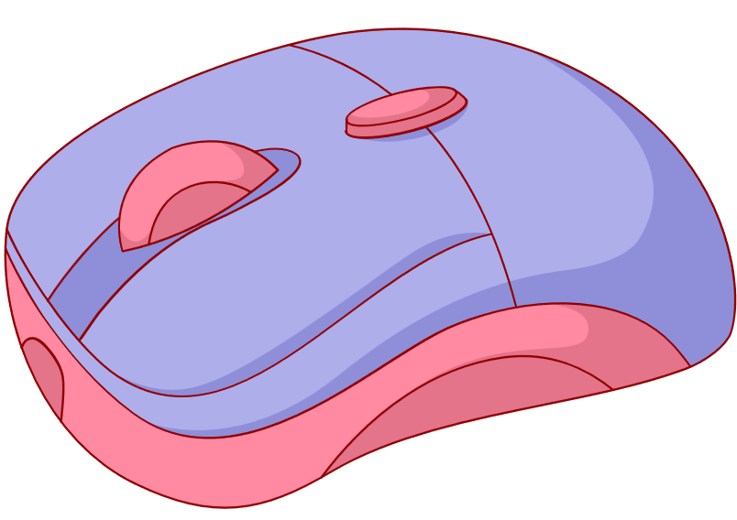


Unit 2
My Favourite Things
Lesson 3: Activity 4-5-6

Slide 2








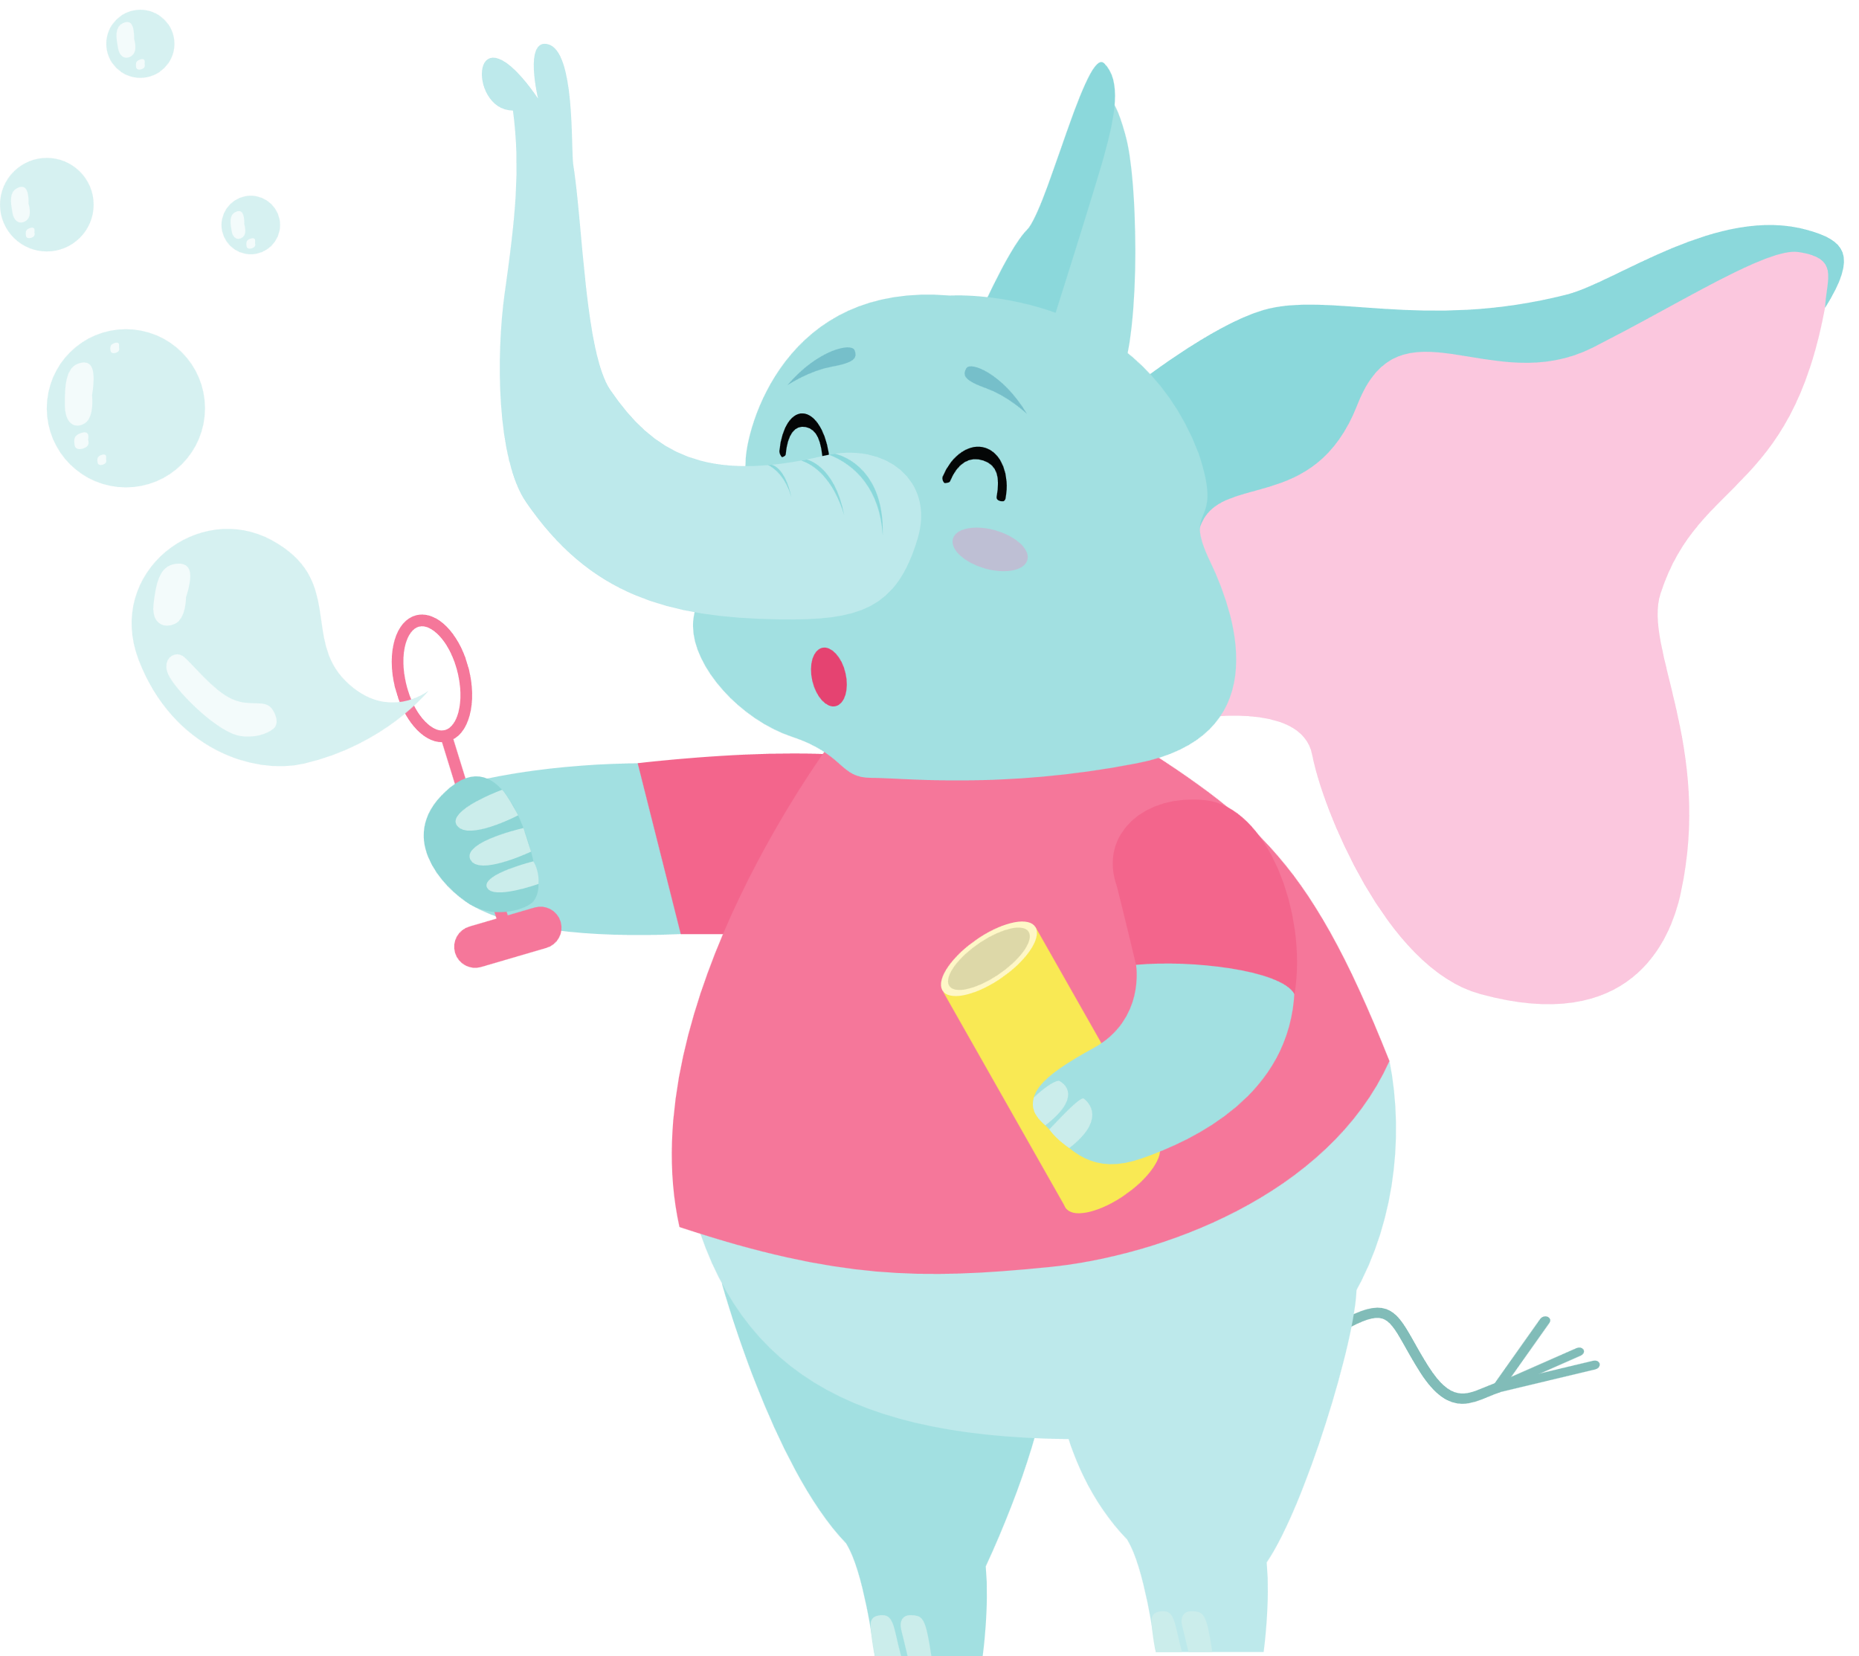



1
Warm Up
2
Presentation
3
Practice
Tables
of content
4
Production
5
Wrap-up & Assessment

Slide 3
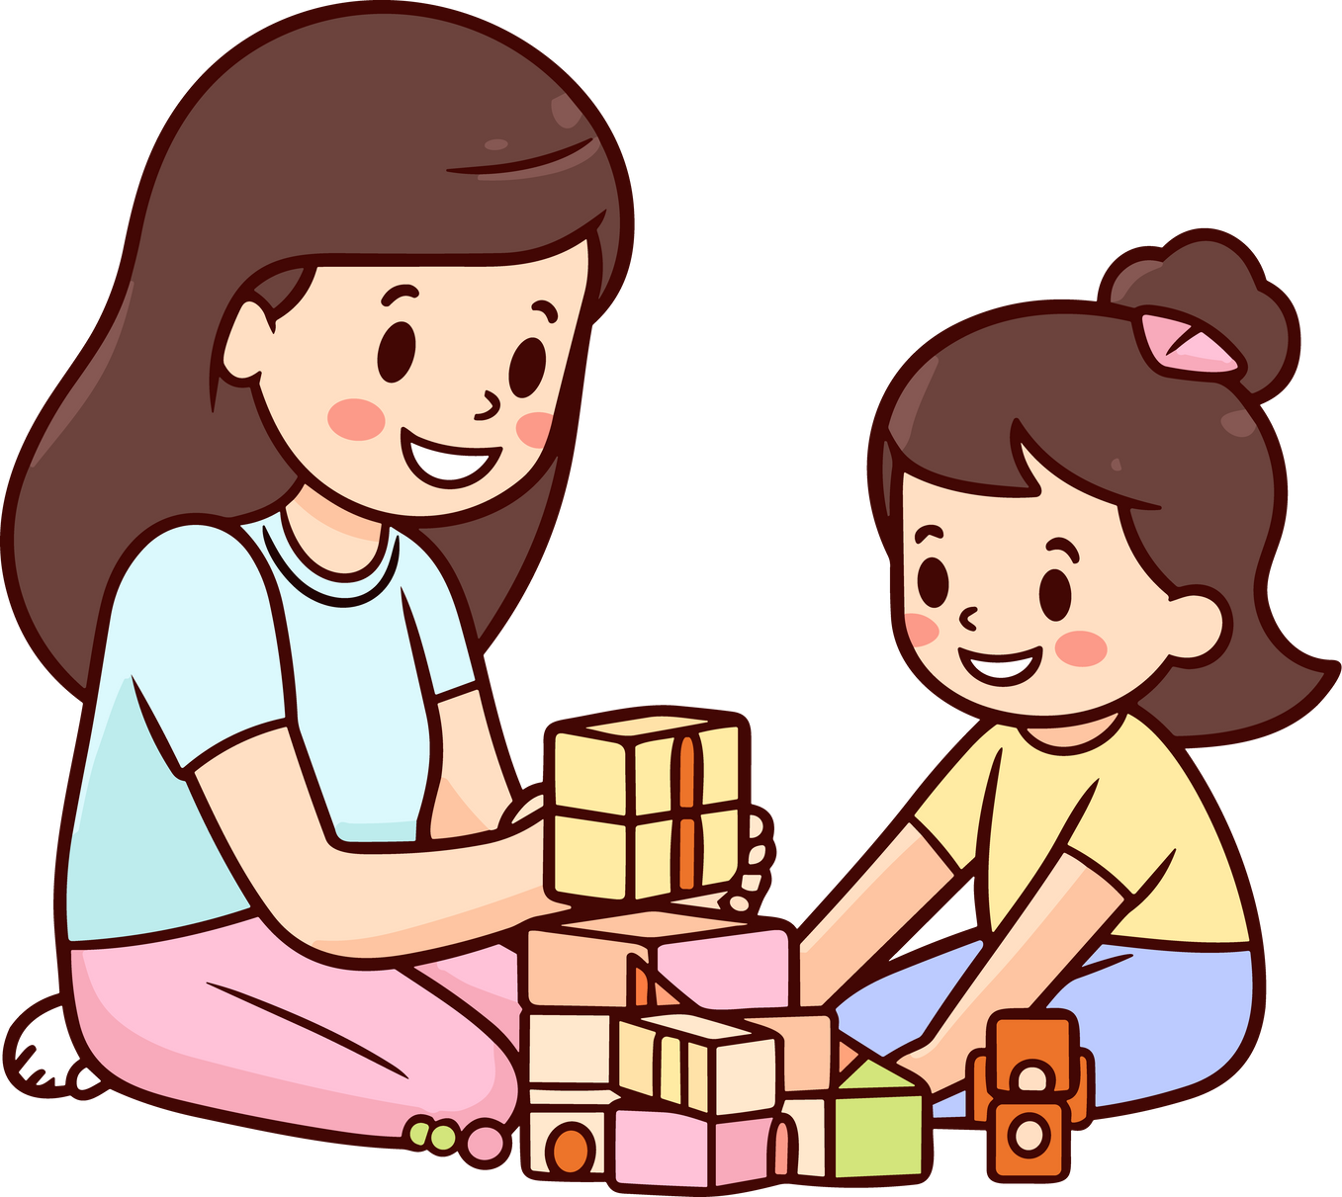

Warm Up
1

Slide 4


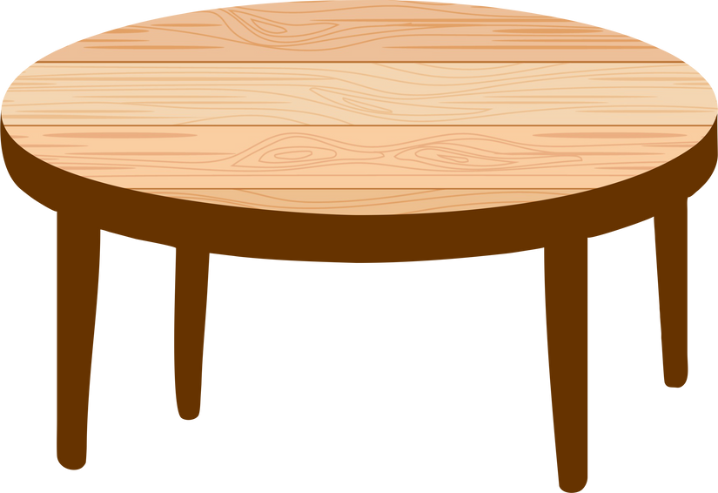

2
Presentation

Slide 5



and
but
/ænd/
/bʌt/
Ann and Jim
expensive but it isn’t good

Slide 6



Let’s check!
Notes:
Look the letters on the blocks to make the correct words

Slide 7
Practice
3

Slide 8
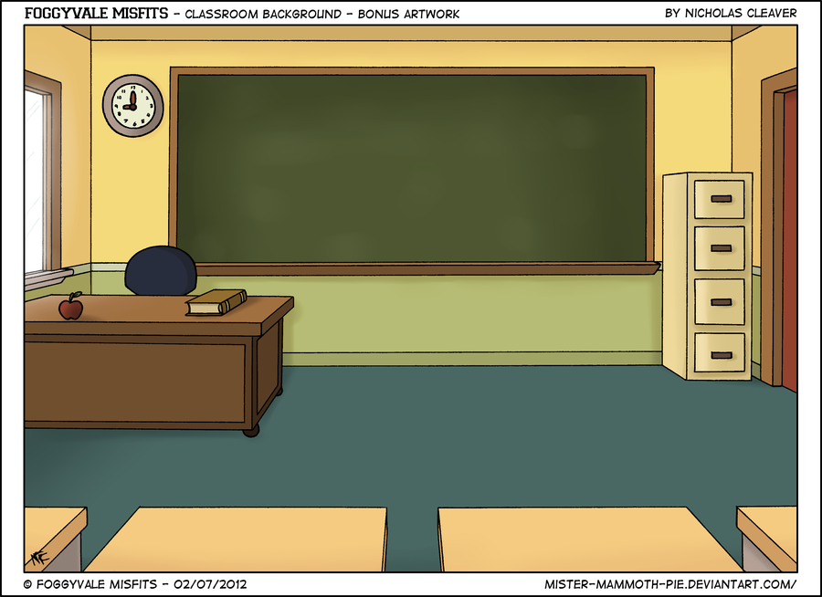


Listen and repeat:
Computers are exciting and fun.

Slide 9
Congratulations!
Let’s roll the dice.

Slide 10
Fill in the blank:
My favourite toys are black ___ yellow.
and

Slide 11
Make a sentence.
The camera / new / isn’t very good.
The camera is new, but it isn’t very good.

Slide 12
Make a sentence:
My favourite toys / comic books / puppets
My favourite toys are comic books and puppets.

Slide 13
Listen and repeat:
This book is interesting, but it’s expensive.

Slide 14
Listen and answer: How is the magazine?
The magazine is new, but it’s boring.

Slide 15
Congratulations!
Let’s roll the dice.

Slide 16
4
Production

Slide 17

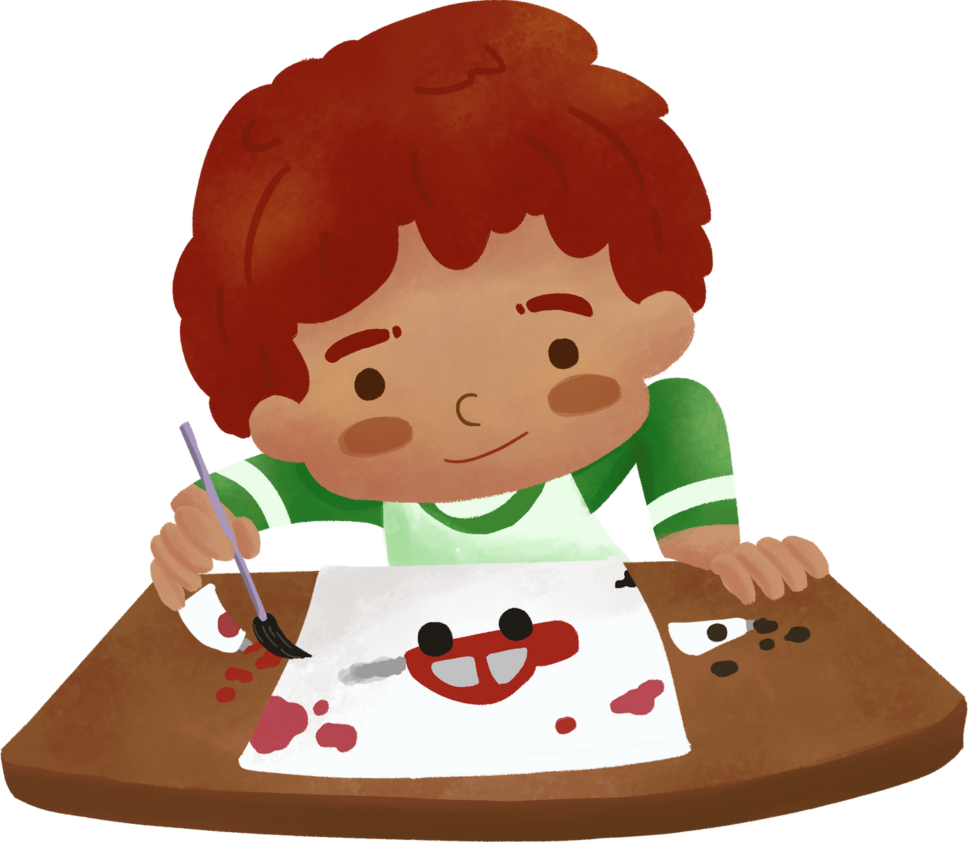
Draw and write about your favourite things using “and” and “but”.
My favourite things are my toy cars. They are black and yellow. My cars are nice but they are expensive …

Slide 18

Wrap-up &
Assessment
5

Slide 19

Wrap-Up
Vocabulary
and, but
Unit 2: My favourite things
Lesson 3 – Part 4,5,6
What have we learn today?
(and, but)
Structure
… yellow and black
… new but it isn’t very good.

