Slide 1

UNIT 3
WEATHER
LESSON: 1.1
Notes:
Thanh Yến Trần 0967 255 149 zalo/ FB https://www.facebook.com/thanhyentrananhngutaymy/

Slide 2
Table of contents
01
02
03
Warm Up
Vocabulary
Grammar

Slide 3
Warm Up
01

Slide 4


Slide 5
04
Vocabulary

Slide 6


sunny
Notes:
Thanh Yến Trần 0967 255 149 zalo/ FB https://www.facebook.com/thanhyentrananhngutaymy/

Slide 7
sunny
Notes:
Thanh Yến Trần 0967 255 149 zalo/ FB https://www.facebook.com/thanhyentrananhngutaymy/

Slide 8

snowy

Slide 9

cloudy

Slide 10

windy

Slide 11

foggy

Slide 12

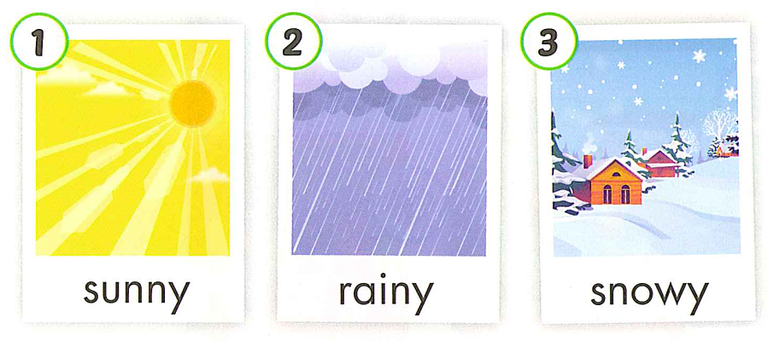
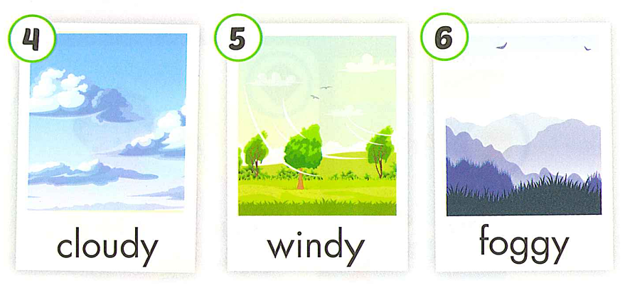

Slide 13
Review Vocabulary

Slide 14

rai
Next
Look and choose
a
a. ne
b. ny
c.yn
A
B
C
Notes:
Thanh Yến Trần 0967 255 149 zalo/ FB https://www.facebook.com/thanhyentrananhngutaymy/

Slide 15
listen
Next
Look and choose
a.
snowy
b.
foggy
c.
windy
A
B
C
Notes:
Thanh Yến Trần 0967 255 149 zalo/ FB https://www.facebook.com/thanhyentrananhngutaymy/

Slide 16





foggy
Next
Look and choose
a
b
c
A
B
C
Notes:
Thanh Yến Trần 0967 255 149 zalo/ FB https://www.facebook.com/thanhyentrananhngutaymy/

Slide 17

Listen
Next
Look and choose
a.
windy
b.
cloudy
c.
sunny
A
B
C
Notes:
Thanh Yến Trần 0967 255 149 zalo/ FB https://www.facebook.com/thanhyentrananhngutaymy/

Slide 18

snowy
Next
Look and choose
a
a.
b.
c.
A
B
C
Notes:
Thanh Yến Trần 0967 255 149 zalo/ FB https://www.facebook.com/thanhyentrananhngutaymy/

Slide 19
win
Next
Look and choose
a. dy
b. gy
c. ny
A
B
C
Notes:
Thanh Yến Trần 0967 255 149 zalo/ FB https://www.facebook.com/thanhyentrananhngutaymy/

Slide 20
03
Grammar

Slide 21




Slide 22
What’s the weather like today ?
It’s +……

Slide 23
Review Sentence

Slide 24

BALLOONS
GAMES
START

Slide 25





a.
windy
b.
rainy
c.
snowy
What’s the weather like today?
It’s…
Notes:
Thanh Yến Trần 0967 255 149 zalo/ FB https://www.facebook.com/thanhyentrananhngutaymy/

Slide 26
a
b
c
What’s the weather like today?
It’s rainy.

Slide 27
b. What’s are you doing ?
a.What’s the weather like today?
C. What time is it ?
It’s sunny
Notes:
Thanh Yến Trần 0967 255 149 zalo/ FB https://www.facebook.com/thanhyentrananhngutaymy/

Slide 28
What’s like today the weather?
What’s the weather like today?
What’s today the weather today?
like/ weather/ the/ today?/ What’s
Notes:
Thanh Yến Trần 0967 255 149 zalo/ FB https://www.facebook.com/thanhyentrananhngutaymy/

Slide 29
b.
a
a.
the
c.
is
What’s…weather like today?
Notes:
Thanh Yến Trần 0967 255 149 zalo/ FB https://www.facebook.com/thanhyentrananhngutaymy/

Slide 30
b.
What’s
the like weather today ?
a.
What’s
weather the like today ?
c.
What’s
the weather like today ?
Reorder : What/the/ ’s/ like/ weather/today?

Slide 31
a. I like sunny weather.
c. I sleep in snowy weather.
b. It’s foggy.
What’s the weather like ?
………………….

Slide 32

Practice

Slide 33

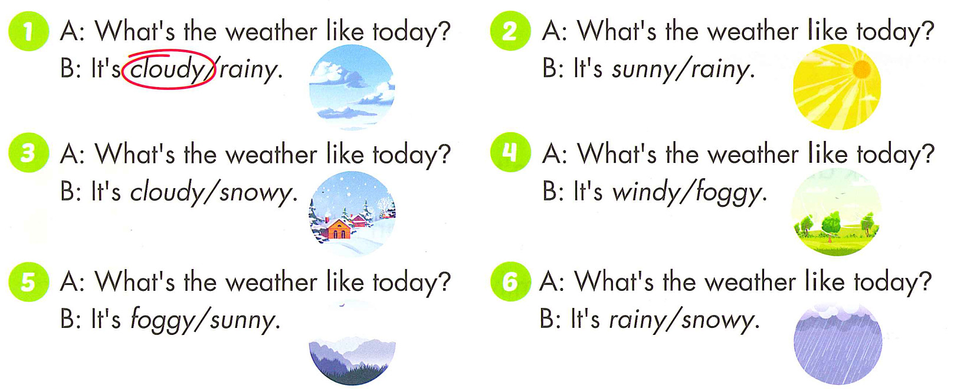

Slide 34
Good Bye

