Slide 1

UNIT 2
WHAT I CAN DO
LESSON 2.3
Notes:
Thanh Yến Trần 0967 255 149 zalo/ FB https://www.facebook.com/thanhyentrananhngutaymy/

Slide 2
01
WARM UP

Slide 3
Table of contents
WARM UP
01
SOUND
02
LISTENING
03

Slide 4



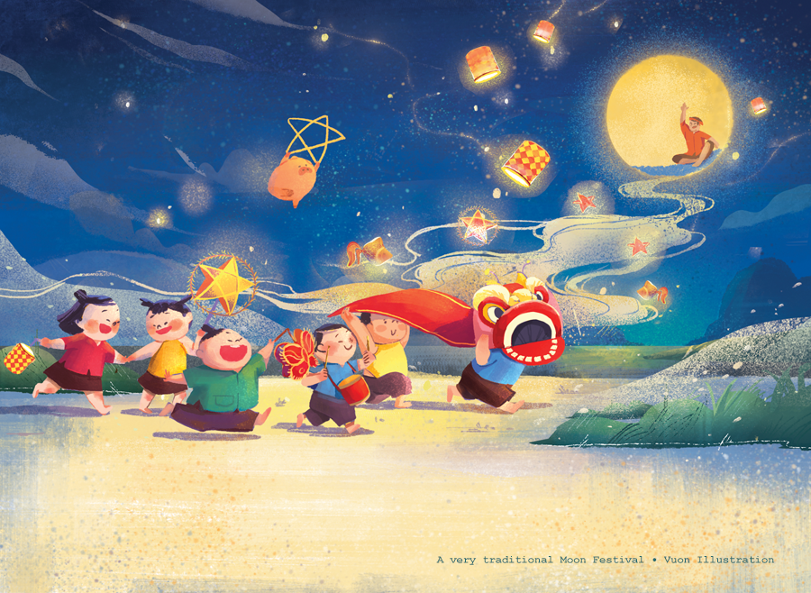
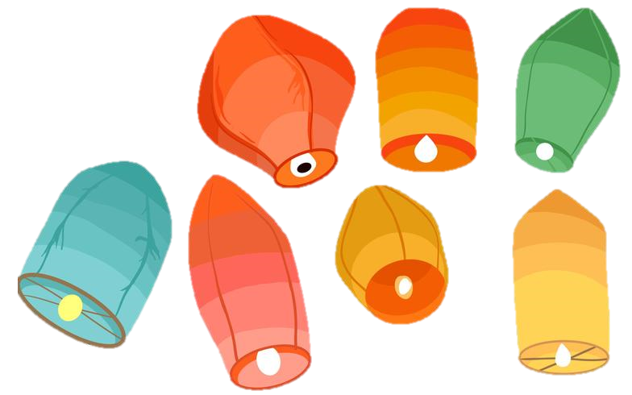



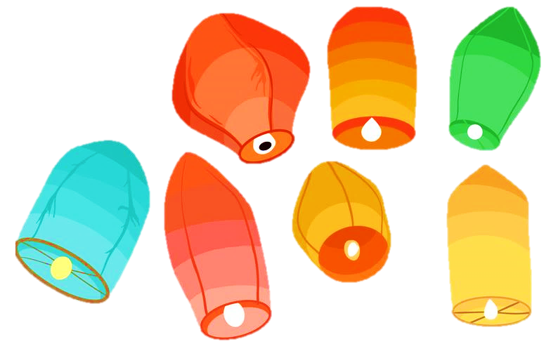
Lantern
game
Notes:
Thanh Yến Trần 0967 255 149 zalo/ FB https://www.facebook.com/thanhyentrananhngutaymy/

Slide 5


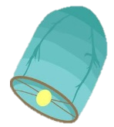
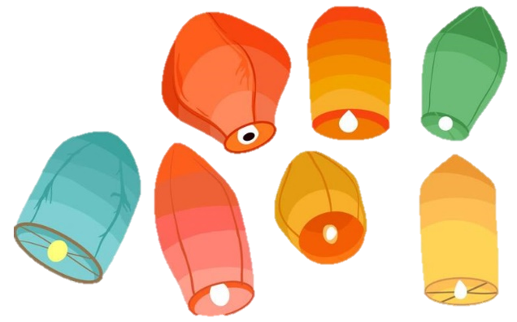

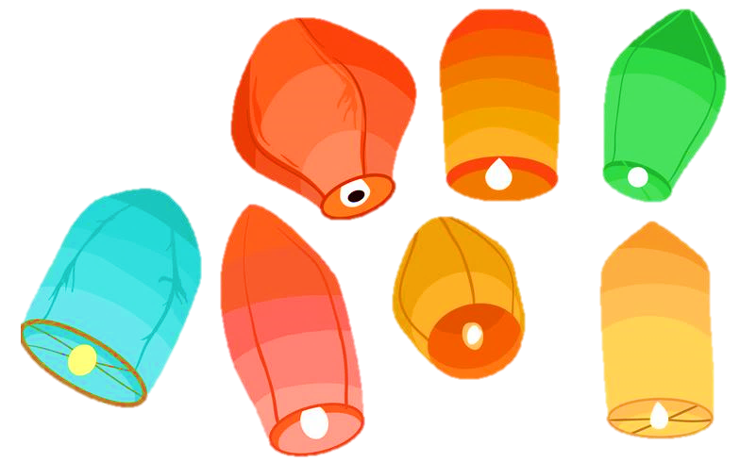
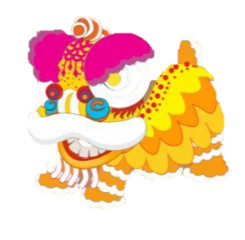

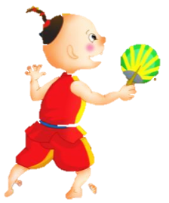

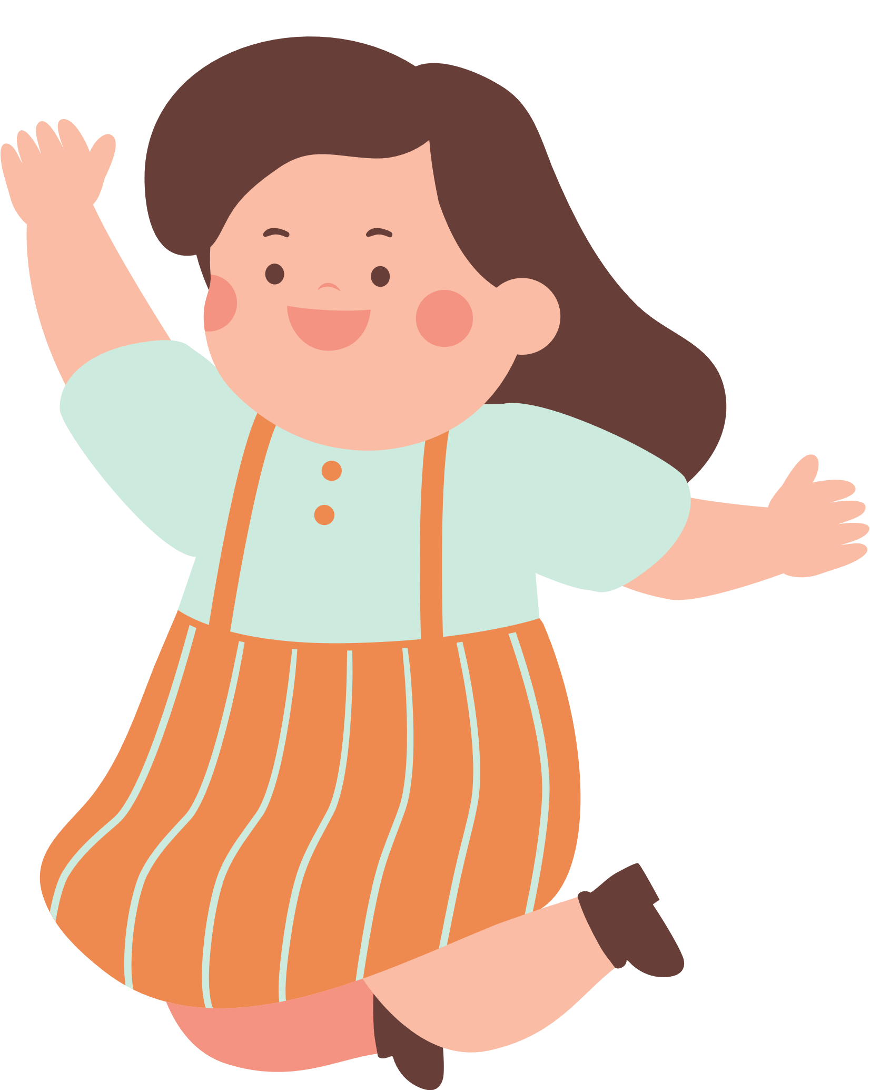





NEXT
Notes:
Thanh Yến Trần 0967 255 149 zalo/ FB https://www.facebook.com/thanhyentrananhngutaymy/

Slide 6






A
fly
B
hop
C
swim

Slide 7
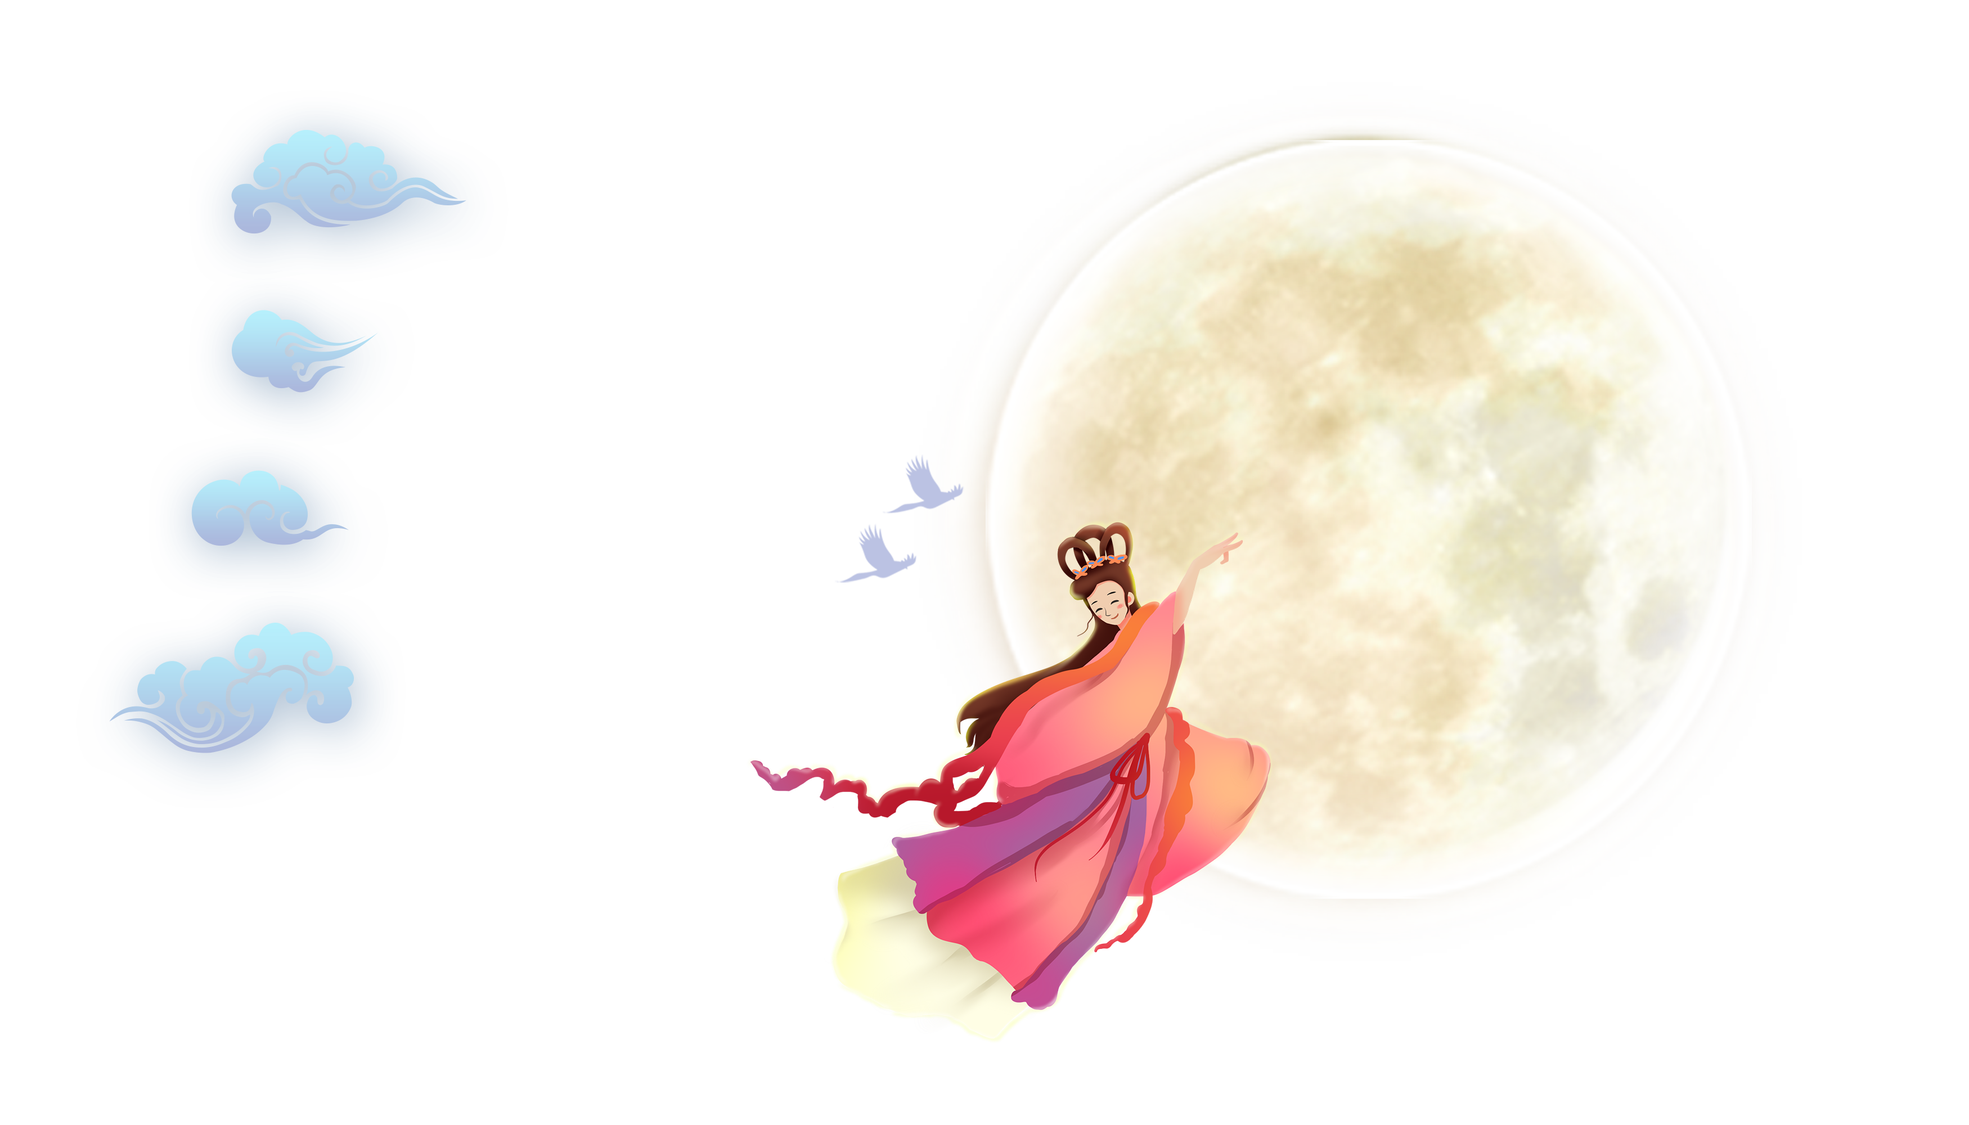
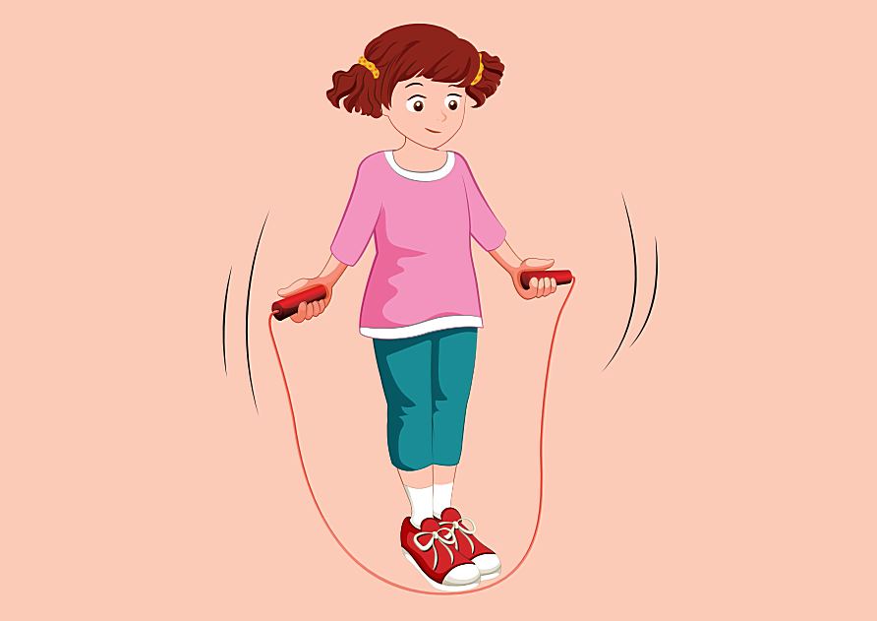
A
run
B
jump (rope)
C
fly
Notes:
Thanh Yến Trần 0967 255 149 zalo/ FB https://www.facebook.com/thanhyentrananhngutaymy/

Slide 8
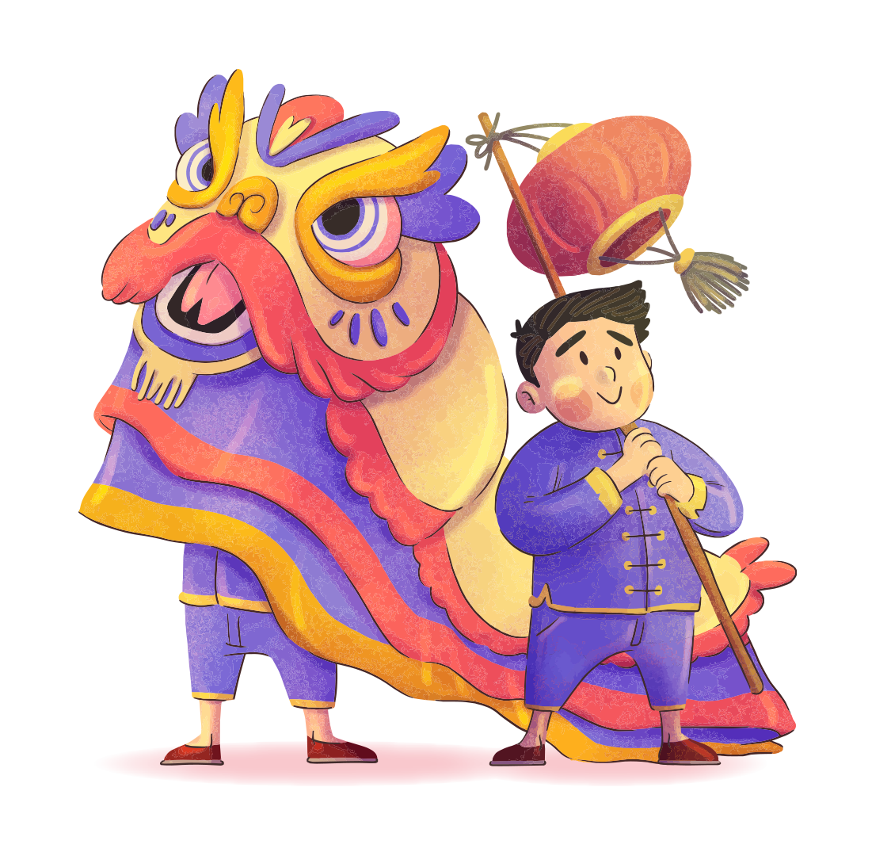
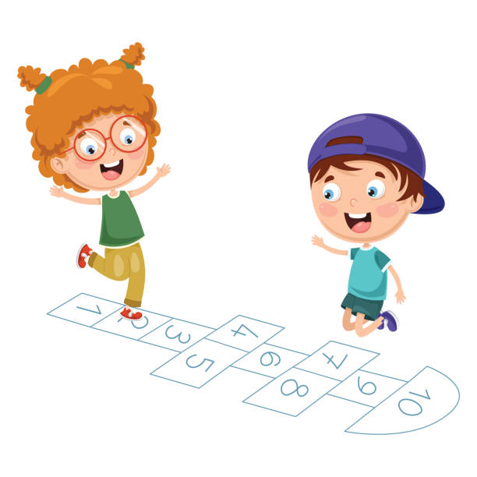



A
Listen and choose
B
C
Notes:
Thanh Yến Trần 0967 255 149 zalo/ FB https://www.facebook.com/thanhyentrananhngutaymy/

Slide 9
A
run
Listen and choose:
Can Lucy…..?
B
hop
C
jump
Notes:
Thanh Yến Trần 0967 255 149 zalo/ FB https://www.facebook.com/thanhyentrananhngutaymy/

Slide 10
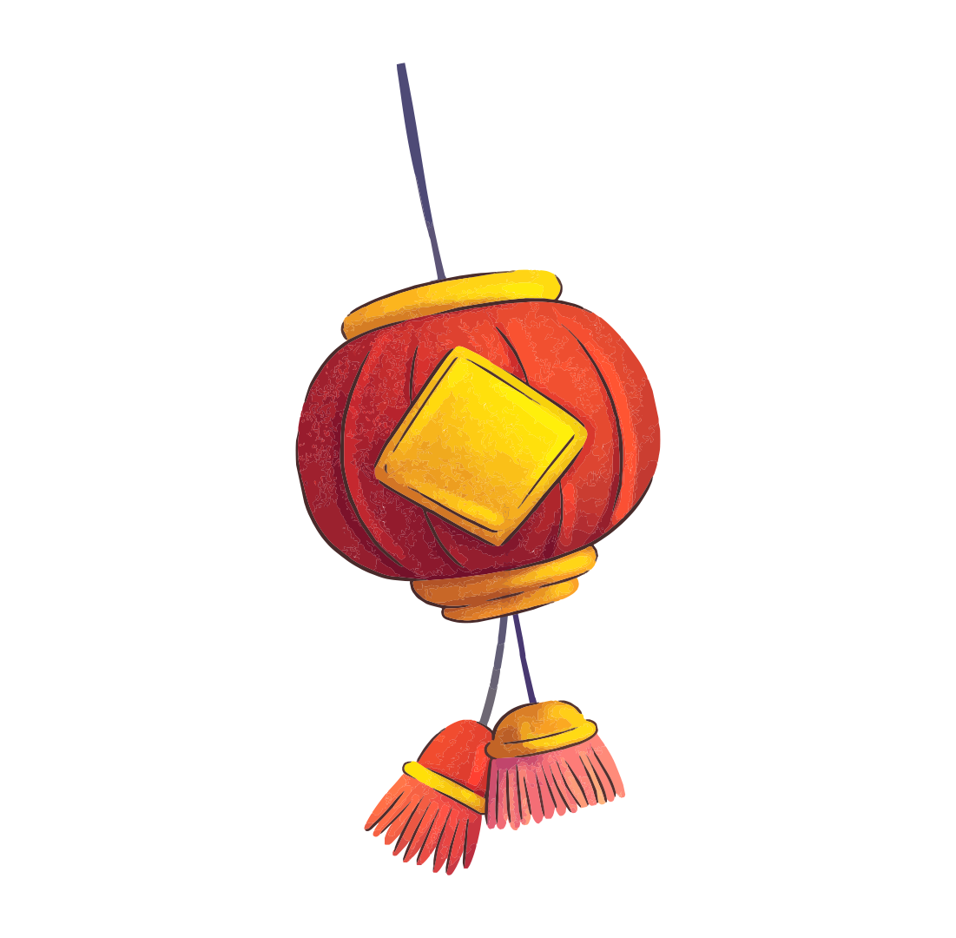
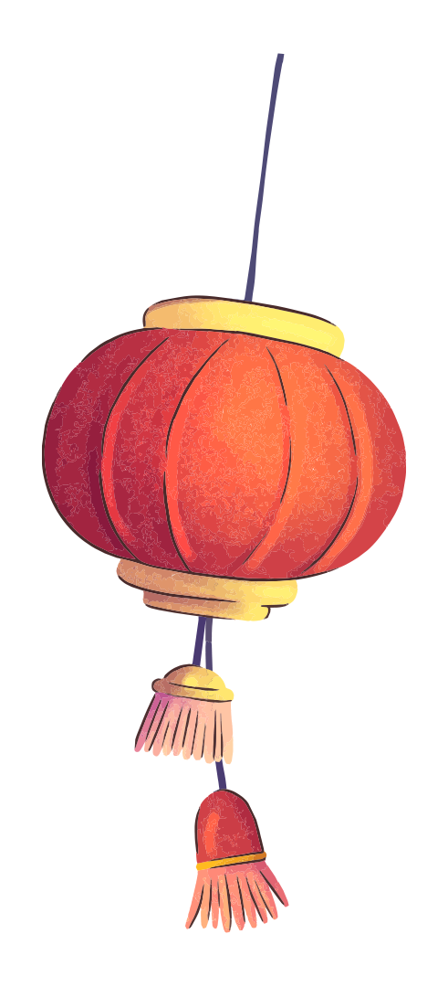
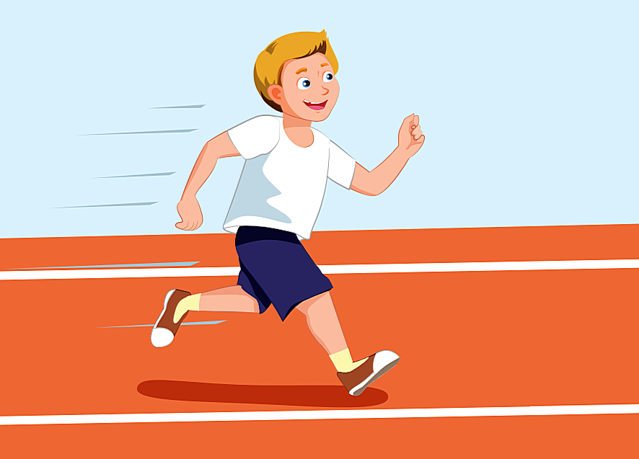
A
Can he swim? Yes, he can.
B
Can he run? Yes, he can.
C
Can he hop? Yes, he can.
Notes:
Thanh Yến Trần 0967 255 149 zalo/ FB https://www.facebook.com/thanhyentrananhngutaymy/

Slide 11
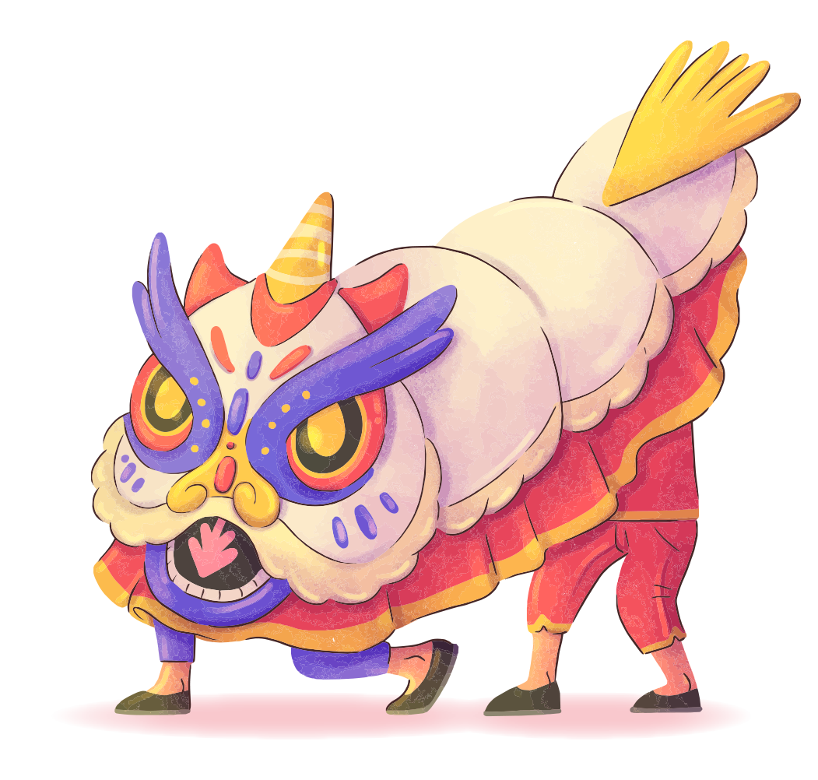

A
Mai: Can they climb a tree?
Nam: …….
No, they can’t.
B
Yes, we can.
C
Yes, they can.
Notes:
Thanh Yến Trần 0967 255 149 zalo/ FB https://www.facebook.com/thanhyentrananhngutaymy/

Slide 12
02 sound

Slide 13
1. Listen and repeat
/p/, /p/, rope , hop
/b/, /b/, Ben , keyboard

Slide 14
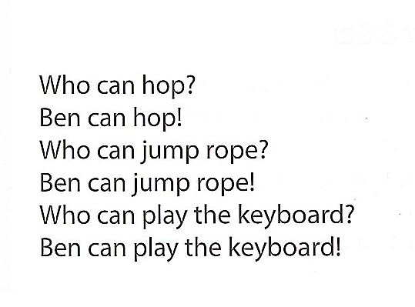
2. Chant

Slide 15
03
LISTENING

Slide 16

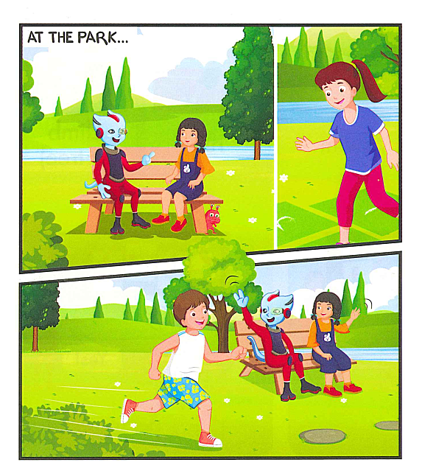
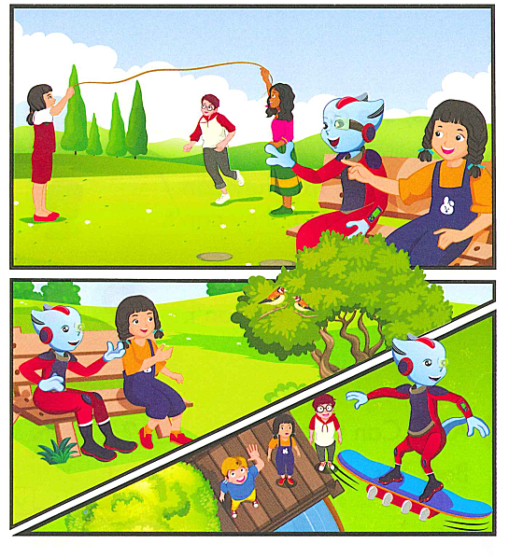

Slide 17

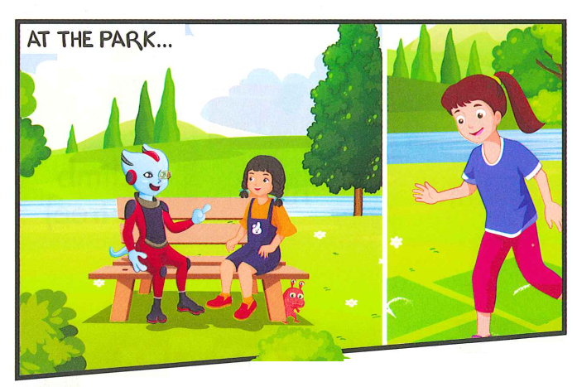
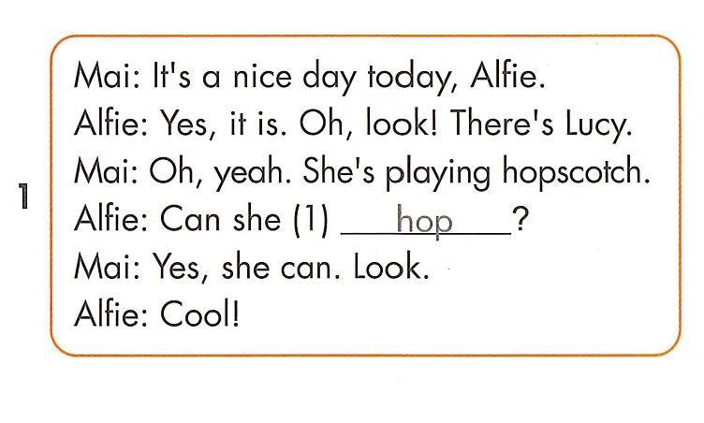
Notes:
Thanh Yến Trần 0967 255 149 zalo/ FB https://www.facebook.com/thanhyentrananhngutaymy/

Slide 18
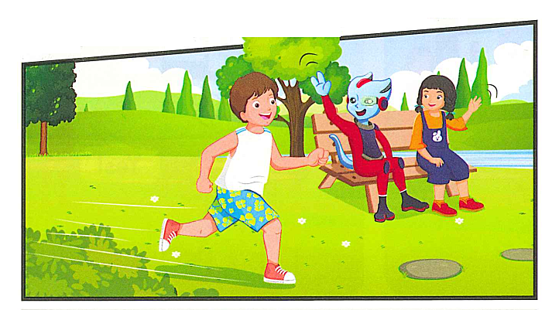

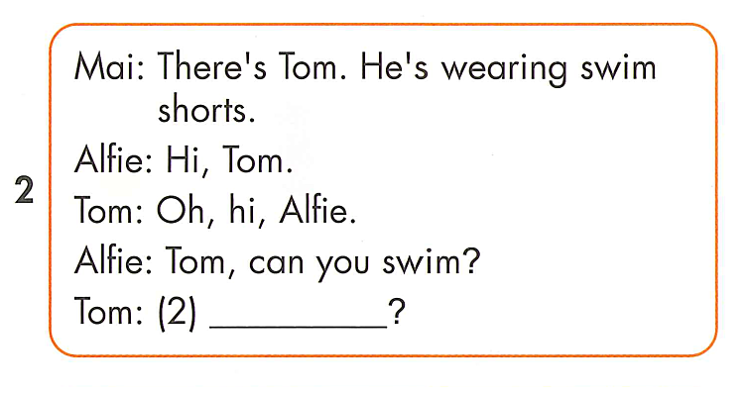
Yes, I can
Notes:
Thanh Yến Trần 0967 255 149 zalo/ FB https://www.facebook.com/thanhyentrananhngutaymy/

Slide 19
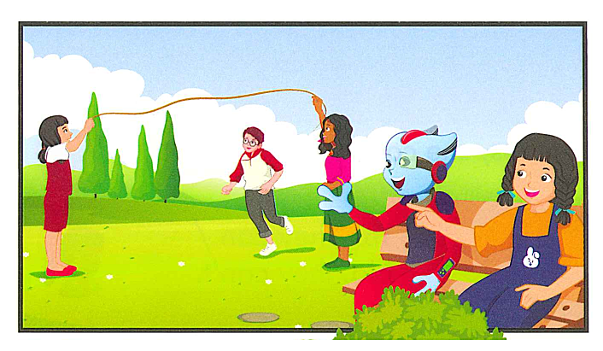
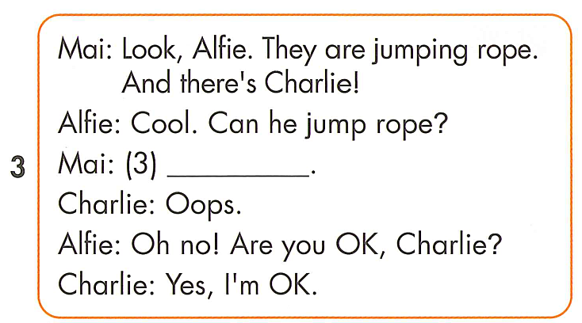
No, I can’t

Slide 20
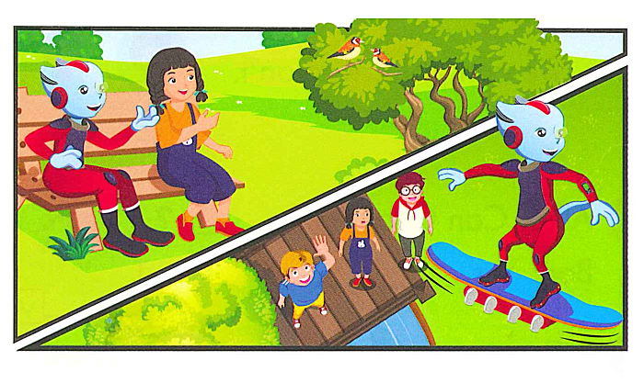
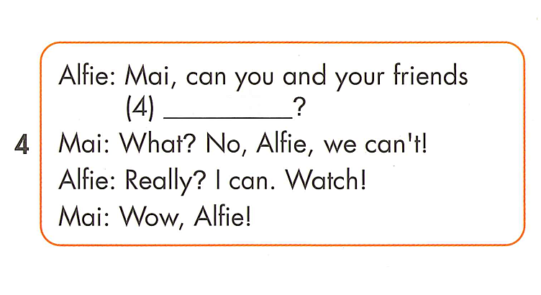
fly

Slide 21
REVIEW READING

Slide 22


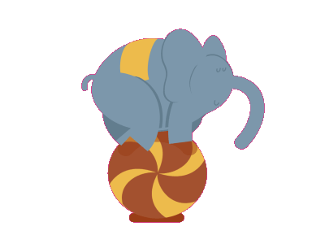
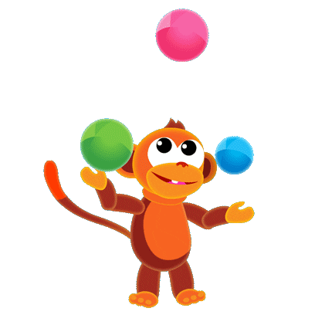
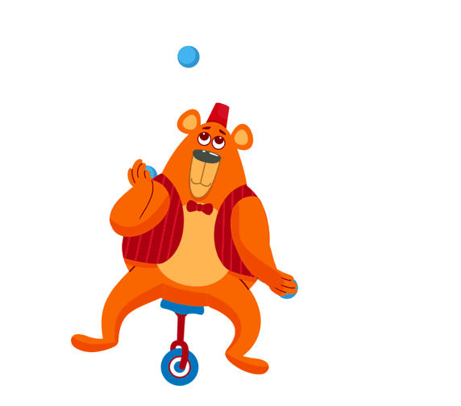
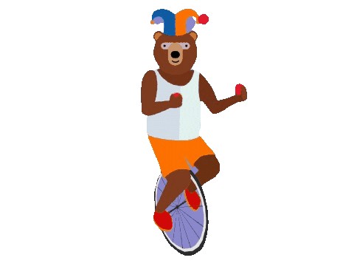
Funny Circus
Notes:
Thanh Yến Trần 0967 255 149 zalo/ FB https://www.facebook.com/thanhyentrananhngutaymy/

Slide 23







Notes:
Thanh Yến Trần 0967 255 149 zalo/ FB https://www.facebook.com/thanhyentrananhngutaymy/

Slide 24



What’s Lucy doing?
A. She is playing soccer.
B. She is playing hopscotch.
C. She is watching TV.
D. She is singing.
Notes:
Thanh Yến Trần 0967 255 149 zalo/ FB https://www.facebook.com/thanhyentrananhngutaymy/

Slide 25
Can Tom swim?
A. Yes, he can.
B. No, he can’t.
C. No, he can run.
D. No, he can hop.
Notes:
Thanh Yến Trần 0967 255 149 zalo/ FB https://www.facebook.com/thanhyentrananhngutaymy/

Slide 26
What are Charlie and his friends doing?
A. They are swimming.
B. They are dancing.
C. They are jumping rope.
D. They are running.
Notes:
Thanh Yến Trần 0967 255 149 zalo/ FB https://www.facebook.com/thanhyentrananhngutaymy/

Slide 27
Can Charlie jump rope?
A. Yes, he can.
B. Yes, he can jump.
C. No, he can.
D. No, he can’t.
Notes:
Thanh Yến Trần 0967 255 149 zalo/ FB https://www.facebook.com/thanhyentrananhngutaymy/

Slide 28
Can Alfie fly?
A. Yes, he can.
B. No, he can’t.
C. No, he can’t fly.
D. Yes, he can’t.

Slide 29
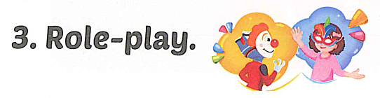

Slide 30
GOOD BYE

