Slide 1

UNIT 3 WEATHER
GEOGRAPHY 1.3
Notes:
Thanh Yến Trần 0967 255 149 zalo/ FB https://www.facebook.com/thanhyentrananhngutaymy

Slide 2
02
03
01
Table of contents
Reading
Writing
Warm Up

Slide 3
01
WARM UP

Slide 4
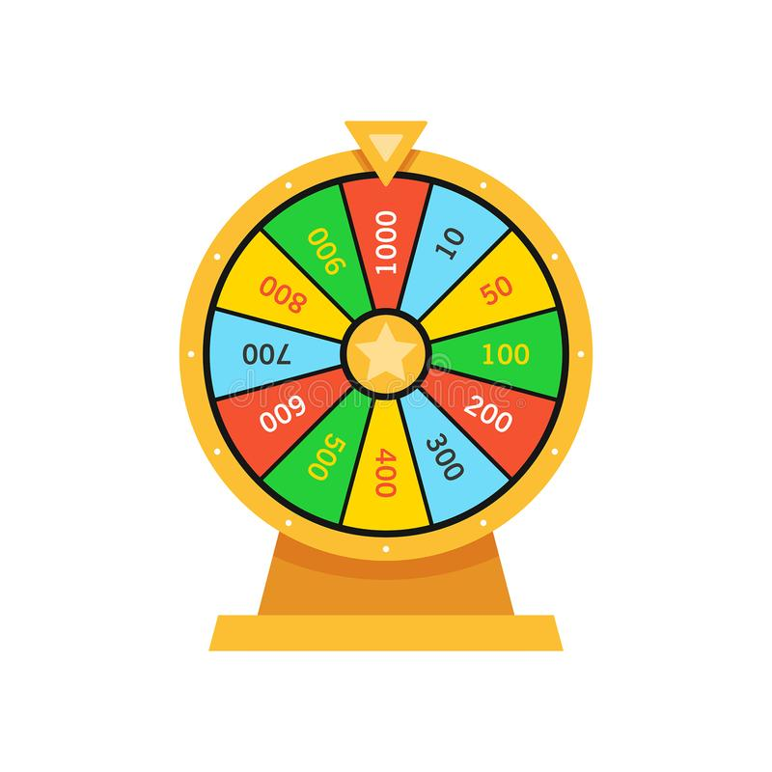
Lucky wheel

Slide 5





Lucky wheel
30
20
40
10
1
2
3
50
80
4
5
6
60
70
7
8
9
SPIN
Notes:
Thanh Yến Trần 0967 255 149 zalo/ FB https://www.facebook.com/thanhyentrananhngutaymy/

Slide 6
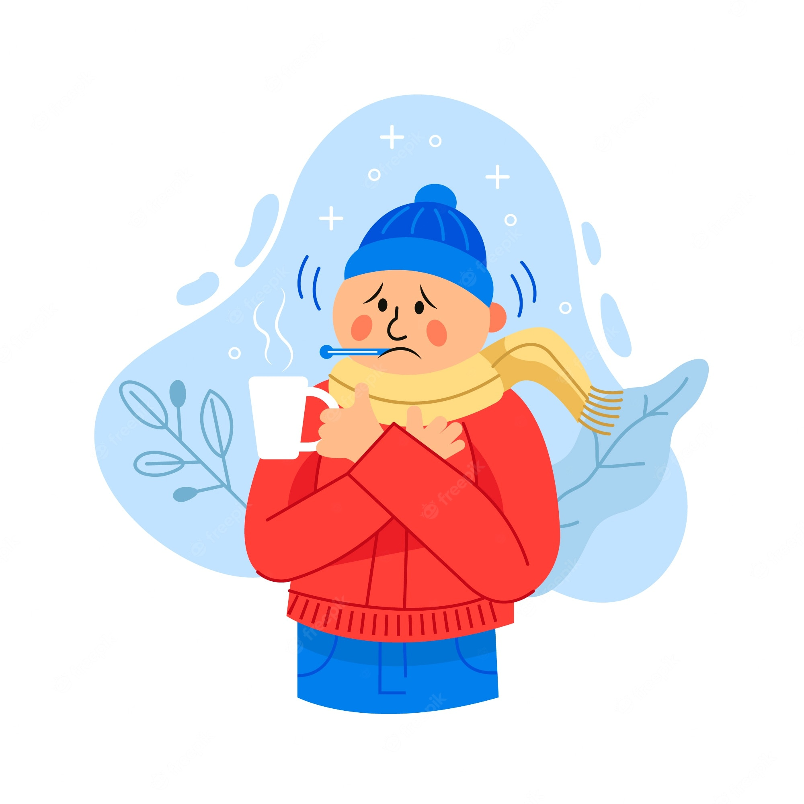
What do you like doing when it’s …..?
I like skating.
A
cold
B
hot
BACK
Notes:
Thanh Yến Trần 0967 255 149 zalo/ FB https://www.facebook.com/thanhyentrananhngutaymy

Slide 7
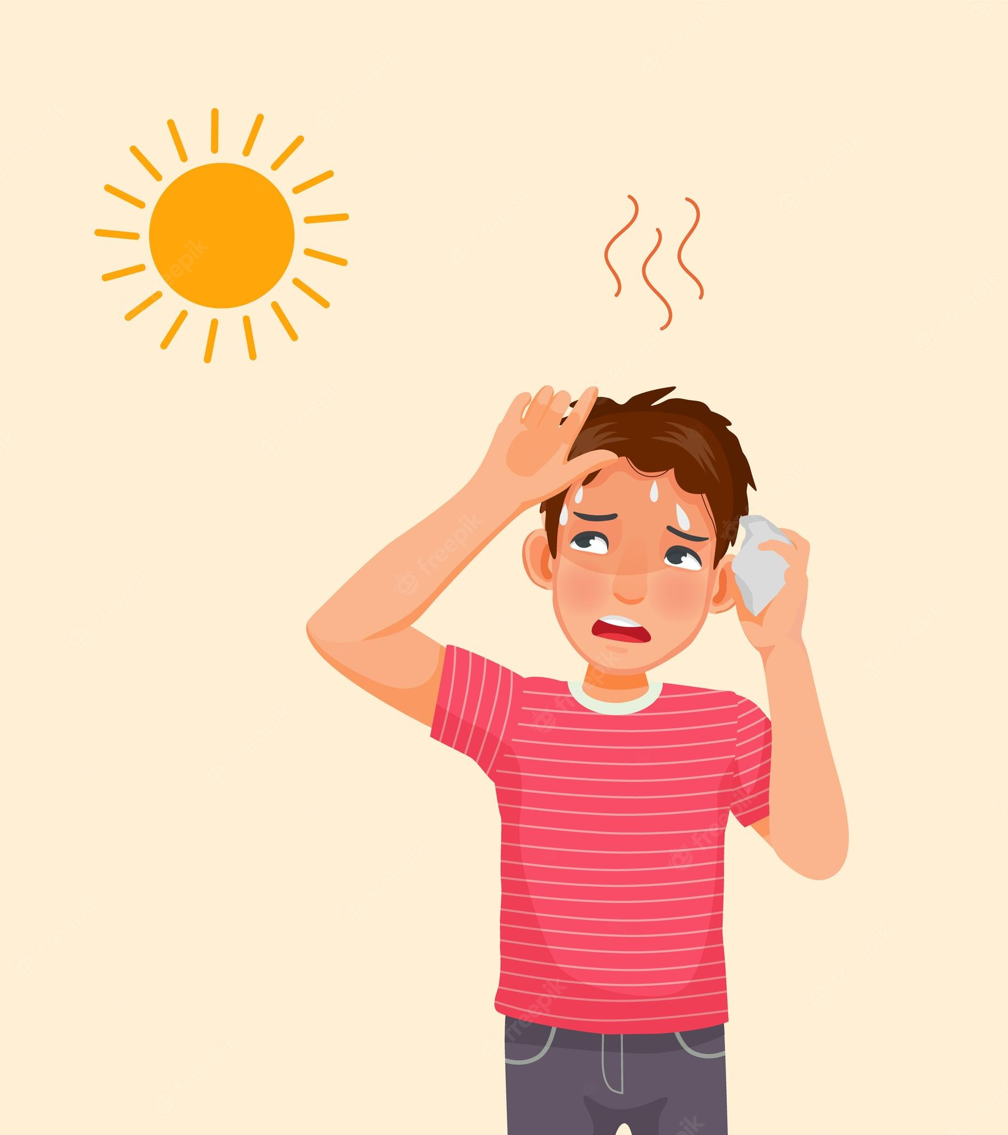
Look and choose
A
cold
B
hot
C
freezing
BACK
Notes:
Thanh Yến Trần 0967 255 149 zalo/ FB https://www.facebook.com/thanhyentrananhngutaymy/

Slide 8
doing/What/do/doing/when it’s /freezing?/you like
A
When do you like it’s doing what freezing?
B
What do you like doing when it’s freezing?
C
What you do like doing when it’s freezing?
BACK
Notes:
Thanh Yến Trần 0967 255 149 zalo/ FB https://www.facebook.com/thanhyentrananhngutaymy/

Slide 9
What …. he like doing
when it’s stormy?
A
does
B
do
BACK
Notes:
Thanh Yến Trần 0967 255 149 zalo/ FB https://www.facebook.com/thanhyentrananhngutaymy/

Slide 10
Listen and choose
A
warm
B
stormy
BACK
Notes:
Thanh Yến Trần 0967 255 149 zalo/ FB https://www.facebook.com/thanhyentrananhngutaymy/

Slide 11
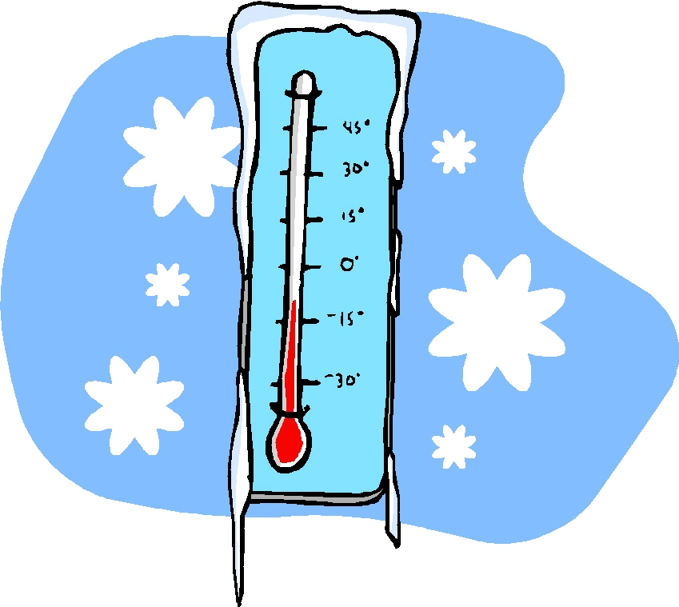
Look and choose:
A
cool
B
freezing
C
hot
BACK
Notes:
Thanh Yến Trần 0967 255 149 zalo/ FB https://www.facebook.com/thanhyentrananhngutaymy/

Slide 12
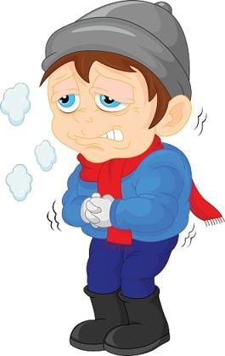
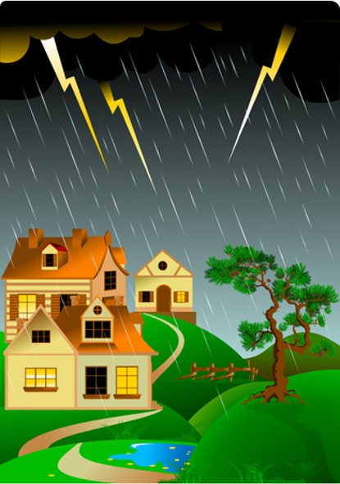
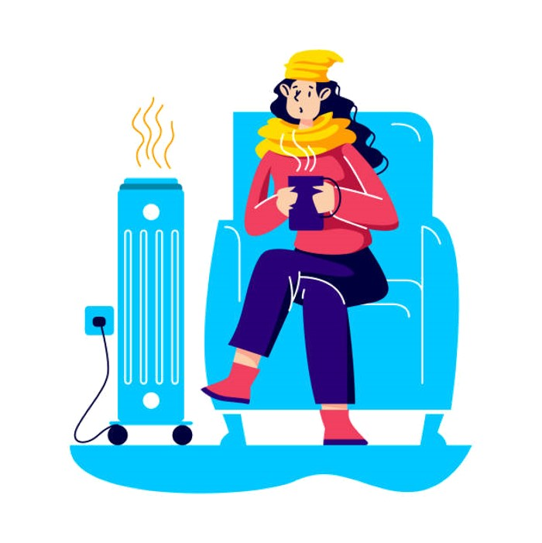
A
B
C
BACK
Notes:
Thanh Yến Trần 0967 255 149 zalo/ FB https://www.facebook.com/thanhyentrananhngutaymy/

Slide 13

What do you like doing when it’s stormy?
A
I like reading to bed.
B
I like go ride a bike.
C
I like read to bed.
BACK

Slide 14
What does he like doing
when it’s cool?
A
I like going for a walk.
B
I like go for a walk.
BACK
Notes:
Thanh Yến Trần 0967 255 149 zalo/ FB https://www.facebook.com/thanhyentrananhngutaymy/

Slide 15
READING
02

Slide 16

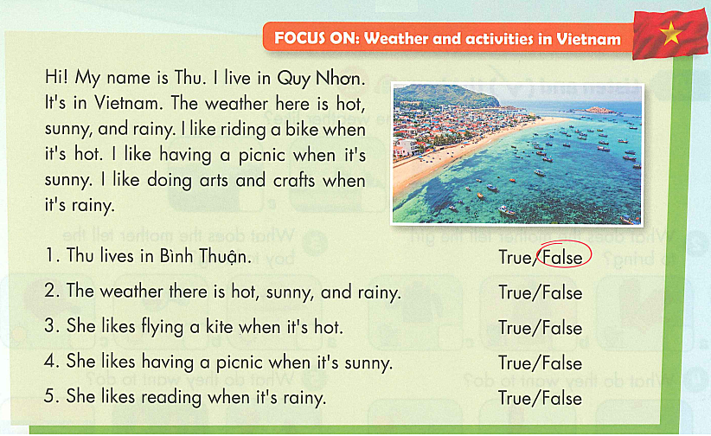
E. 1. READ AND CRICLE TRUE OR FALSE.

Slide 17
2. LISTEN AND READ.

Slide 18
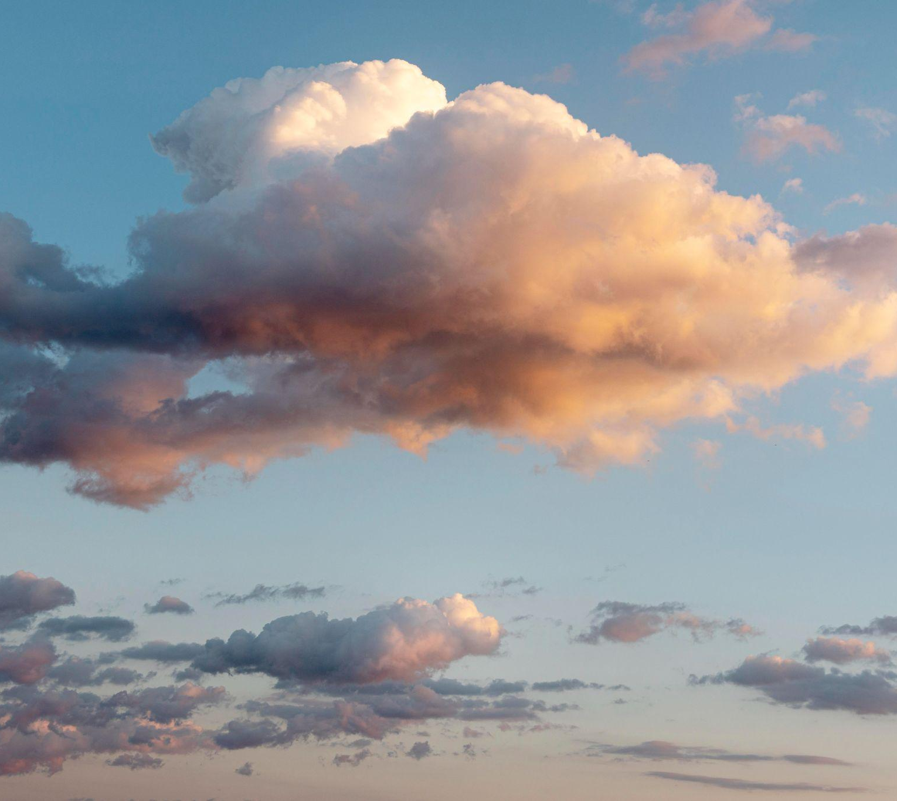
Review Reading

Slide 19


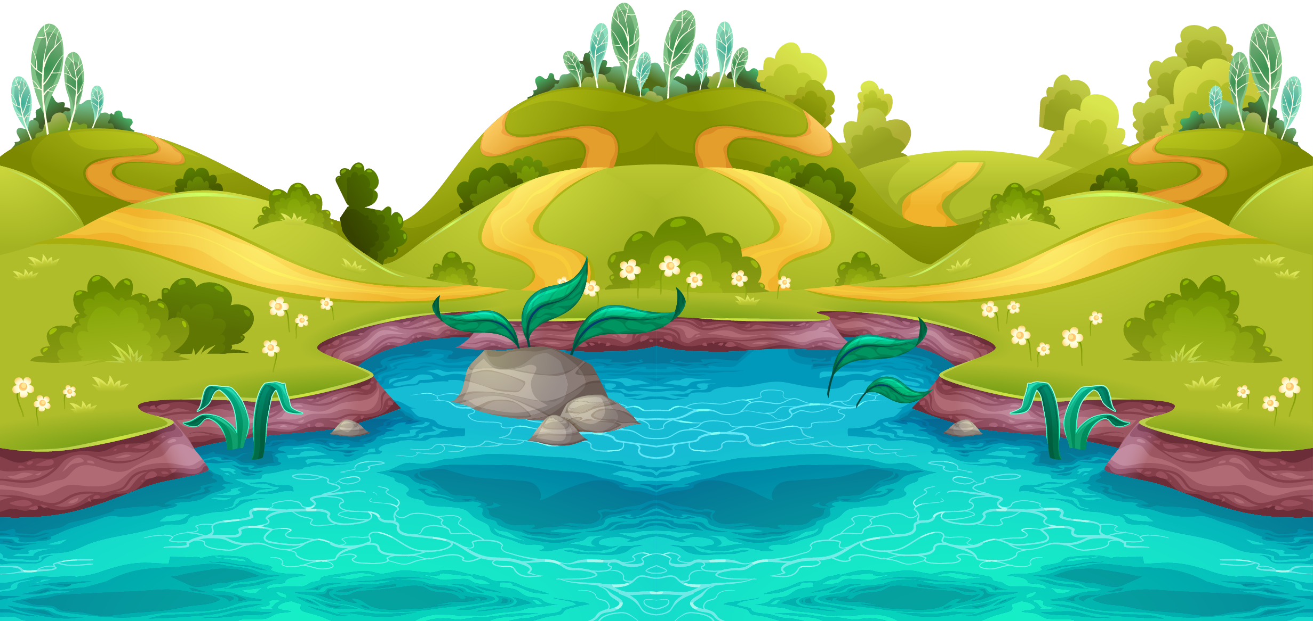











Lotus game

Slide 20



NEXT
4
2
3
5
1
Notes:
Thanh Yến Trần 0967 255 149 zalo/ FB https://www.facebook.com/thanhyentrananhngutaymy

Slide 21
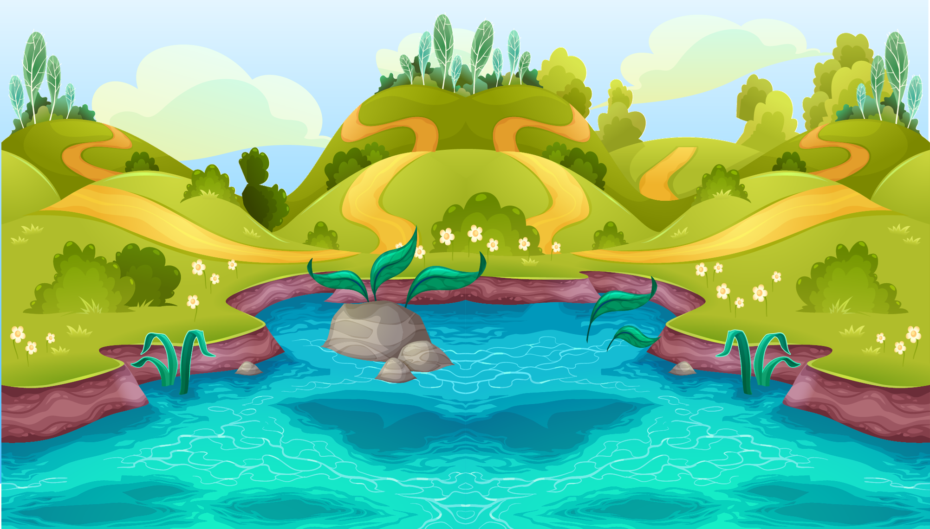




Where is Thu from?
a. Quy Nhon
b. Nha Trang
c. Vung Tau
d. Ha Noi
Notes:
Thanh Yến Trần 0967 255 149 zalo/ FB https://www.facebook.com/thanhyentrananhngutaymy

Slide 22
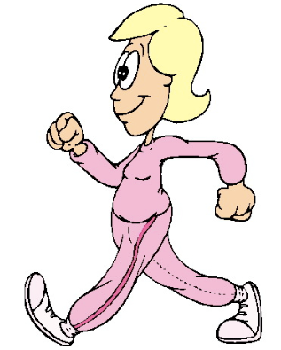
What does she like doing when it’s sunny?
a. She’s like have a picnic
b. She’s like going for a walk
c. She’s like skating
d. He’s like playing the piano
Notes:
Thanh Yến Trần 0967 255 149 zalo/ FB https://www.facebook.com/thanhyentrananhngutaymy

Slide 23
What in the weather like in Quy Nhon?
a. sunny
b. hot
c. rainy
d. sunny, hot and rainy
Notes:
Thanh Yến Trần 0967 255 149 zalo/ FB https://www.facebook.com/thanhyentrananhngutaymy

Slide 24
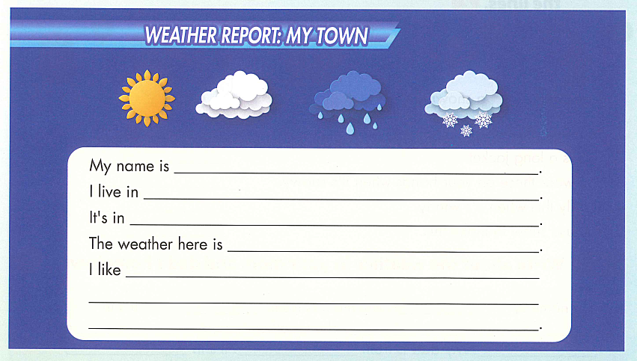
F. LOOK AT. E. WRITE A SHORT WEATHER REPORT
ABOUT YOUR TOWN.

Slide 25

G. TALK ABOUT THE WEATHER IN YOUR TOWN.

Slide 26
GOOD BYE

