Slide 1

Unit 5: Getting Around
Lesson 2.1
Page 67

Slide 2
Objectives
By the end of this lesson, students will be able to…
Vocabulary: Pronounce and use the words related to the topic properly: near, behind, next to, opposite, in front of.
Structure: Where's the park? - It's next to the library.

Slide 3

WARM UP

Slide 4

New words
near, behind, next to,
opposite, in front of

Slide 5

Presentation

Slide 6
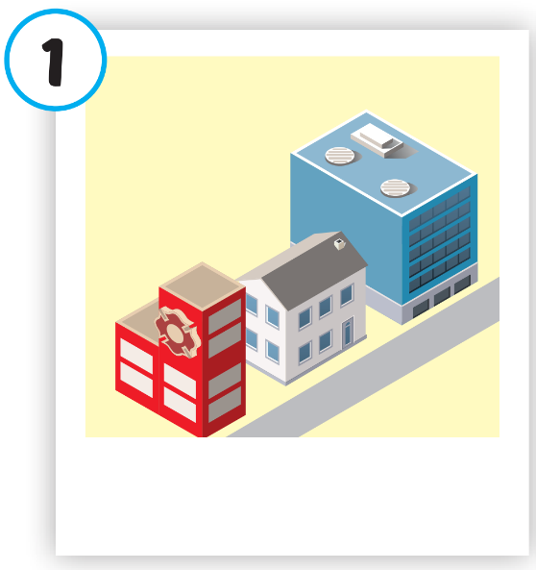
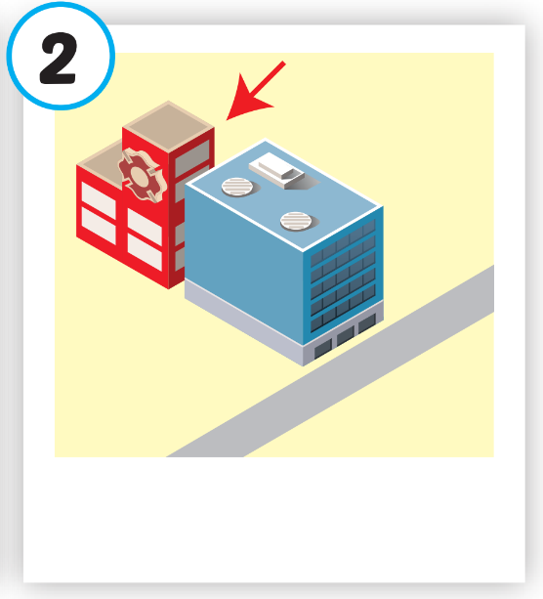
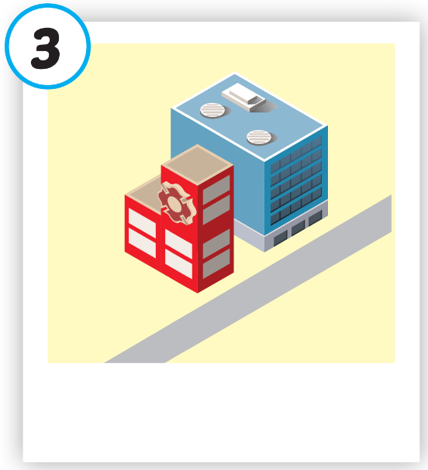
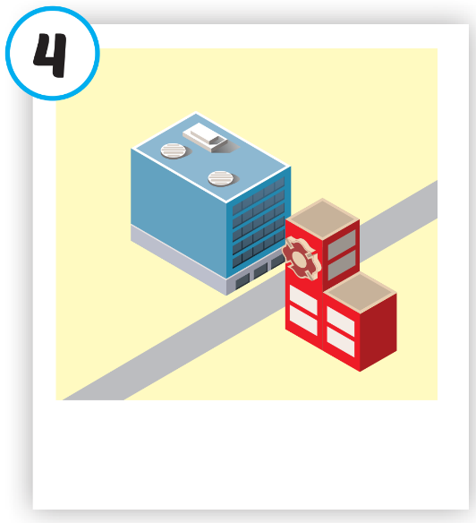
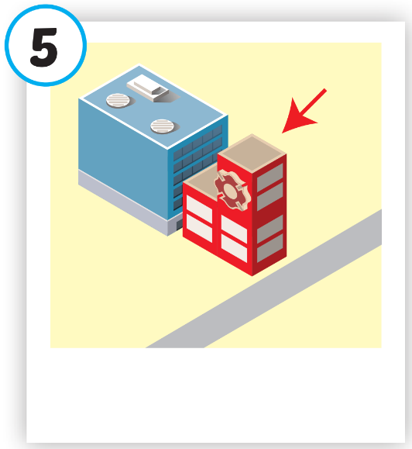





Click on each picture to hear the sound.
/nɪr/
gần
/bɪˈhaɪnd/
đằng sau
/nekst tə/
bên cạnh
/ˈɑːpəzɪt/
đối diện
/ɪn ˈfrʌnt əv/
phía trước
Notes:
Click vào hình A. 1. Listen and point. Repeat để cho cả audio full chạy

Slide 7

Click on each picture to hear the sound.
/nɪr/
gần

Slide 8
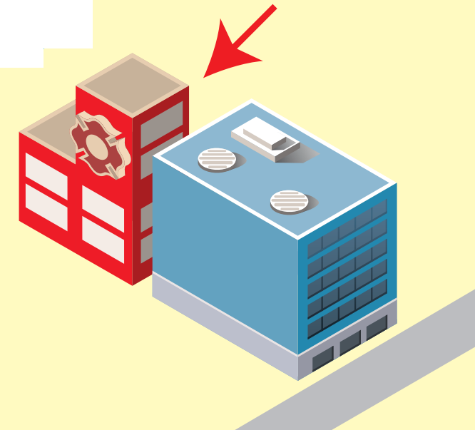
Click on each picture to hear the sound.
/bɪˈhaɪnd/
đằng sau
Notes:
Click vào hình A. 1. Listen and point. Repeat để cho cả audio full chạy

Slide 9

Click on each picture to hear the sound.
/nekst tə/
bên cạnh

Slide 10

Click on each picture to hear the sound.
/ˈɑːpəzɪt/
đối diện

Slide 11
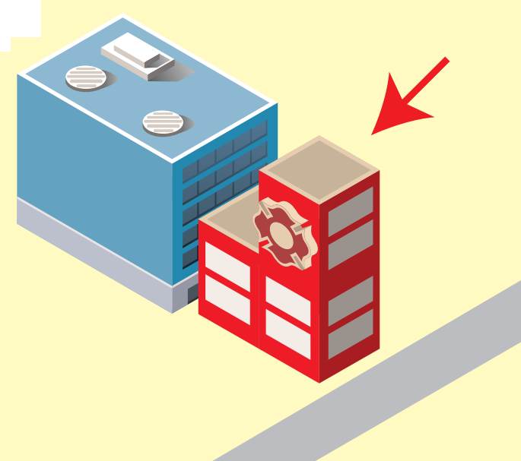
Click on each picture to hear the sound.
/ɪn ˈfrʌnt əv/
phía trước

Slide 12
Practice

Slide 13
Check your memory

Slide 14






PLAY

Slide 15


Click on the SPIN button and guess the word.

Slide 16




near
Which word is it?
NEXT
r
ar
fast
d
fa
ne
r
e
a
a
m
ak
fa
br
Check

Slide 17
opposite
Which word is it?
NEXT
site
ar
fast
h
fa
po
p
si
te
p
op
h
n
fa
br
Check

Slide 18
next to
Which word is it?
NEXT
to
ar
fast
d
fa
xt
r
br
e
a
ne
m
ak
fa
br
Check

Slide 19

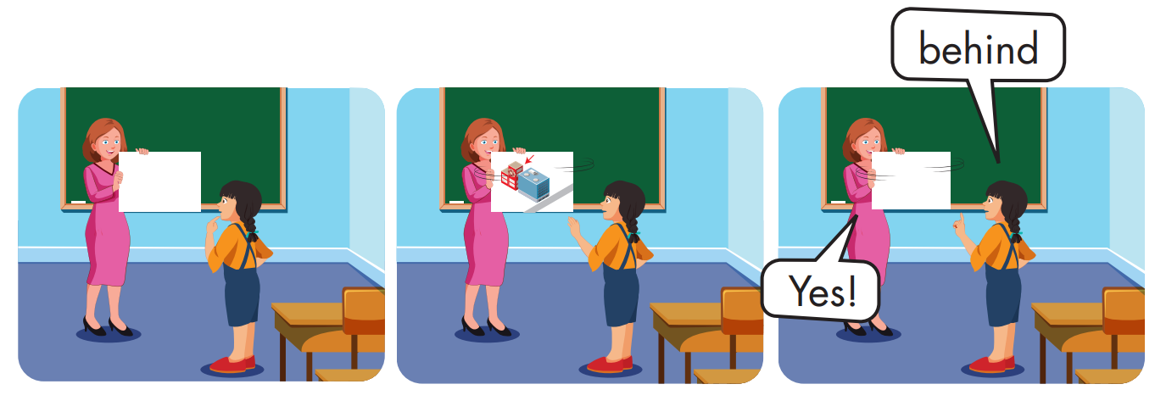

Slide 20
Structure
Where's the park?
It's next to the library.

Slide 21

Practice

Slide 22


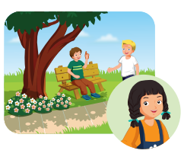
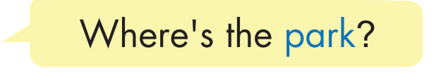
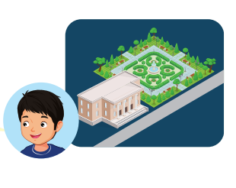


Slide 23
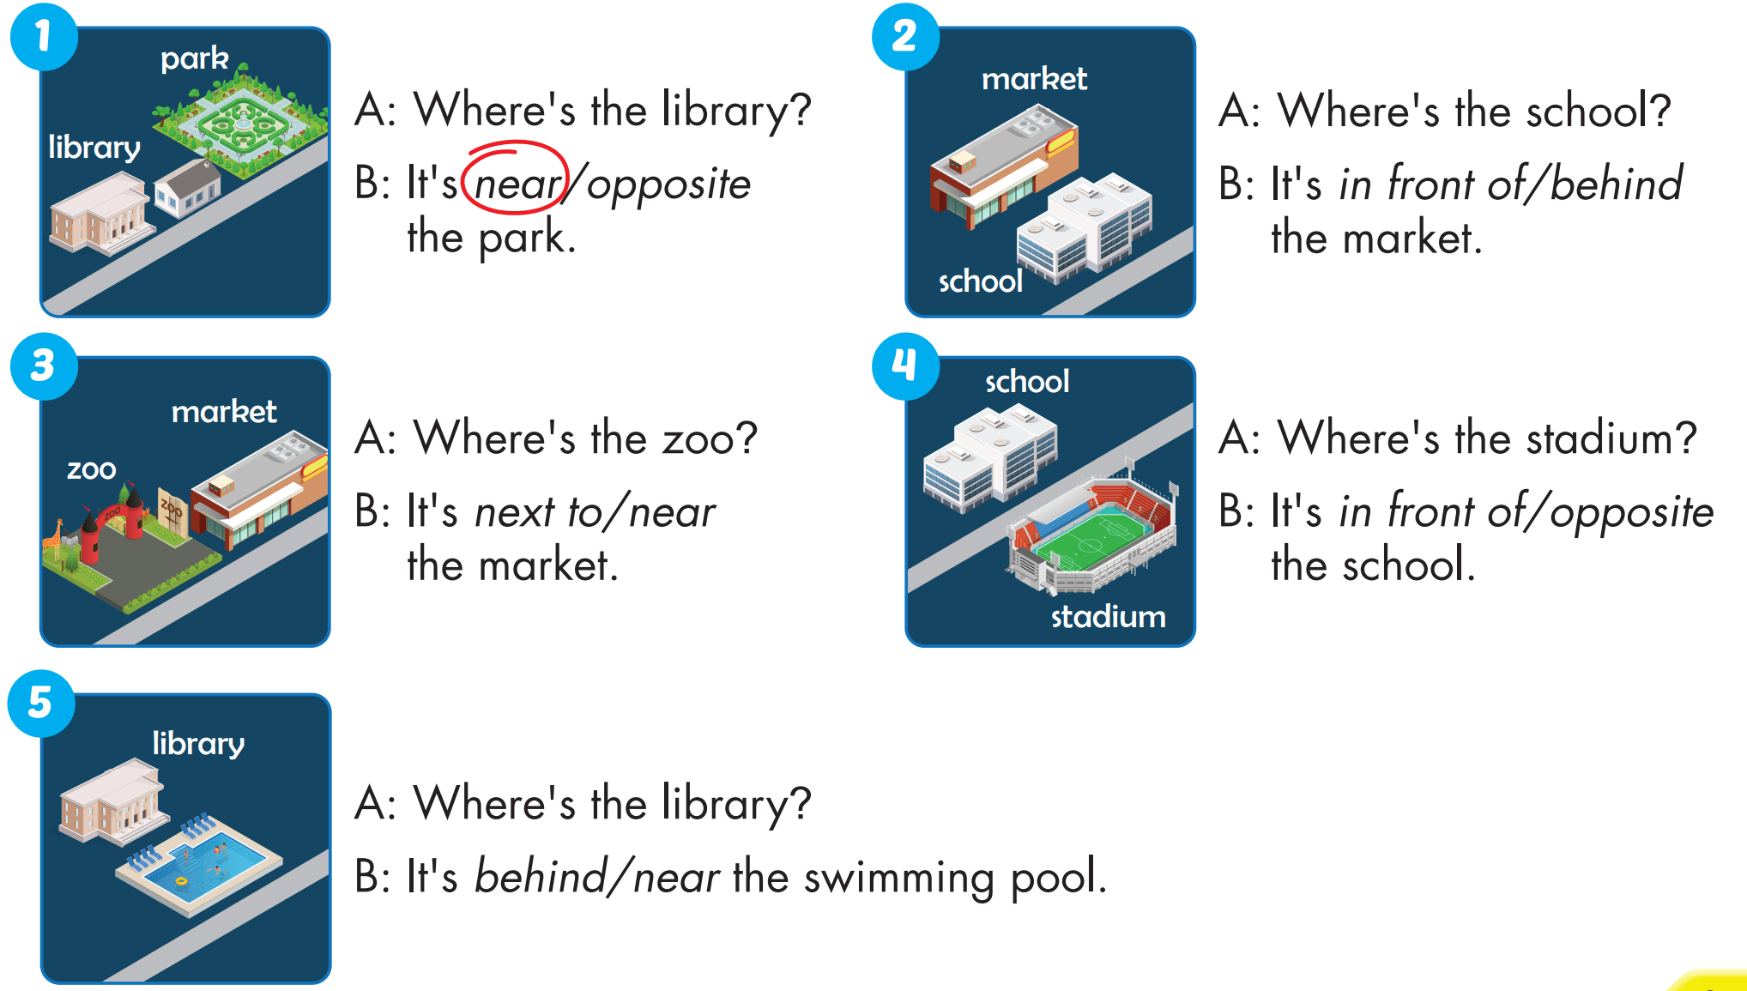


Slide 24
Today’s lesson
Vocabulary
near, behind, next to, opposite, in front of.
Structures/ Sentence patterns
Where's the park?
- It's next to the library.

Slide 25
Homework
Practice the vocabularies and structure; and make sentences using them.
Do the exercises in Tiếng Anh 4 i-Learn Smart Start WB (page 44).
Do the exercises in Tiếng Anh 4 i-Learn Smart Start Notebook (page 29).
Prepare the next lesson (page 68 SB).

Slide 26

Enjoy your day!

