Slide 1



Unit 5
MsPham
0936082789
Sports and hobbies
Lesson 1

Slide 2
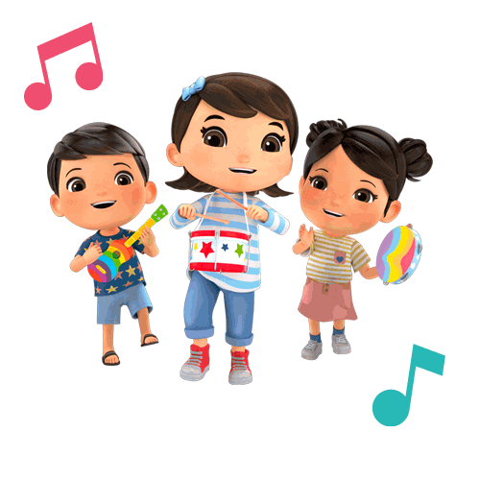
MsPham
0936082789
Warm-up

Slide 3

MsPham
0936082789
Sounds

Slide 4
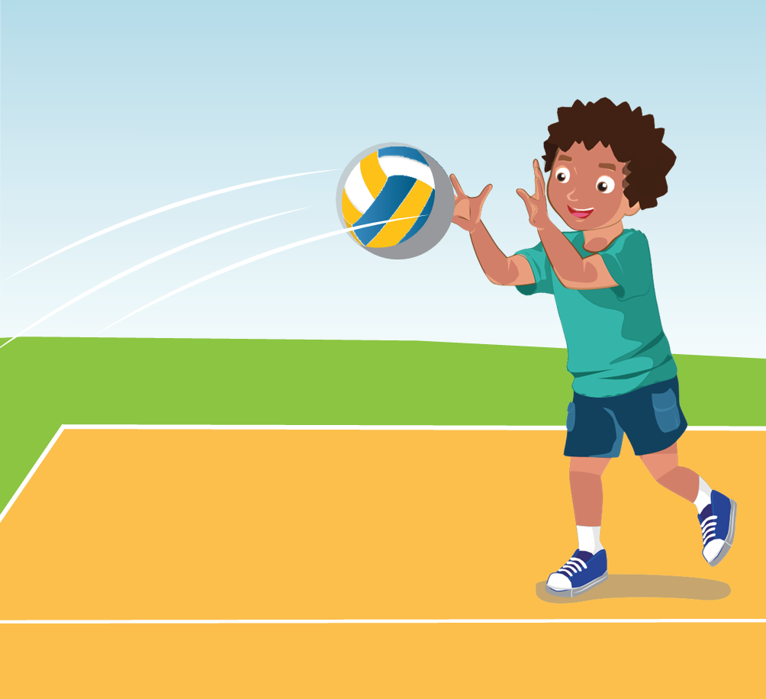
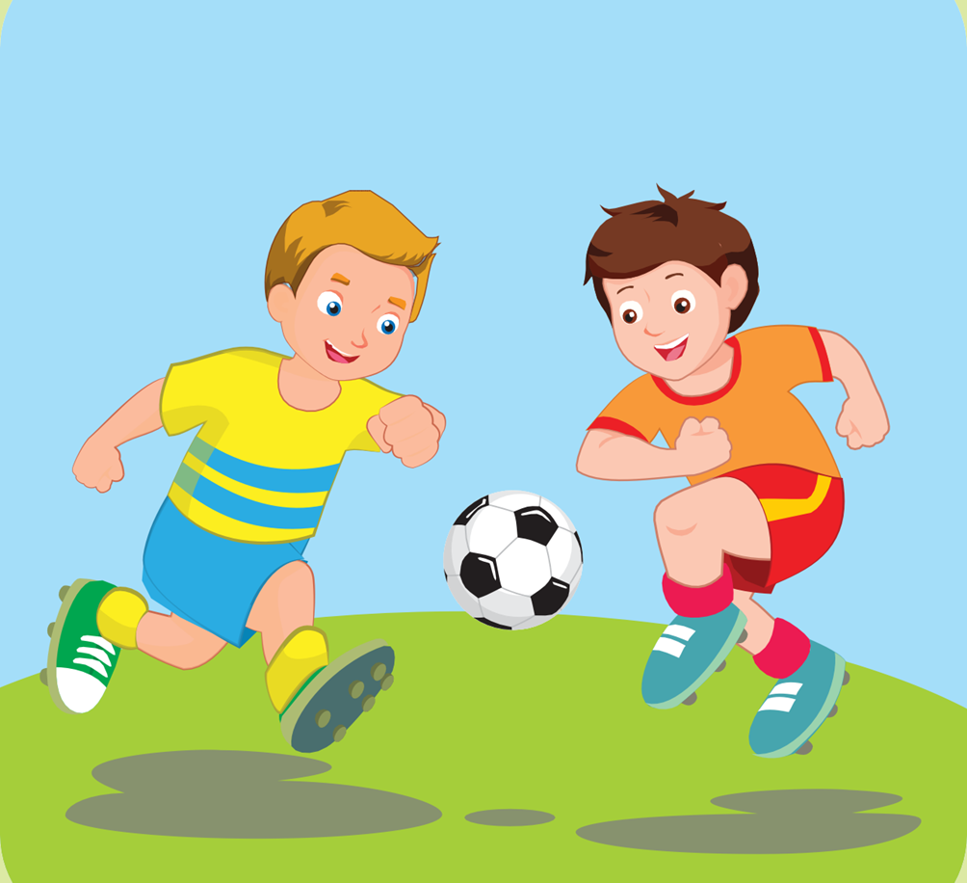
C
1. Listen and repeat.
volleyball
soccer
/ˈvɑːlibɑːl/
/ˈsɑːkər/

Slide 5
Sounds
o
/ɑː/
volleyball
soccer
a
/ɑː/
father
yard

Slide 6

C
2. Chant
/ɑː/, /ɑː/, /ɑː/, /ɑː/, /ɑː/, /ɑː/, volleyball, soccer, /ɑː/, /ɑː/, /ɑː/.

Slide 7

Listening

Slide 8
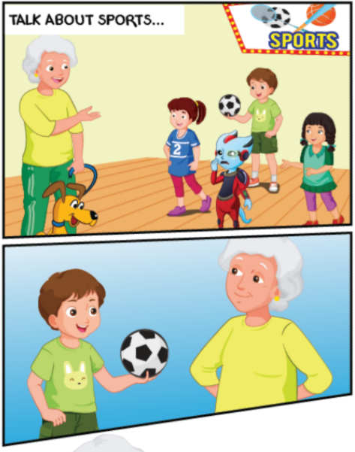
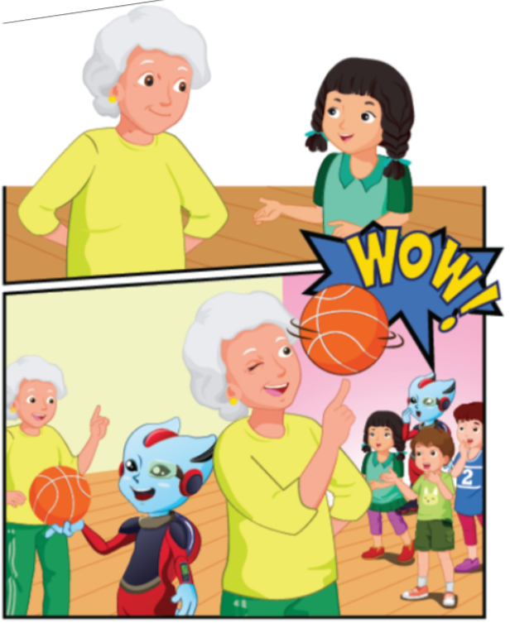
D
1. Look and listen.
3
1
4
2

Slide 9
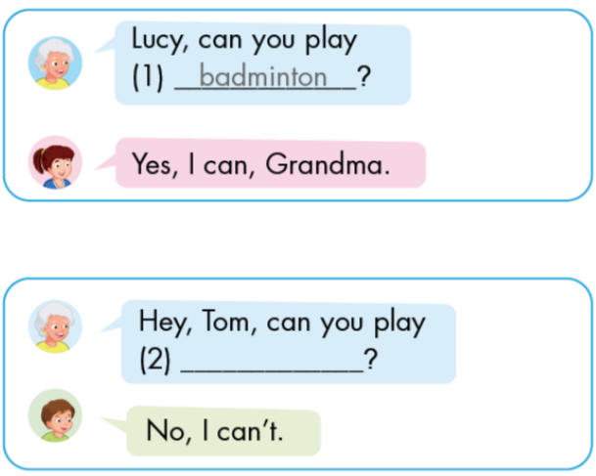
D
2. Listen and write.
1
2

Slide 10
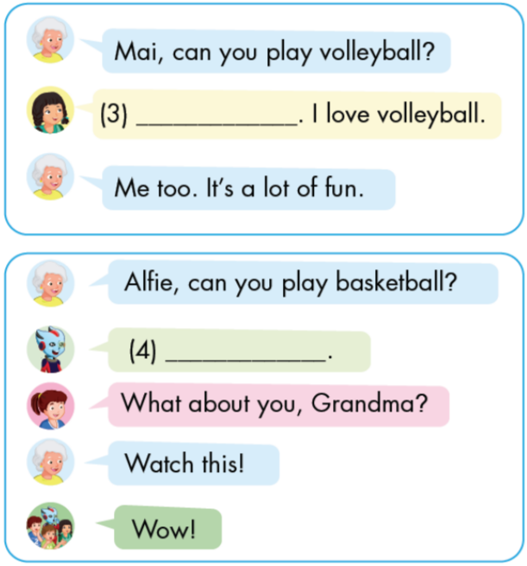
D
2. Listen and write.
3
4

Slide 11


D
3. Practice with your friends.
Yes, I can./
No, I can't.
Can you play soccer?

Slide 12
MsPham
0936082789
Practice
Workbook

Slide 13

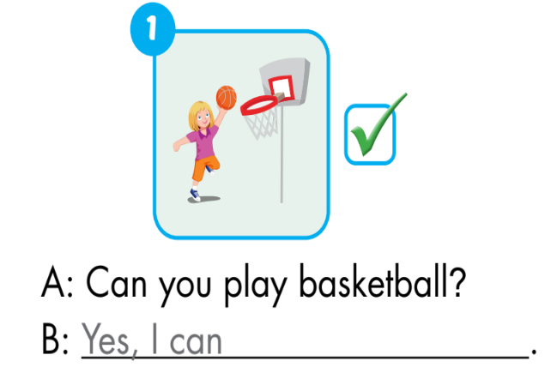
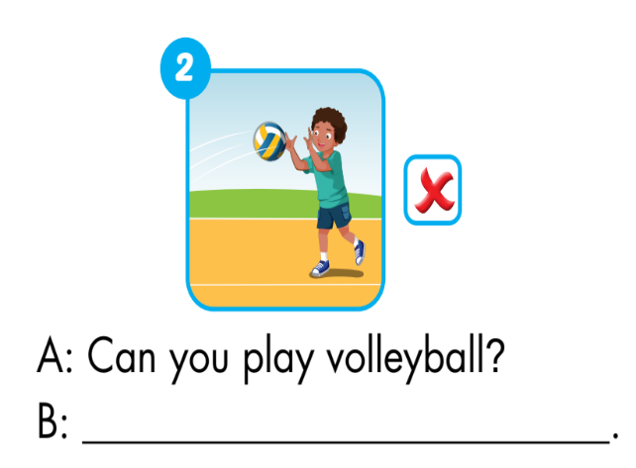
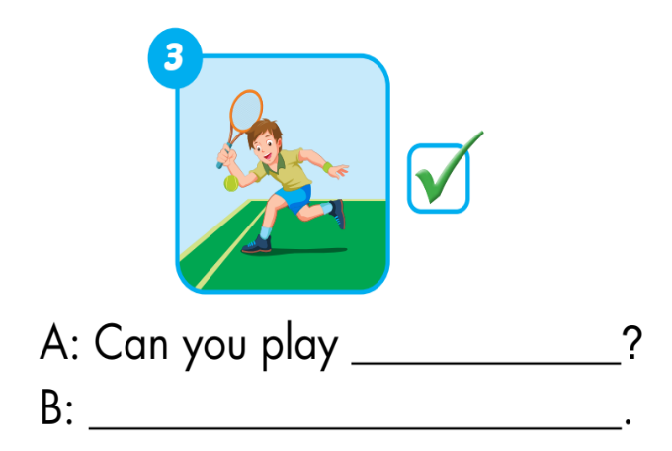
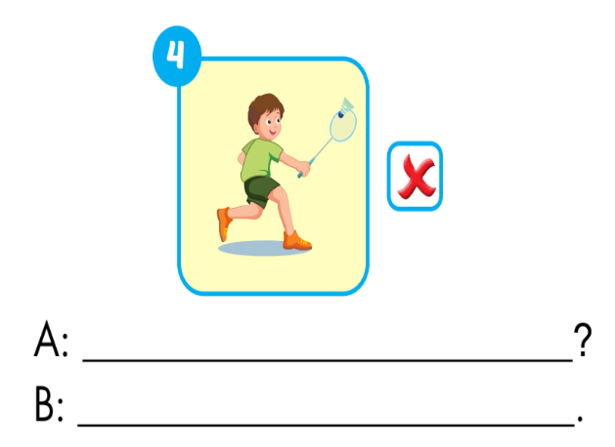
D
Look and write
No, I can’t
tennis
Can you play badminton
Yes, I can
No, I can’t.

