Slide 1



Unit 5
MsPham
0936082789
Sports and hobbies
Lesson 1

Slide 2

MsPham
0936082789
MsPham
0936082789
Warm-up

Slide 3

MsPham
0936082789
Vocabulary

Slide 4






A
Listen and point. Repeat.
badminton
tennis
volleyball
basketball
soccer

Slide 5
A
Listen and point. Repeat.
badminton
tennis
volleyball
basketball
soccer
/ˈbædmɪntən/
cầu lông
/ˈtenɪs/
quần vợt
/ˈvɑːlibɑːl/
bóng chuyền
/ˈbæskɪtbɑːl/
bóng rổ
/ˈsɑːkər/
bóng đá

Slide 6


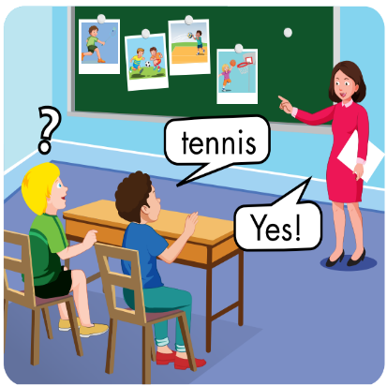
A
2. Play Heads up. What’s missing?
MsPham
0936082789
Notes:
- Click on the WORDS to hear the SOUND

Slide 7
MsPham
0936082789
Structure

Slide 8



B
1. Listen and practice.
MsPham
0936082789
Notes:
- Click on the WORDS to hear the SOUND

Slide 9
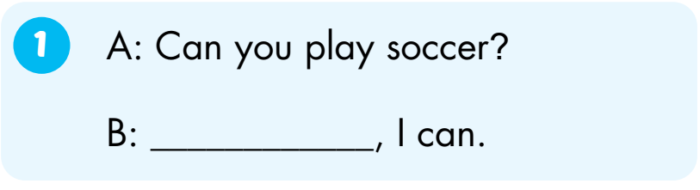
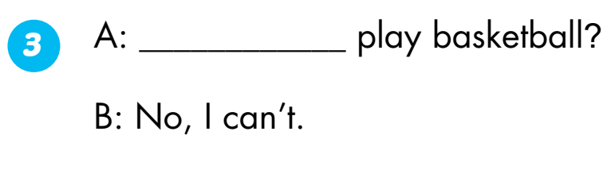
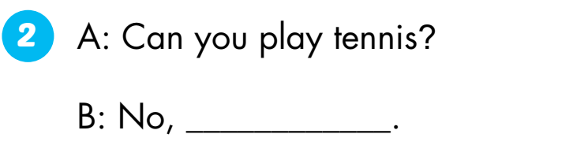
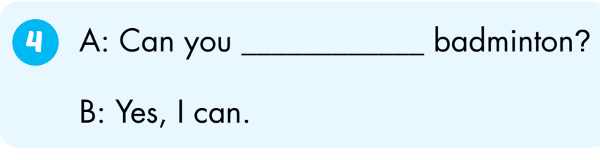
B
2. Look and write. Practice.
Can you
MsPham
0936082789
Yes
play
I can’t.
Notes:
- Click on the WORDS to hear the SOUND

