Slide 1














UNIT 4
FUN TIME & PROJECT
Period 2

Slide 2

1 WARM-UP
Let’s dance

Slide 3

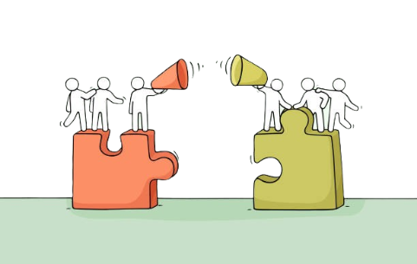
Hot seat
- 1 S is chosen from each team faces to the classroom to guess the word.
- T writes a word on the board or shows it on the screen.
- Team members must help the chosen S guess the words by describing them by actions.

Slide 4
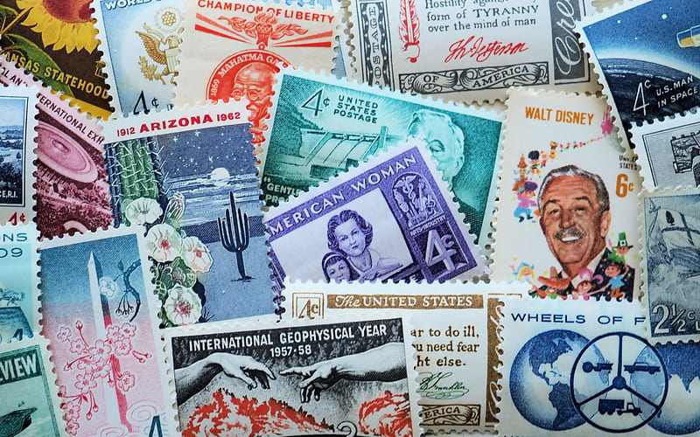
collect stamps

Slide 5
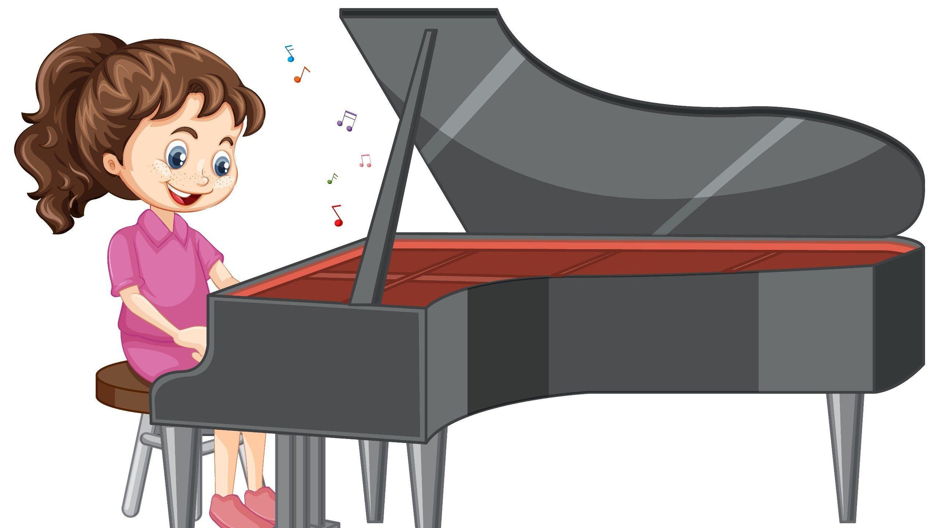
play the piano

Slide 6

watch movies

Slide 7
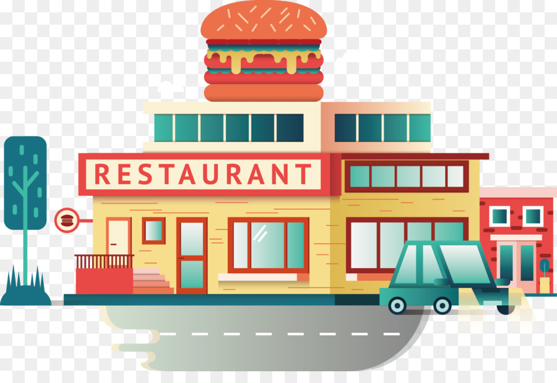

Slide 8
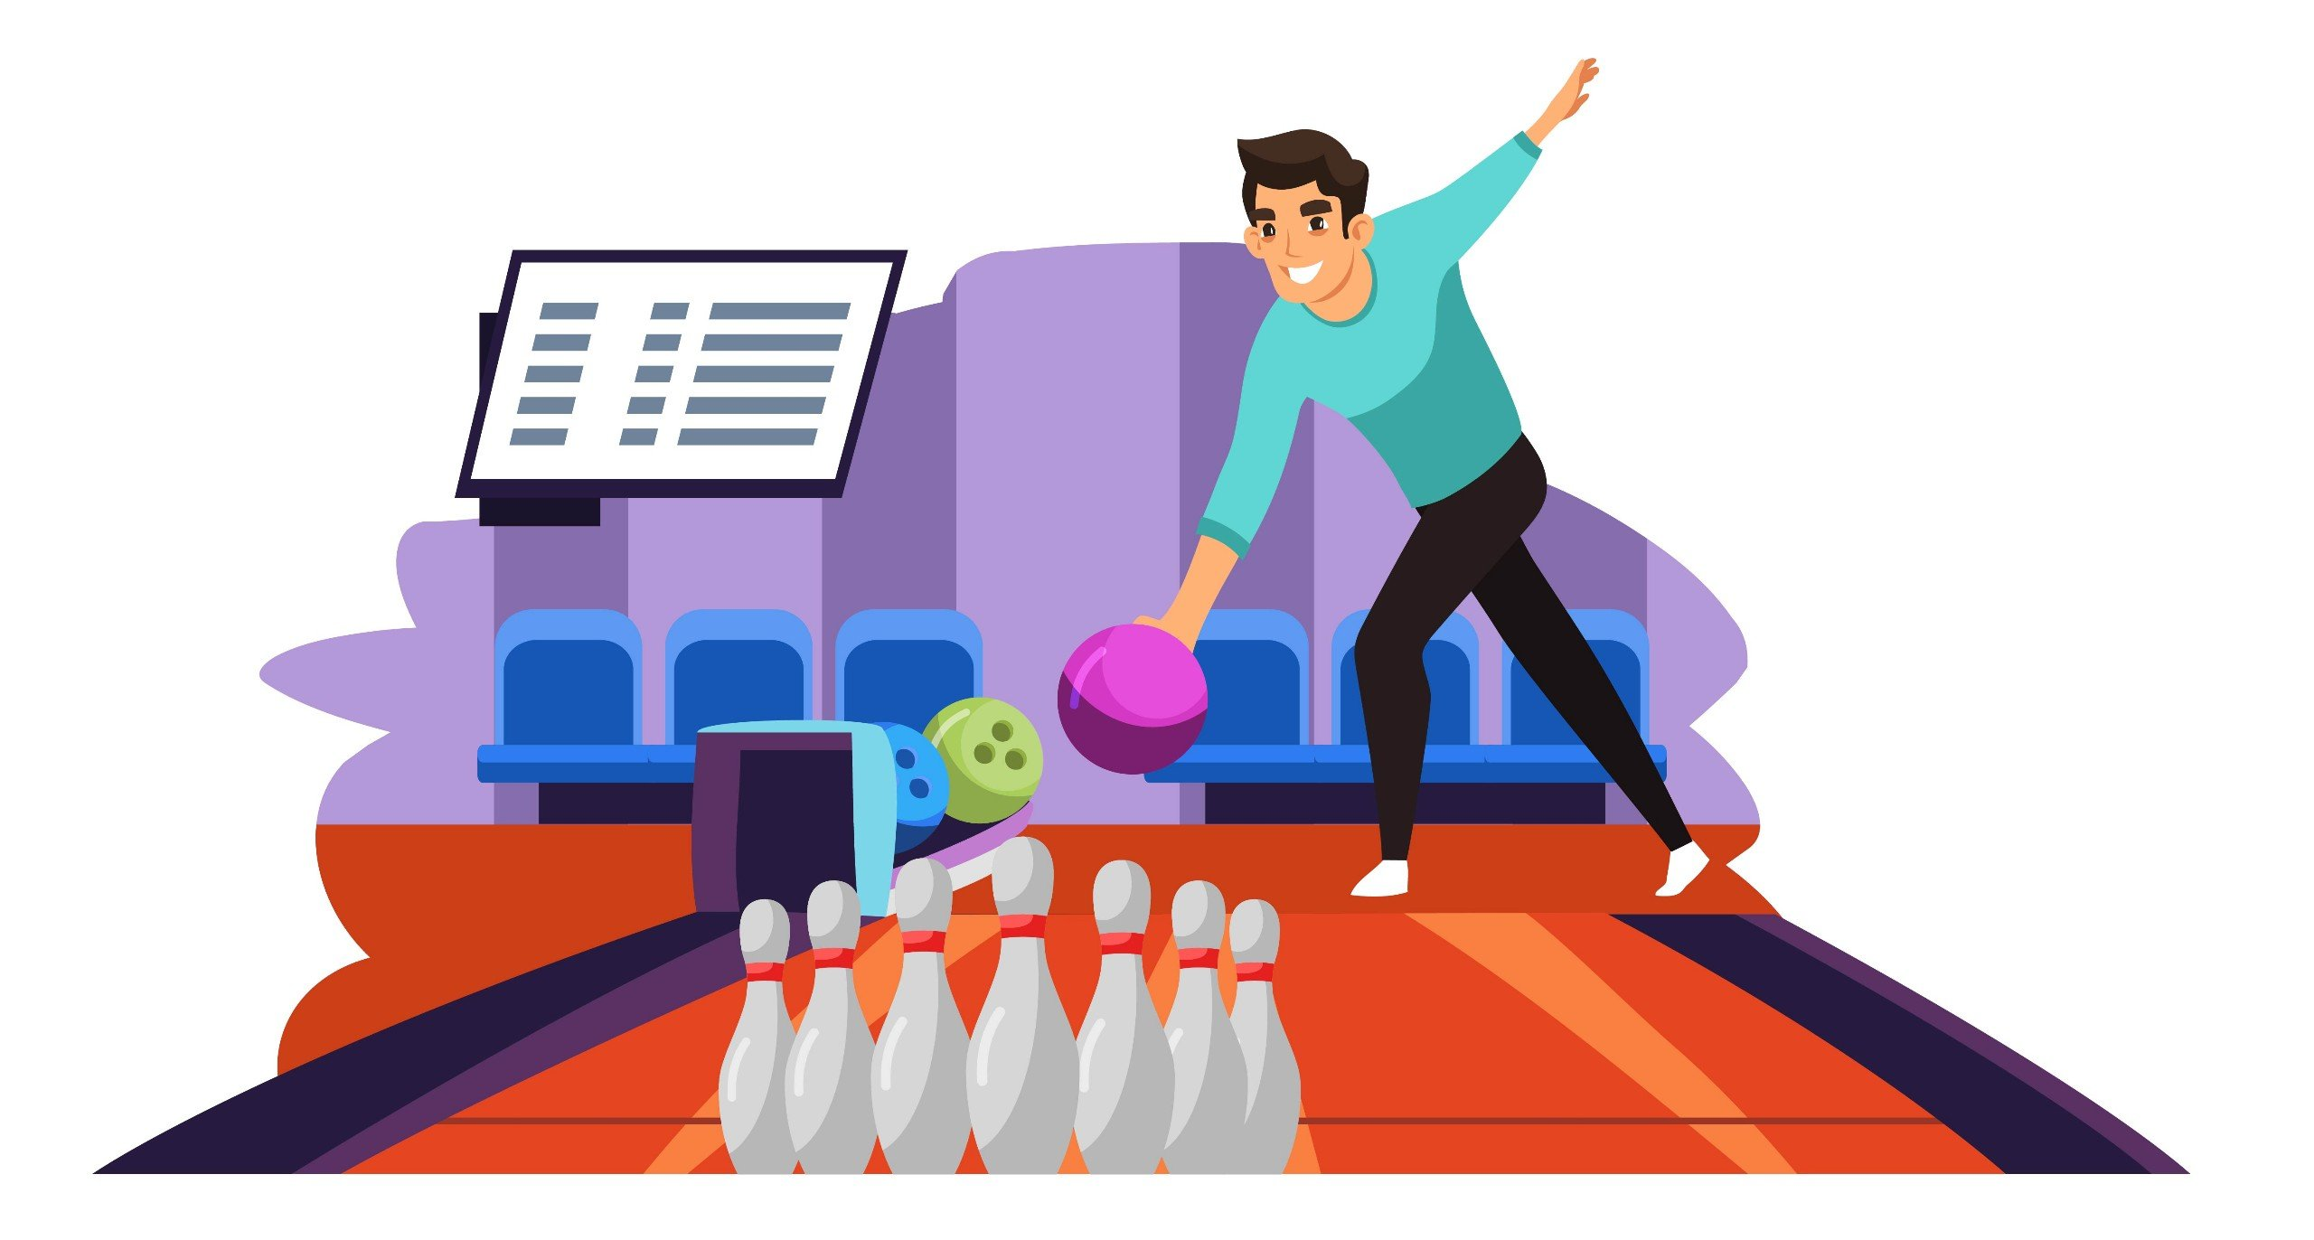
go bowling

Slide 9
2 REVIEW

Slide 10
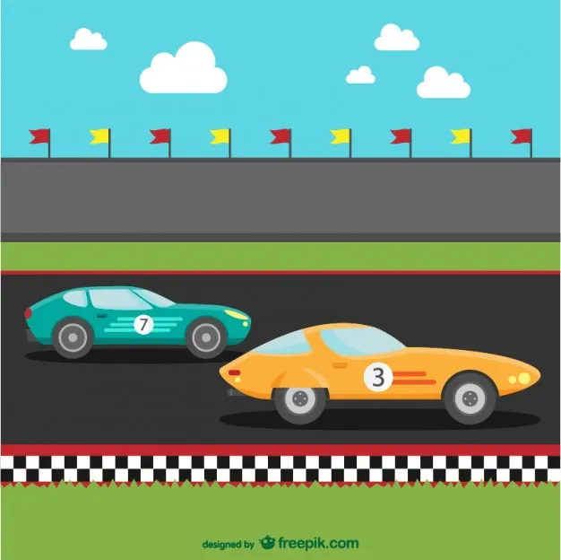




RACE
GAME
on the car that has the answer you choose
RULE
correct answer
to get stars
8

Slide 11
3 PROJECT
Task 4. Project:
Do a class survey

Slide 12

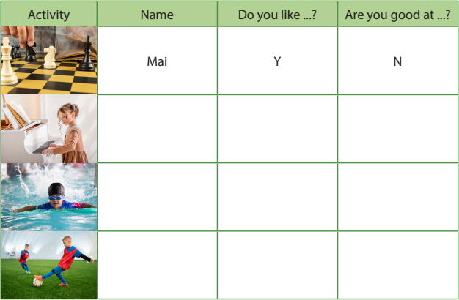


Walk around the room and ask three classmates about their hobbies. Write Y for Yes and N for No.
Mai, do you like playing chess?
Yes, I do.
Are you good at playing chess?
No, I’m not.

Slide 13
4 PRACTICE
Task 5. Let’s talk.

Slide 14
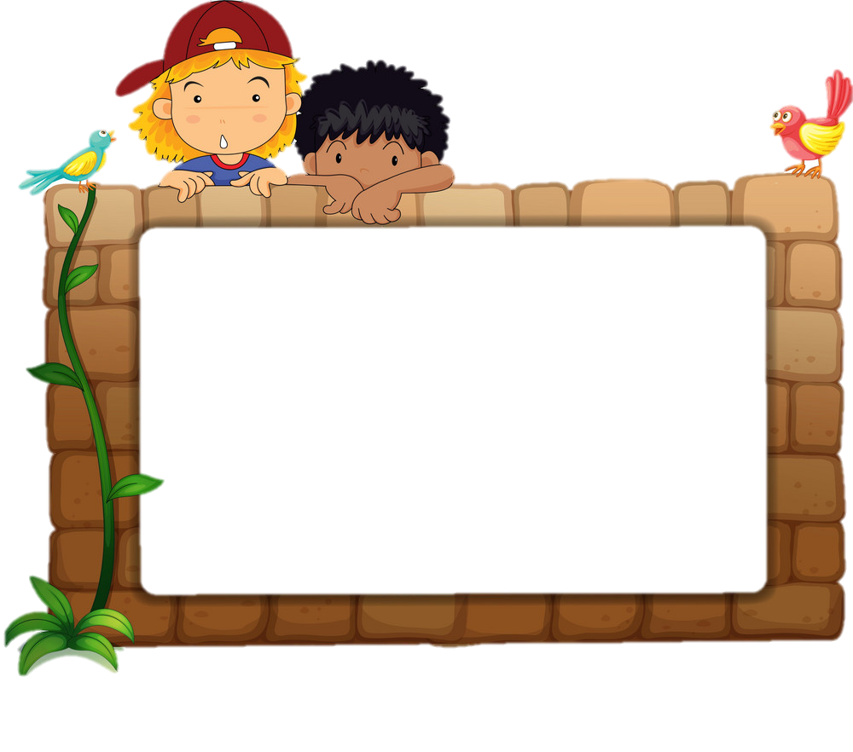
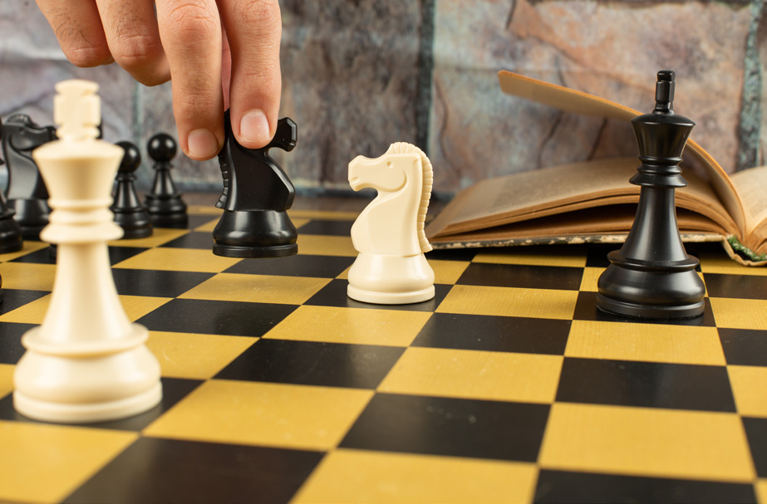
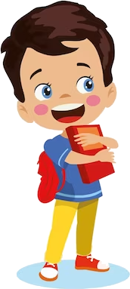
Tell your class about your survey results.
Mai likes playing chess, but she isn’t good at it.

Slide 15
5 WRAP-UP & ASSESSMENT

Slide 16
đ
collecting swimming go faster live playing
Dear Alex,
My name is Ann Smiths. I (0) _______ in London with my family. In my free time, I like (1) _________ stamps and (2) _________ video games. I also (3) _______bowling on Sundays. I am good at (4) ___________. I can swim (5) _________than anyone in my family. How about you? What are your hobbies?
Write soon and tell me about you!
Ann.
live
collecting
playing
go
swimming
faster

Slide 17
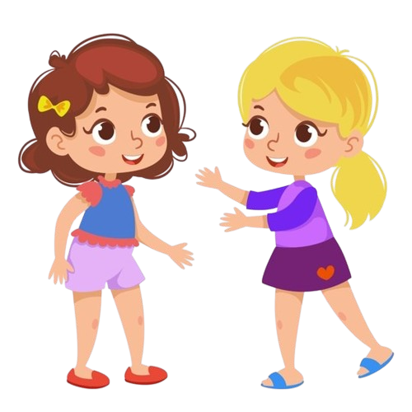
Wrap-up: What we learnt today
Review vocabulary: go ice-skating, ride the roller coaster, collect stamps, watch movies, make a paper bird, play football, etc.
Review structure:
Verb forms (gerund and infinitive)

