Slide 1

LONG BIEN DISTRICT DEPARTMENT OF EDUCATION AND TRAINING
GIANG BIEN PRIMARY SCHOOL
WELCOME TEACHERS
TO
4A1 ENGLISH CLASS
English Teacher: Nguyen Thi Thu Hien.

Slide 2

Unit 1: Animals
Lesson 4.1 Science
Page 15

Slide 3

WARM UP

Slide 4




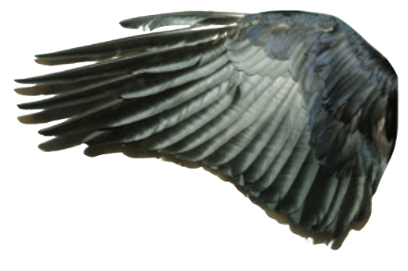


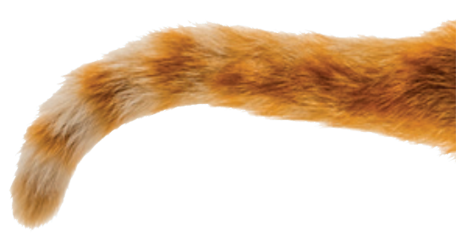

Find the best picture
1
2
3
Next
TAIL

Slide 5


Find the best picture
1
2
3
Next
WING

Slide 6
Find the best picture
1
2
3
Next
FIN

Slide 7
Find the best picture
1
2
3
Next
FEATHER

Slide 8

New words
wing, feather, tail,
fin, fur, claw

Slide 9

Click on each picture to hear the sound.
/teɪl/
cái đuôi

Slide 10

Click on each picture to hear the sound.
/fɪn/
vây cá

Slide 11


Click on each picture to hear the sound.
/fɜːr/
lông (thú)

Slide 12
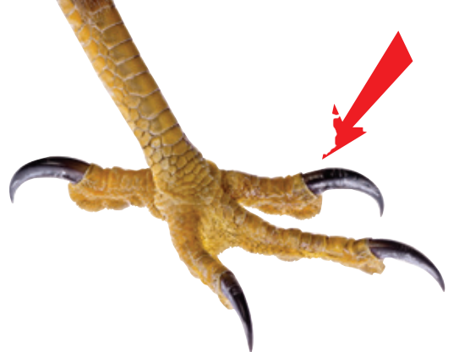

Click on each picture to hear the sound.
/klɑː/
móng vuốt

