Slide 1

LONG BIEN DISTRICT DEPARTMENT OF EDUCATION AND TRAINING
GIANG BIEN PRIMARY SCHOOL
WELCOME TEACHERS
TO
4A1 ENGLISH CLASS
English Teacher: Nguyen Thi Thu Hien.

Slide 2

Unit 1: Animals
Lesson 4.1 Science
Page 15

Slide 3
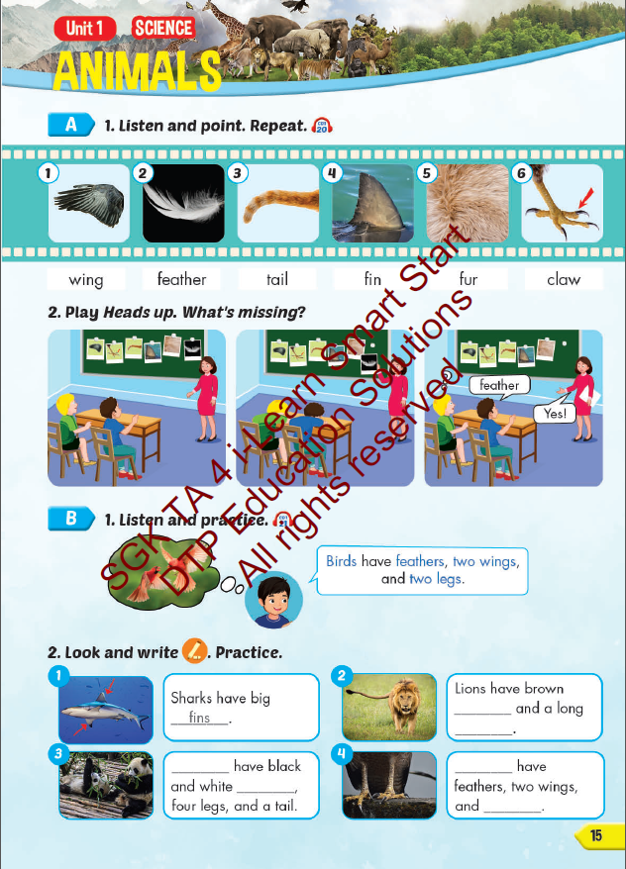
Lesson Outline
Warm-up
Vocabulary
Structure
Consolidation
Wrap-up

Slide 4

Model sentences
Birds have feathers,
two wings, and two legs.

Slide 5


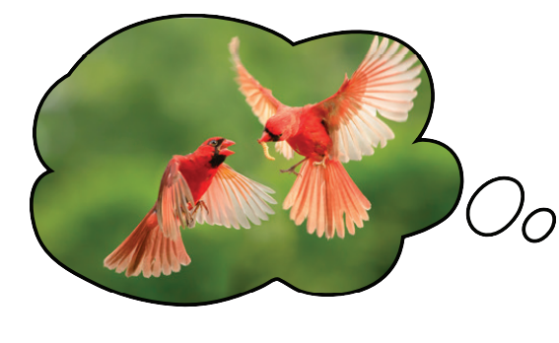
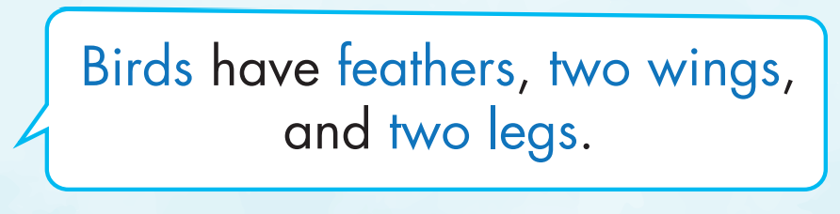


Slide 6

Practice

Slide 7
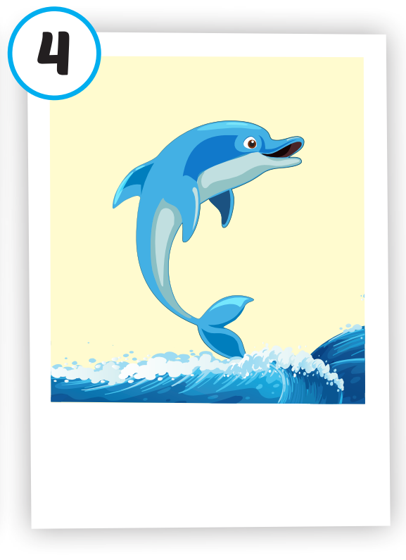

2
1

