Slide 1

Unit 4: Travel
Lesson 1.1
Page 48

Slide 2
Objectives
By the end of this lesson, students will be able to…
Vocabulary: Pronounce and use the words related to the topic properly: mountain, lake, river, beach, ocean, forest New Year (Tết), Christmas, Teachers' Day, Children's Day.
Structure: Practise
I didn't go to the river. I went to the beach.

Slide 3

WARM-UP

Slide 4



Slide 5

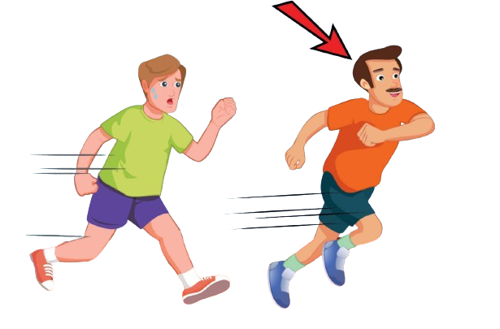
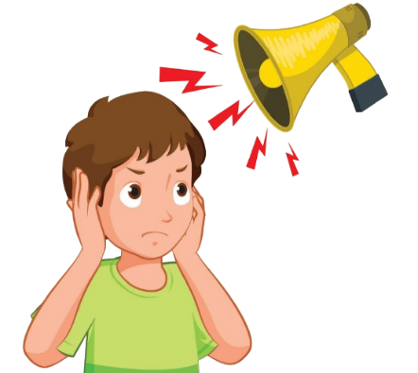
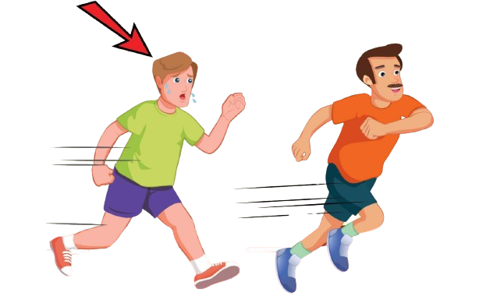

Click on the right option
slowly

Slide 6
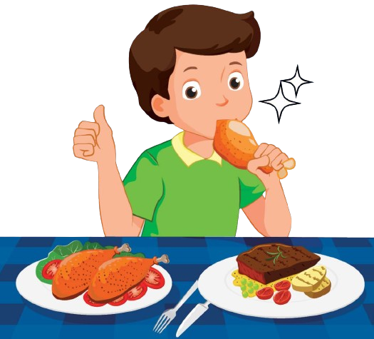


Click on the right option
delicious

Slide 7
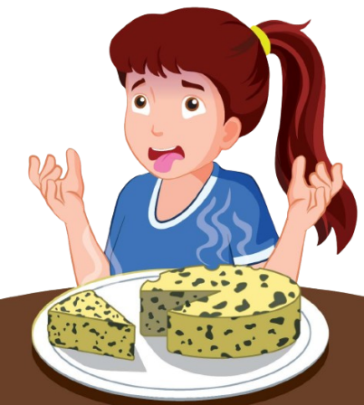

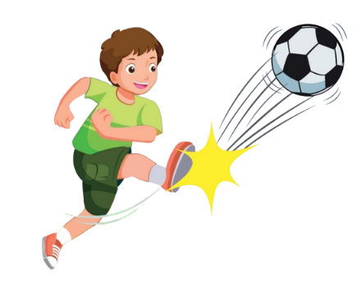
Click on the right option
noisy

Slide 8



Click on the right option
well

Slide 9

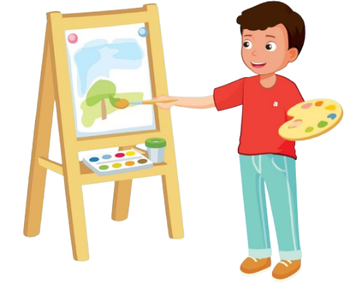
Click on the right option
badly

Slide 10


Click on the right option
paint a picture

Slide 11
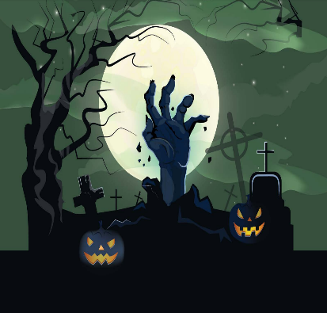
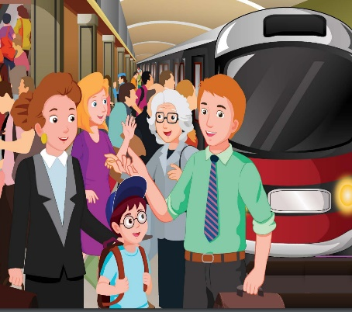
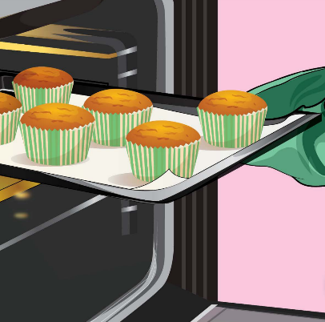
Click on the right option
busy

Slide 12

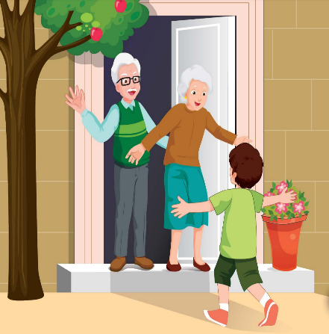

Click on the right option
scary

Slide 13
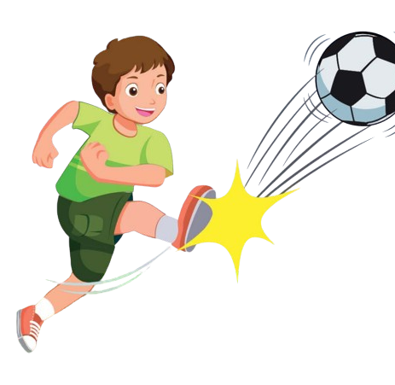
Click on the right option
hard

Slide 14

It’s time to learn …

Slide 15

New words
mountain, lake, river,
beach, ocean, forest

Slide 16

Presentation

Slide 17


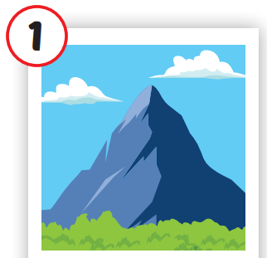
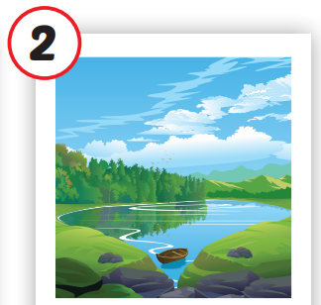
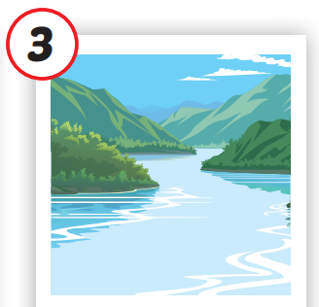
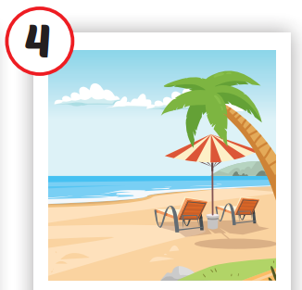
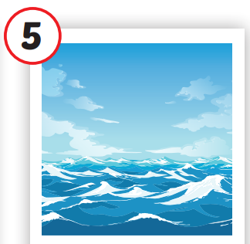
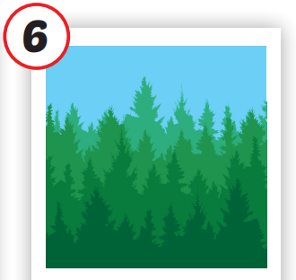






/ˌmaʊntən/
ngọn núi
/leɪk/
hồ
/ˈrɪvər/
sông
/biːtʃ/
bãi biển
/ˈoʊʃən/
đại dương
/ˈfɔrəst/
rừng
Notes:
Click vào hình A. 1. Listen and point. Repeat để cho cả audio full chạy

Slide 18
Practice

Slide 19
Check your memory

Slide 20




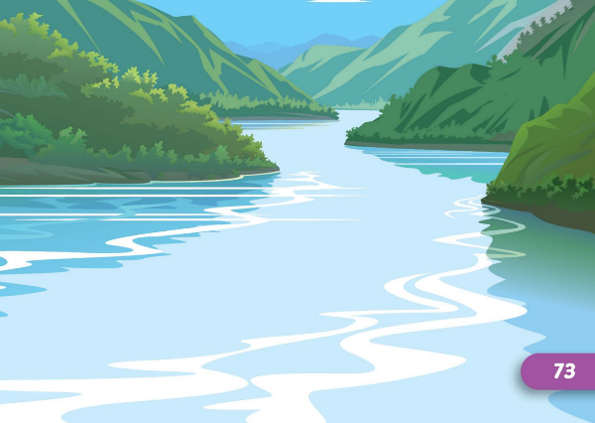

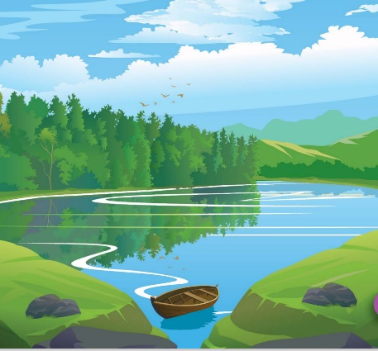


Find the best picture
Next
moutain

Slide 21


Find the best picture
Next
lake

Slide 22
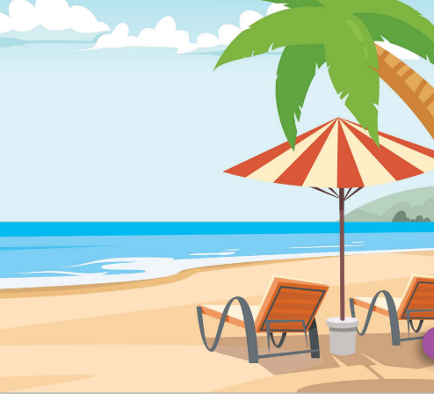
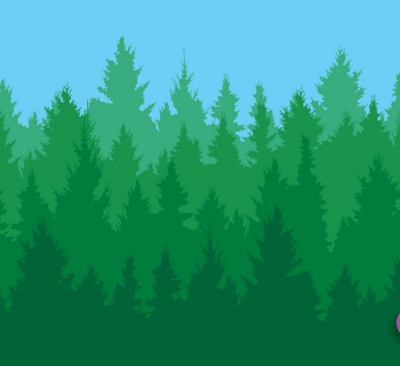
Find the best picture
Next
river

Slide 23

Find the best picture
Next
beach

Slide 24


Find the best picture
Next
ocean

Slide 25


Find the best picture
Next
forest

Slide 26

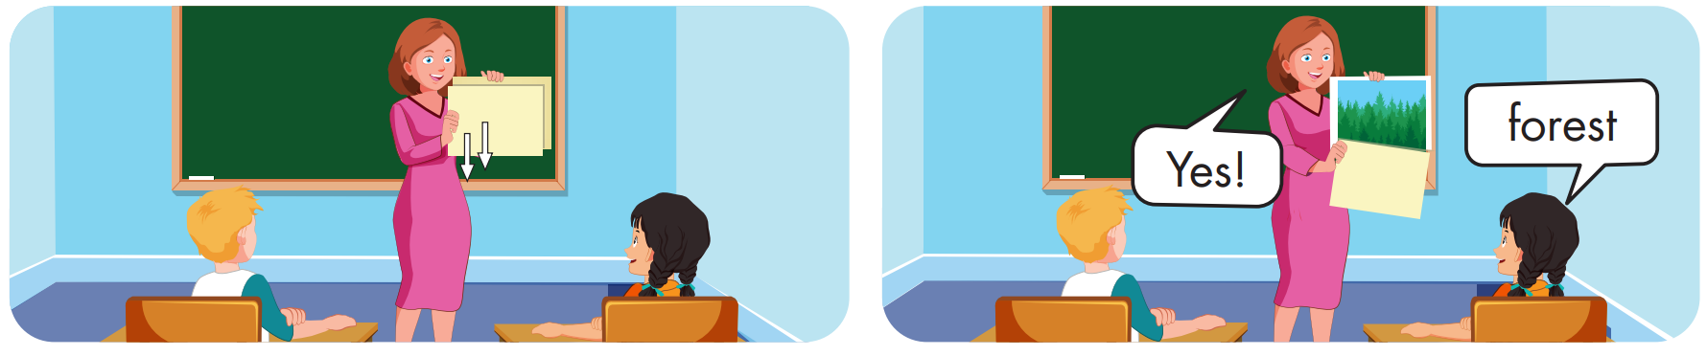

Slide 27
Structure
I didn't go to the river.
I went to the beach.

Slide 28
Presentation

Slide 29
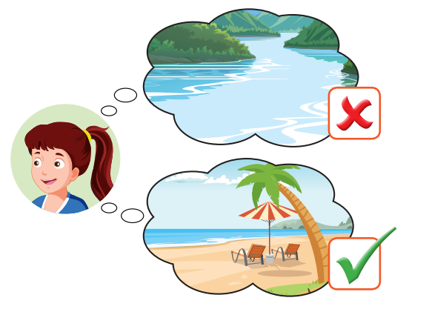
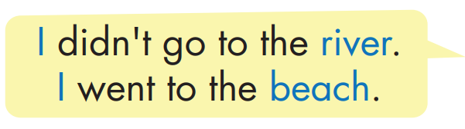
Structure

Slide 30

Practice

Slide 31


Slide 32

Production

Slide 33

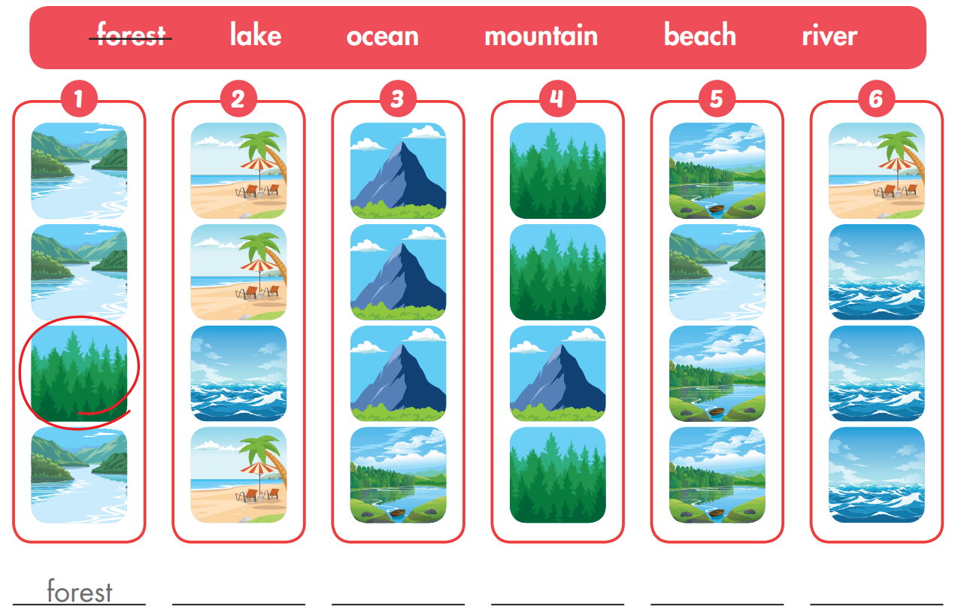

Extra Practice
WB, page 32
ocean
lake
moutain
river
beach

Slide 34

CONSOLIDATION

Slide 35

WRAP-UP

Slide 36
Today’s lesson
Vocabularies
mountain, lake, river, beach, ocean, forest
Structures/ Sentence patterns
I didn't go to the river.
I went to the beach.

Slide 37
Homework
Practice the vocabularies and structure, and make sentences using them.
Do the exercises in Tiếng Anh 5 i-Learn Smart Start WB (page 32)
Do the exercises in Tiếng Anh 5 i-Learn Smart Start Notebook (page 22)
Prepare the next lesson (page 49 SB)
Play the consolidation games in Tiếng Anh 5 i-Learn Smart Start DHA App on www.eduhome.com.vn

