Slide 1

Unit 2: MY FRIENDS AND I
Lesson 1.2
Page 35

Slide 2

WARM-UP

Slide 3

Pronunciation
WORD STRESS

Slide 4

Presentation

Slide 5

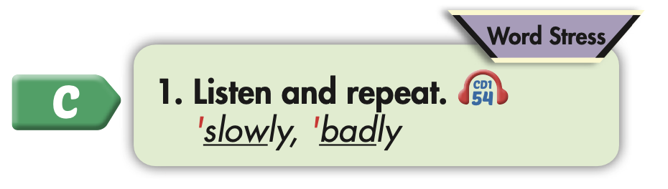
Click on the picture to hear the sound.

Slide 6
Practice

Slide 7

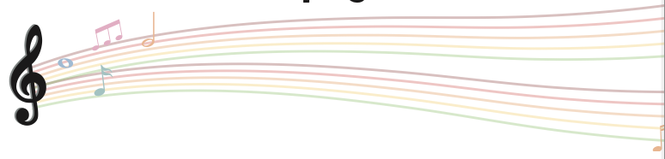

Slide 8
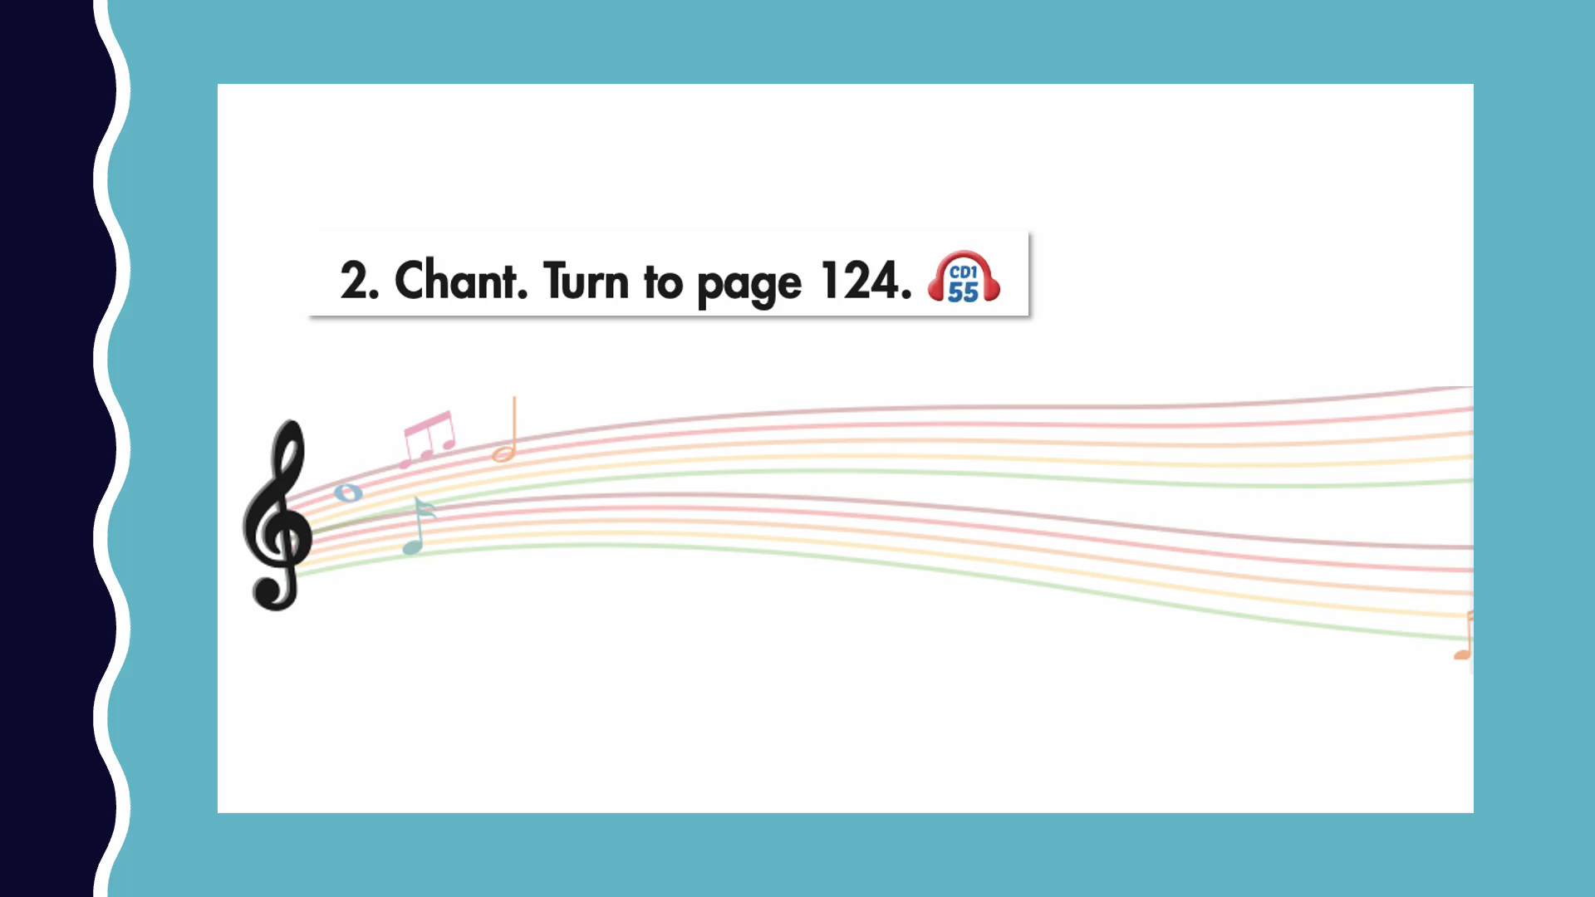

Slide 9
Listening

Slide 10
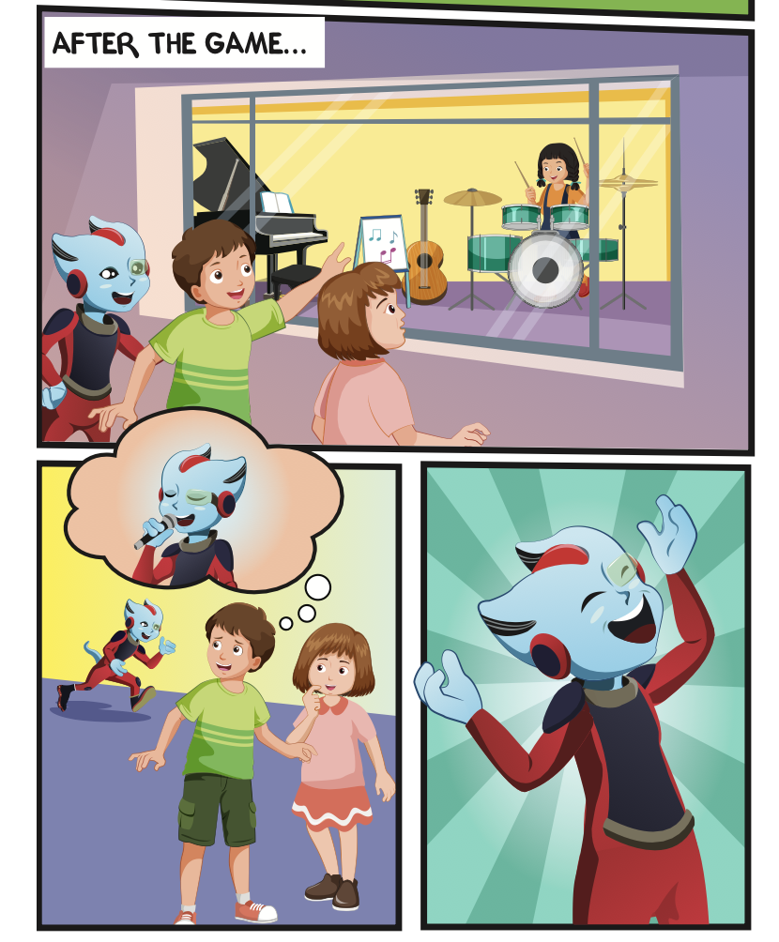
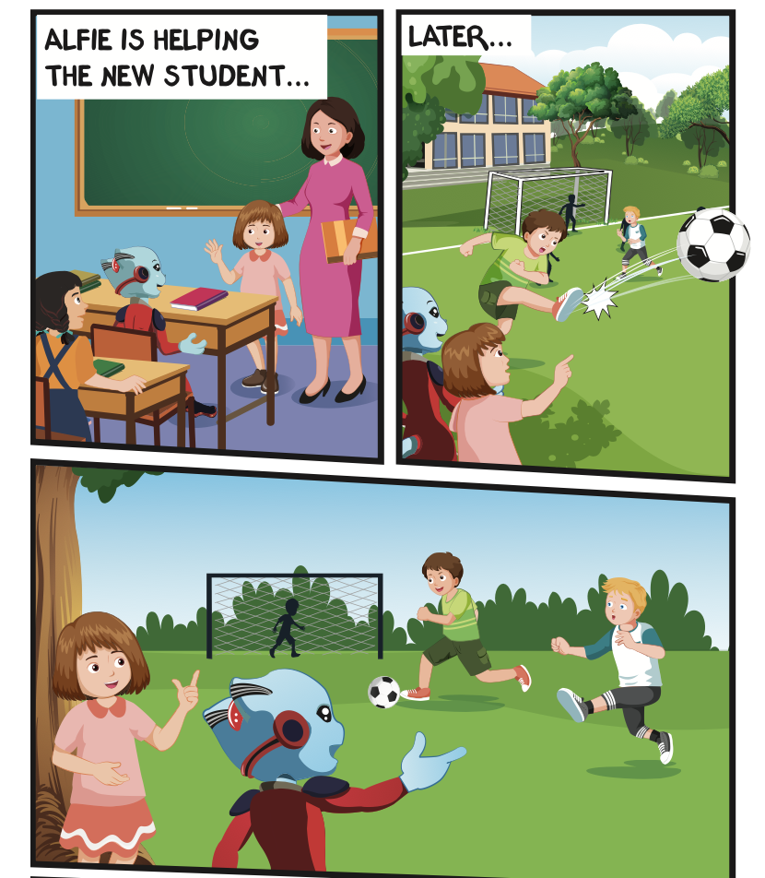
Where are they?
Who is talking?

Slide 11


Slide 12

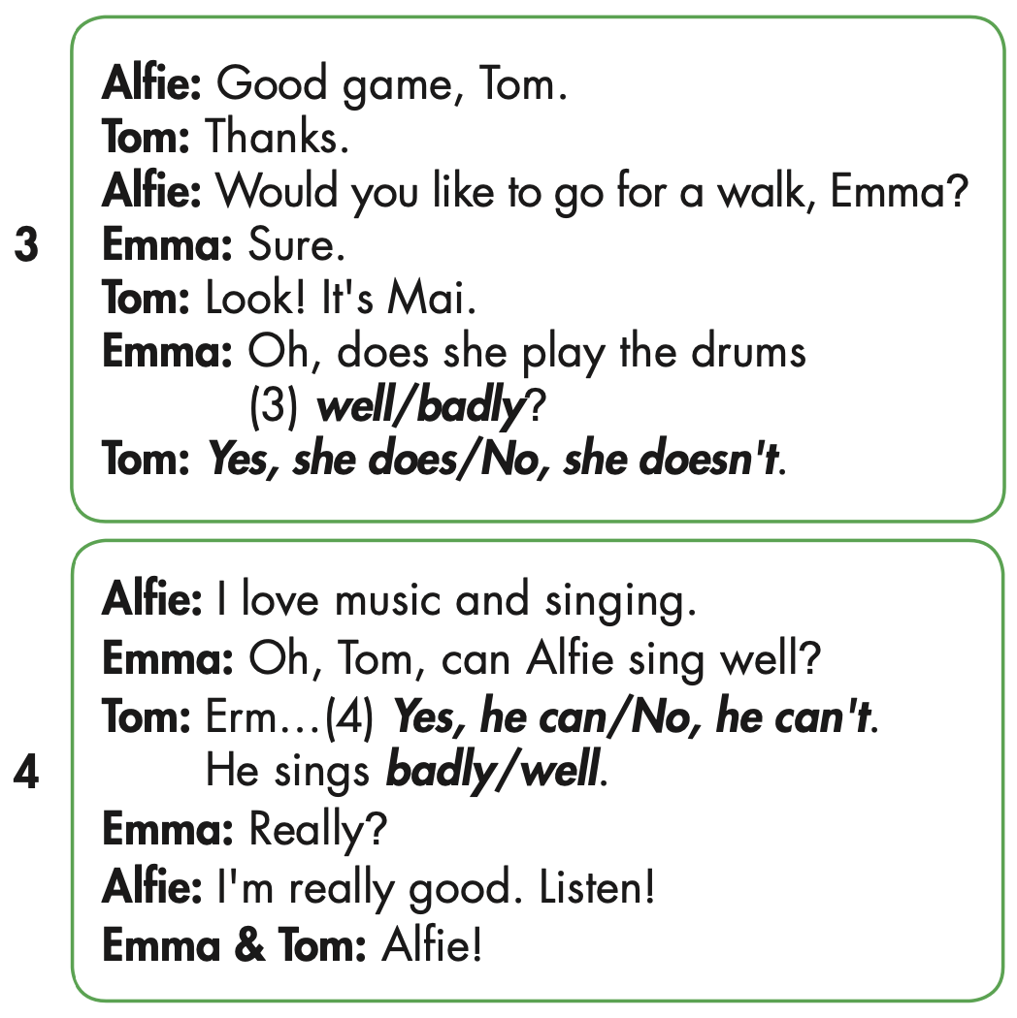
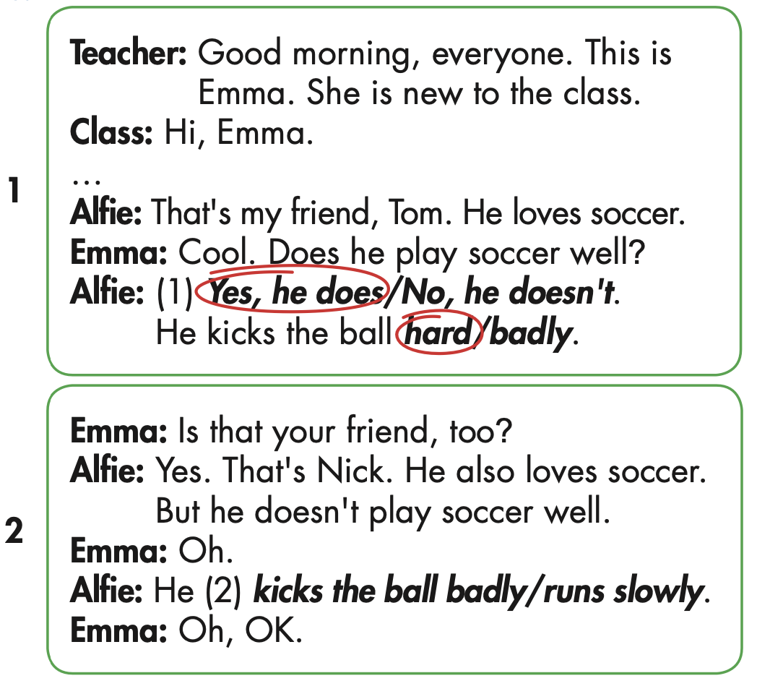

Slide 13

Speaking

Slide 14
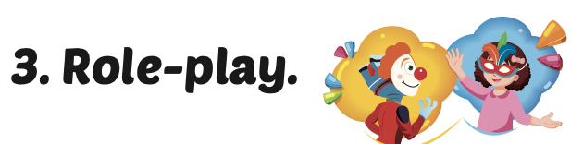
Role-play the conversation. Mind your word stress.

Slide 15

Production

Slide 16

Writing

Slide 17
MAKE YOUR OWN STORY

Slide 18

CONSOLIDATION

Slide 19
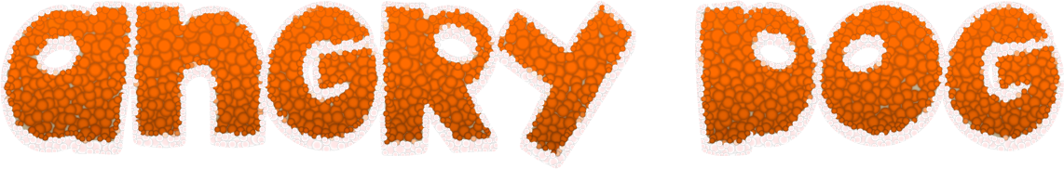
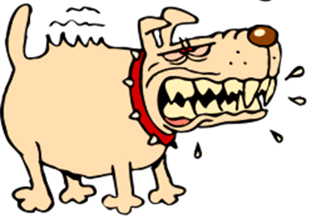
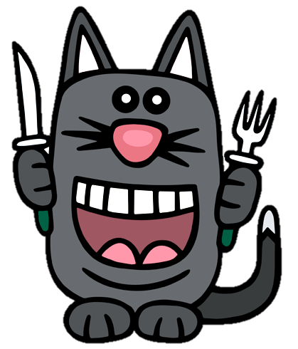

GAME
GAME ON ADVERBS OF MANNER
Notes:
19

Slide 20
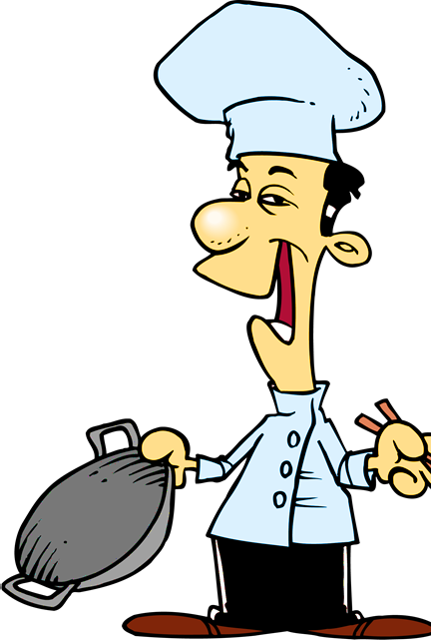

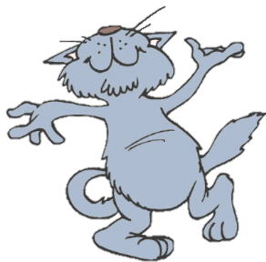
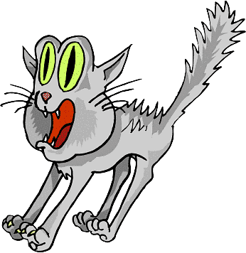
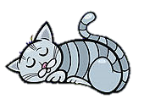
He sings ____________.
You got it!
badly
bad
NEXT
Notes:
20

Slide 21
She sings beautifully.
She is a _________ singer.
You got it!
good
well
NEXT

Slide 22
This bus is too _______ .
We will be late for school.
You got it!
slow
slowly
NEXT
Notes:
22

Slide 23
They are fantastic dancers.
They dance really _______.
You got it!
well
badly
NEXT
Notes:
23

Slide 24
I don’t want to go with him.
He drives too ________ .
You got it!
fast
slow
END

Slide 25

WRAP-UP

Slide 26
Today’s lesson
Pronunciation
Word stress
Structures/ Sentence patterns
Tom kicks the ball hard.

Slide 27
Homework
Practice the vocabularies and structure, and make sentences using them.
Do the exercises in Tiếng Anh 5 i-Learn Smart Start WB (page 23).
Do the exercises in Tiếng Anh 5 i-Learn Smart Start Notebook.
Prepare the next lesson (page 36 SB).
Play the consolidation games in Tiếng Anh 5 i-Learn Smart Start DHA App on www.eduhome.com.vn

