Slide 1

WARM UP

Slide 2
Check your memory

Slide 3

Phonics
/f/

Slide 4
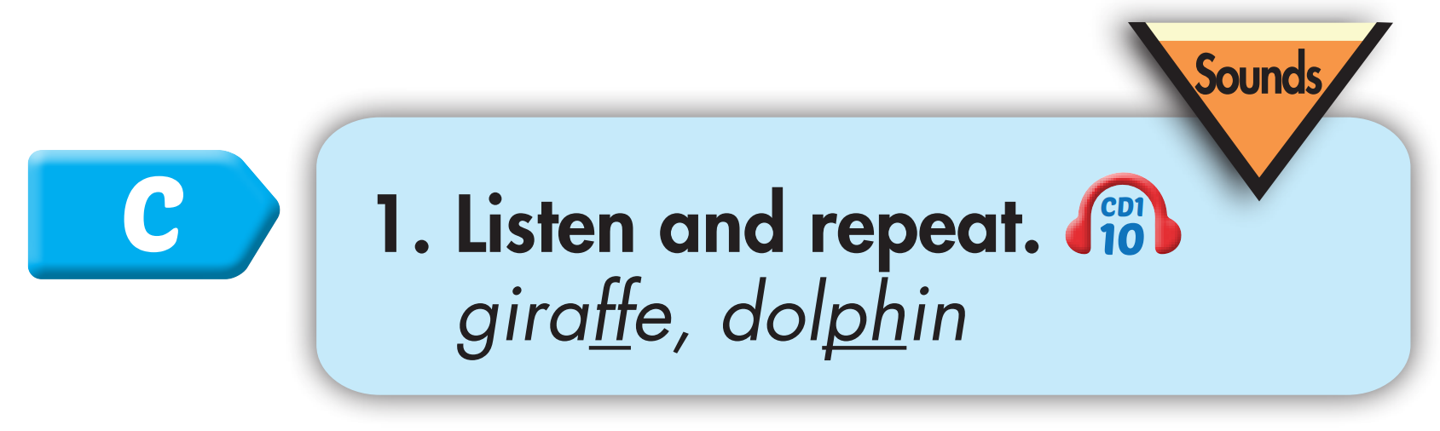
Click CD1 track 10 to hear the sound.
f f giraffe
f f dolphin
Notes:
Bấm vô CD-48 sẽ ra âm thanh

Slide 5
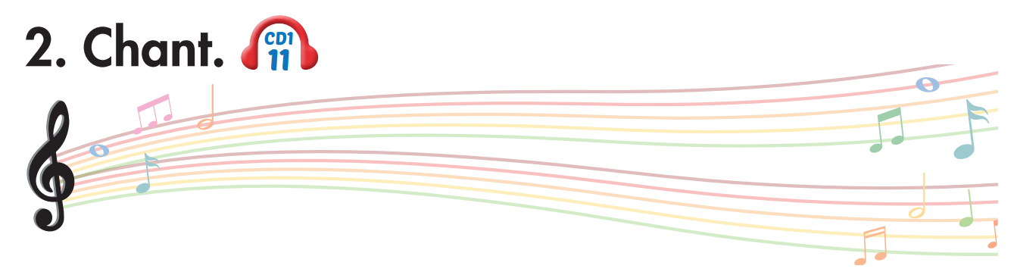
Track 11
Who likes dolphins?
Who likes dolphins?
We like dolphins!
We like dolphins!
Who likes giraffes?
Who likes giraffes?
We like giraffes!
We like giraffes!
We all love friendly animals.
We all love friendly animals.
Click on the music note to hear the sound.

Slide 6

Listening

Slide 7

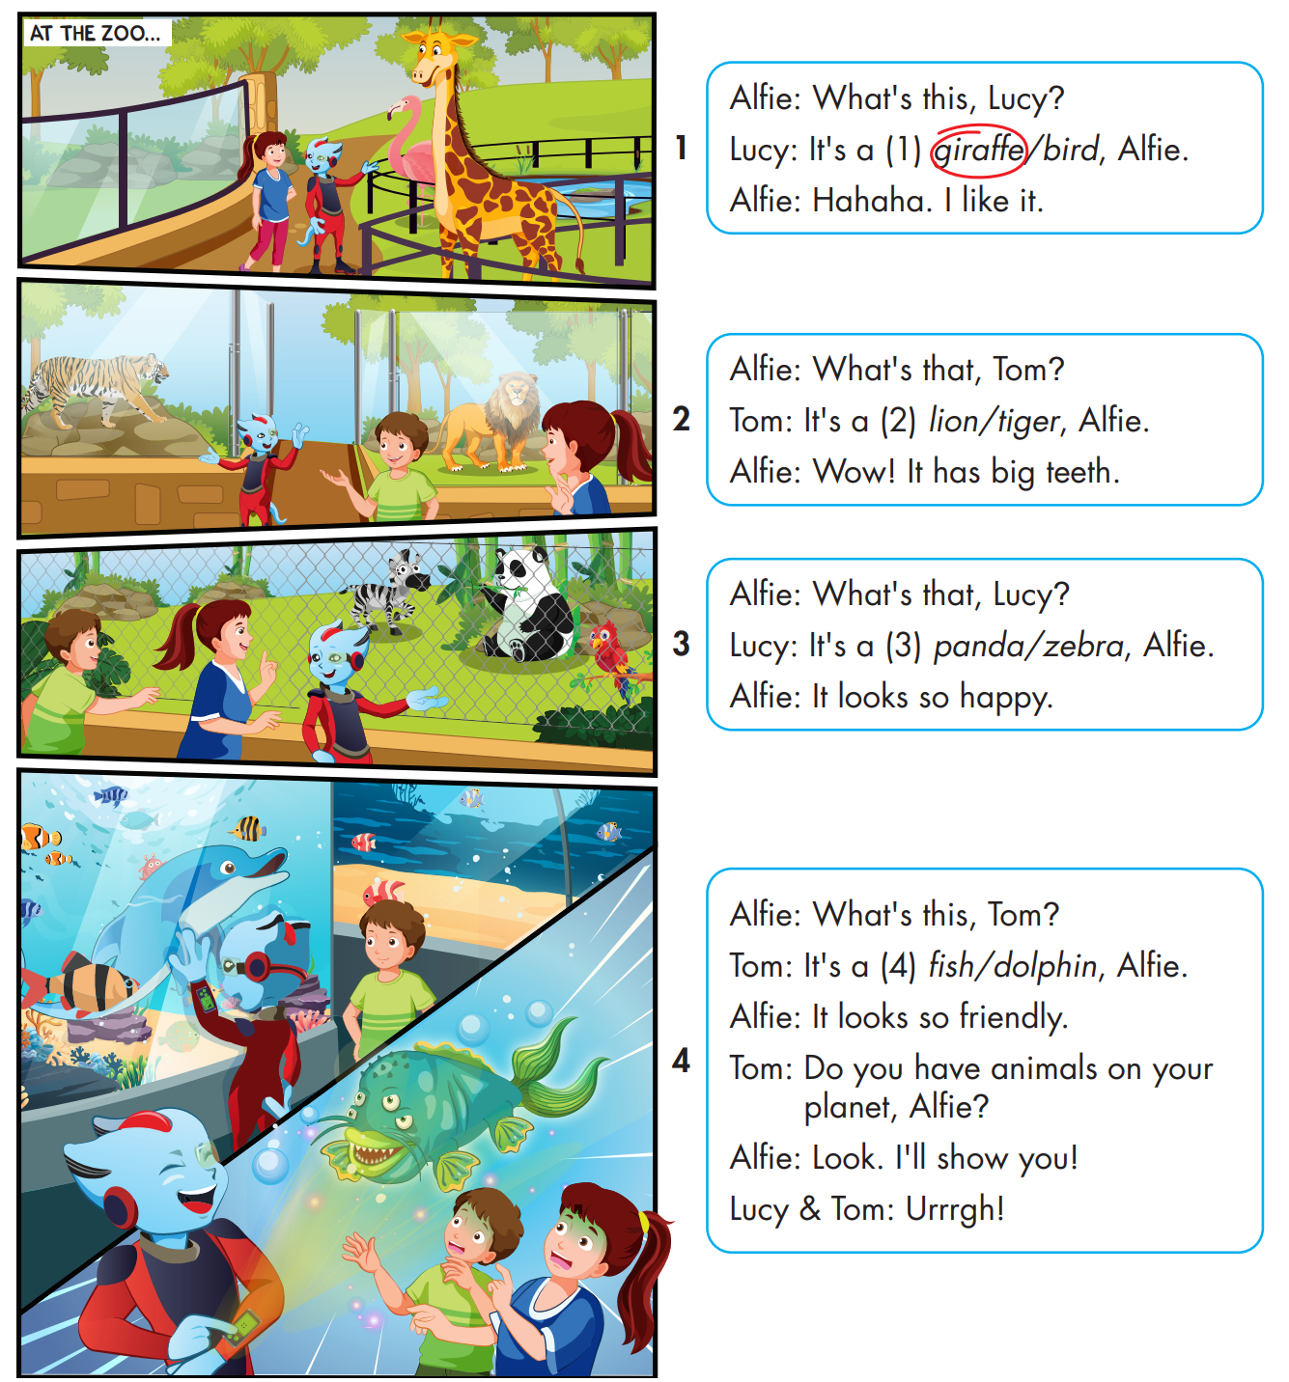

While-Listening

Slide 8

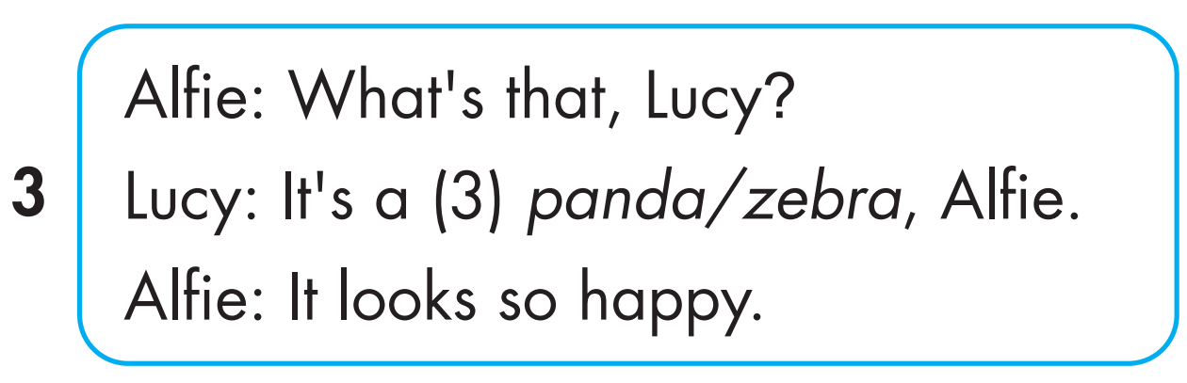
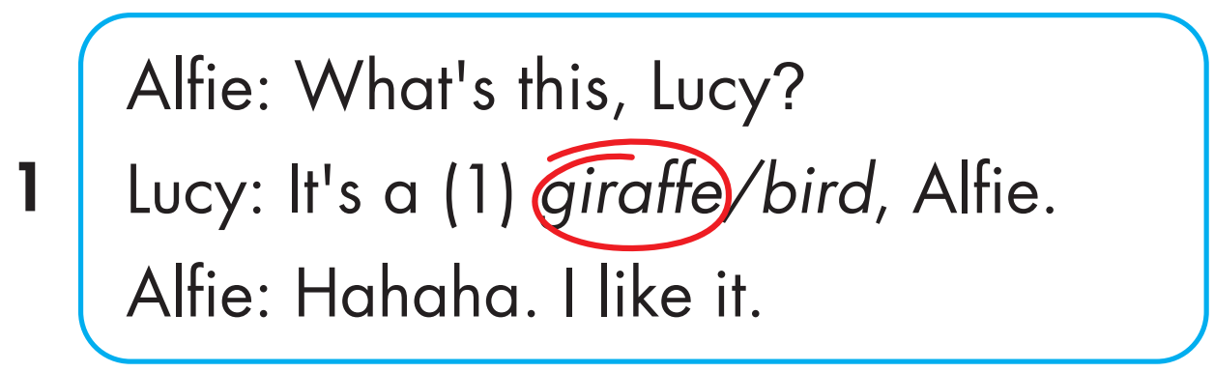

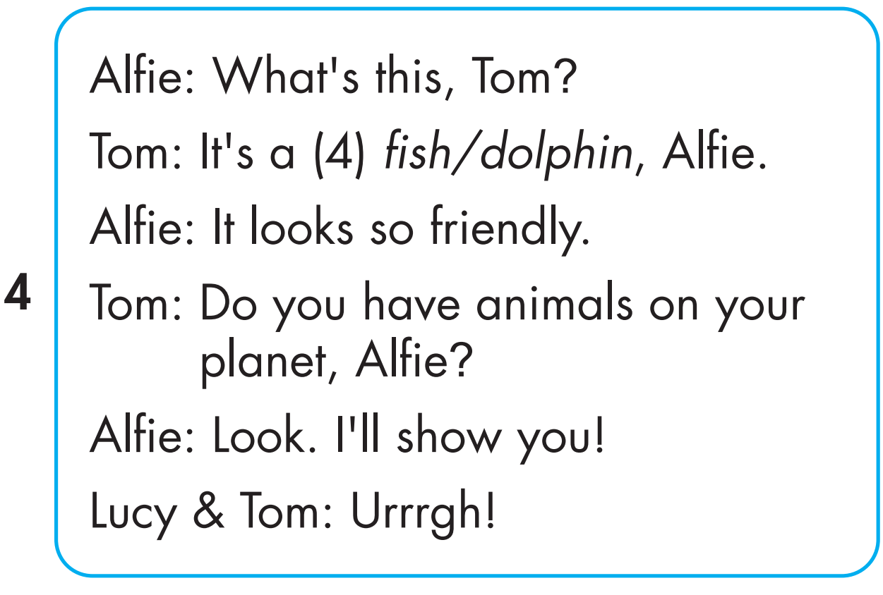
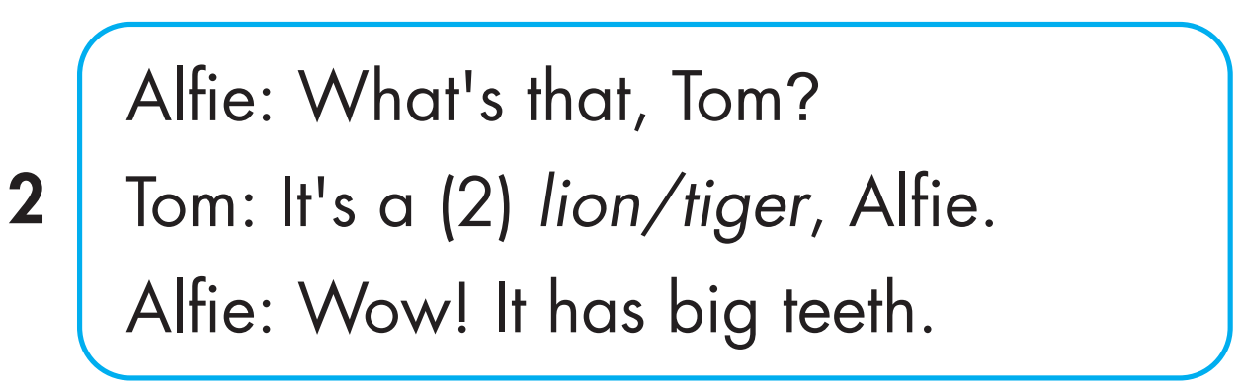
Click on 4 numbers to hear each sentence.
While-Listening
1
3
4
2

Slide 9

Post-Listening

Slide 10

CONSOLIDATION

