Slide 1

WARM UP

Slide 2
Look quickly and say aloud the word.
Who’s faster?

Slide 3
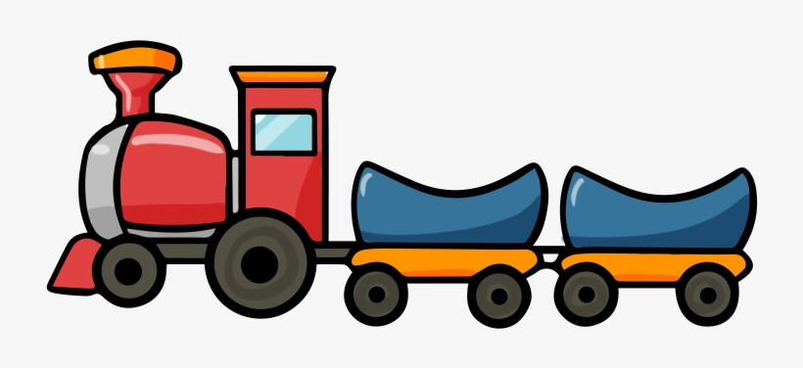
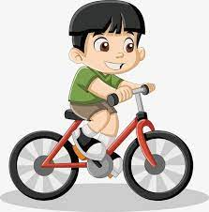
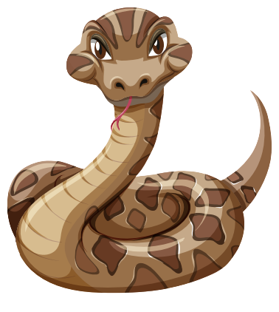

Slide 4



Slide 5



Slide 6

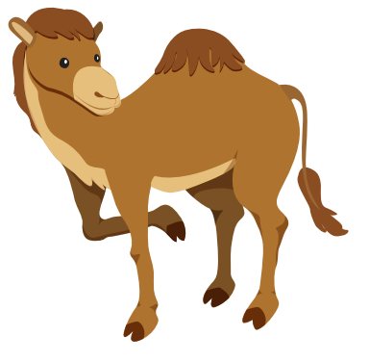

Slide 7
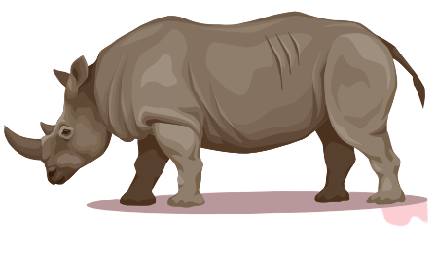

Slide 8


Slide 9

It’s time to learn …

Slide 10

New words
panda, giraffe, lion,
dolphin, tiger, zebra

Slide 11

Presentation

Slide 12


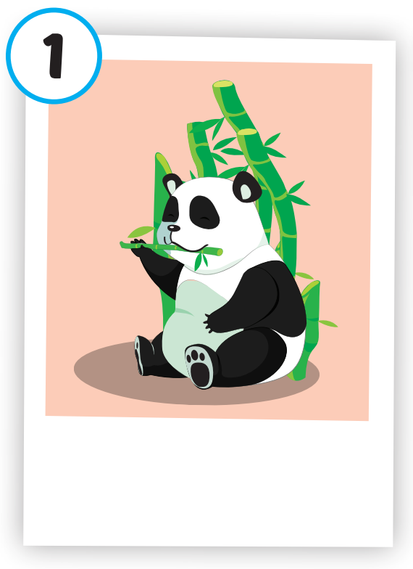
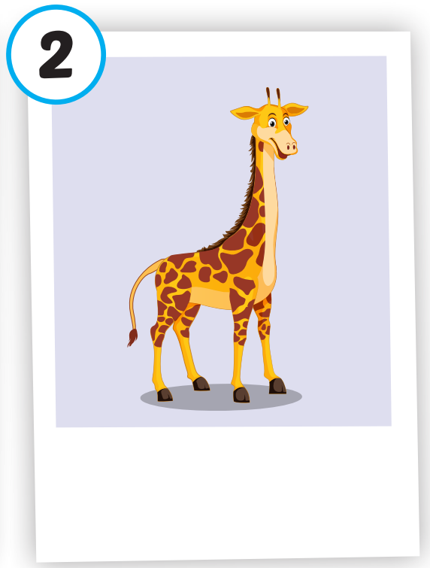
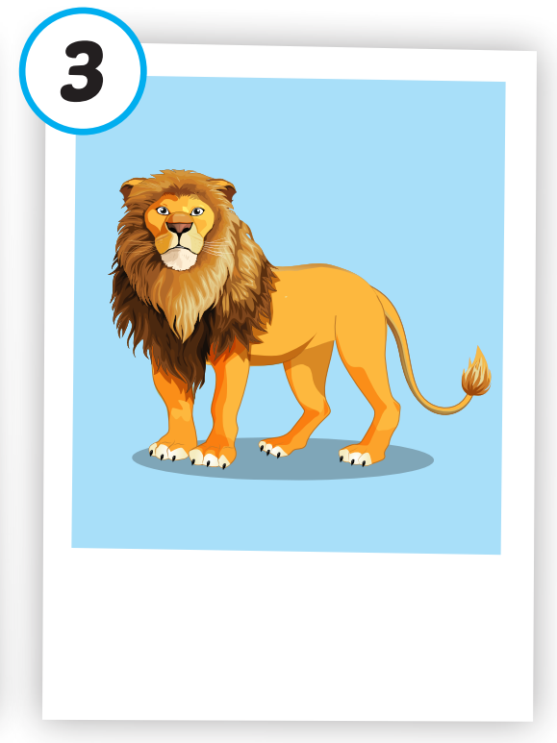
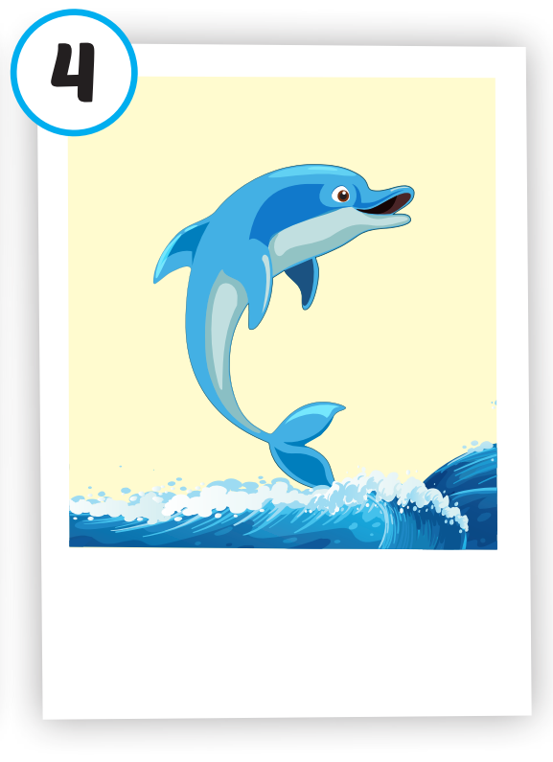
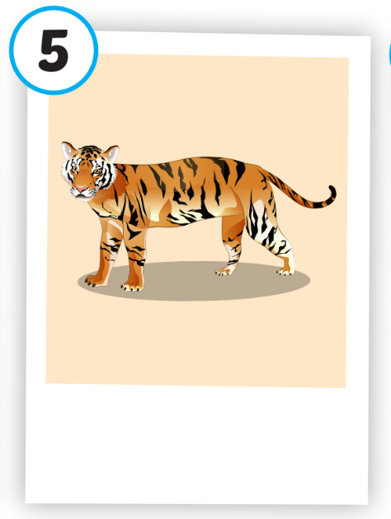
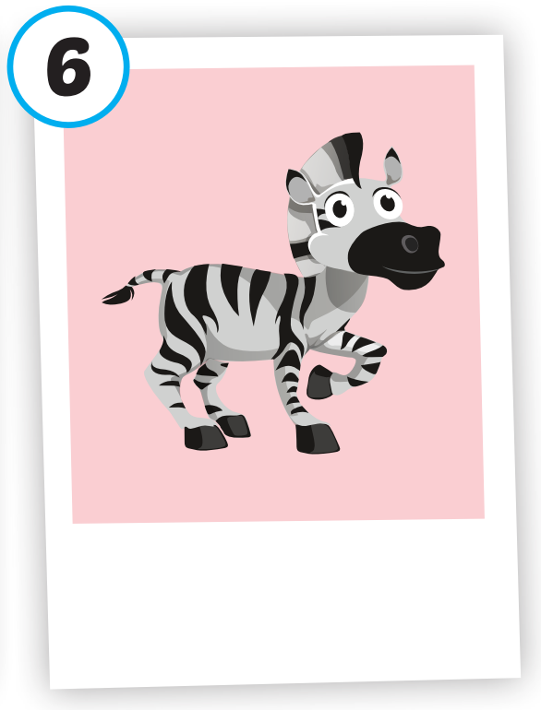






/ˈpændə/
con gấu trúc
/ˈlaɪən/
con sư tử
/ˈdɑːlfɪn/
cá heo
/ˈtaɪɡər/
con hổ
/ˈziːbrə/
con ngựa vằn
/dʒɪˈræf/
con hươu cao cổ

Slide 13
Practice

Slide 14
Check your memory

Slide 15




A. tiger
B. lion
C. panda

Slide 16
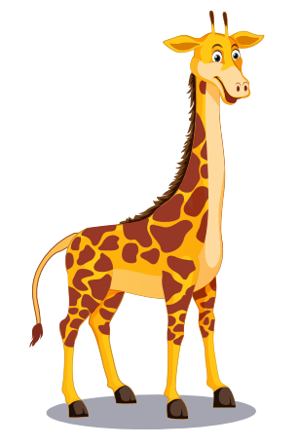
A. dolphin
B. giraffe
C. duck

Slide 17
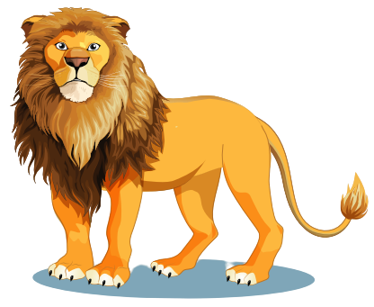
A. monkey
B. lion
C. tiger

Slide 18

A. dolphin
B. tiger
C. lion

Slide 19
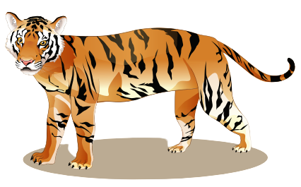
A. camel
B. tiger
C. giraffe

Slide 20
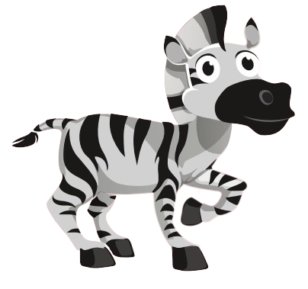
A. lion
B. tiger
C. zebra

Slide 21
Structure
What's this? - It's a panda.
What's that? - It's a dolphin.

Slide 22
Presentation

Slide 23
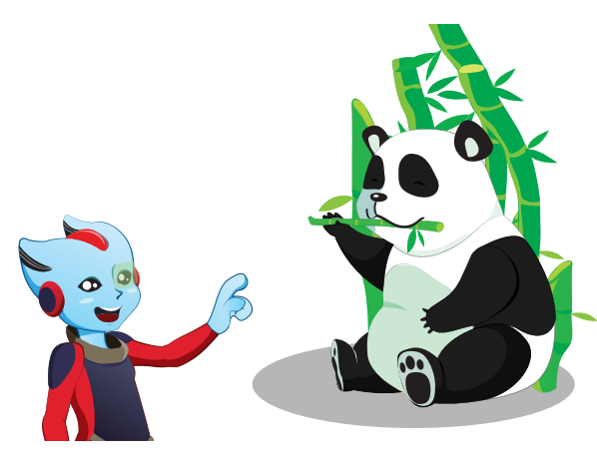



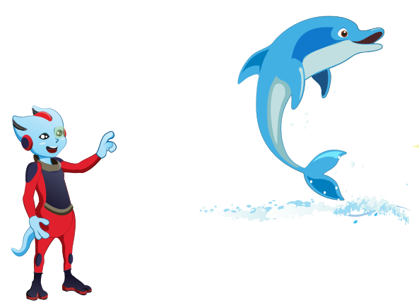

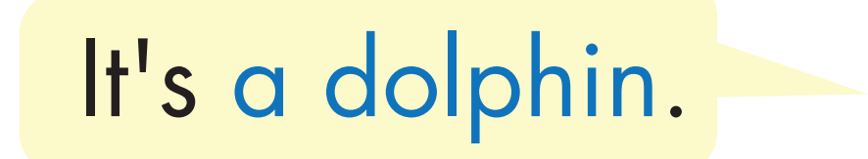

Structure

Slide 24

Practice

Slide 25


Slide 26

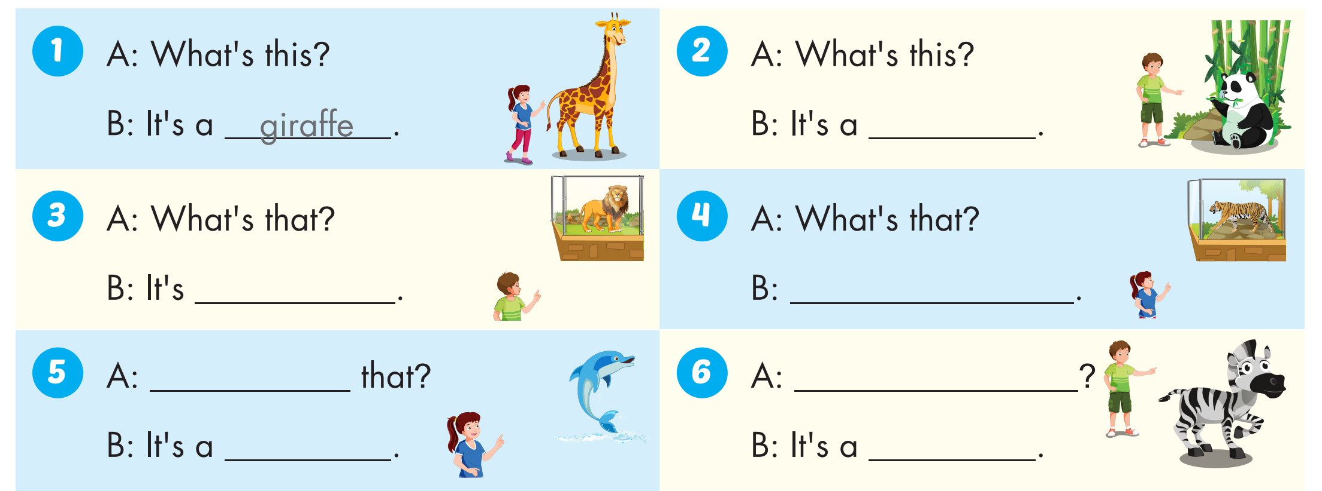
panda
a lion
It's a tiger
What's
What's this?
dolphin
zebra

Slide 27

WRAP-UP

Slide 28
Today’s lesson
Vocabularies
panda, giraffe, lion, dolphin, tiger, zebra.
Structures/ Sentence patterns
What's this? - It's a panda. What's that? - It's a dolphin.

Slide 29
Homework
Practice the vocabularies and structure; and make sentences using them.
Do the exercises in Tiếng Anh 4 i-Learn Smart Start WB (page 4)
Do the exercises in Tiếng Anh 4 i-Learn Smart Start Notebook (page 7)
Prepare the next lesson (page 10 SB)
Play the consolidation games in Tiếng Anh 4 i-Learn Smart Start DHA App on www.eduhome.com.vn

