Slide 1

WARM UP

Slide 2


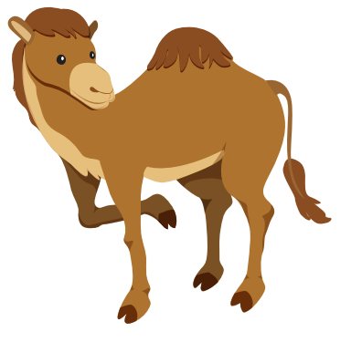
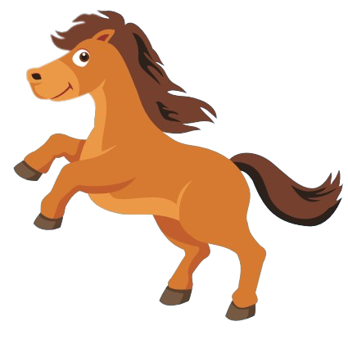

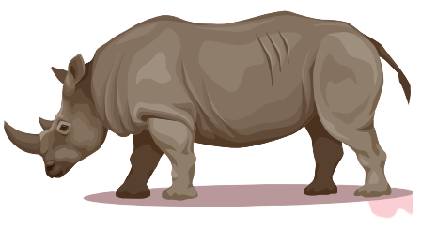
Look at the numbers and say the animals.
1
2
3
Well done!
6
1
4
3
5
4
1
3
2
4
2
6
5
2
6
5
4
6

Slide 3

It’s time to learn …

Slide 4

Speaking

Slide 5

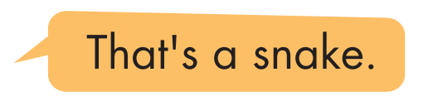
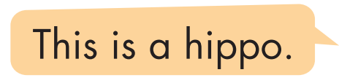
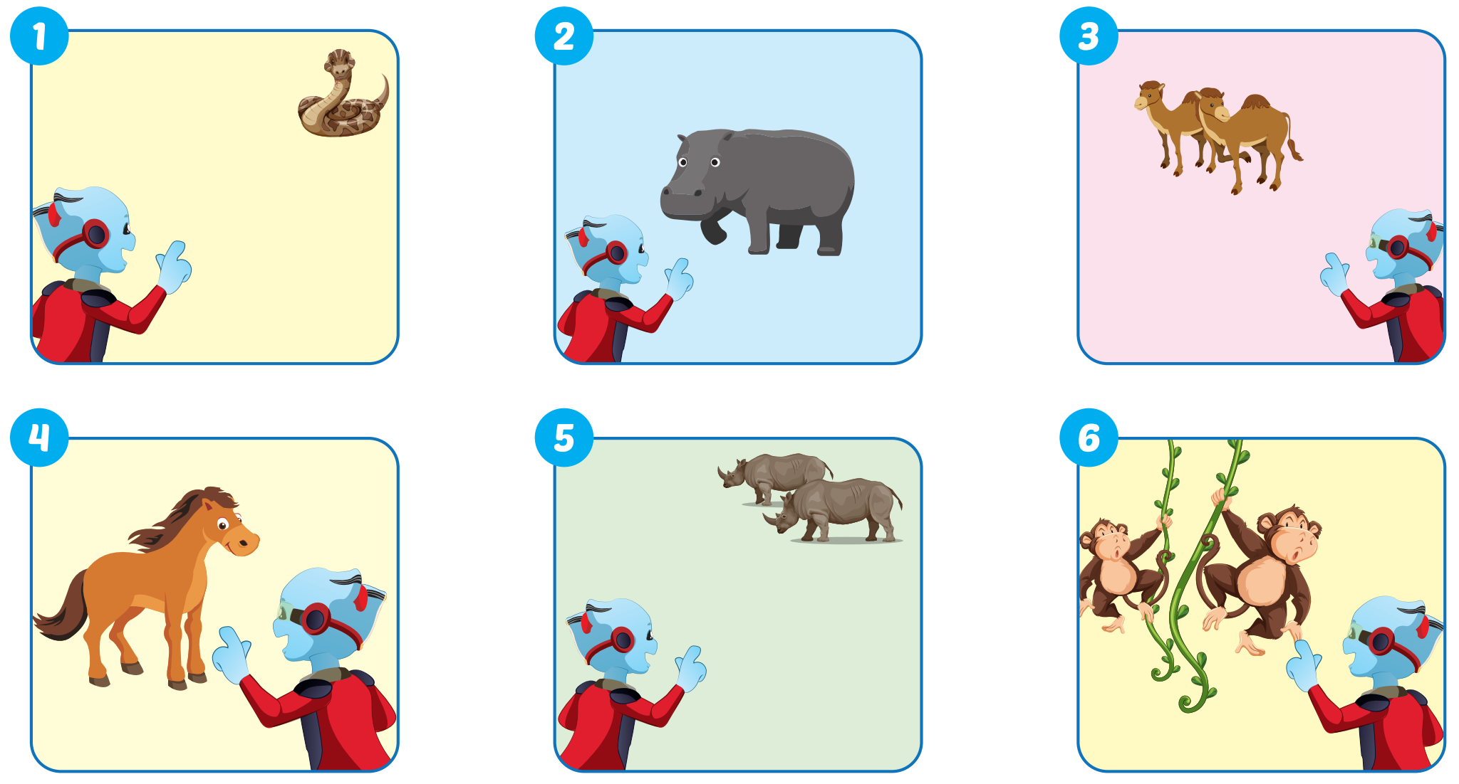

Slide 6
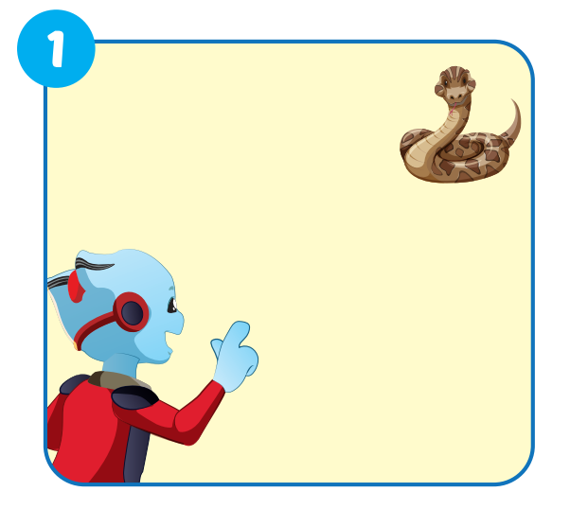

That's a snake.

Slide 7
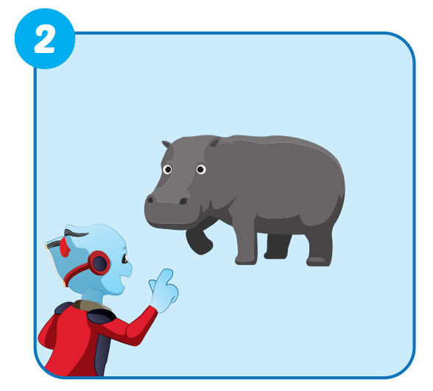
This is a hippo.

Slide 8
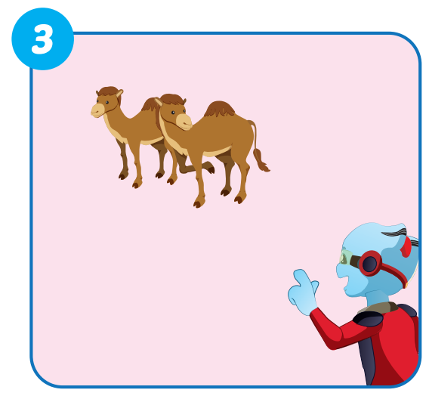
Those are camels.

Slide 9
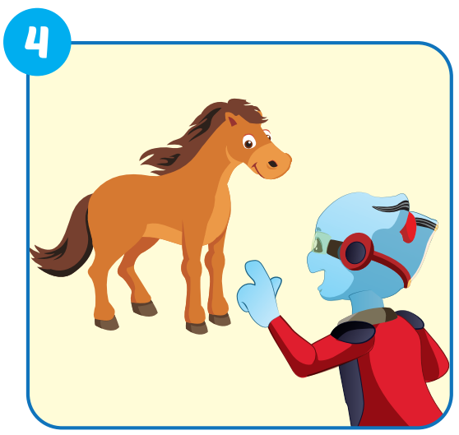
This is a horse.

Slide 10
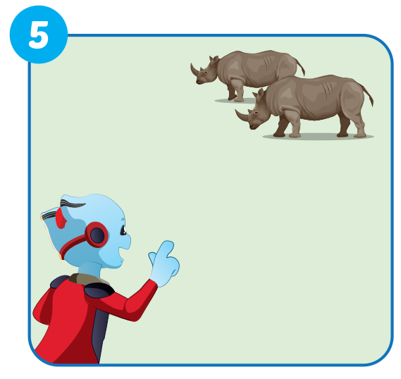
Those are rhinos.

Slide 11
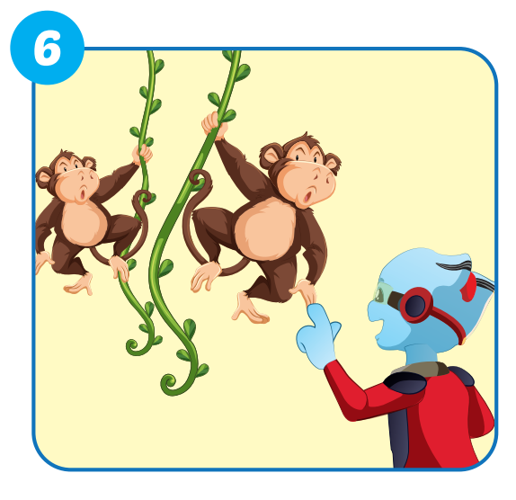
These are monkeys.

Slide 12

Production

Slide 13

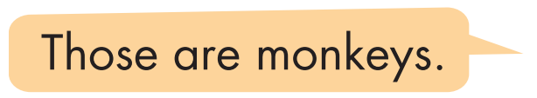
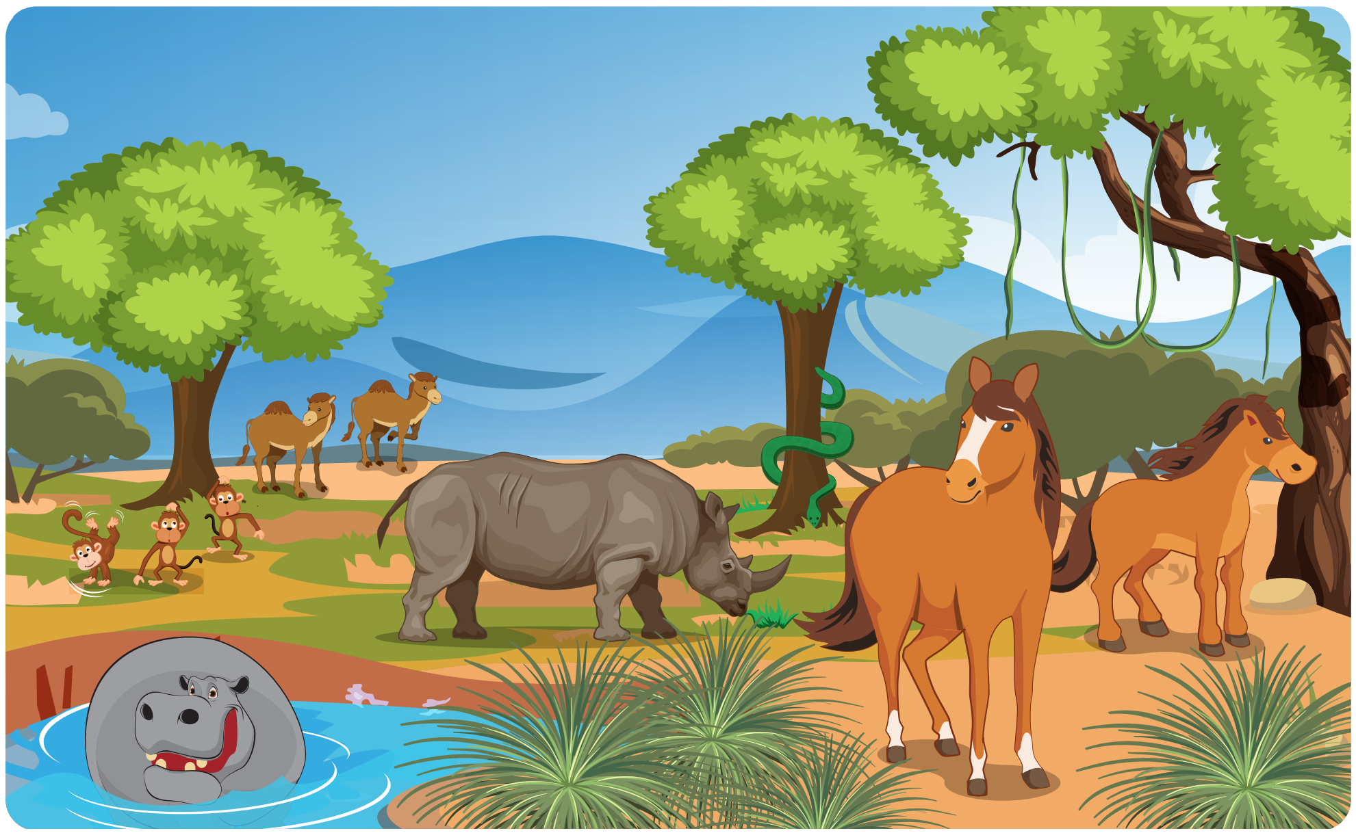

Slide 14
FINDING THE ANIMALS
GAME

Slide 15
Look and say. Which is missing?
START
CHECK

Slide 16
Look and say. Which is missing?
START
CHECK

Slide 17
Look and say. Which is missing?
START
CHECK

Slide 18
Look and say. Which is missing?
START
CHECK

Slide 19
Look and say. Which is missing?
START
CHECK

Slide 20
Look and say. Which is missing?
START
CHECK

Slide 21
Look and say. Which is missing?
START
CHECK

Slide 22

WRAP-UP

Slide 23
Today’s lesson
Structures/ Sentence patterns
This is a monkey.
These are monkeys.
That's a snake.
Those are snakes
Vocabularies
snake, monkey, horse, camel, hippo, rhino.
Phonics
Identify the /h/ sound and practice the conversations.

Slide 24
Homework
Practice the vocabularies and structure; and make sentences using them.
Do the exercises in Tiếng Anh 4 i-Learn Smart Start WB (page 3)
Prepare the next lesson (page 9 SB)
Play the consolidation games in Tiếng Anh 4 i-Learn Smart Start DHA App on www.eduhome.com.vn

