Slide 1

WARM UP

Slide 2



It’s a …..
It’s a horse.
Ms Huyền Phạm
0936.082.789

Slide 3

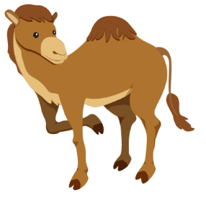
It’s a …..
It’s a camel.
Ms Huyền Phạm
0936.082.789

Slide 4


They’re …..
They’re hippos.
Ms Huyền Phạm
0936.082.789

Slide 5

They’re …..
They’re rhinos.
Ms Huyền Phạm
0936.082.789

Slide 6

It’s time to learn …

Slide 7
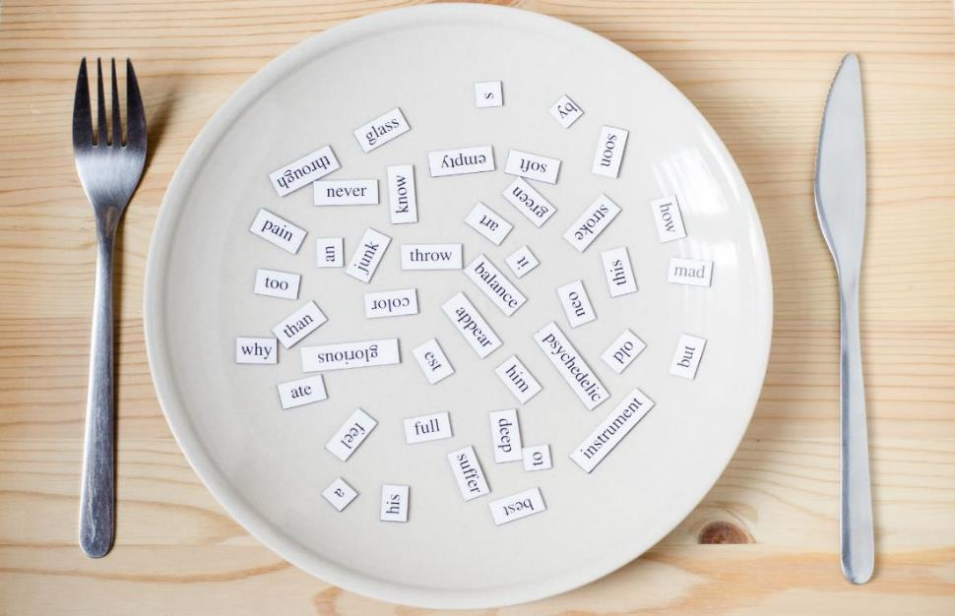
Phonics
/h/

Slide 8


Click CD1 track 04 to hear the sound.
h h horse
h h hippo

Slide 9
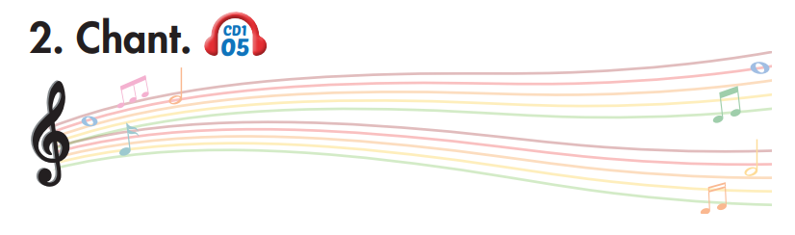
Track 05
This is a horse.
This is a horse.
These are hippos.
These are hippos.
That's a hippo.
That's a hippo.
Those are horses.
Those are horses.
Hippos, horses, hippos, horses
Hippos, horses, hippos, horses
Click on the music note to hear the sound.
Notes:
Bấm vào ngôi sao là ra script, bấm vào hình CD3-49 sẽ ra audio

Slide 10

hat
how
List the words with the same sound /h/. Practice saying them with a partner.
hello
help
house
hope
happy
high

Slide 11

Listening

Slide 12

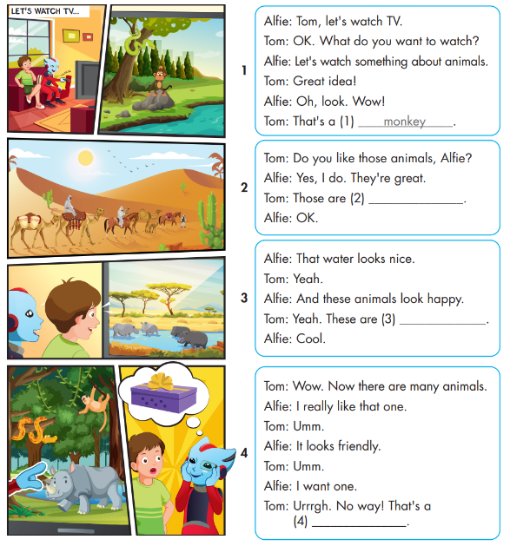
While-Listening

Slide 13
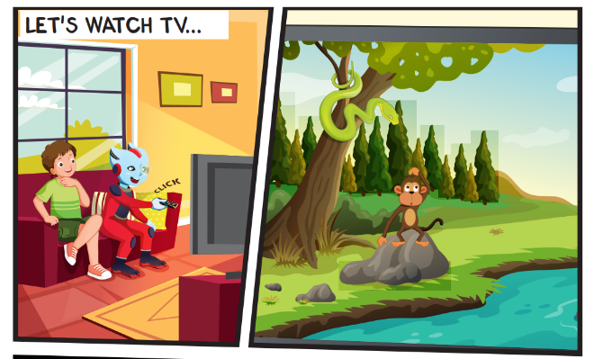
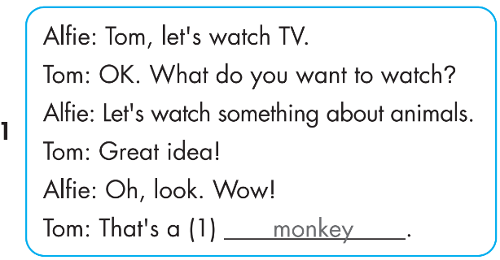
While-Listening

Slide 14
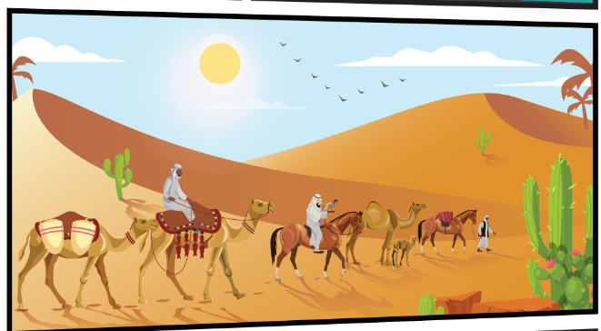
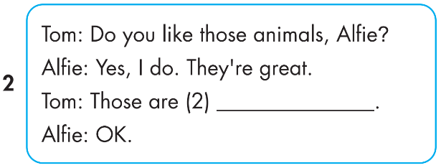
While-Listening
Notes:
Bấm vô chữ listen audio sẽ bật, muốn tắt bấm vô audio lần nữa

Slide 15
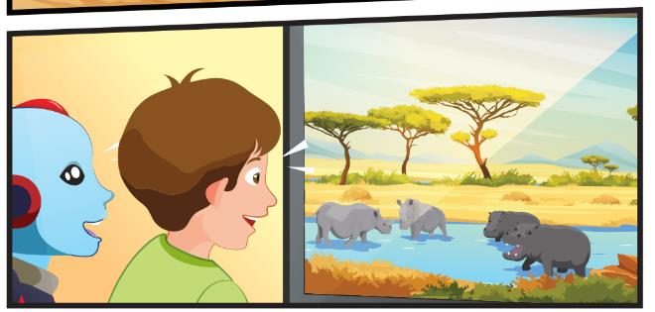
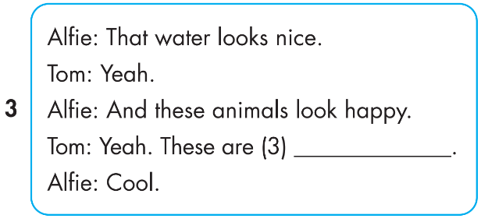
While-Listening

Slide 16
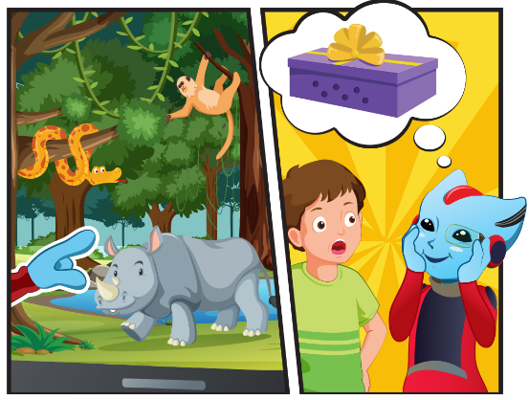
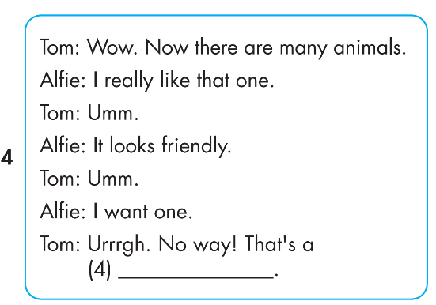
While-Listening

Slide 17

Post-Listening

Slide 18

CONSOLIDATION

Slide 19
Today’s lesson
Structures/ Sentence patterns
This is a monkey.
These are monkeys.
That's a snake.
Those are snakes
Vocabularies
snake, monkey, horse, camel, hippo, rhino.
Phonics
Identify the /h/ sound and practice the conversations.

