Slide 1

WARM UP

Slide 2





Game: Finding the way home.

Slide 3




1
3
4
2
5
7
6
8

Slide 4

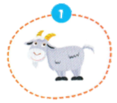
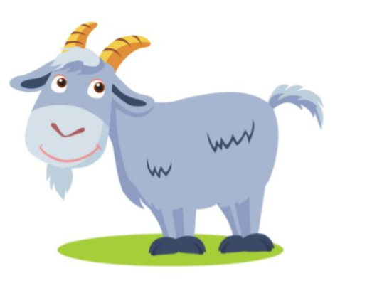

It’s a …..
It’s a goat.

Slide 5

It’s a …..
It’s a bird.

Slide 6

It’s a ….
It’s a mouse.

Slide 7
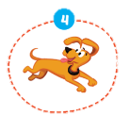
It’s a ….
It’s a dog.

Slide 8
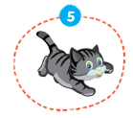
It’s a ….
It’s a cat.

Slide 9

It’s a …..
It’s a cow.

Slide 10

It’s a …..
It’s a duck.

Slide 11
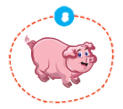
It’s a …..
It’s a pig.

Slide 12

It’s time to learn …

Slide 13

New words
snake, monkey, horse,
camel, hippo, rhino

Slide 14

Presentation

Slide 15

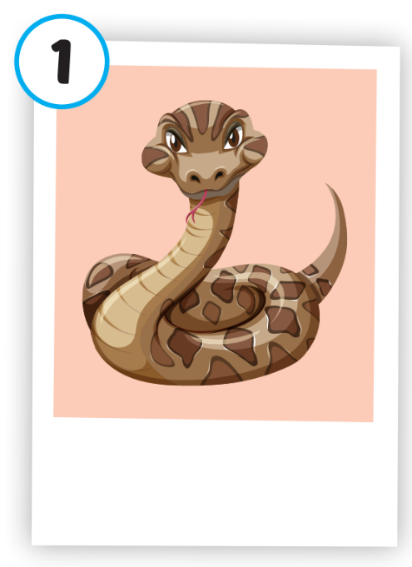
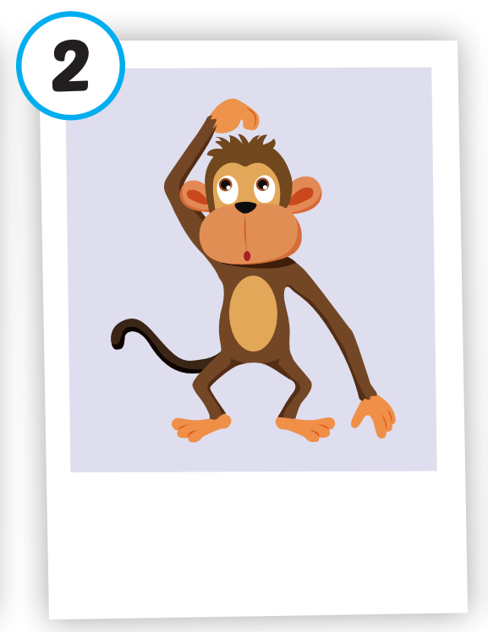
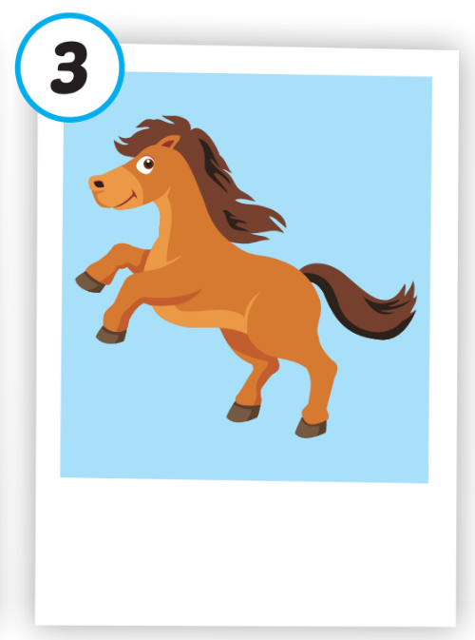
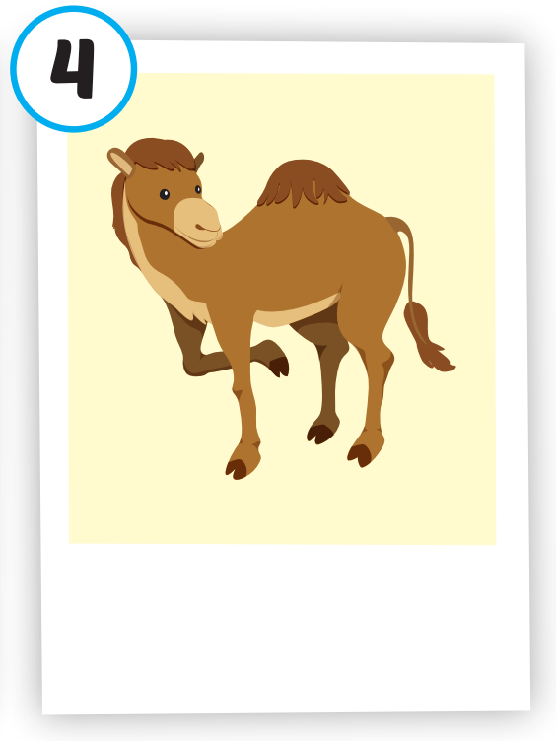
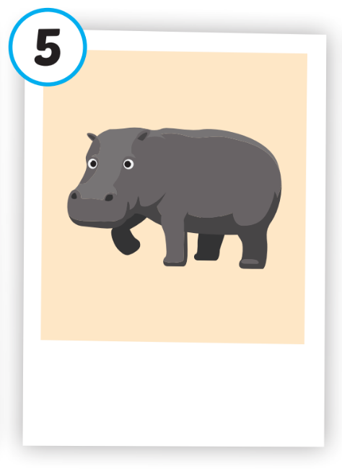
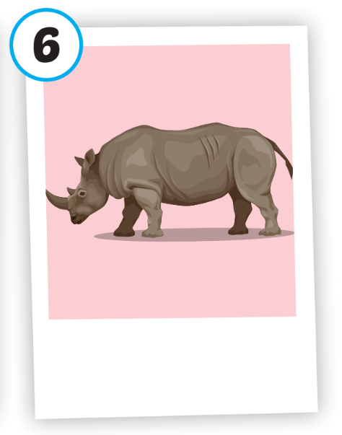






Click on each picture to hear the sound.
/hɔːrs/
con ngựa
/ˈkæməl/
con lạc đà
/ˈhɪpoʊ/
con hà mã
/ˈraɪnoʊ/
con tê giác
/sneɪk/
con rắn
/ˈmʌŋki/
con khỉ

Slide 16
Practice

Slide 17
Check your memory

Slide 18



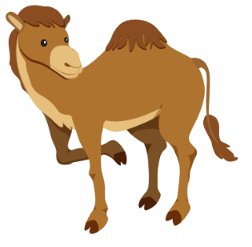


Listen and choose
A
B
C

Slide 19

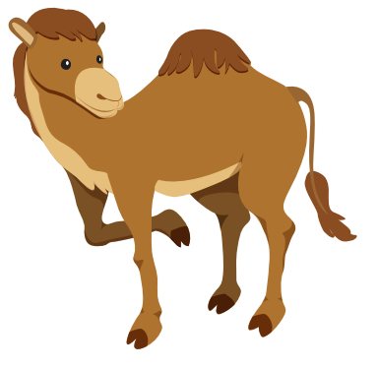
Listen and choose
A
B
C

Slide 20



Listen and choose
A
B
C

Slide 21


Listen and choose
A
B
C

Slide 22


Listen and choose
A
B
C

Slide 23


Listen and choose
A
B
C

Slide 24
Structure
This is a monkey.
These are monkeys.
That's a snake.
Those are snakes

Slide 25
Presentation

Slide 26
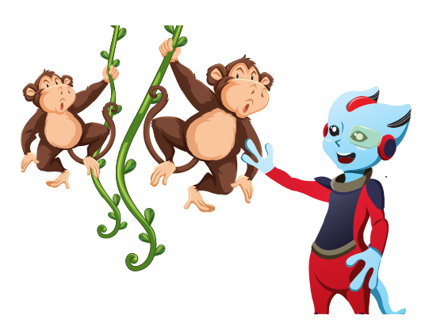
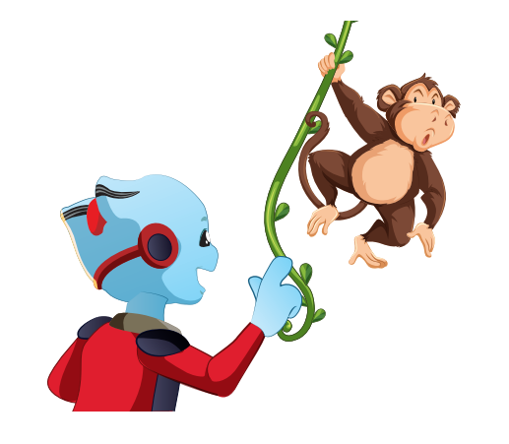



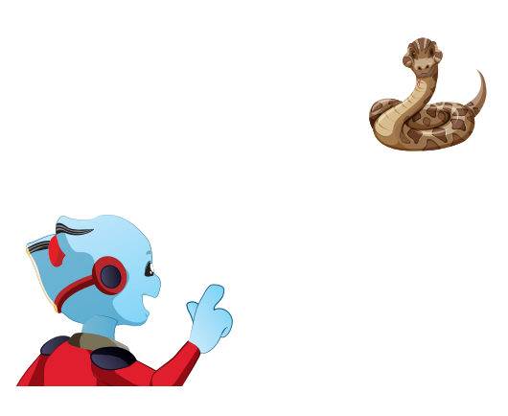
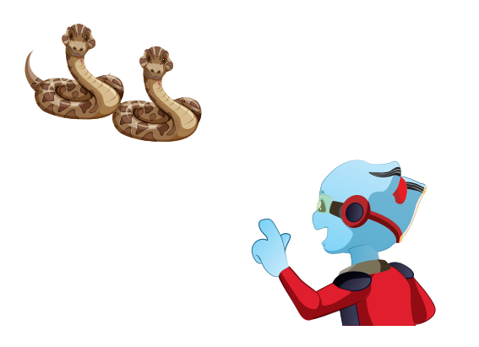


Structure

Slide 27

Practice

Slide 28


Slide 29
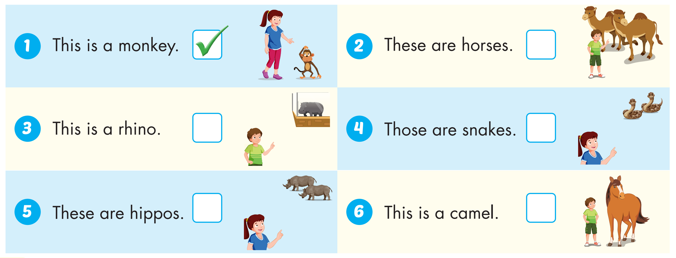



Slide 30

Production

Slide 31

CONSOLIDATION

Slide 32

WRAP-UP

Slide 33
Today’s lesson
Vocabularies
snake, monkey, horse, camel, hippo, rhino.
Structures/ Sentence patterns
This is a monkey.
These are monkeys.
That's a snake.
Those are snakes

Slide 34
Homework
Practice the vocabularies and structure; and make sentences using them.
Do the exercises in Tiếng Anh 4 i-Learn Smart Start WB (page 2)
Do the exercises in Tiếng Anh 4 i-Learn Smart Start Notebook (page 4)
Prepare the next lesson (page 7 SB)
Play the consolidation games in Tiếng Anh 4 i-Learn Smart Start DHA App on www.eduhome.com.vn

