Slide 1
Unit 20:
WHICH ONE IS MORE EXCITING,
LIFE IN THE CITY OR
LIFE IN THE COUNTRYSIDE?
Lesson 3

Slide 2
Warm-up

Slide 3
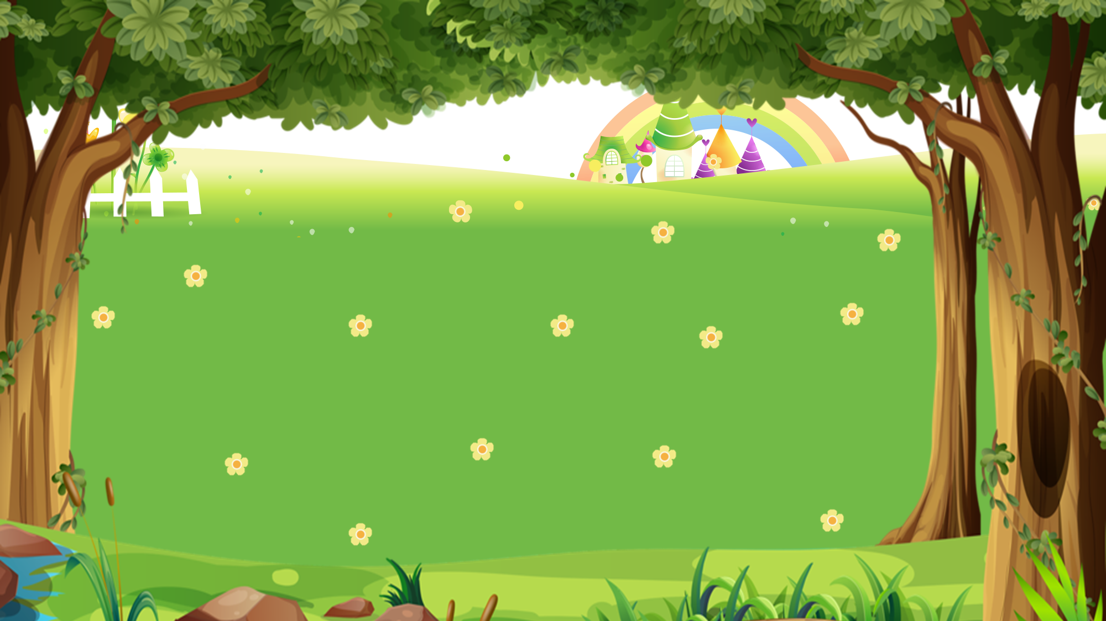
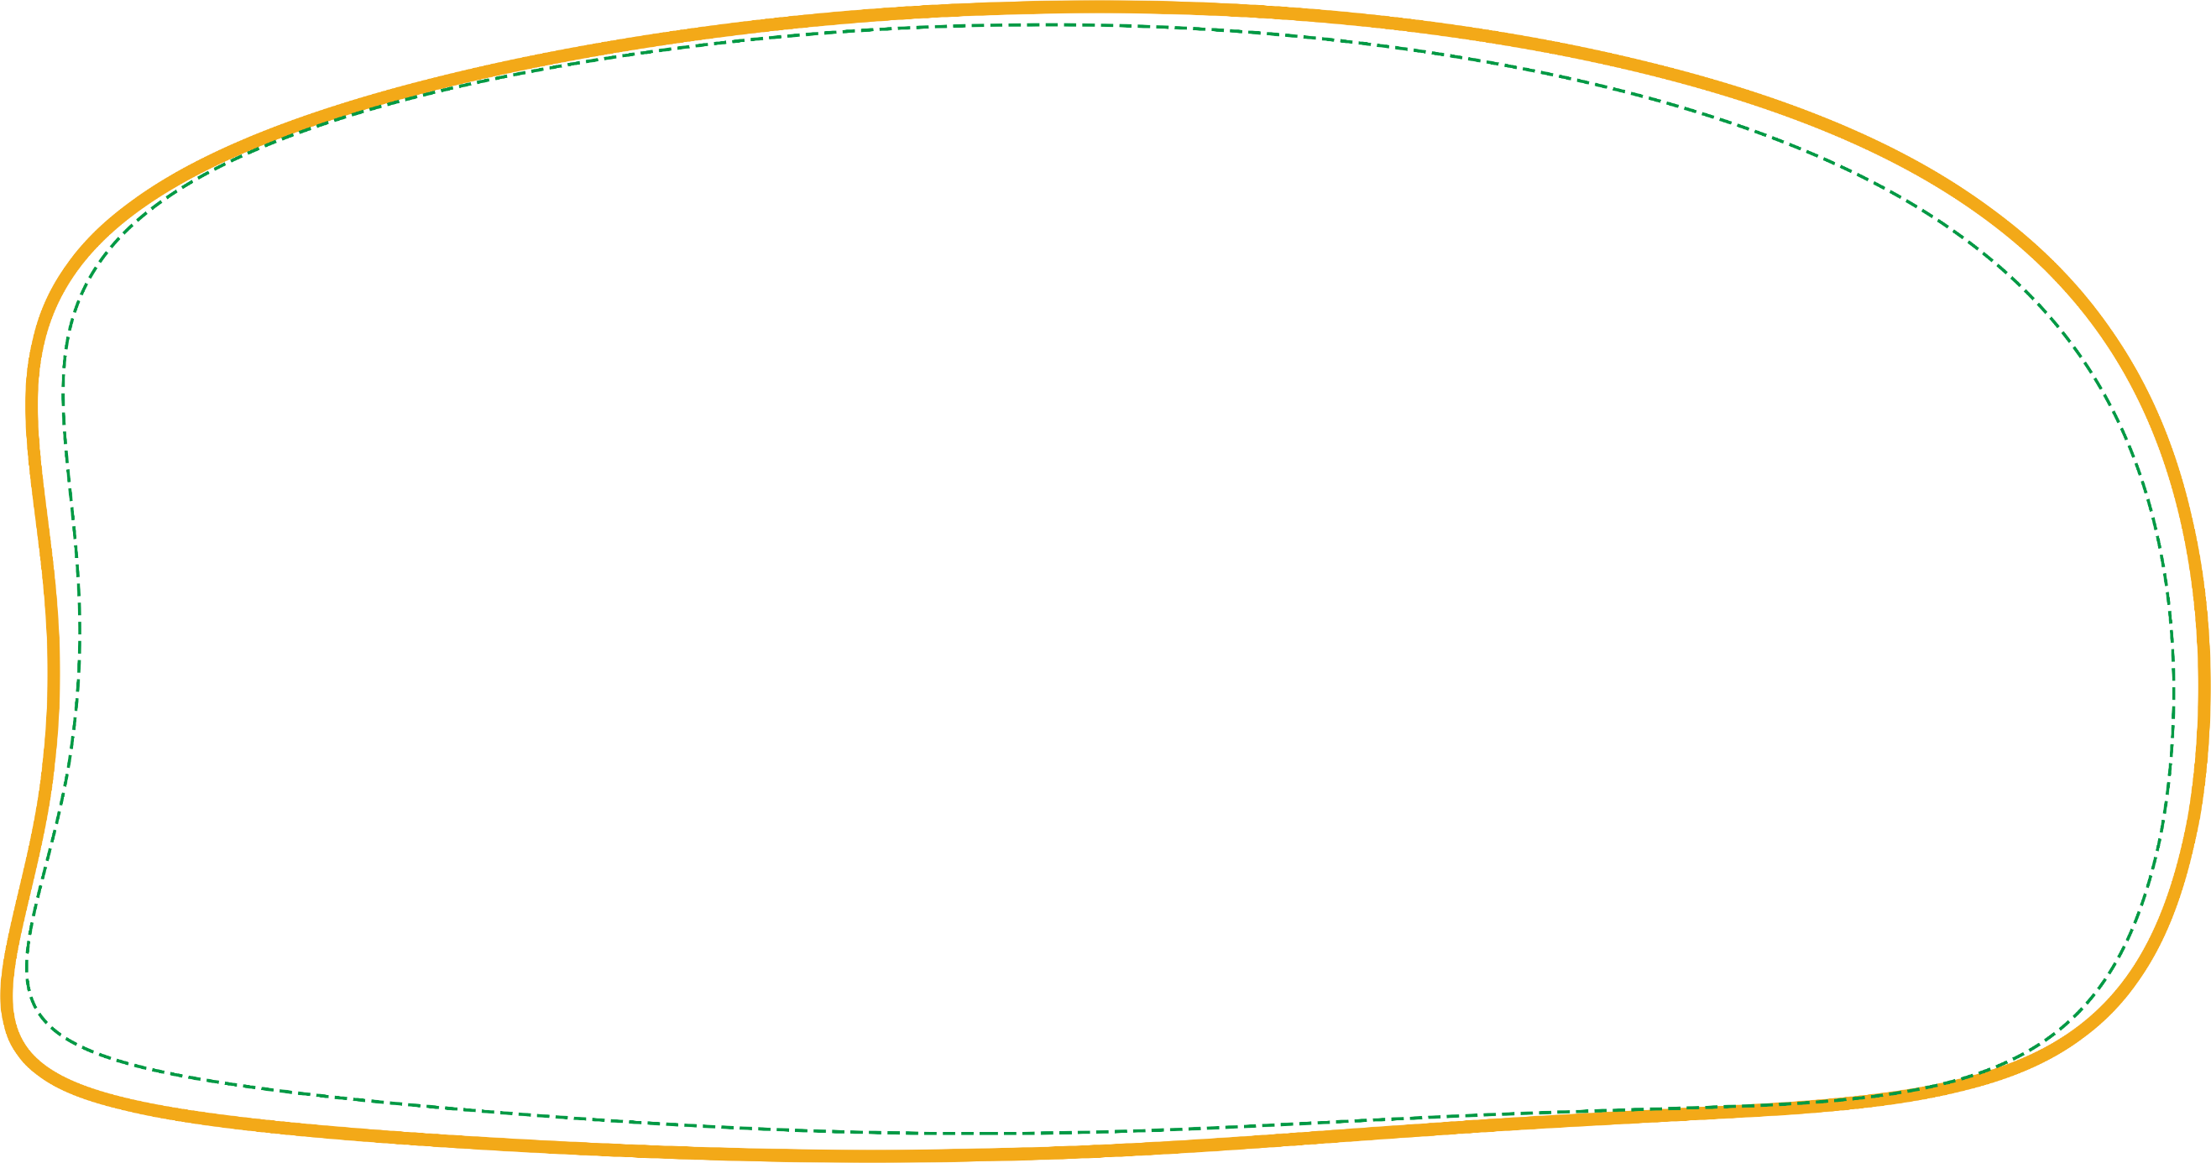
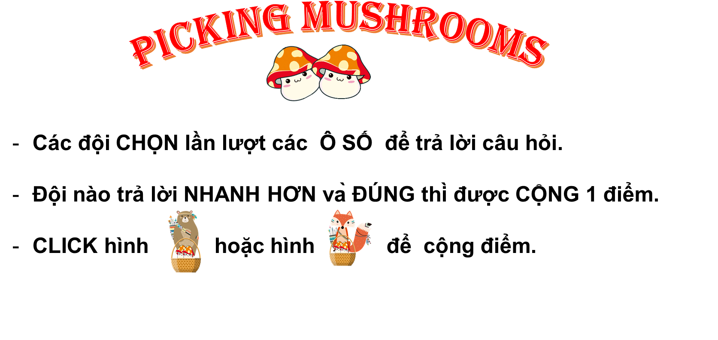


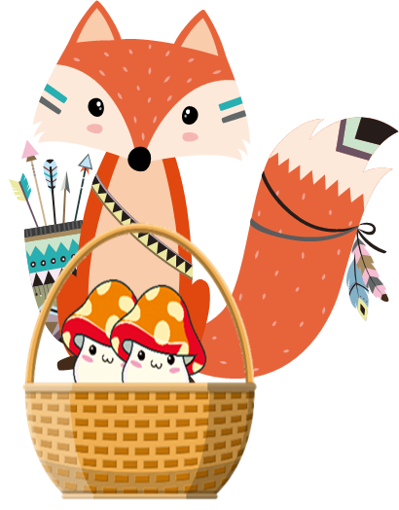



Next
PICKING MUSHROOMS
1
2
3
Các đội CHỌN lần lượt các Ô SỐ để trả lời câu hỏi.
Đội nào trả lời NHANH HƠN và ĐÚNG thì được CỘNG 1 điểm.
CLICK hình hoặc hình để cộng điểm.
4
5
6
7
8
9
10

Slide 4




Time’s up
1
2
3
4
5
6
7
8
9
10
Question
Which one is more intersting,
Thong Nhat Park or Dam Sen Park?
______ Dam Sen Park is.
I think
Back

Slide 5
Time’s up
1
2
3
4
5
6
7
8
9
10
Question
Which one is___________,
Chicken or fish?
I think Chicken is.
more delicious
Back

Slide 6
Time’s up
1
2
3
4
5
6
7
8
9
10
Question
__________ is more peaceful,
a village or a city?
I think a village is.
Which one
Back

Slide 7
Time’s up
1
2
3
4
5
6
7
8
9
10
Question
Which one is (noisy)______________,
a city or a moutain?
noisier
Back

Slide 8
Time’s up
1
2
3
4
5
6
7
8
9
10
Question
Which one is (exciting)______________,
Da Nang or Hoi An?
more exciting
Back

Slide 9
Time’s up
1
2
3
4
5
6
7
8
9
10
Question
Which one is (expensive)______________,
Da Nang or Hoi An?
more expensive
Back

Slide 10
Pronounciation

Slide 11

1. Listen and repeat
1. | Which one is bigger, ↷ London ⤻ or Hue? ↷ I think London is. ↷
2. | Which one is more beautiful, ↷ Ha Long City ⤻ or Nha Trang? ↷ I think Ha Long City is. ↷

Slide 12
2. Listen and mark the sentence intonation (↷ or ⤻).
Then say the sentences aloud.
A: Which one is bigger, __ New York City __ or London? __
B: I think London is. __
A: Which one is larger, __ New York City __ or Da Nang? __
B: I think New York City is. __
A: Which one is more beautiful, __ London __ or Sydney? __
1
↷
⤻
↷
↷
2
↷
⤻
↷
↷
3
↷
⤻
↷
B: I think London is. __
↷

Slide 13
Practise

Slide 14
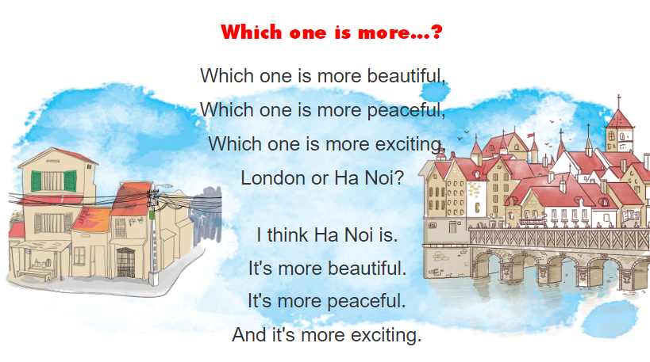


3. Let’s chant.

Slide 15
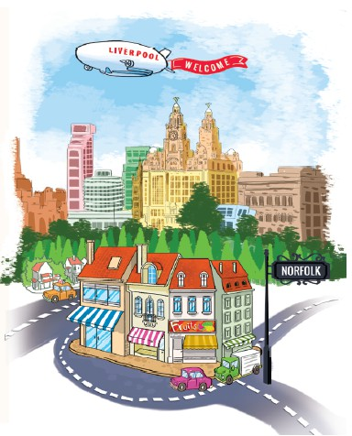
4. Read and answer
1. Where does Anna live?
She lives in Liverpool.
2. Where does she often go for her summer holiday?
She often goes to King's Lynn.
3. Which one is smaller, Liverpool or King's Lynn?
King's Lynn is.
4. Which one is noisier, Liverpool or King's Lynn?
Liverpool is.
5. Where are things more expensive, in Liverpool or in King's Lynn?
Things in Liverpool are more expensive than in
Hello. My name's Anna. I live in Liverpool, a very big city in England. It has a lot of people and interesting buildings. It's very noisy. But I enjoy living here because life is exciting. During summer holidays, I often stay with my grandparents in King's Lynn, a town in the east of England, in a county called Norfolk. It's much smaller and quieter than Liverpool. There are not so many people there, but the shops are really nice and things are cheaper. I like Norfolk because the people are very friendly.

Slide 16
5. Write about where you live
My name is _________.
I live in _________. It's a _________ in Viet Nam.
There are_________. It's _________.
I enjoy living here because it's_________.

Slide 17
6. Project

