Slide 1
Vocabulary

Slide 2
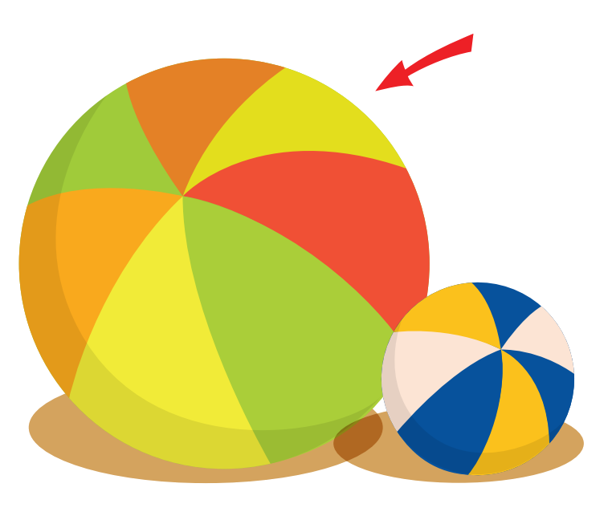

Vocabulary
smaller
/ smɔːlər/
small
/smɔːl/

Slide 3
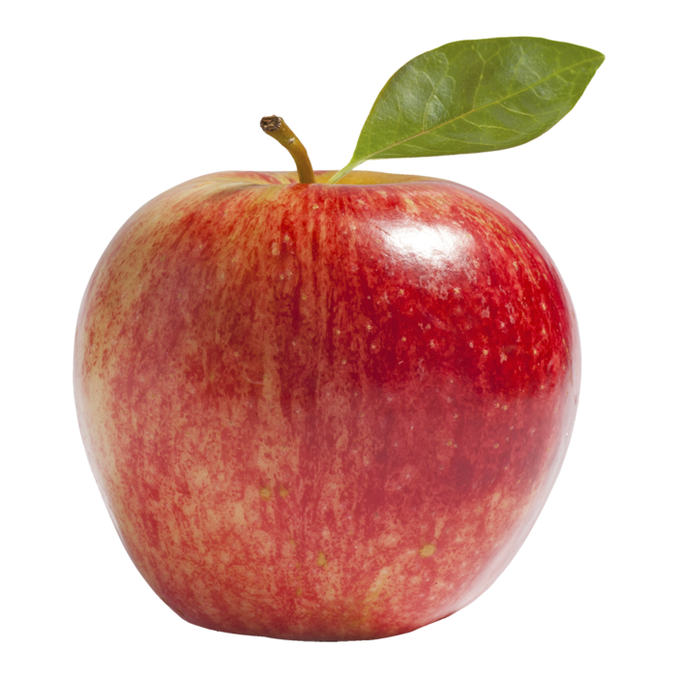
Vocabulary
big
bigger
/big/
/bigər/

Slide 4
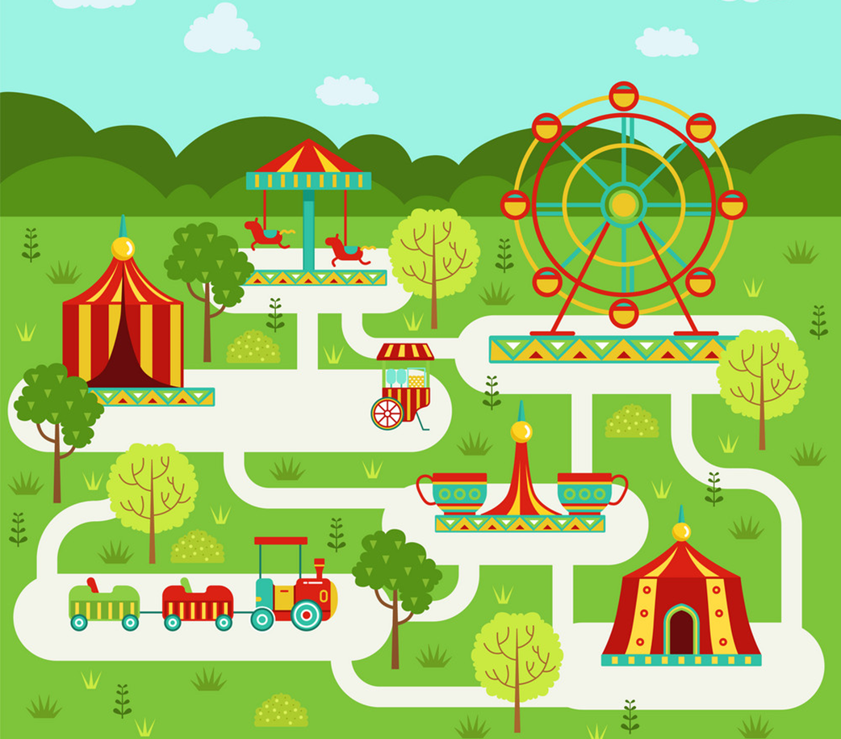
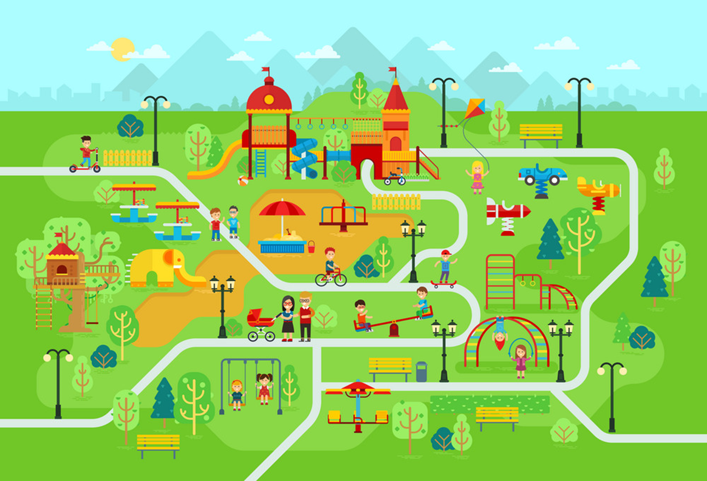
Vocabulary
large
larger
/lɑːrdʒ/
/lɑːrdʒər/

Slide 5

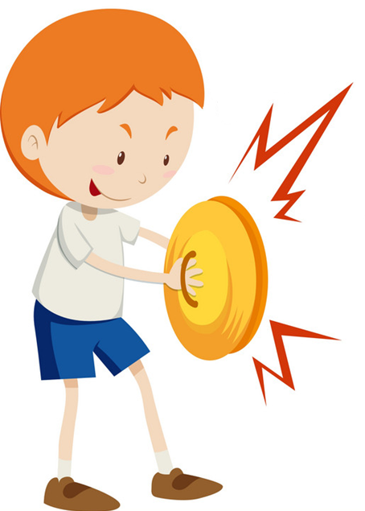
Vocabulary
noisy
noisier
/ˈnɔɪzi/
/ ˈnɔɪziər/

Slide 6


Vocabulary
busy
busier
/ˈbɪzi/
/ ˈbɪziər/

Slide 7




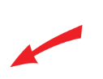
Vocabulary
small
big
large
noisy
busy
smaller
bigger
larger
noisier
busier

Slide 8
Grammar

Slide 9
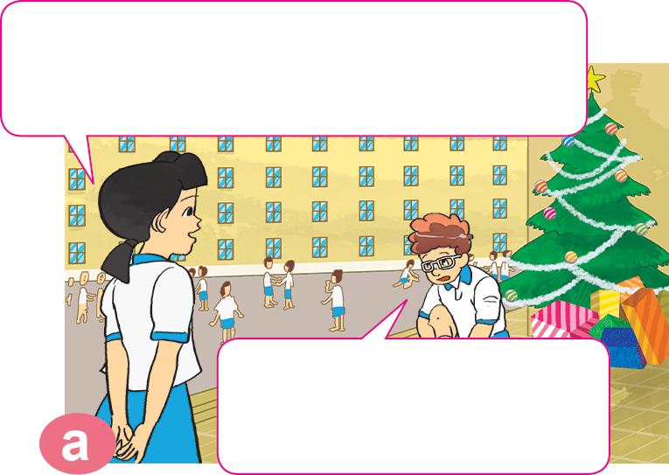
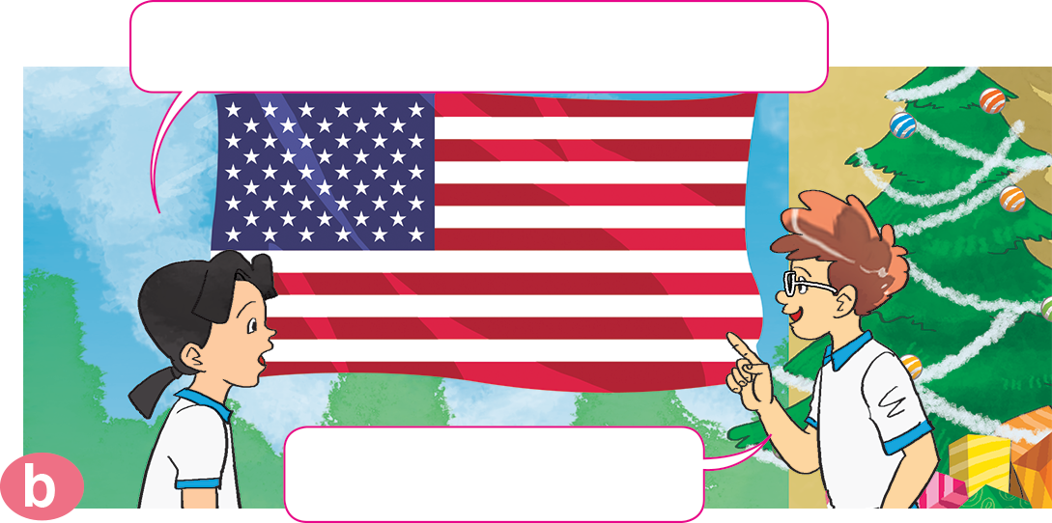

1. Look, listen and repeat.
Where are you going for
your summer holiday, Tom?
Where in the USA do you live?
I'm going back to my hometown.
In New York City.

Slide 10
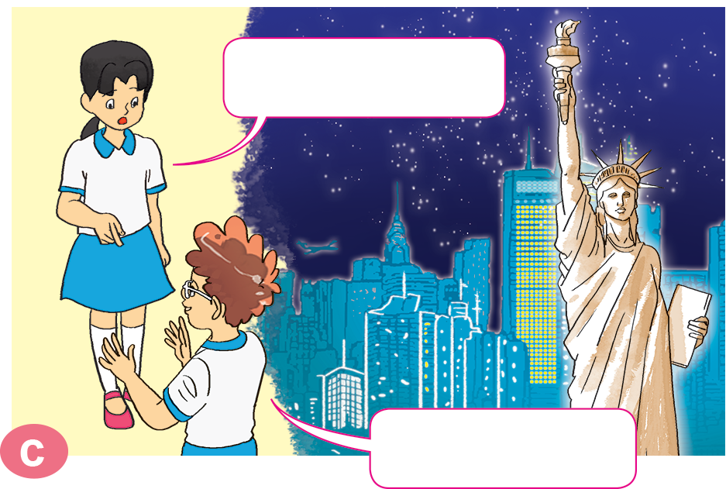
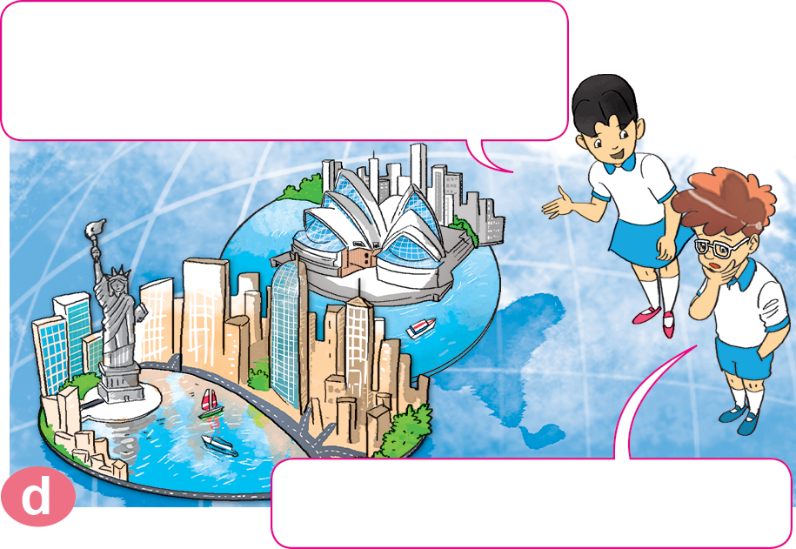
1. Look, listen and repeat.
Which one is bigger, New York City or Sydney?
What's it like?
It's very big.
I think New York City is.

Slide 11


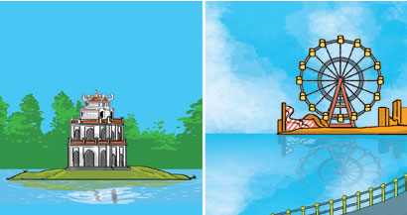
2. Point and say
Which one is _________, _______________ or _______________?
smaller
Hoan Kiem Lake
West Lake
I think ________________.
Hoan Kiem Lake

Slide 12
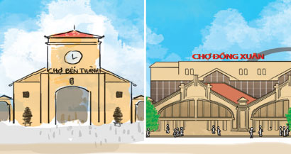
2. Point and say
Which one is _______, _________________ or _________________?
larger
Ben Thanh Market
Dong Xuan Market
I think ________________.
Dong Xuan Market

Slide 13
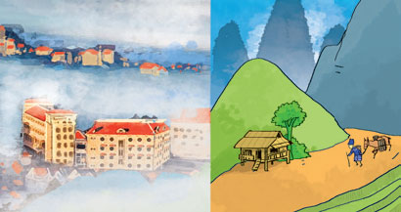
2. Point and say
Which one is _________, _______________ or _____________________?
noisier
life in the city
life in the countryside
I think ________________.
life in the city

Slide 14
2. Point and say
Which one is _________, _______________ or _____________________?
busier
life in the city
life in the mountains
I think ________________.
life in the city

Slide 15
3. Let’s talk.
Which one is _____, _____or _____?
I think _______________.

Slide 16
4. Listen and write.
1. Tony lives in _______. It's _______ than Nha Trang.
2. Linda lives in _______. It's _______ than Da Nang.
3. Tom lives in ____________. It's _______ than Da Lat.
Sydney
noisier
London
larger
New York City
busier

