Slide 1
Unit 18
What will the weather
be like tomorrow?
Lesson 1

Slide 2
Vocabulary

Slide 3


Vocabulary
cloudy
/ˈklaʊdi/

Slide 4

Vocabulary
windy
/ˈwɪndi/

Slide 5

Vocabulary
snowy
/ˈsnəʊi/

Slide 6

Vocabulary
rainy
/ˈreɪni/

Slide 7

Vocabulary
sunny
/ˈsʌni/

Slide 8
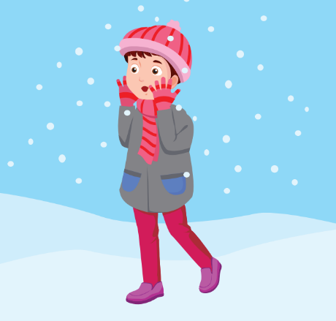
Vocabulary
cold
/kəʊld/

Slide 9
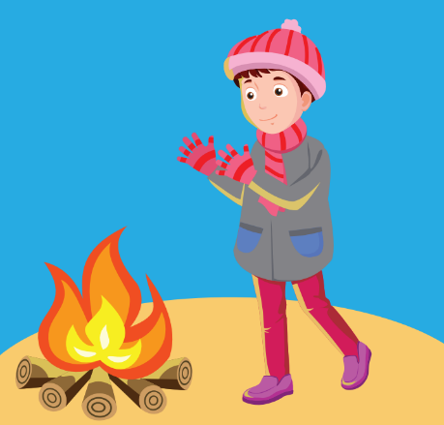
Vocabulary
warm
/wɔːrm/

Slide 10
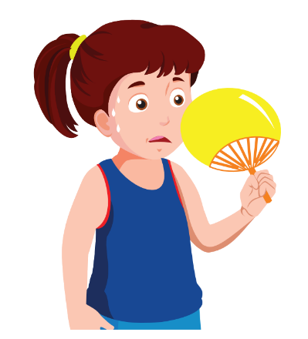
Vocabulary
hot
/hɒt/

Slide 11
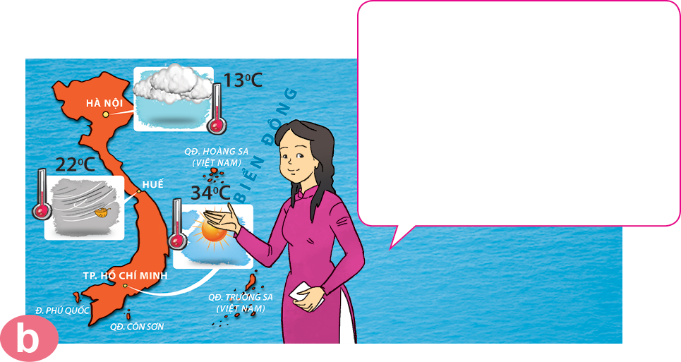
weather forecast
/ˈweðə fɔːkɑːst/
take a look
/teɪk ə lʊk/
Đón xem

Slide 12
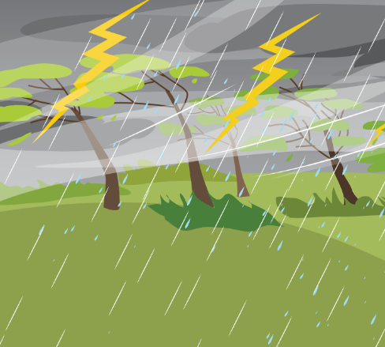





Vocabulary
stormy
cloudy
rainy
sunny
windy
snowy
cold
cool
warm
hot

Slide 13
Grammar

Slide 14
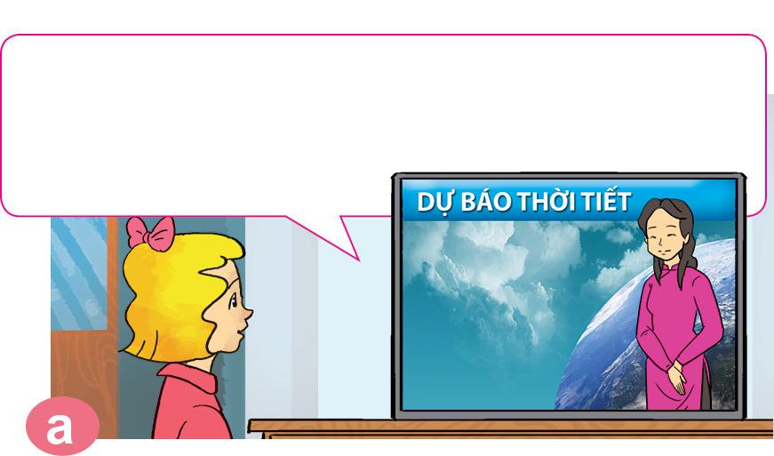
1. Look, listen and repeat.
It's cold and cloudy in Ha Noi. It's cool and windy in Hue. It's hot and sunny in Ho Chi Minh City.
Good evening and welcome to the weather forecast. Let's take a look at the weather today.

Slide 15
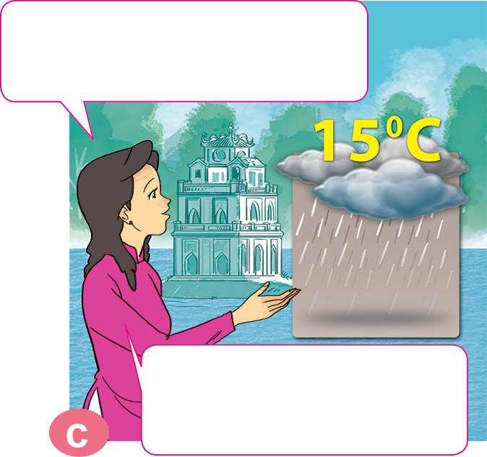
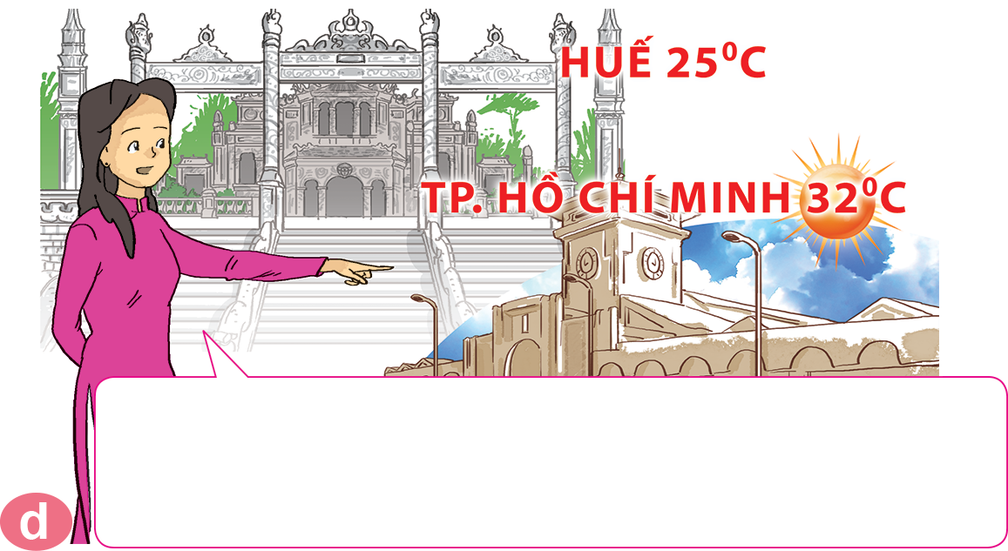
1. Look, listen and repeat.
What will the weather be like tomorrow?
It will be warm and foggy in Hue. In Ho Chi Minh City, it will be hot and sunny. That's the weather forecast for tomorrow.
Well, it will be cold and rainy in Ha Noi.

Slide 16


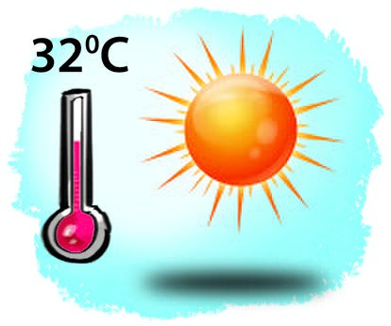
2. Point and say.
What will the weather be like tomorrow?
It will be __________________.
hot and sunny

Slide 17
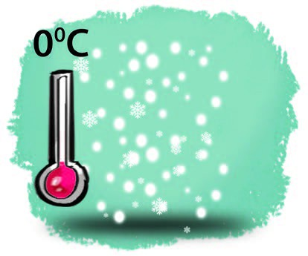
2. Point and say.
What will the weather be like tomorrow?
It will be __________________.
cold and snowy

Slide 18
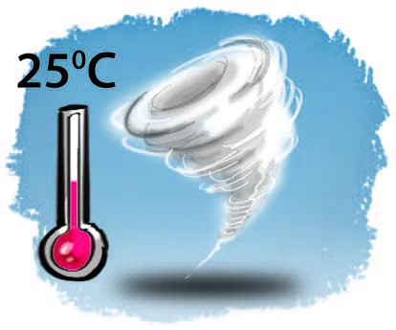
2. Point and say.
What will the weather be like tomorrow?
It will be __________________.
warm and stormy

Slide 19

2. Point and say.
What will the weather be like tomorrow?
It will be __________________.
cool and cloudy

Slide 20
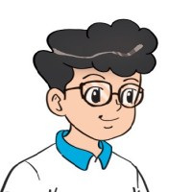

3. Let’s talk
What's the weather like today?
It's _____ and _______.
What will the weather be like tomorrow?
It will be _____ and ______.

Slide 21
4. Listen and circle a, b or c.
a. snowy and stormy.
b. snowy and very cold.
c. stormy and very cold.
1
It will be ___________
in Sa Pa tomorrow.
a. foggy and windy.
b. snowy and windy.
c. cold and windy.
2
It will be ____________
in Ha Noi tomorrow.
a. sunny and foggy.
b. stormy and cloudy.
c. sunny and windy.
It will be ___________
in Da Nang tomorrow.
3

Slide 22
5. Read and complete.
Mai: Let's (1) _______ for a picnic tomorrow.
Tony: What will the (2) _______ be like tomorrow?
Linda: Well, it will be cold and (3) ________.
Mai: How do you know that?
Linda: I watched the weather (4) ________ on TV.
Tony: We can't go for a picnic if it's stormy.
Mai: OK, let's stay home, eat popcorn and
(5) _________ cartoons.
Tony and Linda: Great idea!
go
weather
watch
forecast
go
stormy
weather
stormy
forecast
watch

