Slide 1

Unit 17
What would you like to eat
Lesson 2

Slide 2
VOCABULARY

Slide 3

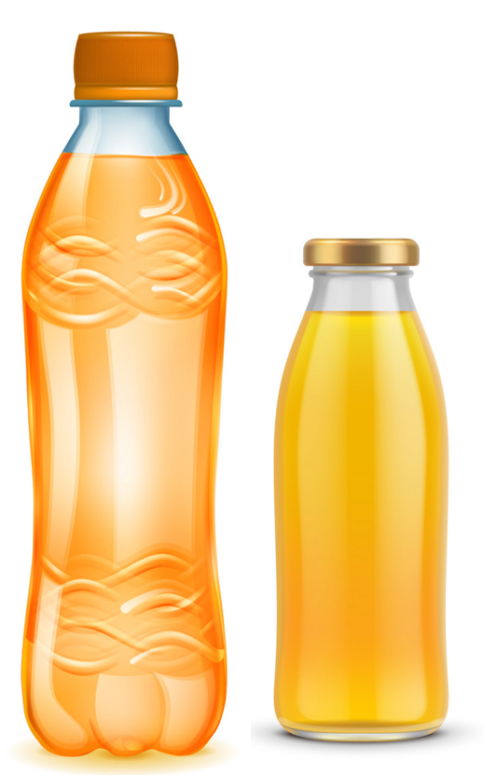
Vocabulary
bottle
/ˈbɒtl/

Slide 4
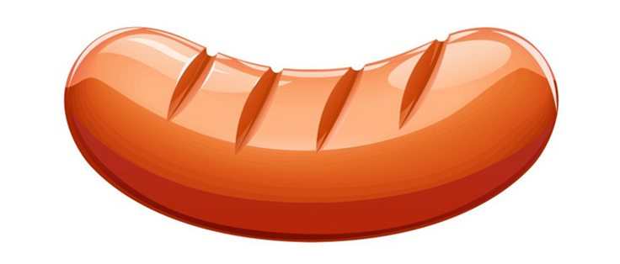
Vocabulary
sausage
/ˈsɔːsɪdʒ/

Slide 5
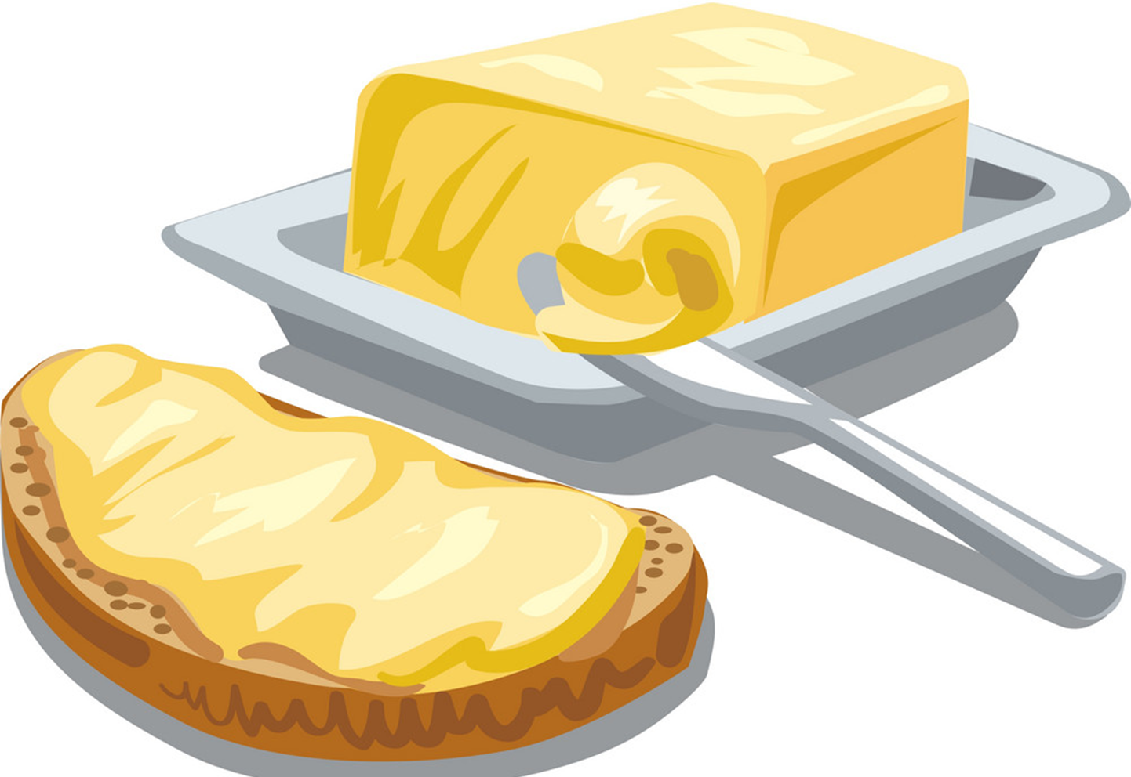
Vocabulary
butter
/ˈbʌtər/

Slide 6
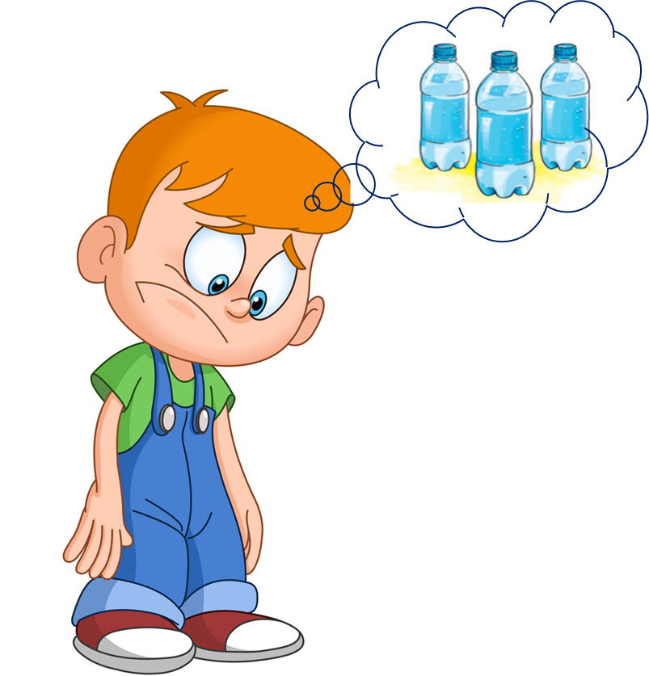
Vocabulary
thirsty
/ˈθɜːrsti/

Slide 7

Vocabulary
fresh
/freʃ/

Slide 8
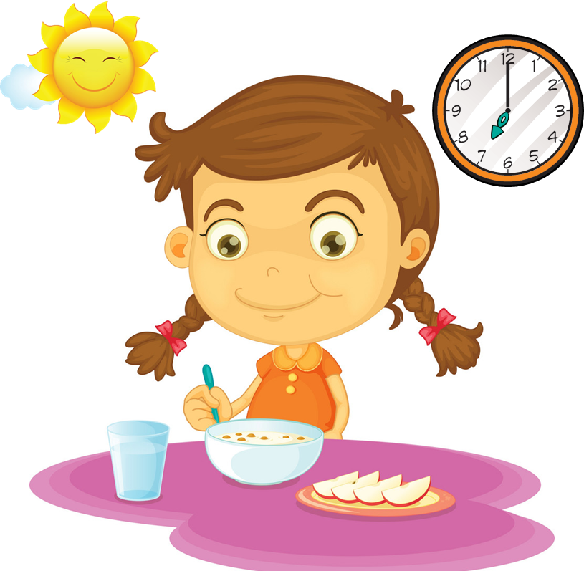
Vocabulary
breakfast
/ˈbrekfəst/

Slide 9
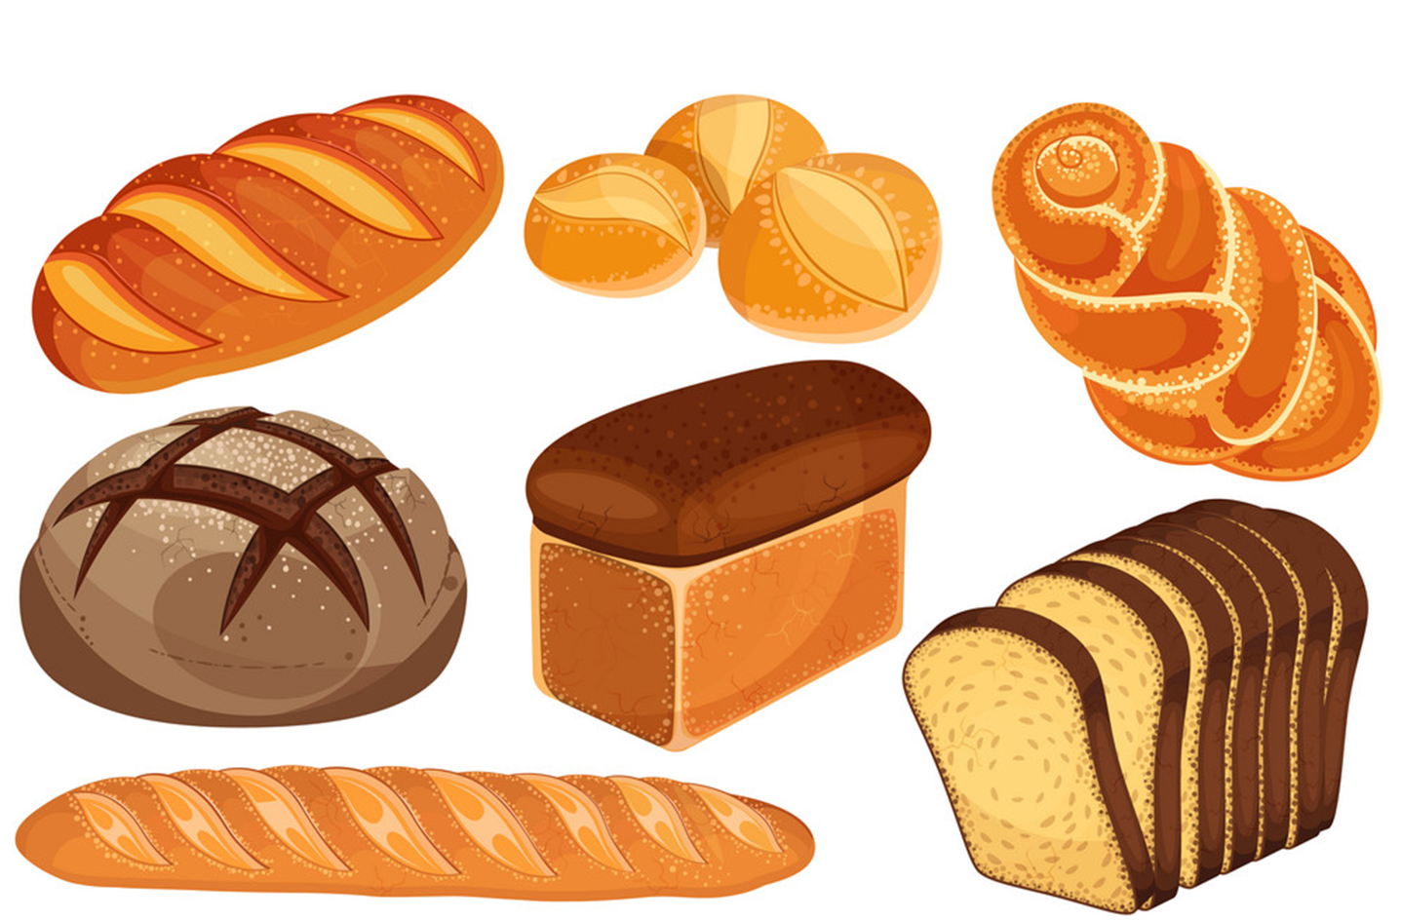
Vocabulary
bread
/bred/

Slide 10
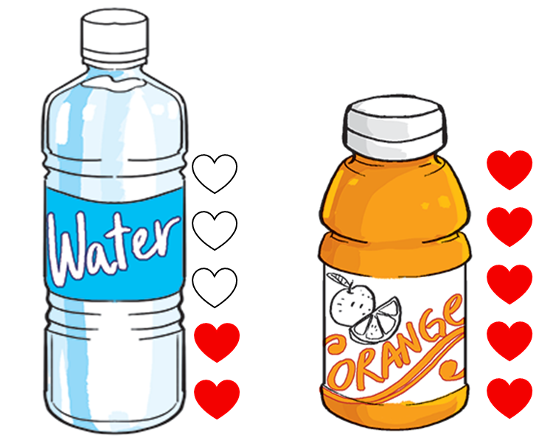
Vocabulary
favourite
/ˈfeɪvərɪt/

Slide 11
Vocabulary
bread
breakfast
fresh
bottle
sausage
butter
thirsty
favourite

Slide 12
GRAMMAR

Slide 13
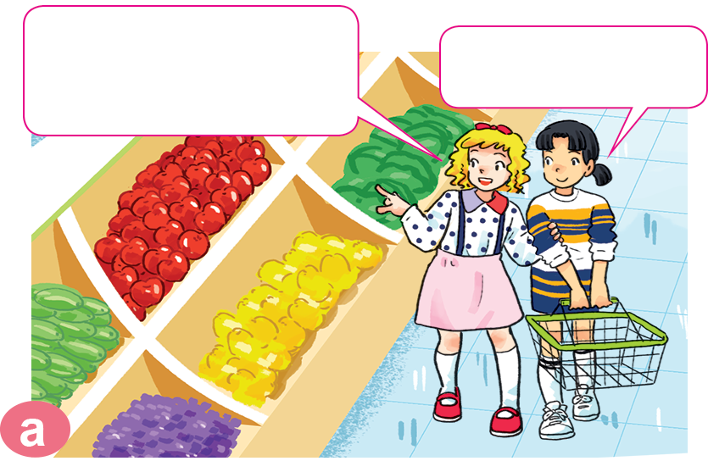
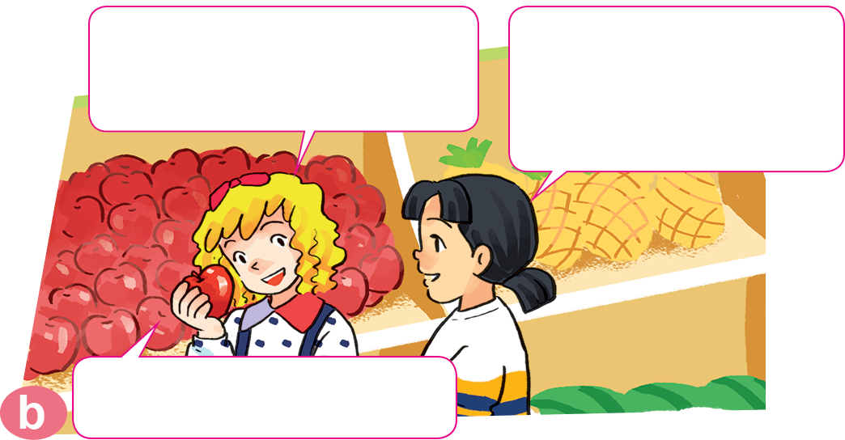

1. Look, listen and repeat.
The apples look very fresh.
I like apples.
How many apples do you eat every day?
Two. I'm thirsty. Where can we
get some drinks?
They're over there.

Slide 14
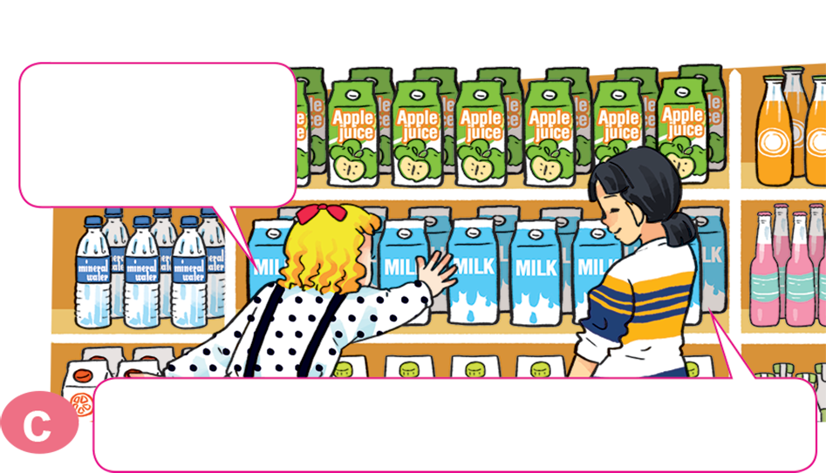
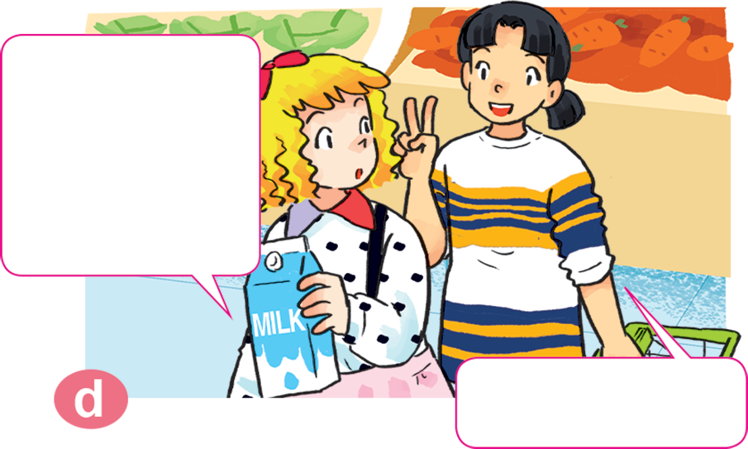
1. Look, listen and repeat.
How much milk do you drink every day?
Do you like milk, Mai?
Yes, I do. It's my favourite drink.
Two glasses.

Slide 15


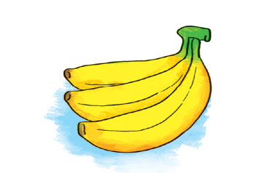
2. Point and say.
How many _________ do you eat every day?
bananas
I eat _____________________.
three bananas

Slide 16
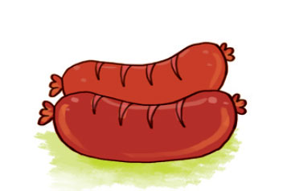
2. Point and say.
How many _________ do you eat every day?
sausages
I eat _____________________.
two sausages

Slide 17
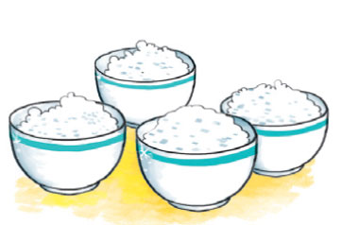
2. Point and say.
How much _________ do you eat every day?
rice
I eat _____________________.
four bowls

Slide 18
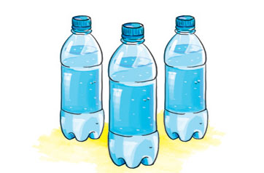
2. Point and say.
How much _______ do you drink every day?
water
I eat _____________________.
three bottles

Slide 19
How many/much _______ do you eat/drink every day?
I eat ______________________.
bananas
water
sausages
rice
three bottles
three bananas
two sausages
four bowls
Ms.Phạm English

Slide 20


3. Let’s talk
How many/much ______ do you
eat/drink every day?
I eat/drink _______.

Slide 21
4. Listen and circle.
1. How many bananas does Tony eat every day?
a. One. b. Two. c. Three.
2. How much rice does Nam eat every day?
a. Two bowls. b. Three bowls. c. Four bowls.
3. How much water does Mai drink every day?
a. Three bottles. b. Four bottles. c. Five bottles.
4. How many sausages does Tom eat every day?
a. One. b. Two. c. Three.

Slide 22
5. Read and complete.
Mai: What do you usually have for breakfast?
Tom: Some bread with butter, sausages, eggs, chocolate and milk.
Mai: (1) _________ sausages and eggs do you have?
Tom: I usually have two sausages and one egg.
Mai: (2) _________ chocolate do you eat?
Tom: One or two bars.
Mai: And how much (3) ______ do you drink?
Tom: A big glass.
Mai: You (4) ___________ eat too many sausages
and chocolate bars.
Tom: Why not?
Mai: Because they're not very (5) _________!
shouldn't
Healthy
How many
milk
How much
How many
How much
milk
shouldn't
healthy

