Slide 1

Unit 6
DESCRIBING PEOPLE
ART LESSON 1
PAGE 87

Slide 2

WARM UP

Slide 3

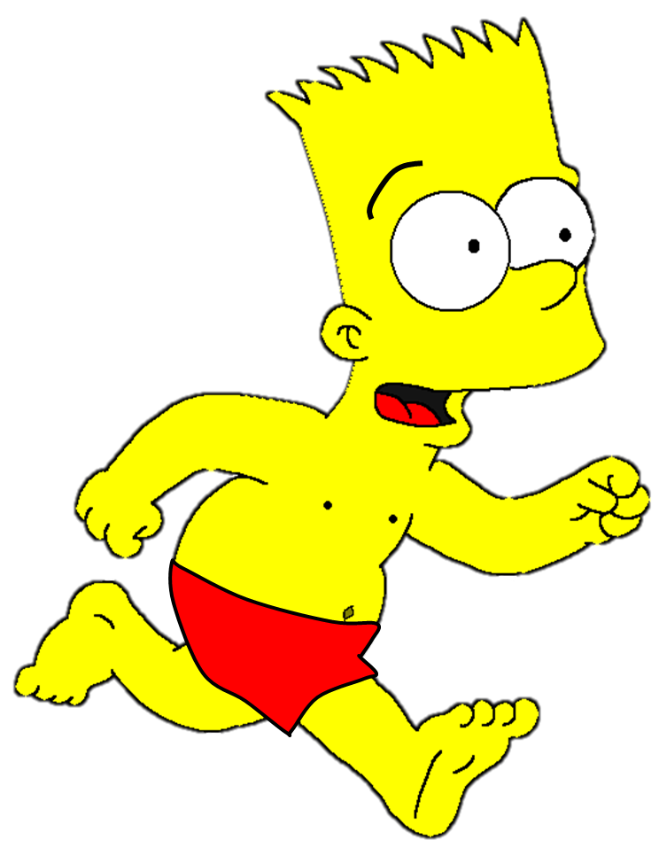
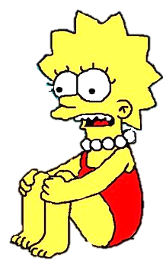




Slide 4



nose
tongue
mouth

Slide 5
mouth
nose
ear

Slide 6
eye
mouth
ear

Slide 7
eyebrow
elbow
eye

Slide 8
leg
mustache
beard

Slide 9
mouth
mustache
beard

Slide 10

It’s time to learn …

Slide 11

New words
handsome,
pretty,
cute,
young,
old.

Slide 12

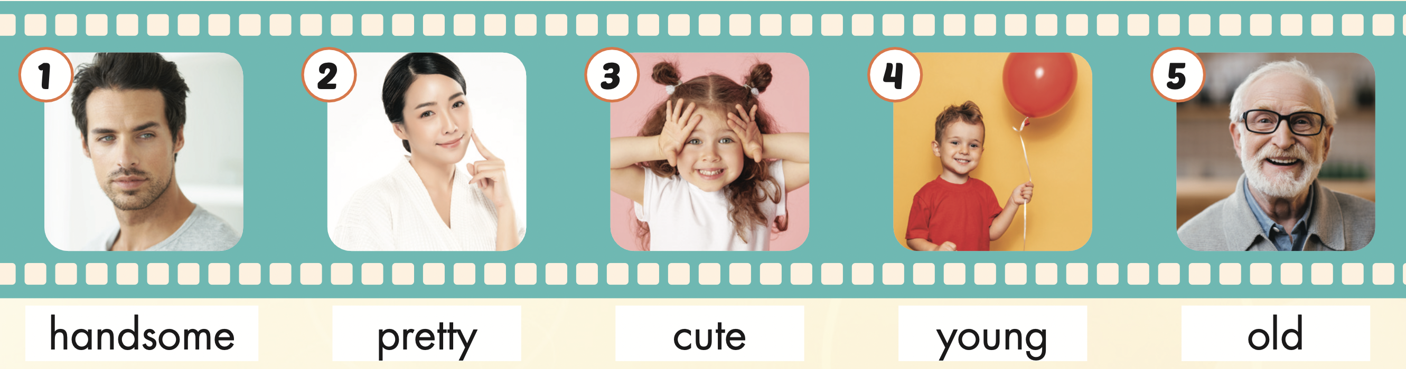
Click the icon to hear the sound.

Slide 13
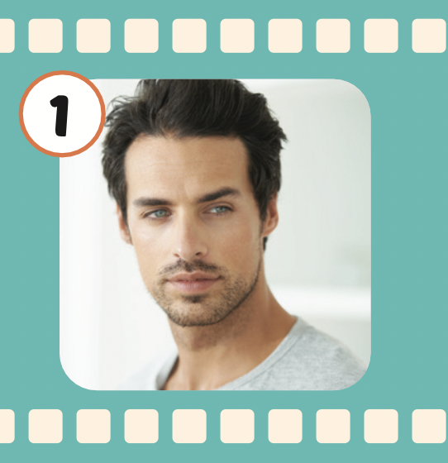
Click the picture to hear the sound.
handsome
/ˈhænsəm/ đẹp trai

Slide 14
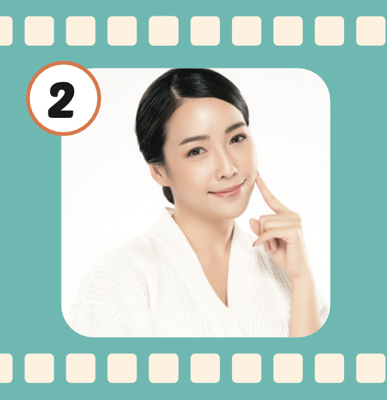
Click the picture to hear the sound.
pretty
/ˈprɪti/
xinh xắn

Slide 15

Click the picture to hear the sound.
cute
/kjuːt/
dễ thương, đáng yêu

Slide 16
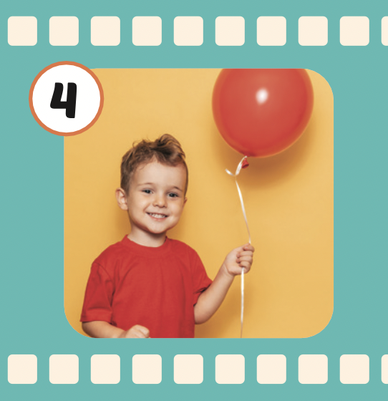
Click the picture to hear the sound.
young
/jʌŋ/
trẻ

Slide 17
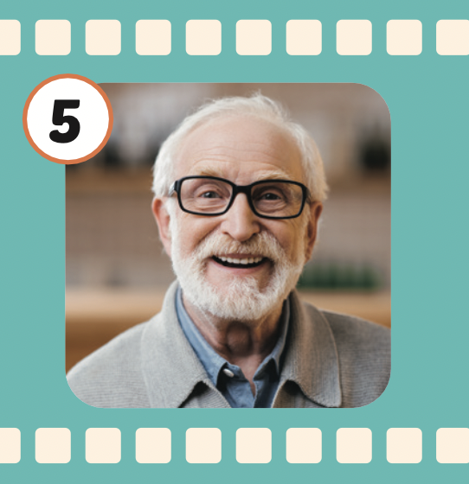
Click the picture to hear the sound.
old
/oʊld/
già

Slide 18

Practice

Slide 19
WHO’S MISSING?

Slide 26

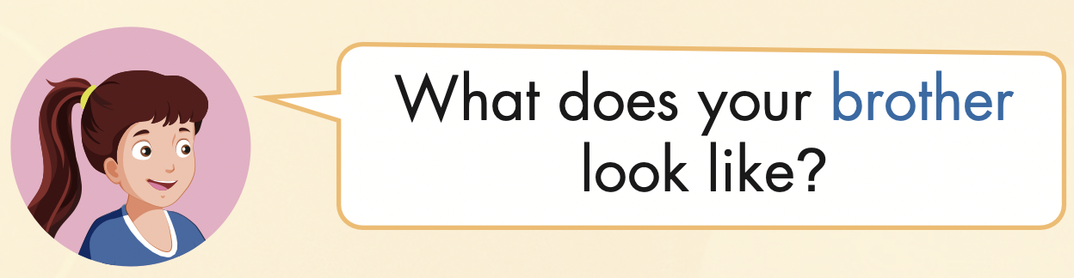
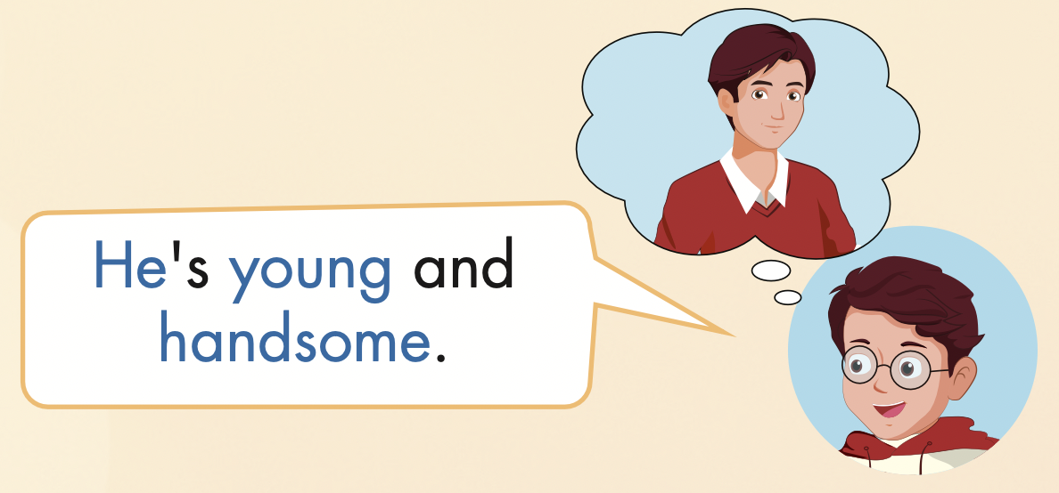

Slide 27
Practice

Slide 28
grandfather
What does your grandfather look like?
He is old.

Slide 29
Mother
What does your mother look like?
She is pretty.

Slide 30
sister
What does your sister look like?
She is cute.

Slide 31
brother
What does your brother look like?
He is young.

Slide 32
uncle
What does your uncle look like?
He is handsome.

Slide 33

Writing

Slide 34


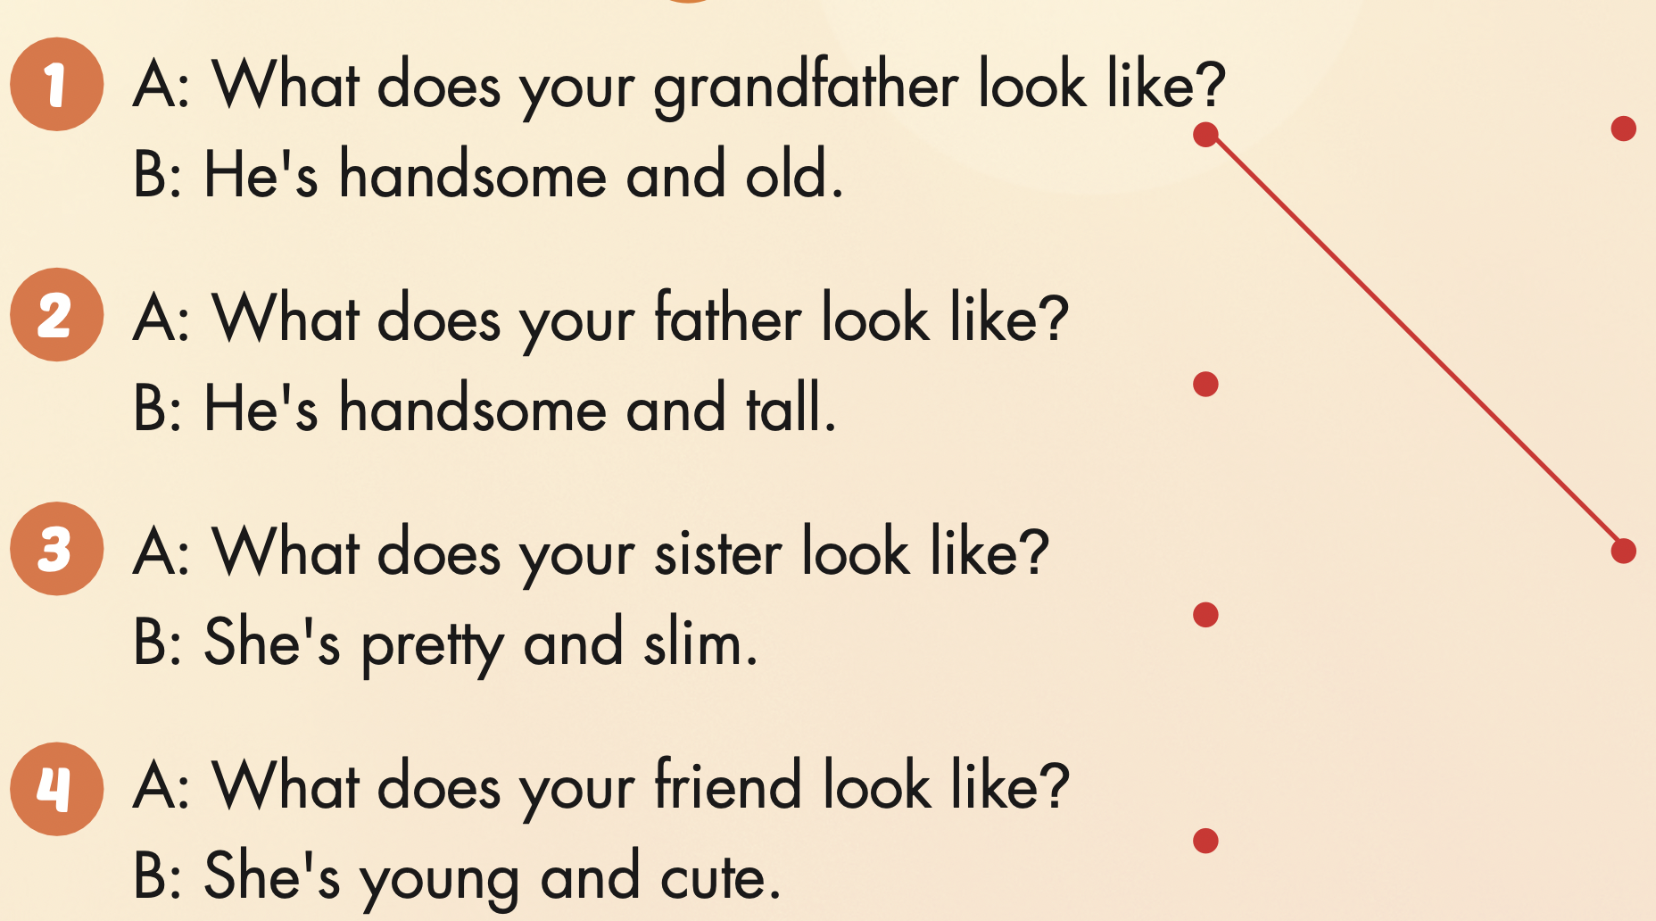

Slide 35

CONSOLIDATION

Slide 36

WRAP-UP

Slide 37
Today’s lesson
Vocabularies
handsome,
pretty,
cute,
young,
old.
Structures/ Sentence patterns
What does your brother look like?
He's young and handsome.

Slide 38
Homework
Practice the vocabularies and structure; and make sentences using them.
Do the exercises in Tiếng Anh 4 i-Learn Smart Start WB (page 58)
Prepare the next lesson (page 88 SB)

Slide 39
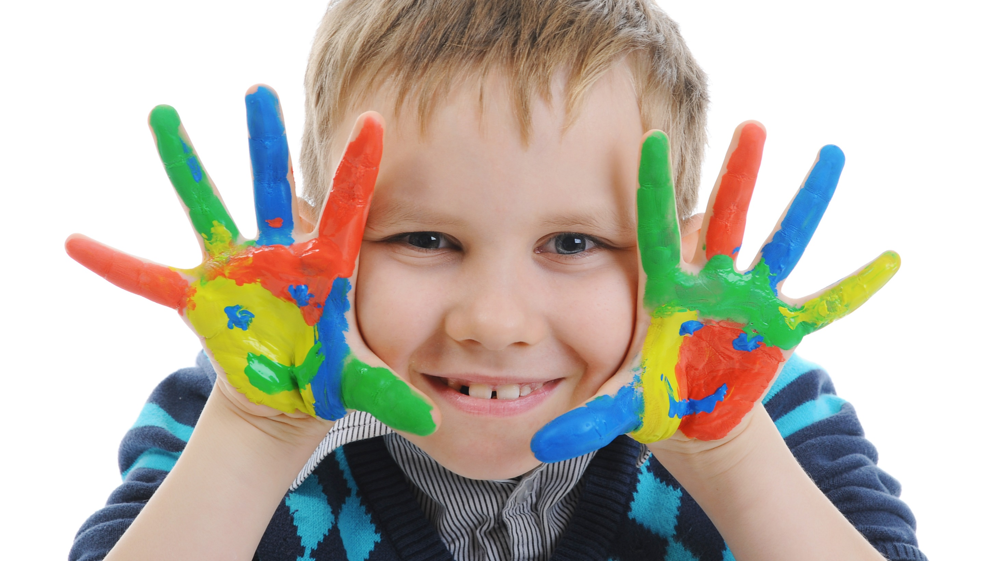
Enjoy your day!

