Slide 1

Unit 6
DESCRIBING PEOPLE
LESSON 3.1 - PAGE 84

Slide 2

WARM UP

Slide 3

have or has
GAME

Slide 4
Great
She________ a small nose.
have
has

Slide 5
Great
I _______ big eyes .
have
has

Slide 6
Great
My father_______ a mustache.
have
has

Slide 7
Great
He doesn’t_______ big ears.
have
has

Slide 8

It’s time to learn …

Slide 9

New words
hair,
long,
short,
straight,
curly,
blond.

Slide 10

Presentation

Slide 11

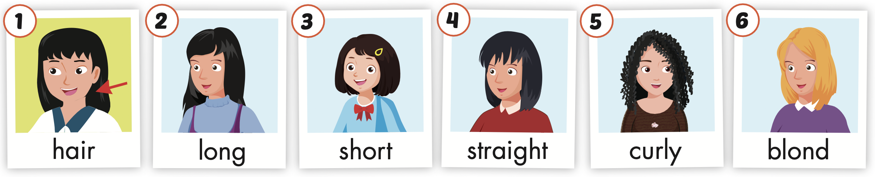
Click the icon to hear the sound.

Slide 12
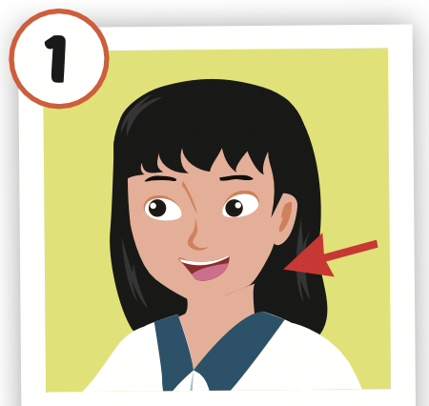
Click the picture to hear the sound.
hair
/her/
tóc

Slide 13
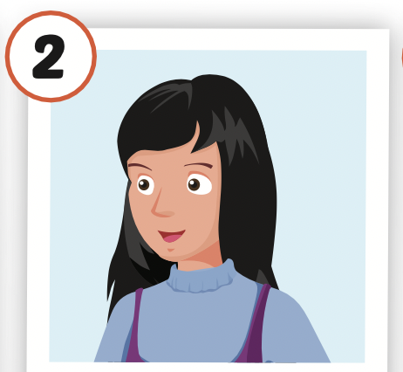
Click the picture to hear the sound.
long
/lɑːŋ/
dài

Slide 14
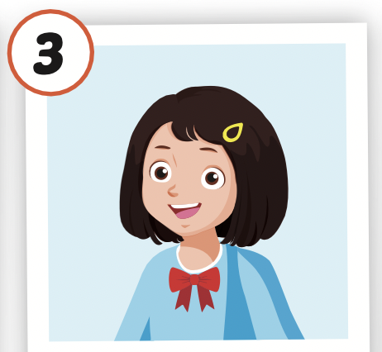
Click the picture to hear the sound.
short
/ʃɔːrt/
thấp, ngắn

Slide 15
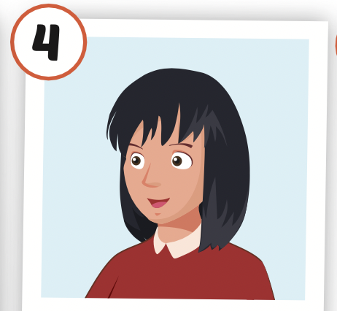
Click the picture to hear the sound.
straight
/streɪt/
thẳng

Slide 16
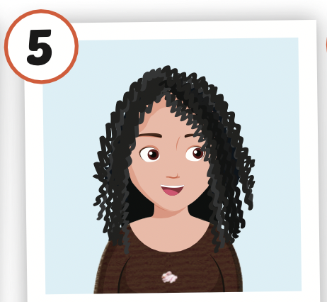
Click the picture to hear the sound.
curly
/ˈkɜːrli/
xoăn, quăn

Slide 17
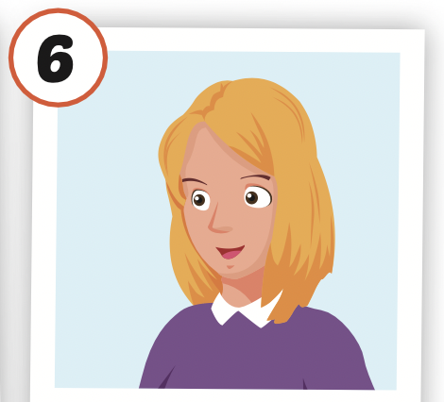
Click the picture to hear the sound.
blond
/blɑnd/
(tóc) vàng hoe

Slide 18

Practice

Slide 19



LISTEN AND CHOOSE

Slide 23
Structures
Does your sister have long, blond hair?
- Yes, she does.
Does your brother have short, curly hair?
- No, he doesn't. He has long, straight hair.

Slide 24
Presentation

Slide 25

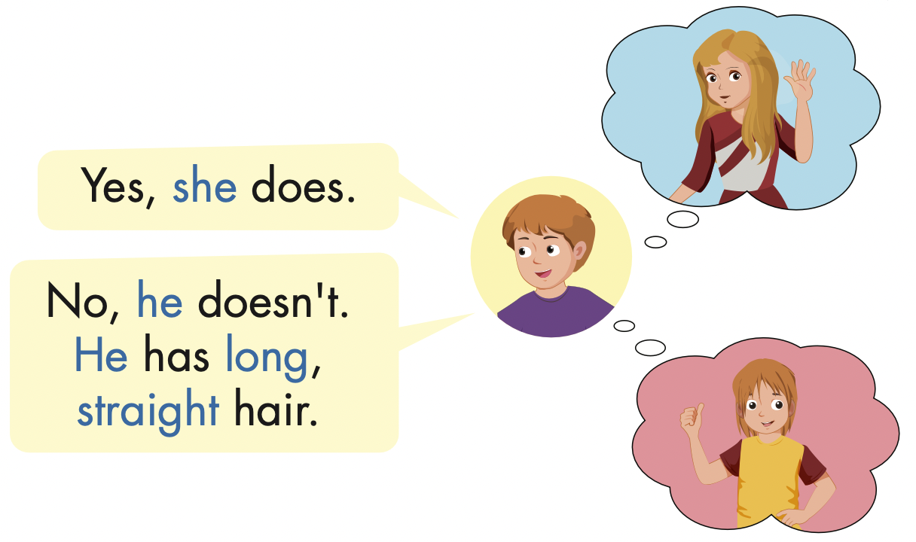
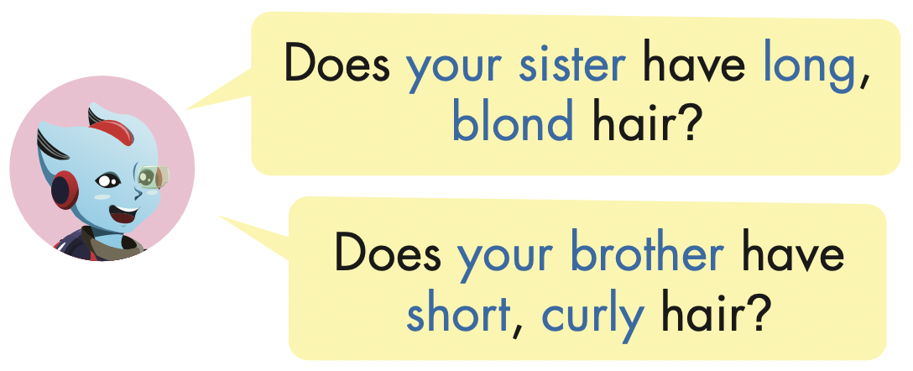

Slide 26
Practice

Slide 27
Does she have long curly hair?
Yes, she does.

Slide 28
Does she have straight, black hair?
No, she doesn’t.
She has straight, blond hair.

Slide 29
No, she doesn’t.
She has short, black hair.
Does your sister have long, black hair?

Slide 30
Does Kim have long, straight hair?
Yes, she does.

Slide 31

Writing

Slide 32

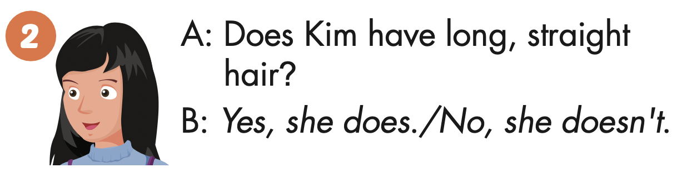

Slide 33
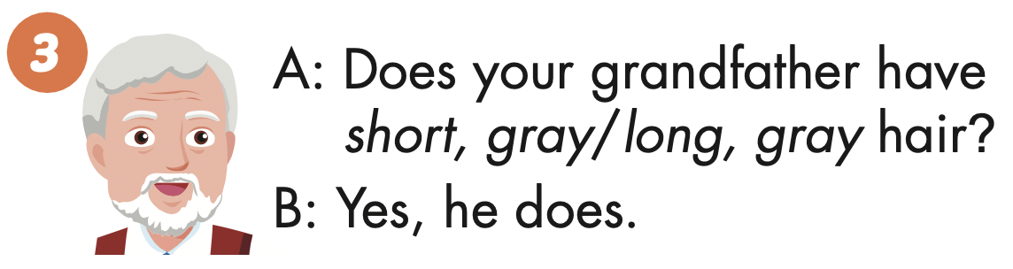

Slide 34
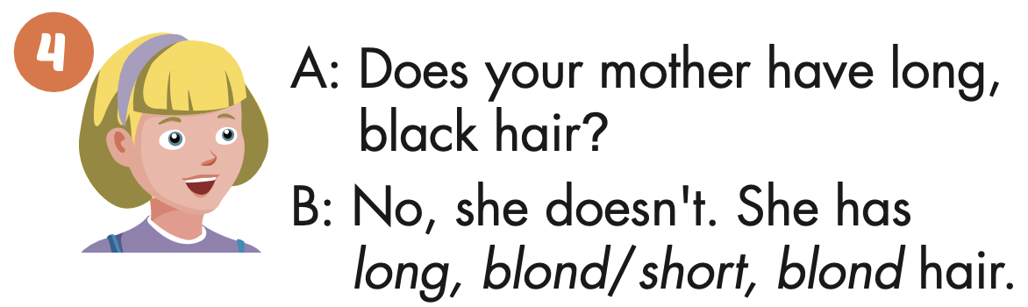

Slide 35

Production

Slide 36

Read and answer

Slide 37
Next
CHECK
Does she have short, black hair?
Yes, she does.
…………….………………….

Slide 38
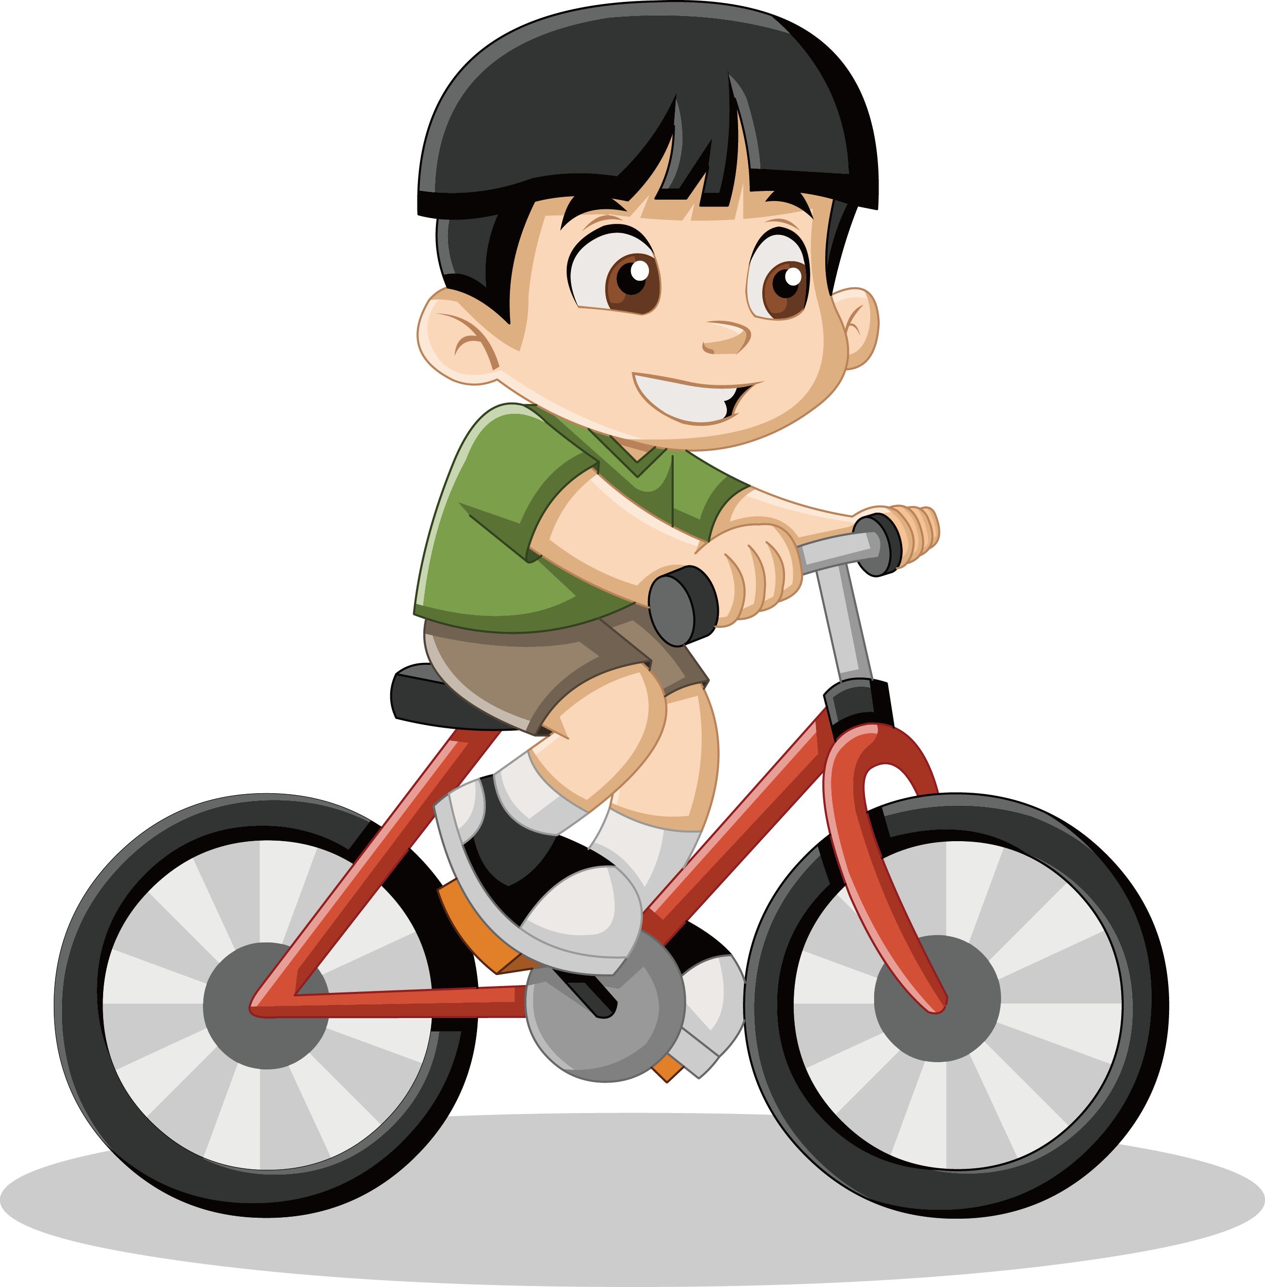
Next
CHECK
Does he have long, black hair?
No, he doesn’t.
…………….………………….

Slide 39
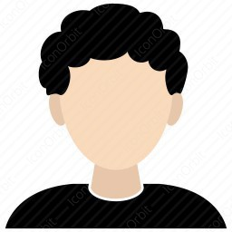
Next
CHECK
Does Tom have curly, black hair?
Yes, he does.
…………….………………….

Slide 40
Next
CHECK
Does your friend have curly, blond hair?
No, she doesn’t.
…………….………………….

Slide 41

CONSOLIDATION

Slide 42

WRAP-UP

Slide 43
Today’s lesson
Vocabularies
hair,
long,
short,
straight,
curly,
blond.
Structures/ Sentence patterns
Does your sister have long, blond hair?
- Yes, she does.
Does your brother have short, curly hair?
- No, he doesn't. He has long, straight hair.

Slide 44
Homework
Practice the vocabularies and structure; and make sentences using them.
Do the exercises in Tiếng Anh 4 i-Learn Smart Start WB (page 56)
Prepare the next lesson (page 85 SB)

Slide 45

Enjoy your day!

