Slide 1
Unit 15 – Lesson 2
What would you like to be in the future?

Slide 2
VOCABULARY

Slide 3


Vocabulary
write stories for children
/ raɪt ˈstɔːriz fə ˈʧɪldrən/

Slide 4
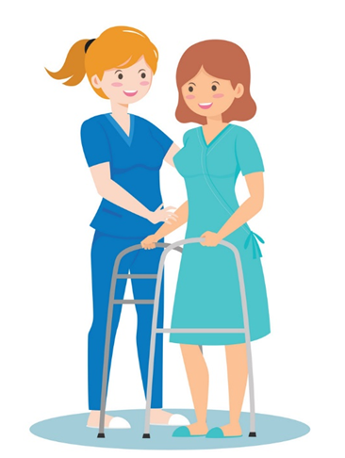
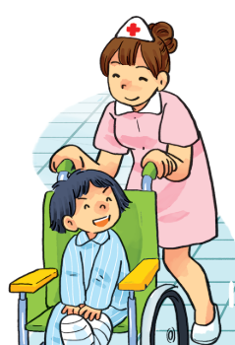
Vocabulary
look after patients
/lʊk ˈɑːftə ˈpeɪʃənts/

Slide 5
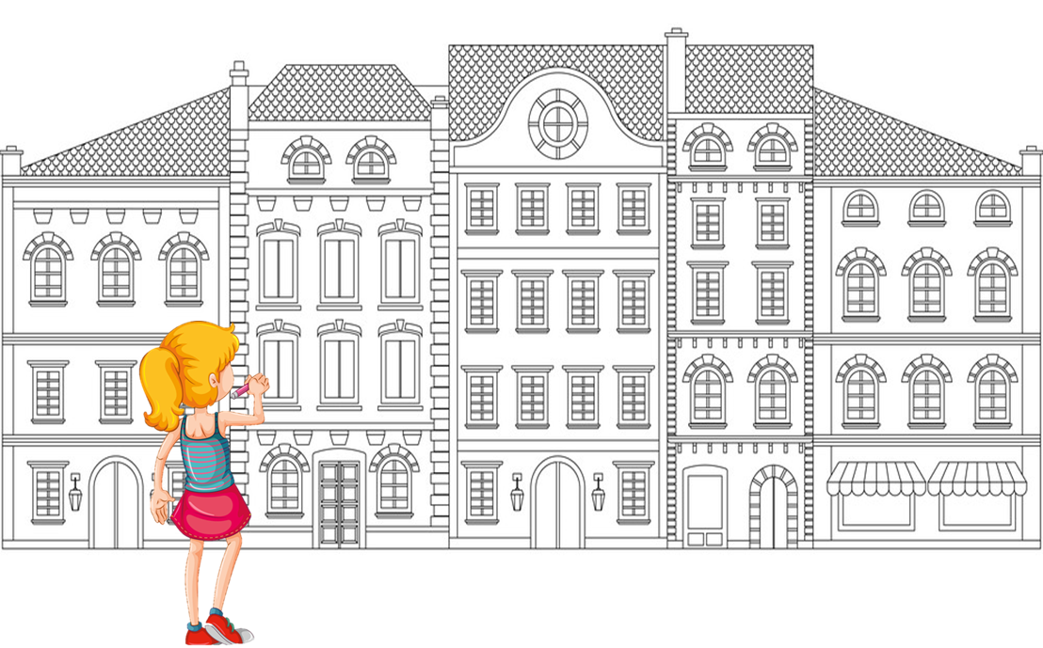
Vocabulary
design buildings
/dɪˈzaɪn ˈbɪldɪŋz/

Slide 6
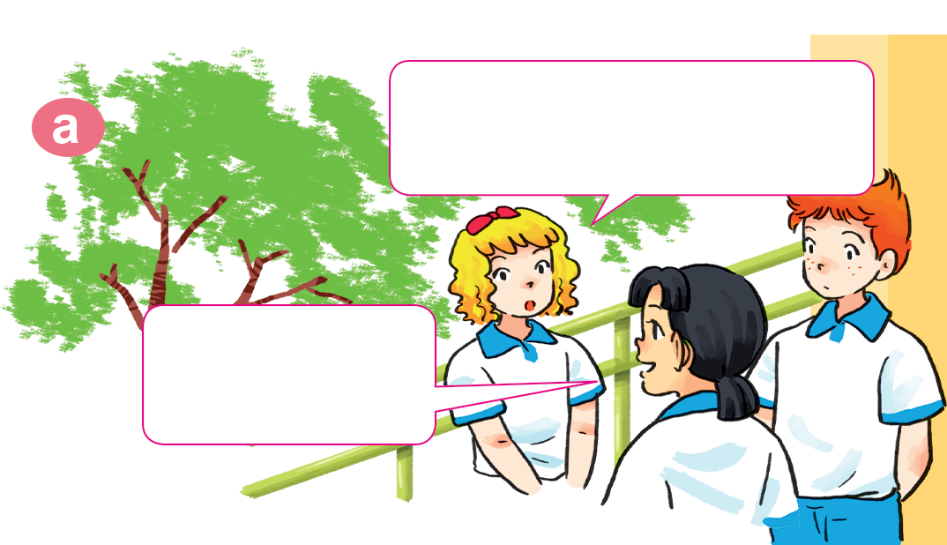
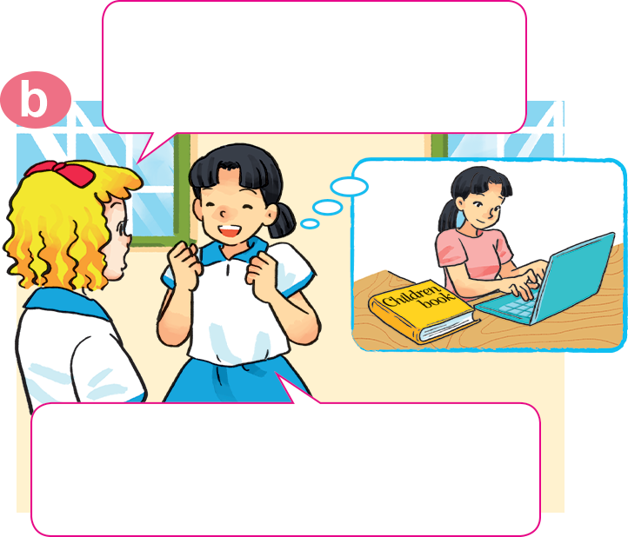

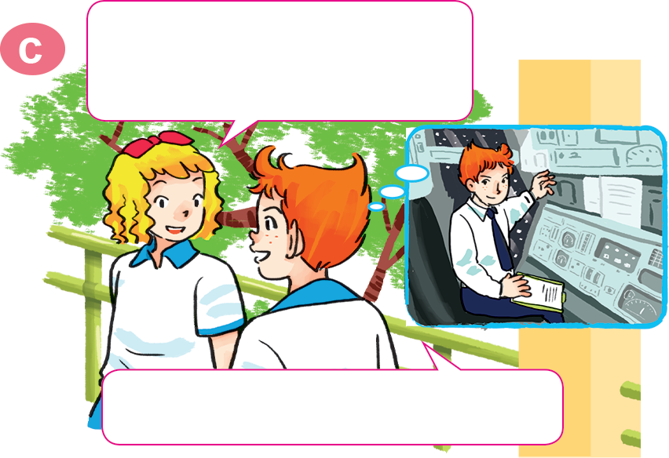
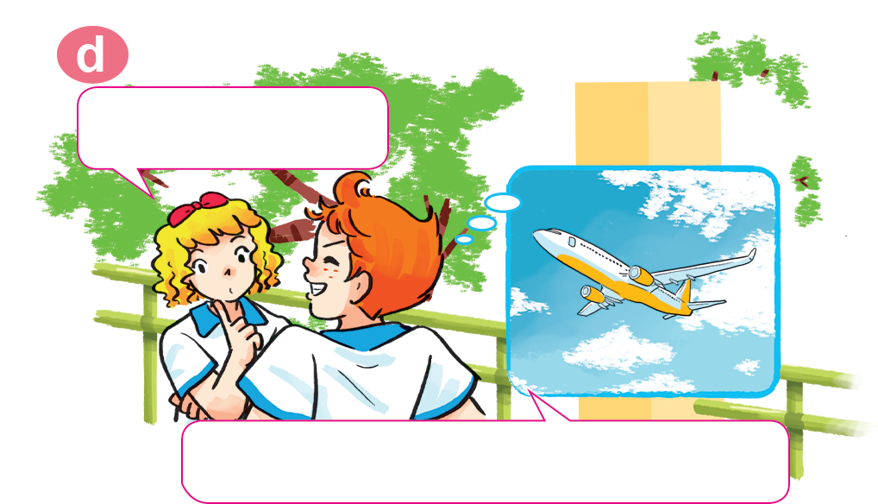
1. Look, listen and repeat
Why would you like to be a writer?
What would you like to be in the future, Mai?
I'd like to be a writer.
Because I'd like to write stories for children.
Would you like to be a writer too, Tony?
A pilot? Why?
No. I'd like to be a pilot.
Because I'd like to fly a plane.

Slide 7
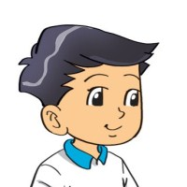

2. Point and say
a nurse
Why would you like to be _________?
Because I'd like to ________________.
look after patients

Slide 8
2. Point and say
a writer
Why would you like to be _________?
Because I'd like to _____________________.
write stories for children

Slide 9

2. Point and say
a pilot
Why would you like to be _________?
Because I'd like to ________________.
fly a plane

Slide 10
2. Point and say
Why would you like to be ___________?
an architect
Because I'd like to ________________.
design buildings

Slide 11
Why would you like to be _________?
Because I'd like to _____________.
look after patients
design buildings
write stories for children
fly a plane

Slide 12
3. Let’s talk

Slide 13
4. Listen and circle a, b or c
1. Trung would like to be ___________.
a. an engineer b. an artist c. an architect
2. Mai would like to be ___________.
a. a nurse b. a teacher c. a singer
3. Tony would like to ___________.
a. drive a car b. fly a plane c. work in a factory
4. Tom would like to ___________.
a. grow vegetables b. look after flowers
c. work on a farm

Slide 14
5. Read and complete.
A: What would you like to be in the future?
B: I'd like to be a (1) __________.
A: Why?
B: Because I'd like to (2) __________ patients.
A: Where would you like to work?
B: In a (3) __________ in the countryside.
A: What would you like to (4) _____ in your free time?
B: I'd like to (5) __________ comic stories.
nurse
look after
hospital
do
write

