Slide 1
Objectives
By the end of this lesson, students will be able to…
Vocabulary: Pronounce and use the words related to the topic properly: stop, do not enter, turn left, turn right, no parking.
Structure: What does that sign mean? - It means "Stop".

Slide 2

WARM UP

Slide 3

It’s time to learn …

Slide 4

New words
stop, do not enter, turn left,
turn right, no parking.

Slide 5

Presentation

Slide 6





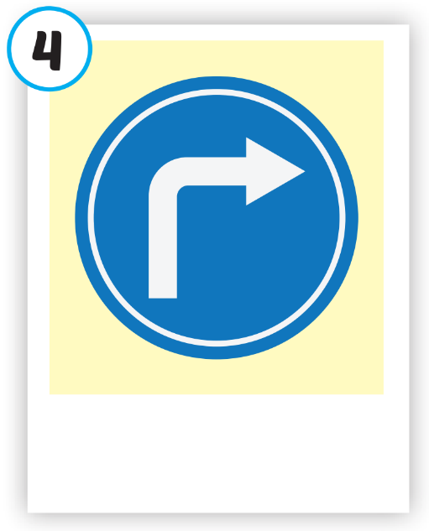






Click on each picture to hear the sound.
/stɑːp/
ngừng lại, dừng lại
/duː nɑːt ˈentər/
cấm vào
/tɜːrn left/
rẽ trái
/tɜːrn raɪt/
rẽ phải
/noʊ ˈpɑːrkɪŋ/
cấm đỗ xe

Slide 7

Click on each picture to hear the sound.
/stɑːp/
ngừng lại, dừng lại

Slide 8

Click on each picture to hear the sound.
/duː nɑːt ˈentər/
cấm vào

Slide 9

Click on each picture to hear the sound.
/tɜːrn left/
rẽ trái

Slide 10

Click on each picture to hear the sound.
/tɜːrn raɪt/
rẽ phải

Slide 11

Click on each picture to hear the sound.
/noʊ ˈpɑːrkɪŋ/
cấm đỗ xe

Slide 12
Practice

Slide 13
Check your memory

Slide 14



Look at the the line and say what disappears with the wind within the time limit (5 seconds)

Slide 15

What disappears?
TIME’S UP
stop

Slide 16




What disappears?
TIME’S UP
no parking

Slide 17




What disappears?
do not enter
TIME’S UP

Slide 18

What disappears?
turn left
TIME’S UP

Slide 19
What disappears?
turn right
TIME’S UP

Slide 20





What disappears?
a teddy bear
TIME’S UP

Slide 21

What disappears?
a train
TIME’S UP

Slide 22

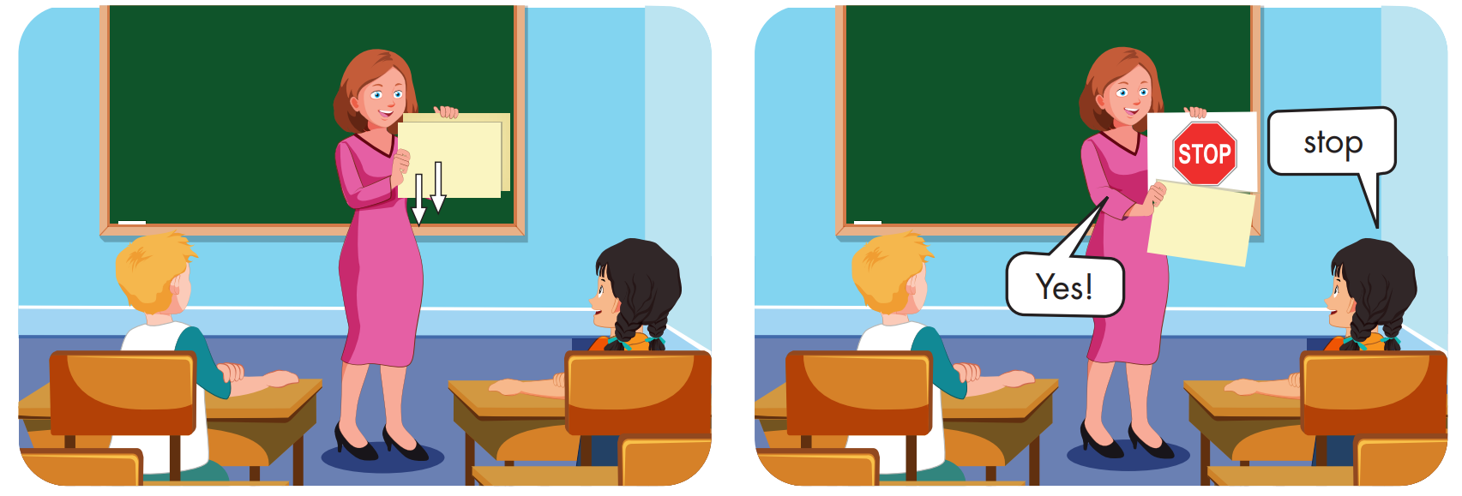

Slide 23
Structure
What does that sign mean?
It means "Stop".

Slide 24
Presentation

Slide 25


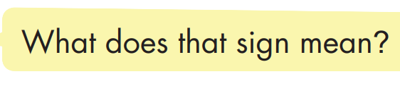
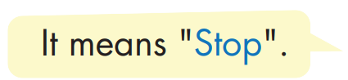

Structure

Slide 26

Practice

Slide 27


Slide 28

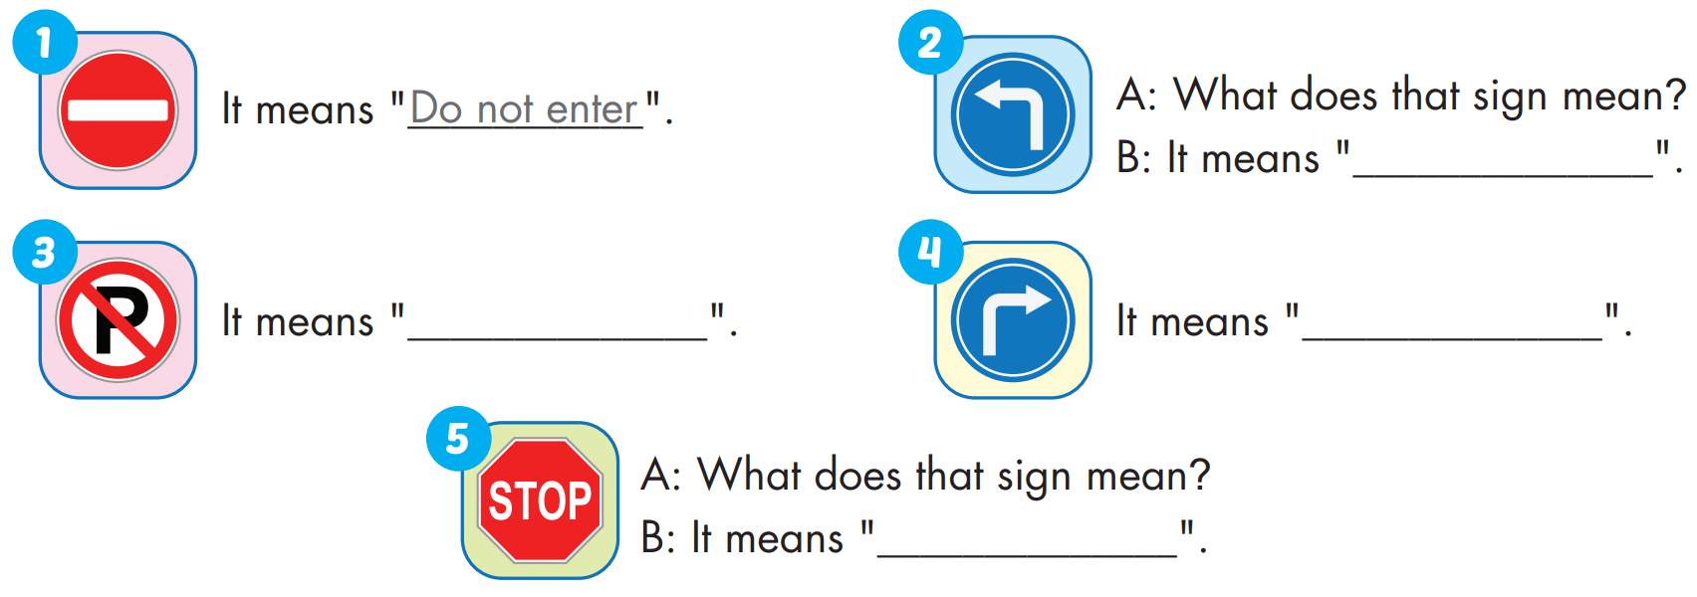
turn left
no parking
turn right
stop

Slide 29

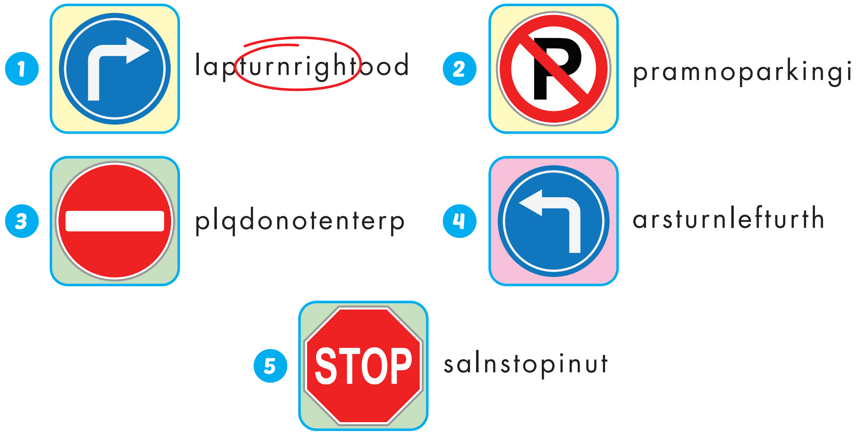

Extra Practice
WB, page 42

Slide 30

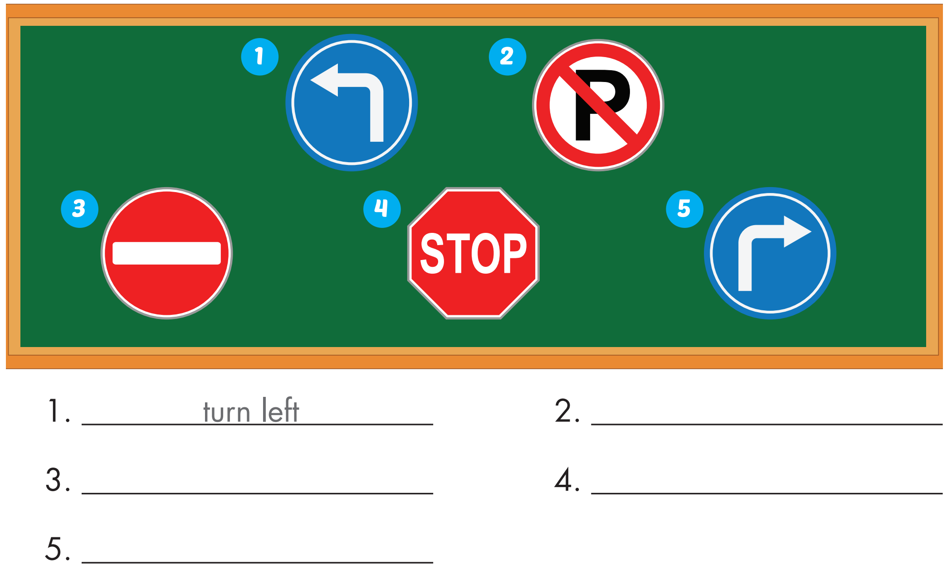
Extra Practice
WB, page 42
no parking
do not enter
stop
turn right

Slide 31

Production

Slide 32

CONSOLIDATION

Slide 33

WRAP-UP

Slide 34
Today’s lesson
Vocabularies
stop, do not enter, turn left, turn right, no parking.
Structures/ Sentence patterns
What does that sign mean?
- It means "Stop".

Slide 35
Homework
Practice the vocabularies and structure; and make sentences using them.
Do the exercises in Tiếng Anh 4 i-Learn Smart Start WB (page 42).
Do the exercises in Tiếng Anh 4 i-Learn Smart Start Notebook (page 28).
Prepare the next lesson (page 65 SB).
Play the consolidation games in Tiếng Anh 4 i-Learn Smart Start DHA App on www.eduhome.com.vn

Slide 36

Enjoy your day!

