Slide 1
Unit 11
What’s the matter with you?
Lesson 2

Slide 2
Vocabulary

Slide 3
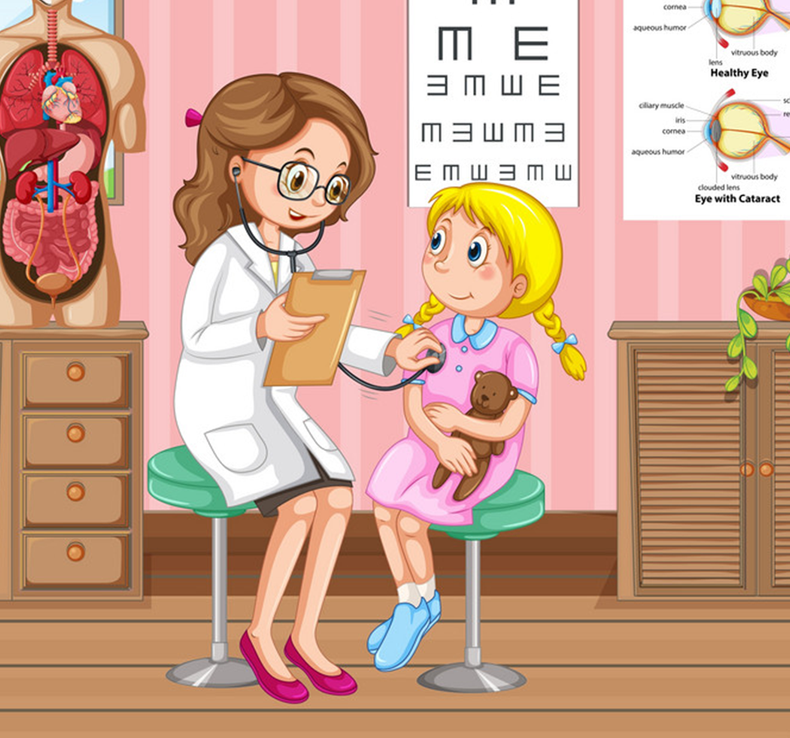
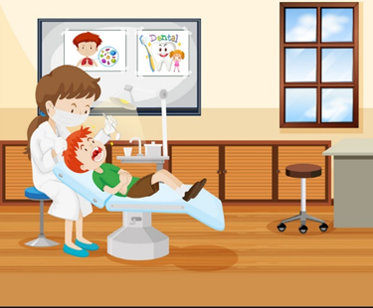

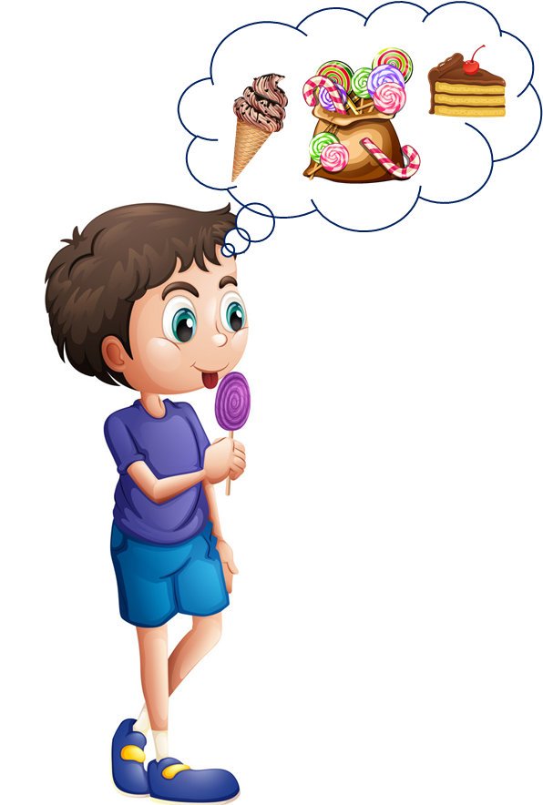
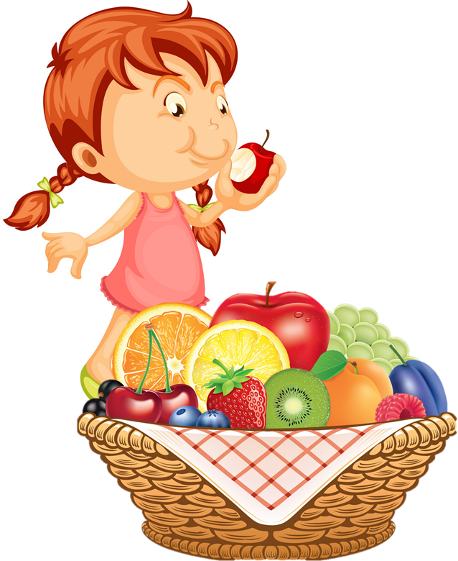
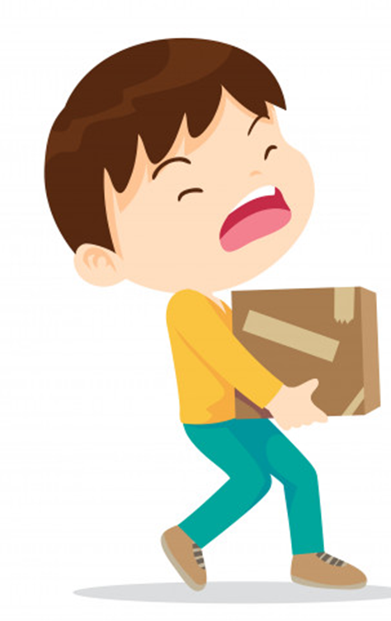
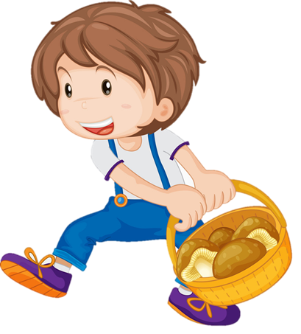
Review
1
2
3
go to the doctor
go to the dentist
take a rest
4
5
6
eat a lot of sweets
eat a lot of fruit
carry heavy things

Slide 4

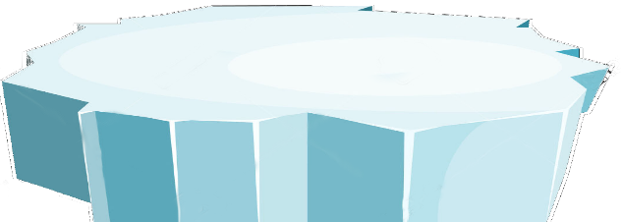




The little penguins
PLAY
Notes:
Ms Huyền Phạm - 0936.082.789 – YOUTUBE: MsPham. Facebook: Dạy và học cùng công nghệ.

Slide 5
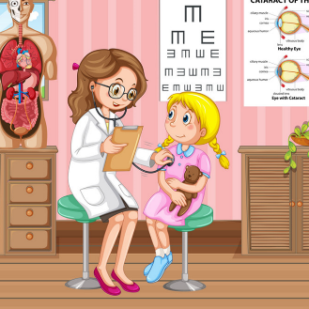
SURFING
NEXT
STOP
Go to the doctor
Notes:
Ms Huyền Phạm - 0936.082.789 – YOUTUBE: MsPham. Facebook: Dạy và học cùng công nghệ.

Slide 6
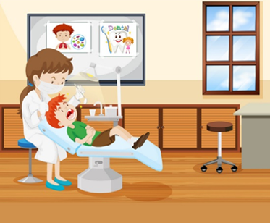
SURFING
NEXT
STOP
Go to the dentist
Notes:
Ms Huyền Phạm - 0936.082.789 – YOUTUBE: MsPham. Facebook: Dạy và học cùng công nghệ.

Slide 7
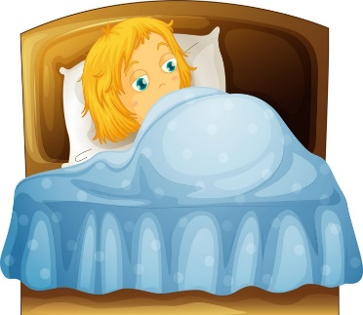
SURFING
NEXT
STOP
Take a
rest
Notes:
Ms Huyền Phạm - 0936.082.789 – YOUTUBE: MsPham. Facebook: Dạy và học cùng công nghệ.

Slide 8

SURFING
NEXT
STOP
Eat a lot
of fruit
Notes:
Ms Huyền Phạm - 0936.082.789 – YOUTUBE: MsPham. Facebook: Dạy và học cùng công nghệ.

Slide 9
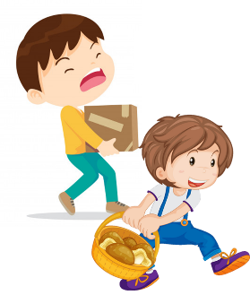
SURFING
NEXT
STOP
Carry
heavy things
Notes:
Ms Huyền Phạm - 0936.082.789 – YOUTUBE: MsPham. Facebook: Dạy và học cùng công nghệ.

Slide 10

SURFING
NEXT
STOP
Eat a lot
of sweet
Notes:
Ms Huyền Phạm - 0936.082.789 – YOUTUBE: MsPham. Facebook: Dạy và học cùng công nghệ.

Slide 11
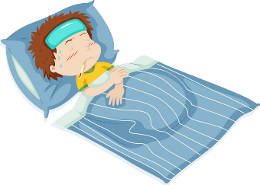
SURFING
NEXT
STOP
Flu
Notes:
Ms Huyền Phạm - 0936.082.789 – YOUTUBE: MsPham. Facebook: Dạy và học cùng công nghệ.

Slide 12
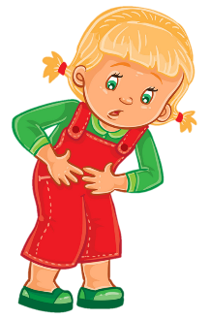
SURFING
NEXT
STOP
Stomach ache
Notes:
Ms Huyền Phạm - 0936.082.789 – YOUTUBE: MsPham. Facebook: Dạy và học cùng công nghệ.

Slide 13
SURFING
NEXT
STOP
Go to the doctor
Notes:
Ms Huyền Phạm - 0936.082.789 – YOUTUBE: MsPham. Facebook: Dạy và học cùng công nghệ.

Slide 14
SURFING
NEXT
STOP
Take a
rest
Notes:
Ms Huyền Phạm - 0936.082.789 – YOUTUBE: MsPham. Facebook: Dạy và học cùng công nghệ.

Slide 15
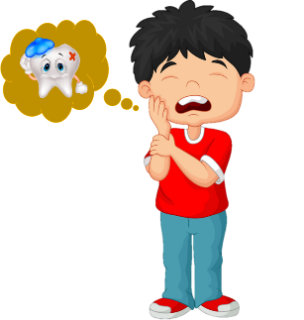
SURFING
NEXT
STOP
Toothache
Notes:
Ms Huyền Phạm - 0936.082.789 – YOUTUBE: MsPham. Facebook: Dạy và học cùng công nghệ.

Slide 16
SURFING
NEXT
STOP
Eat a lot
of fruit
Notes:
Ms Huyền Phạm - 0936.082.789 – YOUTUBE: MsPham. Facebook: Dạy và học cùng công nghệ.

Slide 17
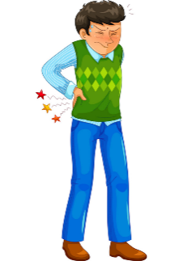
SURFING
NEXT
STOP
Backache
Notes:
Ms Huyền Phạm - 0936.082.789 – YOUTUBE: MsPham. Facebook: Dạy và học cùng công nghệ.

Slide 18
SURFING
NEXT
STOP
Eat a lot
of sweet
Notes:
Ms Huyền Phạm - 0936.082.789 – YOUTUBE: MsPham. Facebook: Dạy và học cùng công nghệ.

Slide 19
SURFING
NEXT
STOP
Go to the dentist
Notes:
Ms Huyền Phạm - 0936.082.789 – YOUTUBE: MsPham. Facebook: Dạy và học cùng công nghệ.

Slide 20
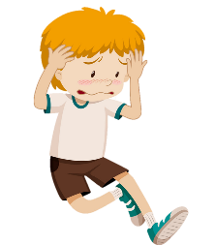
SURFING
NEXT
STOP
Headache
Notes:
Ms Huyền Phạm - 0936.082.789 – YOUTUBE: MsPham. Facebook: Dạy và học cùng công nghệ.

Slide 21
SURFING
NEXT
STOP
Carry
heavy things
Notes:
Ms Huyền Phạm - 0936.082.789 – YOUTUBE: MsPham. Facebook: Dạy và học cùng công nghệ.

Slide 22
Welldone!
EXIT
Notes:
Ms Huyền Phạm - 0936.082.789 – YOUTUBE: MsPham. Facebook: Dạy và học cùng công nghệ.

Slide 23
Grammar

Slide 24
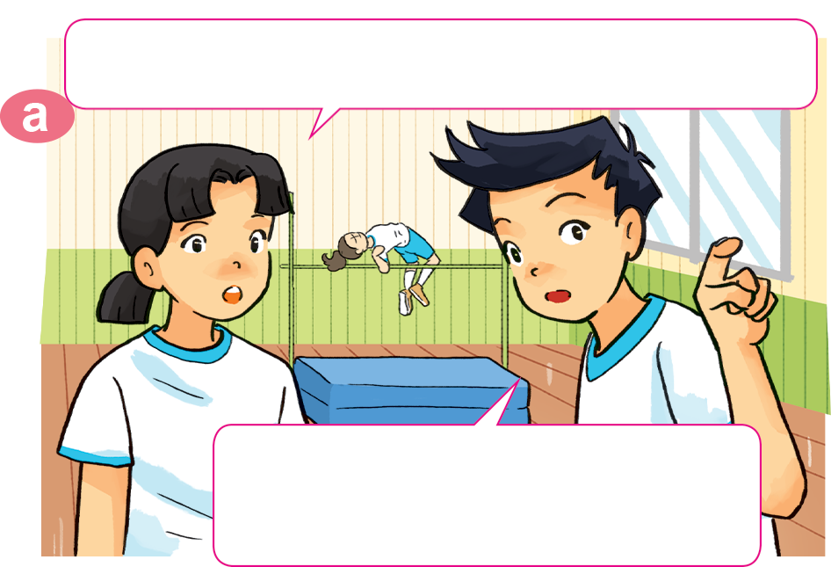
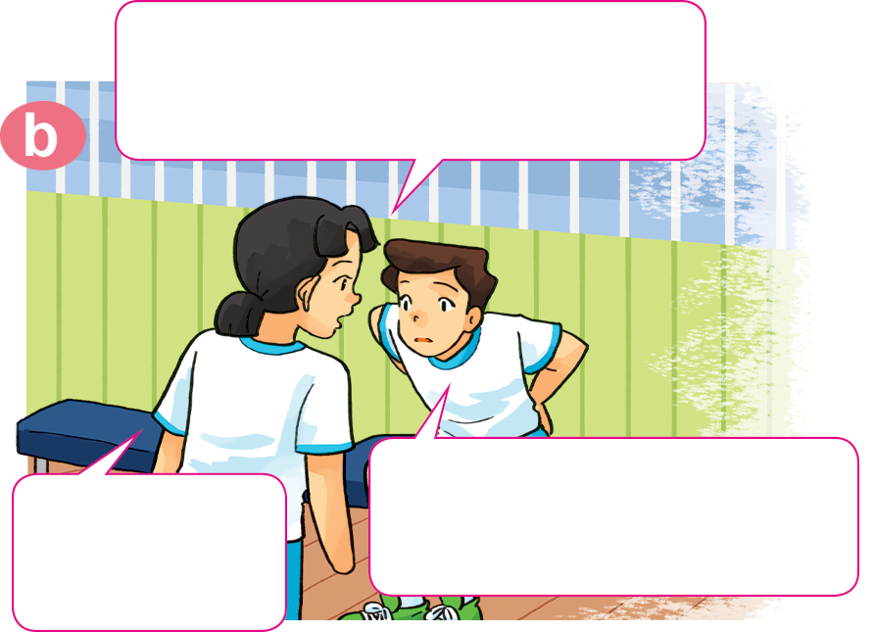

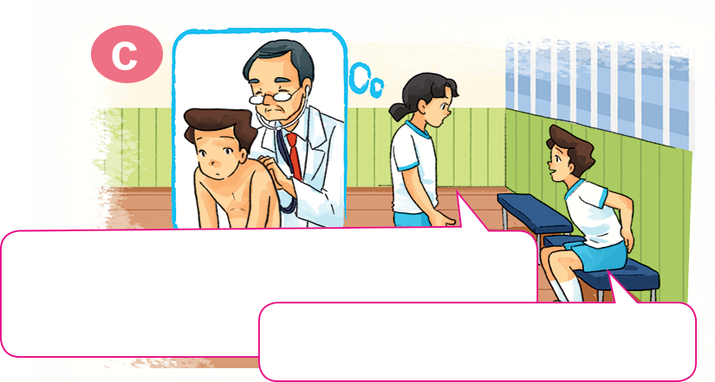
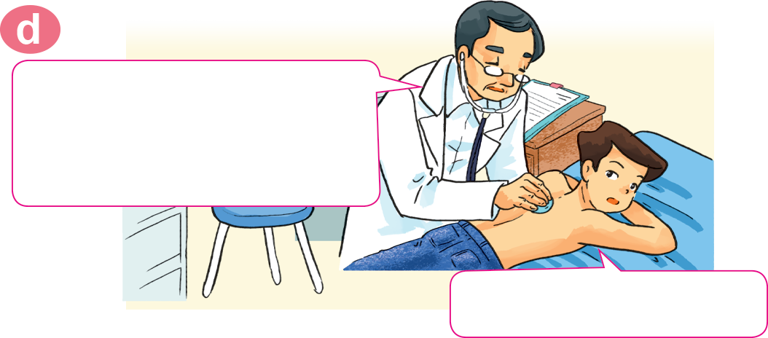
1. Look, listen and repeat.
Where's Nam? I can't see him here.
Hi, Nam. Why aren't you
practising karate?
I don't feel well. I have a backache.
He's sitting over there,
in the corner of the gym.
Sorry to
hear that.
You should take a rest and shouldn't play
sports for a few days.
You should go to the doctor
now, Nam.
OK, I will. Thanks, Mai.
Thank you, doctor.

Slide 25
2. Point and say.
eat a lot of fruit
You should __________________.
Yes, I will. Thanks.

Slide 26
2. Point and say.
go to the doctor
You should __________________.
Yes, I will. Thanks.

Slide 27
2. Point and say.
take a rest
You should __________________.
Yes, I will. Thanks.

Slide 28
2. Point and say.
go to the dentist
You should __________________.
Yes, I will. Thanks.

Slide 29
2. Point and say.
You shouldn’t ____________________.
eat a lot of sweets
Ok, I won’t. Thanks.

Slide 30
2. Point and say.
carry heavy things
You shouldn’t ____________________.
Ok, I won’t. Thanks.

Slide 31
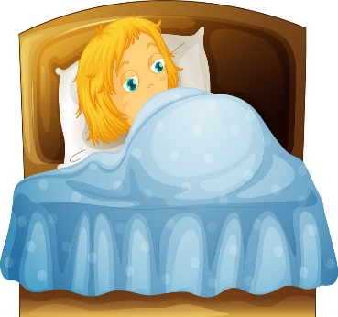
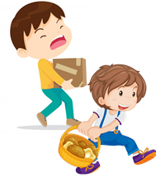
Temperature
/ˈtemprətʃər/
Model sentence
You should/shouldn’t _____________.
Yes, I will. Thanks.
OK, I won't. Thanks
go to the
doctor
take a rest
carry
heavy things
eat a lot of
sweets
go to the
dentist
eat a lot
of fruit
Earache
/ˈɪəreɪk/

Slide 32




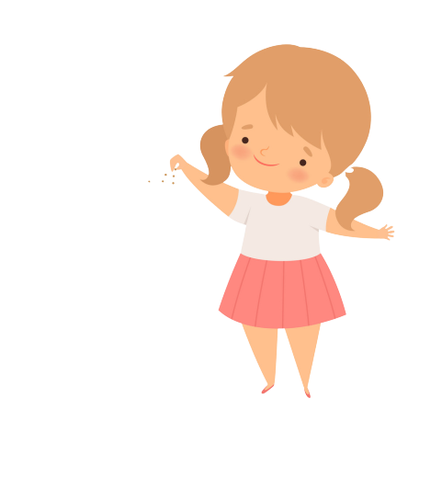

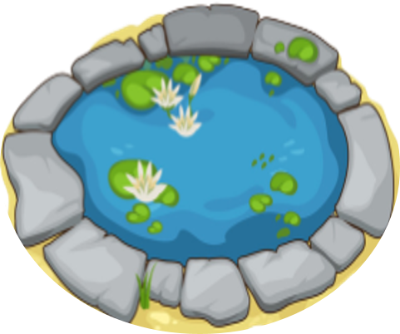

Bống bống bang bang
Mỗi câu trả lời đúng là
CÂU THẦN CHÚ giúp cá Vàng
ngoi lên mặt nước nhận thức ăn.
Nào chúng mình cùng giúp
bạn nhỏ cho cá Vàng ăn nhé!
START

Slide 33


I have a toothache.
You _____ go to the dentist.
Next
Should
Shouldn’t
Sai
Notes:
YOUTUBE: MsPham.
Facebook: Dạy và học cùng công nghệ.

Slide 34
I have a backacke.
You _____ carry heavy things.
Next
Should
Shouldn’t
Sai

Slide 35
I have a toothache.
You _____ eat a lot of sweet.
Next
Should
Shouldn’t
Sai

Slide 36
I have a stomch ache.
You _____ go to the doctor.
Next
Should
Shouldn’t
Sai
Notes:
YOUTUBE: MsPham.
Facebook: Dạy và học cùng công nghệ.

Slide 37
I have a stomach ache.
You _____ eat a lot of sweet.
Next
Should
Shouldn’t
Sai

Slide 38
I have a fever.
You _____ go to school.
Next
Should
Shouldn’t
Sai
Notes:
YOUTUBE: MsPham.
Facebook: Dạy và học cùng công nghệ.

Slide 39
I have a flu.
You _____ take a rest.
Next
Should
Shouldn’t
Sai
Notes:
YOUTUBE: MsPham.
Facebook: Dạy và học cùng công nghệ.

Slide 40
Next
I have a flu.
You should
go to school
You should
take a rest
You should
go to the dentist
Notes:
YOUTUBE: MsPham.
Facebook: Dạy và học cùng công nghệ.

Slide 41
Next
I have a sore throat.
You should carry heavy things.
You shouldn’t
take a rest
You should
take a rest
Notes:
YOUTUBE: MsPham.
Facebook: Dạy và học cùng công nghệ.

Slide 42
Next
I have a backache.
You shouldn’t
carry heavy things.
You should
carry heavy things.
You shouldn’t
take a rest
Notes:
YOUTUBE: MsPham.
Facebook: Dạy và học cùng công nghệ.

Slide 43
Next
I have a toothache.
You shouldn’t
eat a lot of fruit.
You shouldn’t eat
a lot of sweet.
You should eat
a lot of sweet.
Notes:
YOUTUBE: MsPham.
Facebook: Dạy và học cùng công nghệ.

Slide 44
Next
You should
eat a lot of fruit.
I have an apple.
I have a pen.
I have a flu.
Notes:
YOUTUBE: MsPham.
Facebook: Dạy và học cùng công nghệ.

Slide 45
THANK YOU!
Next
Notes:
YOUTUBE: MsPham.
Facebook: Dạy và học cùng công nghệ.

Slide 46

4. Listen and complete.
 | Health problem | Should | Shouldn't
1. Quan
2. Tony
3. Phong
4. Mrs Green
go to
the doctor
stomach ache
fever
go to school
toothache
eat ice cream
carry
heavy things
backache

Slide 47
5. Read and complete.
Quan: Where's Phong?
Mai: He can't go to school today.
Quan: Why not? What's the (1) _________ with him?
Mai: He (2) _______ a bad cough and is going to see the (3) __________ this morning.
Quan: Oh, really? Poor him!
Mai: What's the matter with you, Tony?
Tony: I have a pain in my (4) __________ .
Mai: Oh, dear. You should take a (5) ______ now and go to the doctor later.
Tony: Yes, I will. Thanks, Mai.
stomach
doctor
matter
rest
has
matter
has
doctor
stomach
rest

