Slide 1

Unit 4: Travel
Lesson 2.2
Page 52

Slide 2
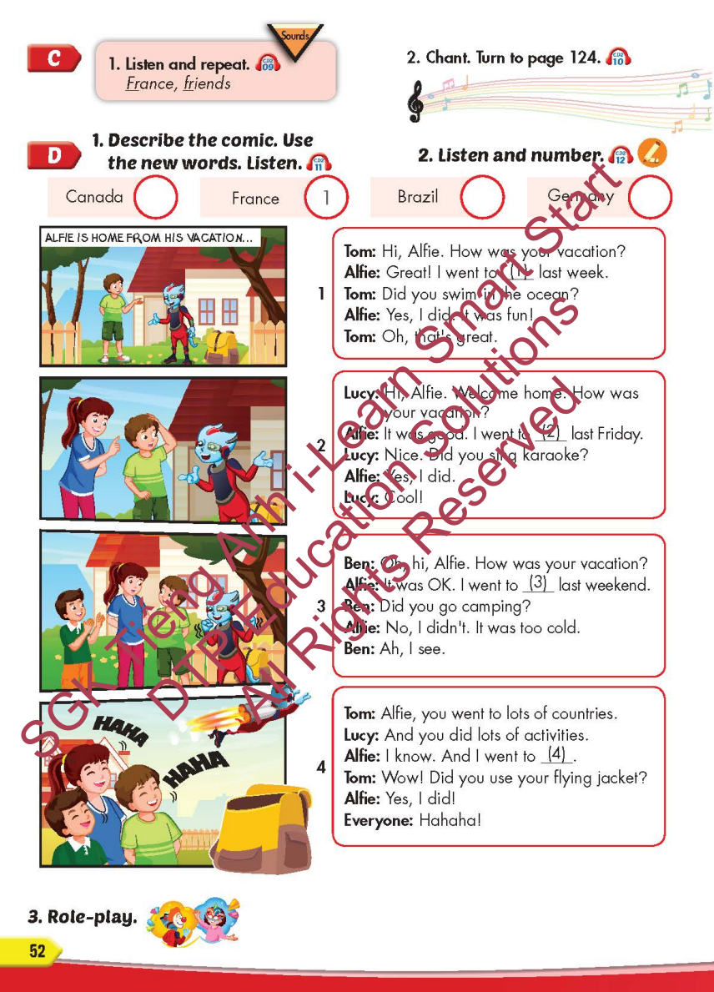
Lesson Outline
Warm-up
Listening
Consolidation
Wrap-up

Slide 3
Objectives
By the end of this lesson, students will be able to…
Sound: France, friends
Structure: I went to South Korea last month.
- Did you sing karaoke?
- Yes, I did./No, I didn't.

Slide 4

WARM-UP

Slide 5

It’s time to learn …

Slide 6

Sound
France, friends

Slide 7

Listening

Slide 8


Fr Fr France
fr fr friends

Slide 9
Practice

Slide 10



Slide 11
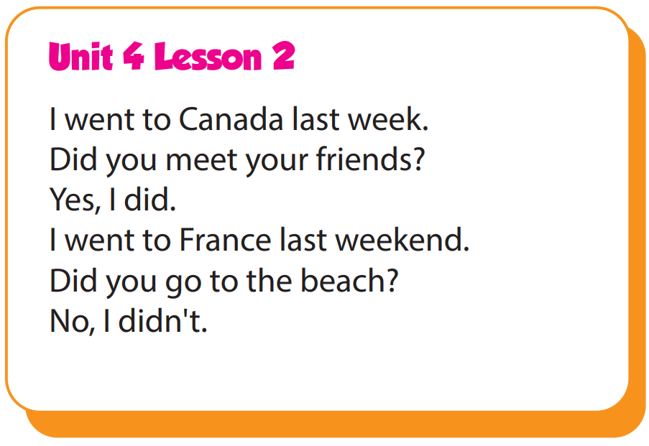

Slide 12
Structure
I went to South Korea last month.
- Did you sing karaoke?
- Yes, I did./No, I didn't.

Slide 13

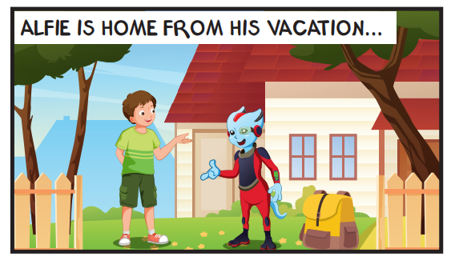
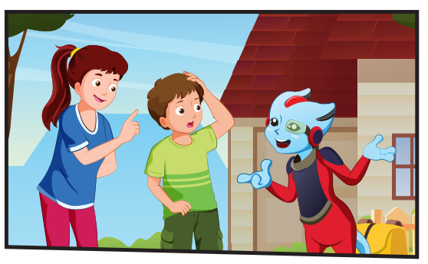
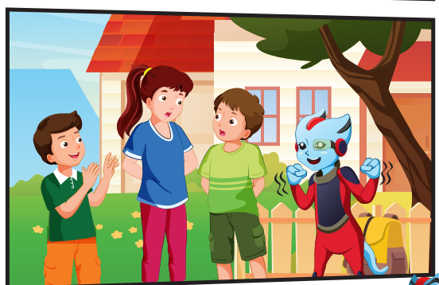
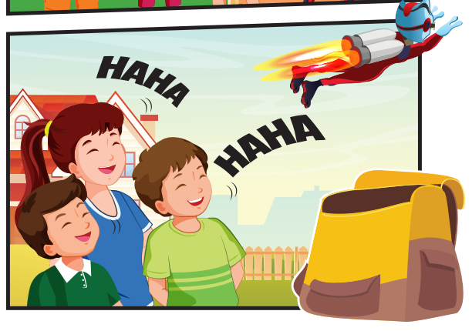

Slide 14

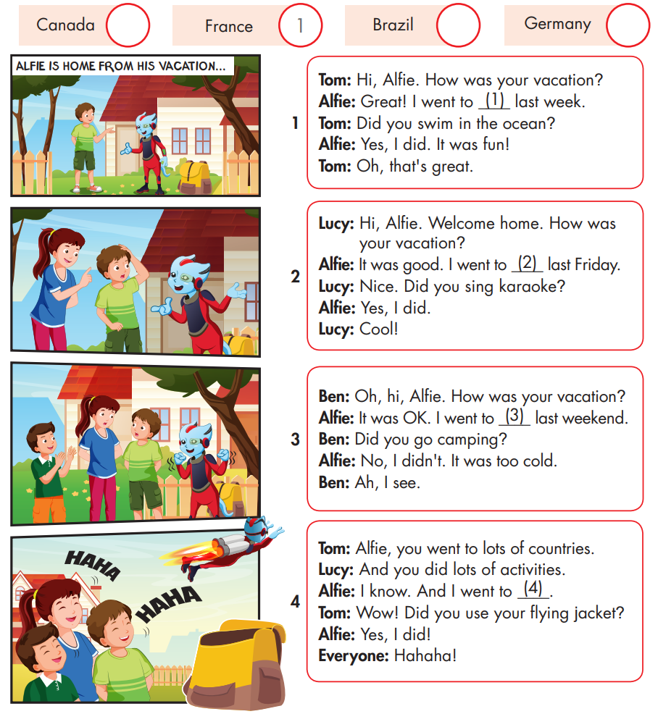

Slide 15



Slide 16

Writing

Slide 17
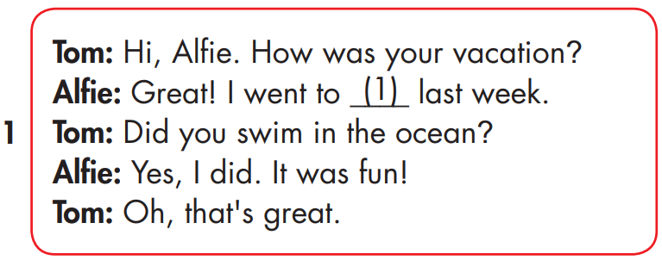
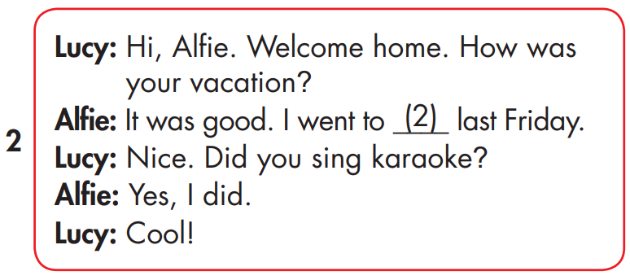
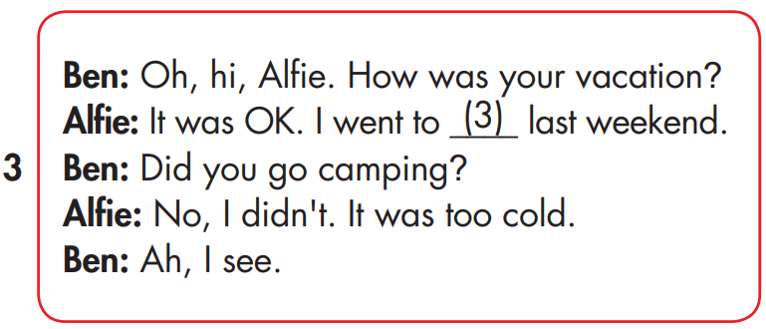
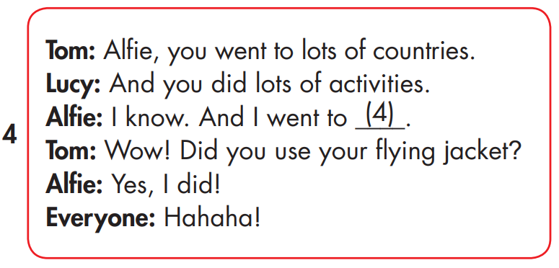
MAKE YOUR OWN STORY
France
Germany
Brazil
Canada

Slide 18

Production

Slide 19

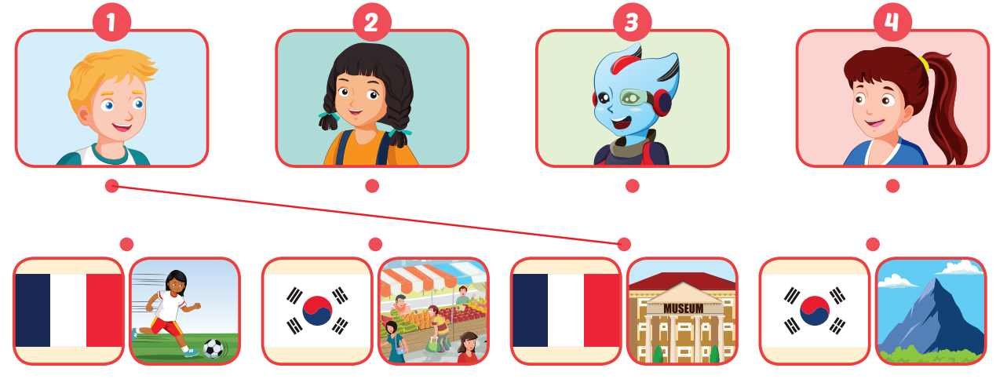
Extra Practice
WB, page 35

Slide 20

CONSOLIDATION

Slide 21

WRAP-UP

Slide 22
Today’s lesson
Structures/ Sentence patterns
I went to South Korea last month.
- Did you sing karaoke?
- Yes, I did./No, I didn't.
Sound
Sound: France, friends

Slide 23
Homework
Practice the vocabularies and structure, and make sentences using them.
Do the exercises in Tiếng Anh 5 i-Learn Smart Start WB (page 35)
Do the exercises in Tiếng Anh 5 i-Learn Smart Start Notebook (page 23)
Prepare the next lesson (page 53 SB)
Play the consolidation games in Tiếng Anh 5 i-Learn Smart Start DHA App on www.eduhome.com.vn

