Slide 1

Unit 4: Travel
Lesson 2.1
Page 51

Slide 2
Objectives
By the end of this lesson, students will be able to…
Vocabulary: Pronounce and use the words related to the topic properly: Canada, France, South Korea, Brazil, Germany, Spain
Structure: I went to South Korea last month.
- Did you sing karaoke?
- Yes, I did./No, I didn't.

Slide 3

WARM-UP

Slide 4
GUESS THE NAME
OF THE COUNTRY

Slide 5

New words
Canada, France, South Korea,
Brazil, Germany, Spain

Slide 6

Presentation

Slide 7


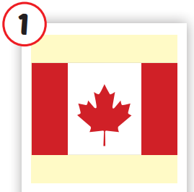
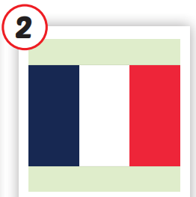
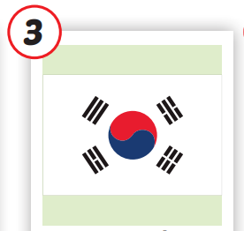
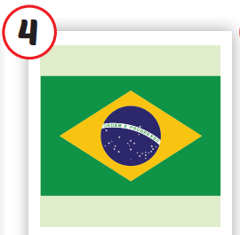
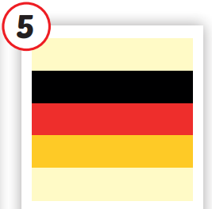
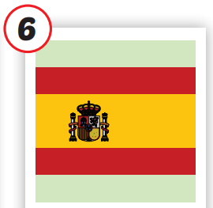







/ˈkænədə/
nước Canada
/fræns/
nước Pháp
/ˌsaʊθ kəˈriːə/
nước Hàn Quốc
/brəˈzɪl/
nước Brazil
/ˈdʒəːrməni/
nước Đức
/speɪn/
nước Tây Ban Nha
Notes:
Click vào hình A. 1. Listen and point. Repeat để cho cả audio full chạy

Slide 8
Practice

Slide 9
Check your memory

Slide 10
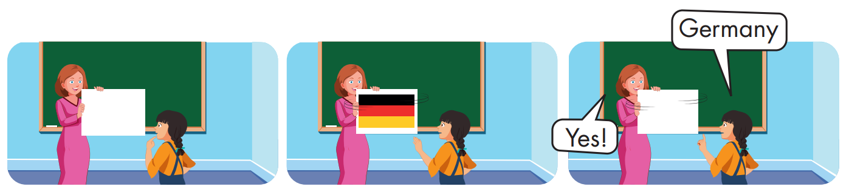

Slide 11
Structure
I went to South Korea last month.
- Did you sing karaoke?
- Yes, I did./No, I didn't.

Slide 12
Presentation

Slide 13
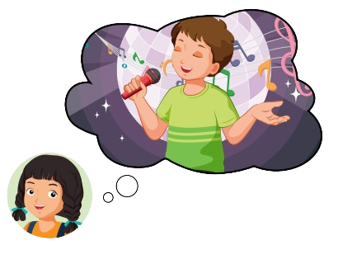




Structure

Slide 14

Practice

Slide 15


Slide 16

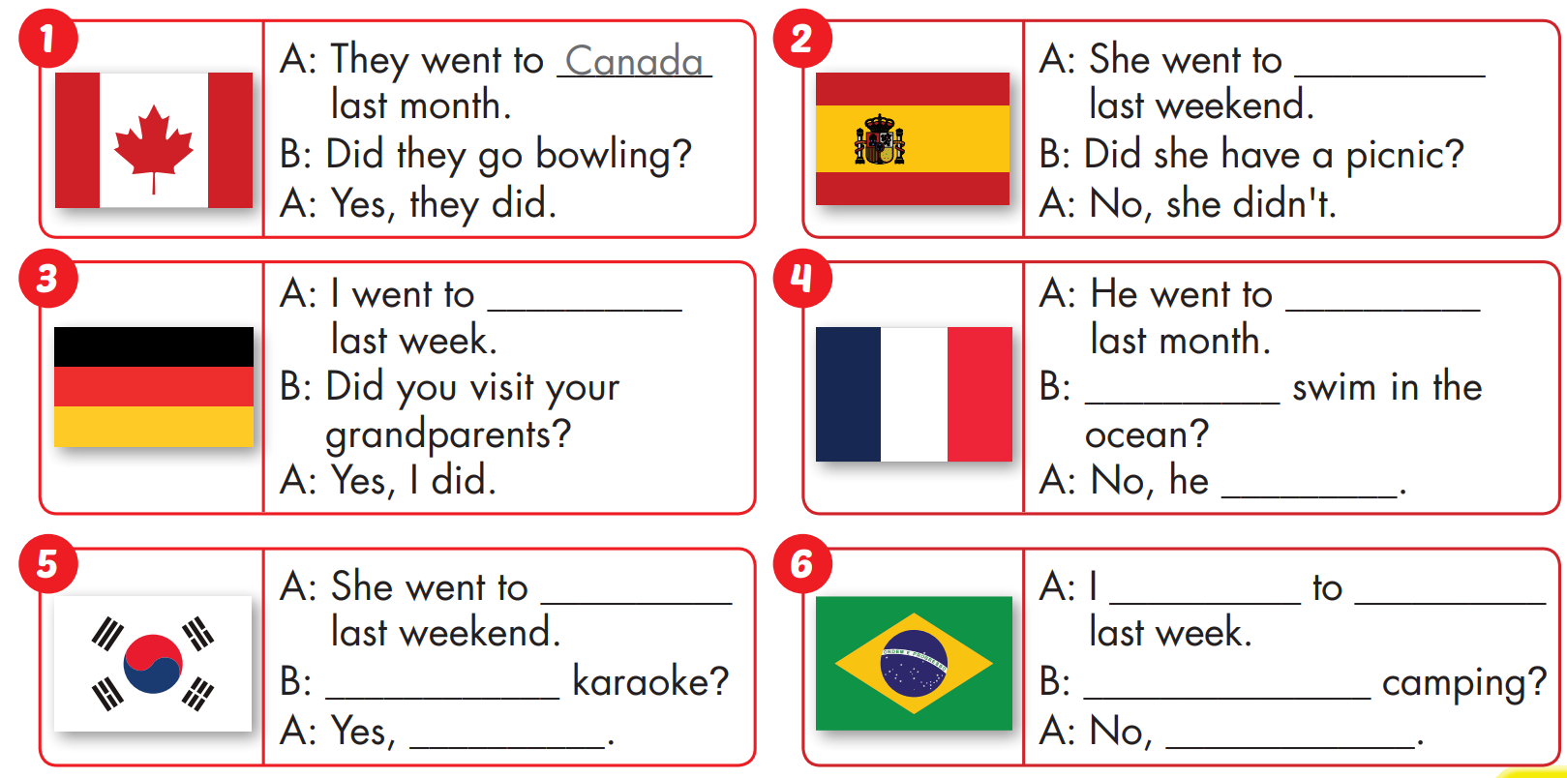
Spain
Germany
France
Did he
didn't
South
Korea
went
Brazil
Did she sing
Did you go
She did
I didn't

Slide 17

Production

Slide 18

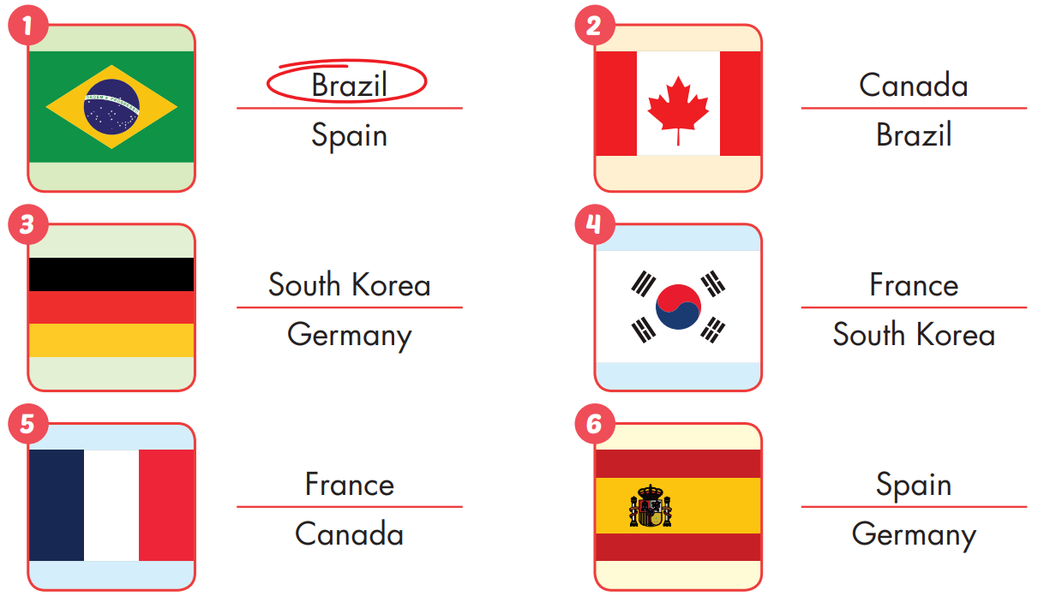

Extra Practice
WB, page 34

Slide 19

CONSOLIDATION

Slide 20

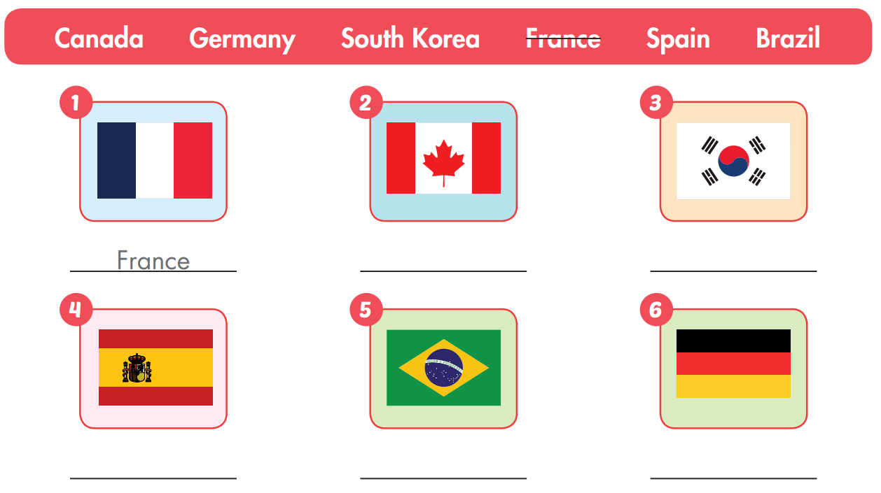
Extra Practice
WB, page 34
Canada
South Korea
Brazil
Germany
Spain

Slide 21

WRAP-UP

Slide 22
Today’s lesson
Vocabularies
Canada, France, South Korea, Brazil, Germany, Spain
Structures/ Sentence patterns
I went to South Korea last month.
- Did you sing karaoke?
- Yes, I did./No, I didn't.

Slide 23
Homework
Practice the vocabularies and structure, and make sentences using them.
Do the exercises in Tiếng Anh 5 i-Learn Smart Start WB (page 34)
Do the exercises in Tiếng Anh 5 i-Learn Smart Start Notebook (page 23)
Prepare the next lesson (page 52 SB)
Play the consolidation games in Tiếng Anh 5 i-Learn Smart Start DHA App on www.eduhome.com.vn

