Slide 1

Unit 4: Travel
Lesson 1.3
Page 50

Slide 2
Objectives
By the end of this lesson, students will be able to…
Vocabulary: Pronounce and use the words related to the topic properly: mountain, lake, river, beach, ocean, forestYear (Tết), Christmas, Teachers' Day, Children's Day.
Structure: I didn't go to the river. I went to the beach.

Slide 3

WARM-UP

Slide 4

It’s time to learn …

Slide 5

Practice

Slide 6

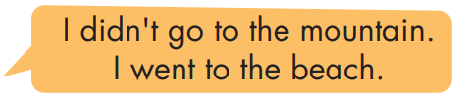
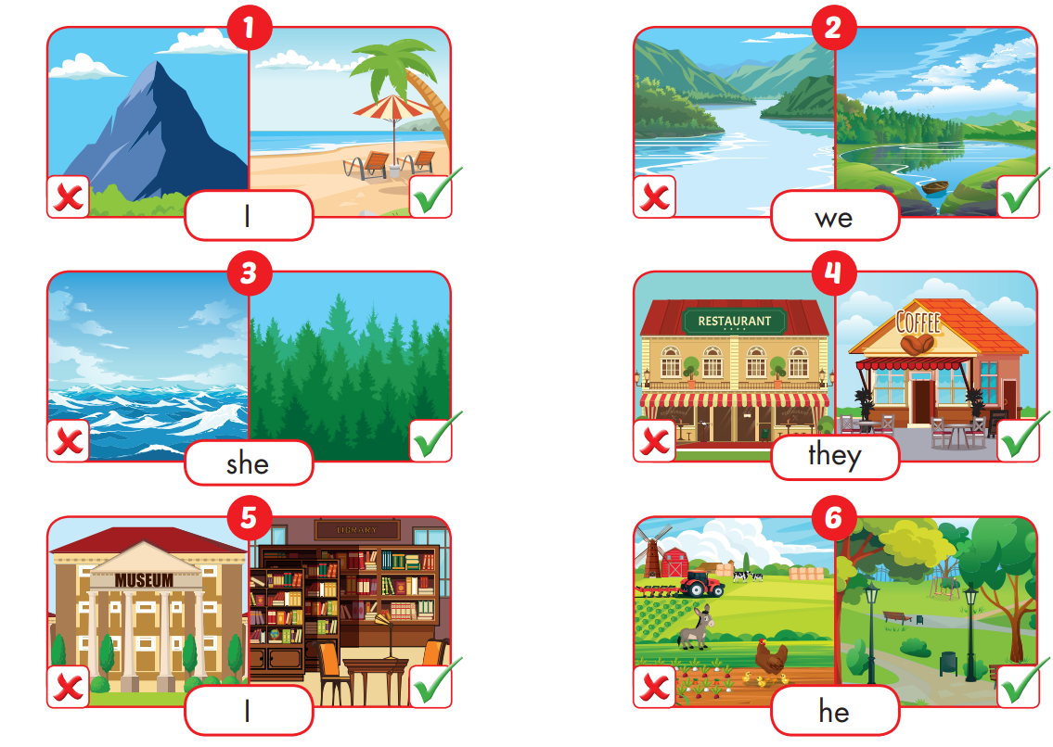

Slide 7

Production

Slide 8

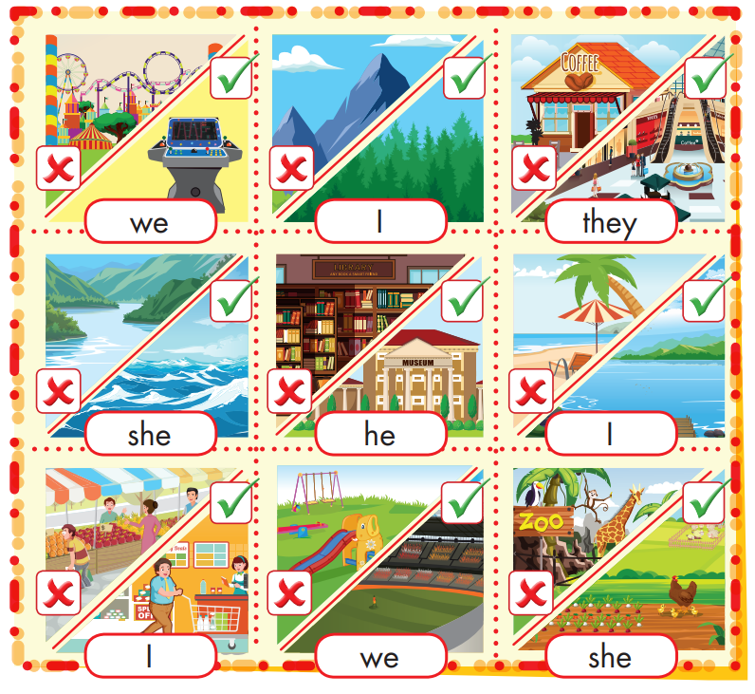
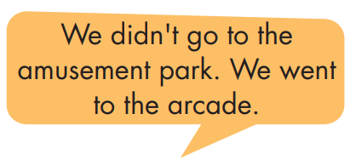
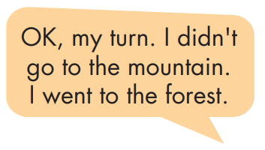

Slide 9

CONSOLIDATION

Slide 10


CHECK YOUR MEMORY

Slide 11


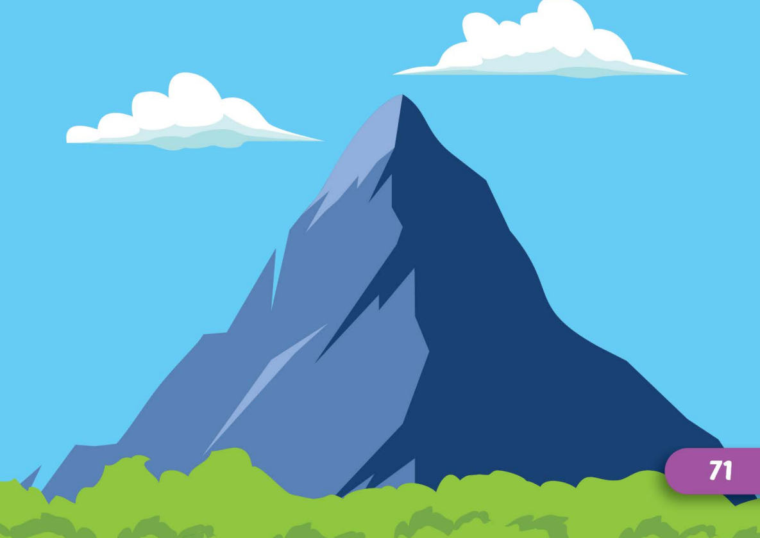
mountain
Click here to guess what vehicle behind.

Slide 12
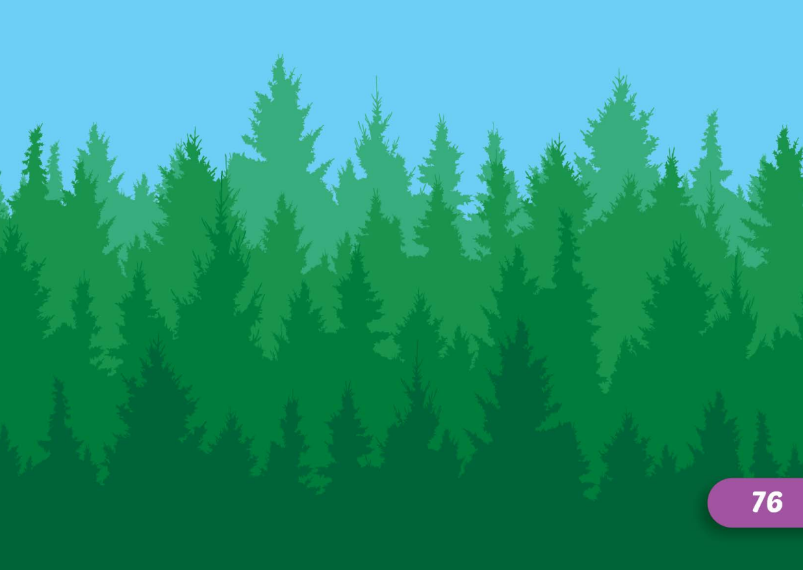
forest
Click here to guess what vehicle behind.

Slide 13
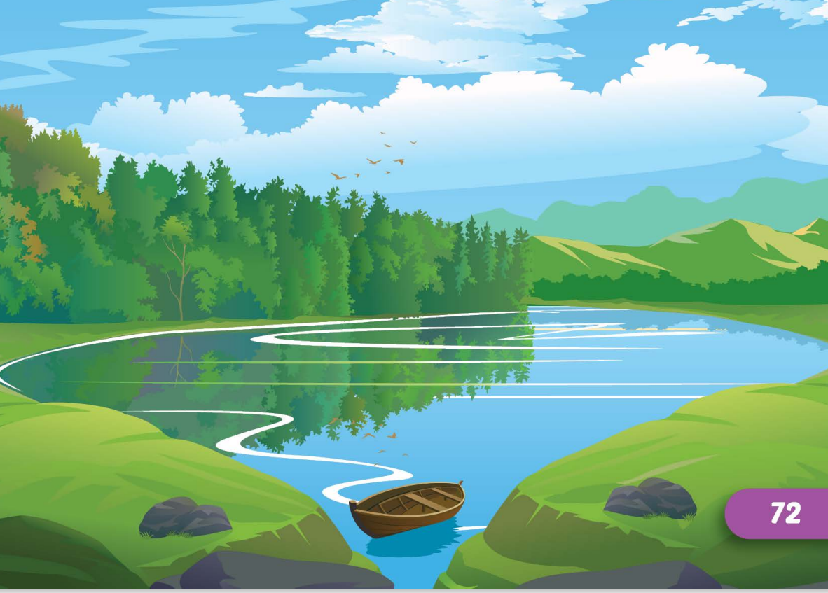
lake
Click here to guess what vehicle behind.

Slide 14
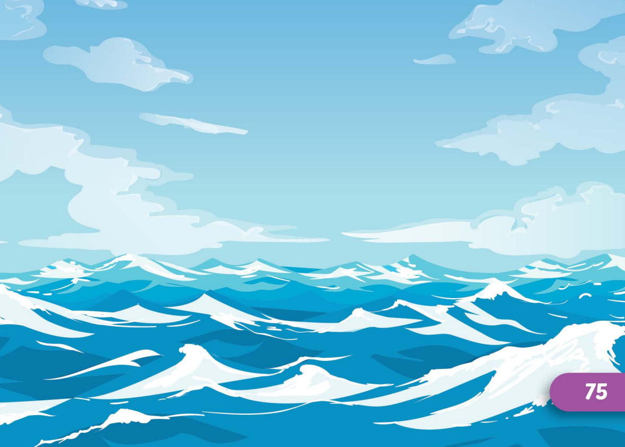
ocean
Click here to guess what vehicle behind.

Slide 15
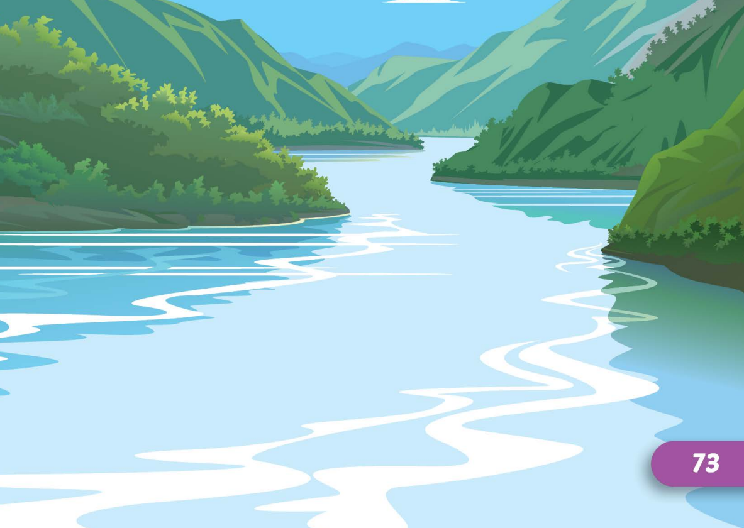
river
Click here to guess what vehicle behind.

Slide 16
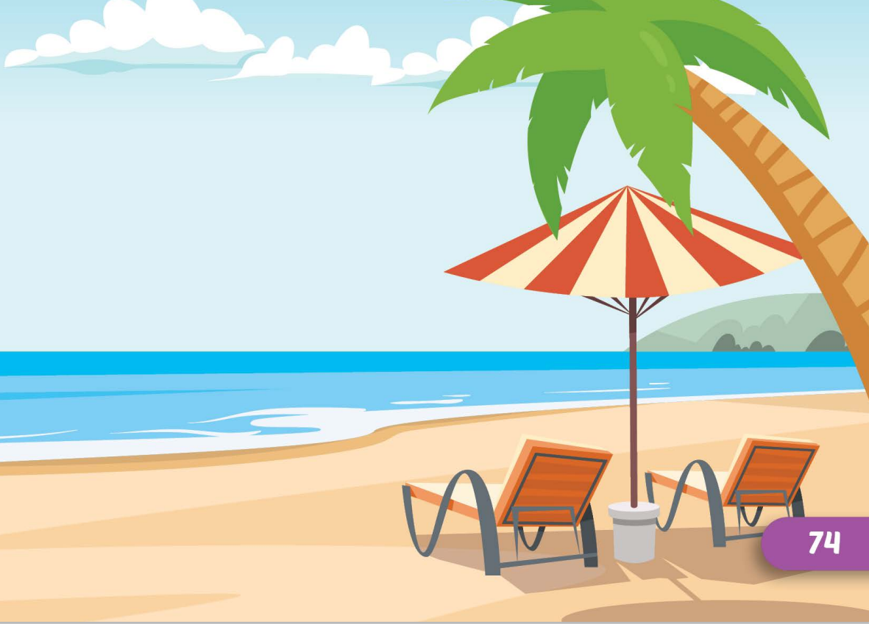
beach
Click here to guess what vehicle behind.

Slide 17

WRAP-UP

Slide 18
Today’s lesson
Vocabularies
mountain, lake, river, beach, ocean, forest
Structures/ Sentence patterns
I didn't go to the river.
I went to the beach.

Slide 19
Homework
Practice the vocabularies and structure, and make sentences using them.
Do the exercises in Tiếng Anh 5 i-Learn Smart Start WB (page 33)
Do the exercises in Tiếng Anh 5 i-Learn Smart Start Notebook (page 22)
Prepare the next lesson (page 51 SB)
Play the consolidation games in Tiếng Anh 5 i-Learn Smart Start DHA App on www.eduhome.com.vn

