Slide 1

Unit 4: Travel
Lesson 1.2
Page 49

Slide 2
Objectives
By the end of this lesson, students will be able to…
Itonation: Falling intonation.
Structure: I didn't go to the river. I went to the beach.

Slide 3

WARM-UP

Slide 4
CHECK YOUR MEMORY

Slide 5
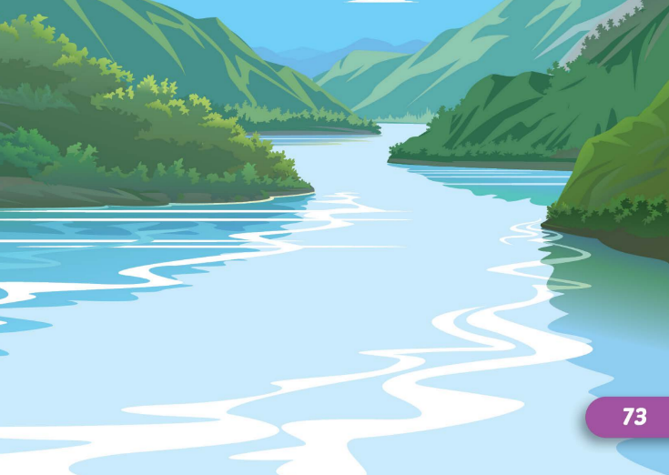

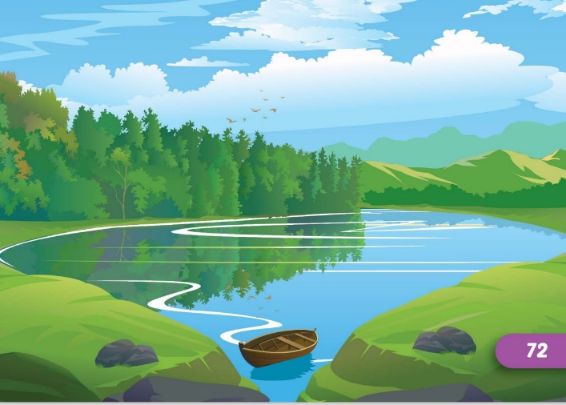
Look and say which is missing?
START
CHECK

Slide 6


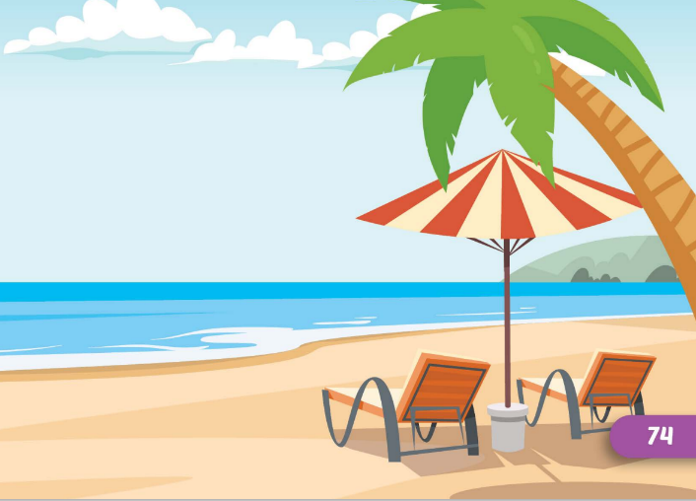
Look and say which is missing?
START
CHECK

Slide 7


Look and say which is missing?
START
CHECK

Slide 8


Look and say which is missing?
START
CHECK

Slide 9



Look and say which is missing?
START
CHECK

Slide 10
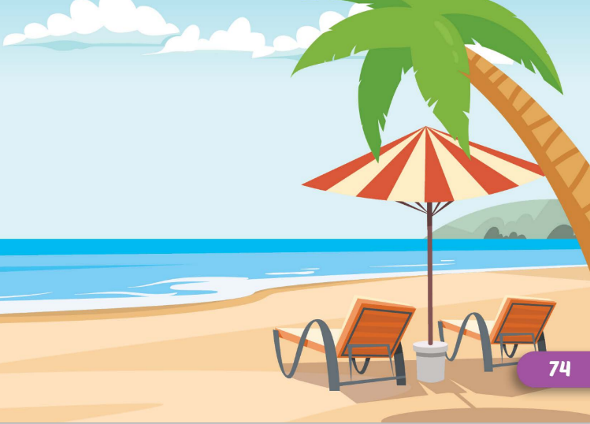


Look and say which is missing?
START
CHECK

Slide 11

It’s time to learn …

Slide 12

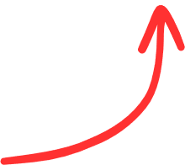
Intonation
Falling intonation

Slide 13

Listening

Slide 14
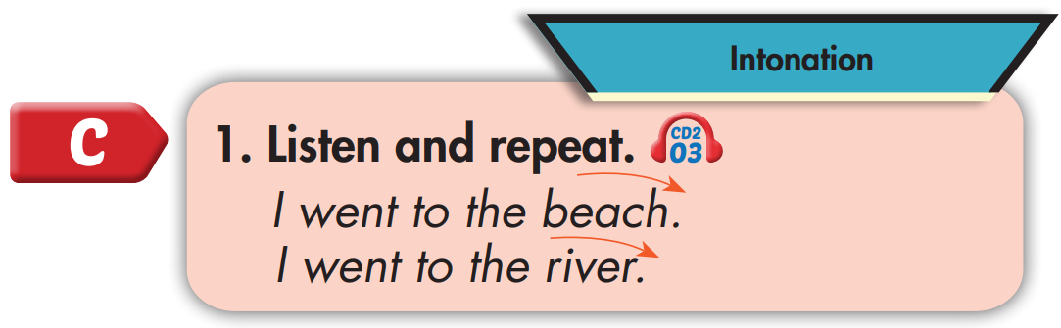

I went to the beach.
I went to the river.

Slide 15
Practice

Slide 16



Slide 17
Structure
I didn't go to the river.
I went to the beach.

Slide 18

Listening

Slide 19

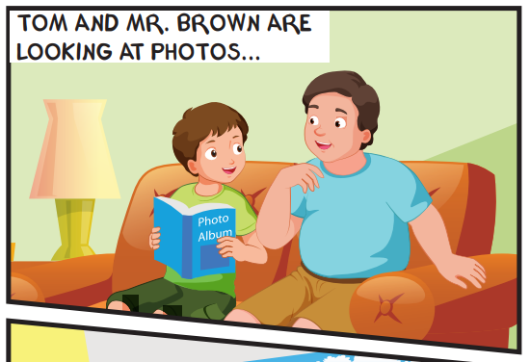
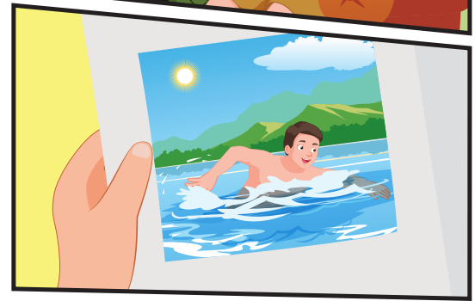
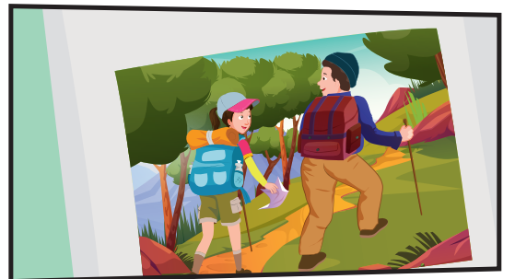
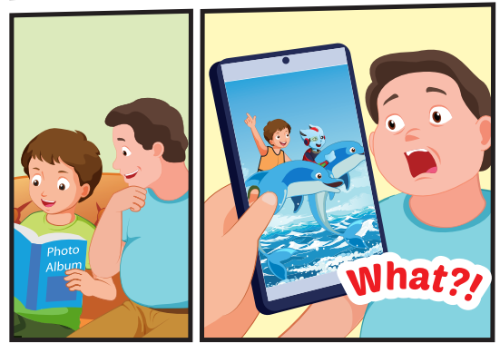

Slide 20

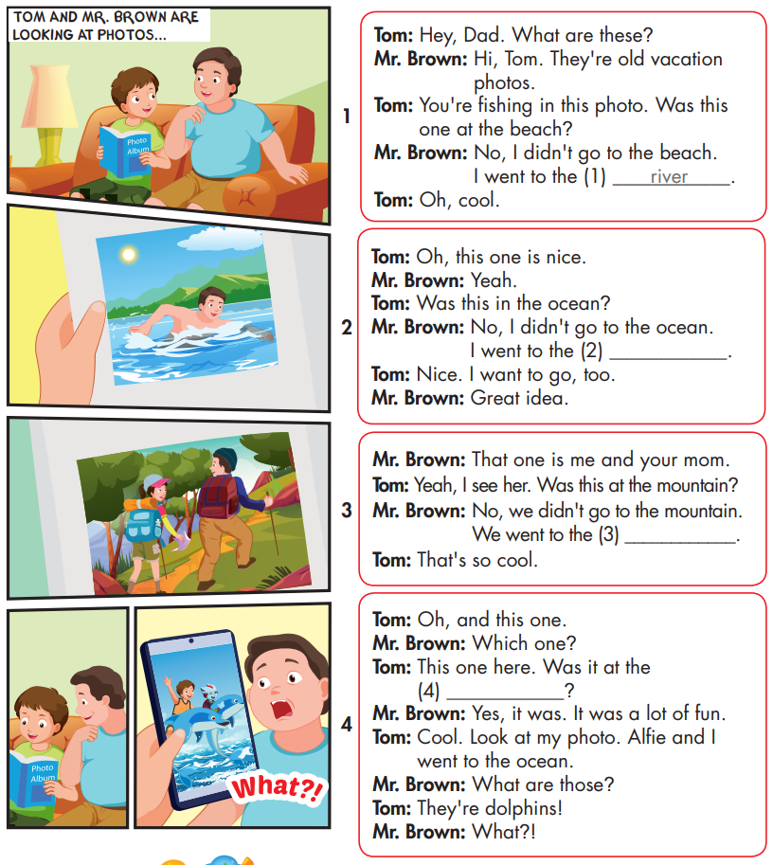

Slide 21

Speaking

Slide 22



Slide 23

Writing

Slide 24
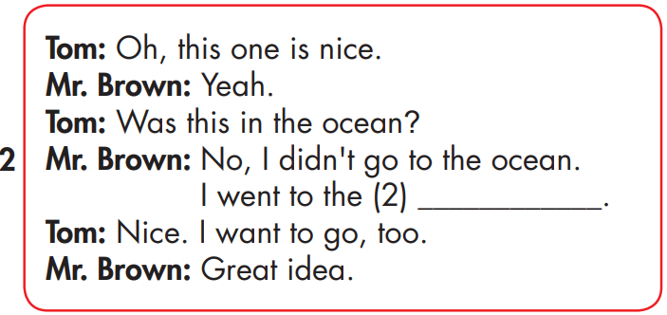
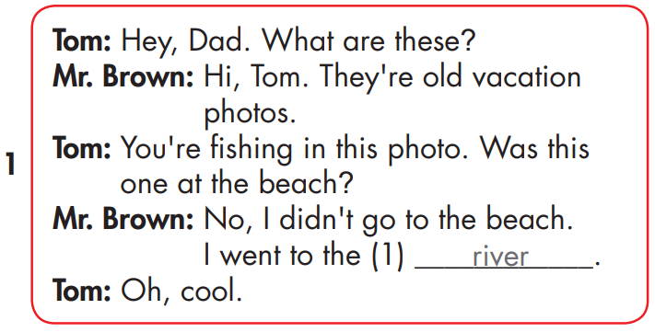
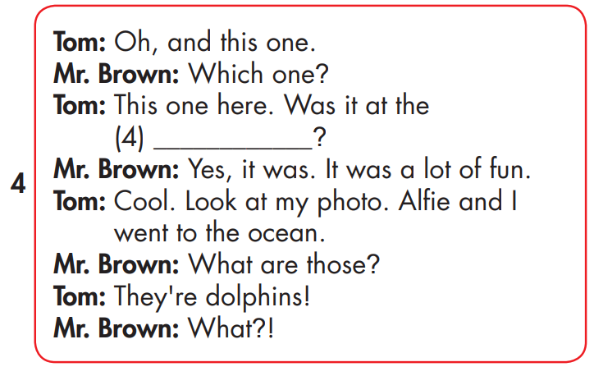
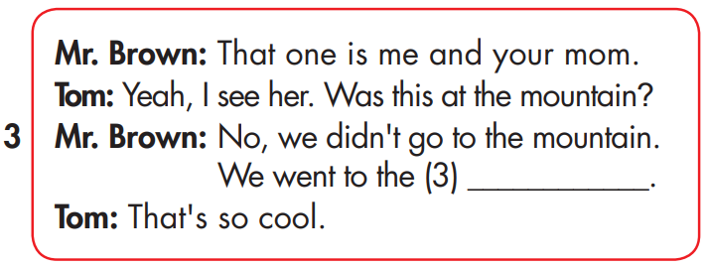
MAKE YOUR OWN STORY
lake
beach
forest

Slide 25

Production

Slide 26

CONSOLIDATION

Slide 27

WRAP-UP

Slide 28
Today’s lesson
Intonation
Falling intonation.
Structures/ Sentence patterns
I didn't go to the river.
I went to the beach.

Slide 29
Homework
Practice the vocabularies and structure, and make sentences using them.
Do the exercises in Tiếng Anh 5 i-Learn Smart Start WB (page 33)
Do the exercises in Tiếng Anh 5 i-Learn Smart Start Notebook (page 22)
Prepare the next lesson (page 50 SB)
Play the consolidation games in Tiếng Anh 5 i-Learn Smart Start DHA App on www.eduhome.com.vn

