Slide 1

Unit 3: MY FRIENDS AND I
Lesson 2.2
Page 38

Slide 2
Objectives
By the end of this lesson, students will be able to identify the intonation and practice the conversations.
Pronunciation: intonation for an affirmative sentence
Structure: Where were you last night?
I was at the movie theater. The movie was scary.

Slide 3

WARM-UP

Slide 4

Pronunciation
intonation for
an affirmative sentence

Slide 5

Presentation

Slide 6

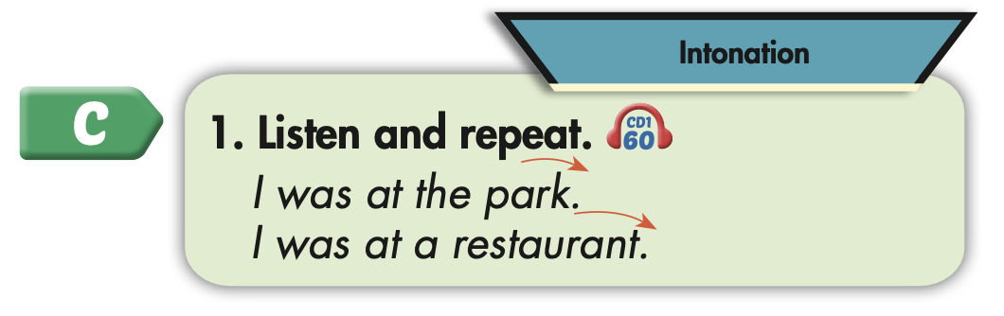

Slide 7
Practice

Slide 8



Slide 9
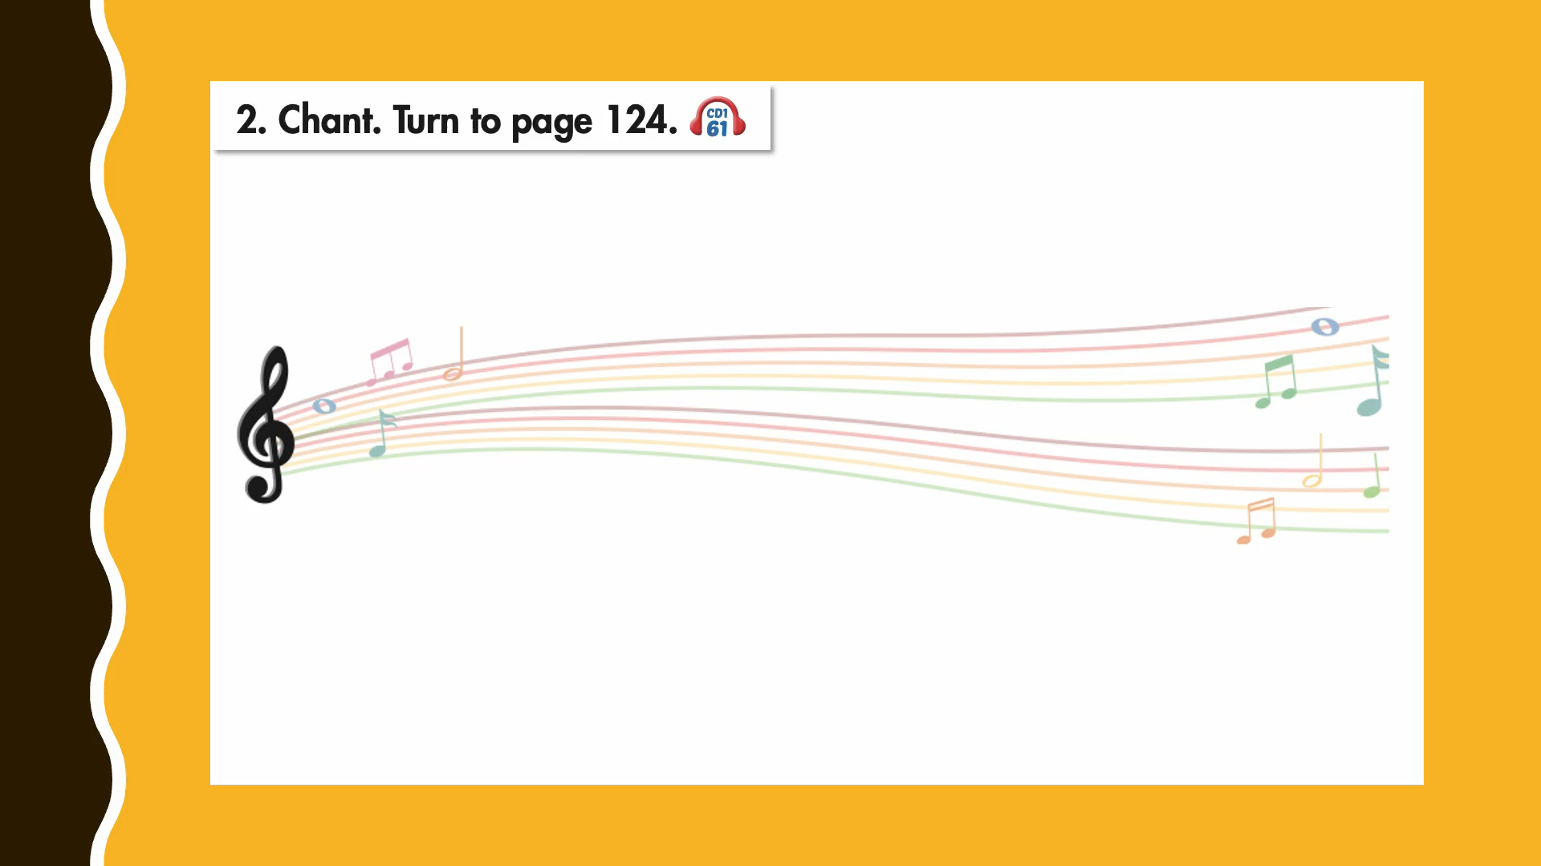

Slide 10

Structure
Where were you last night?
I was at the movie theater.
The movie was scary.

Slide 11

Speaking

Slide 12
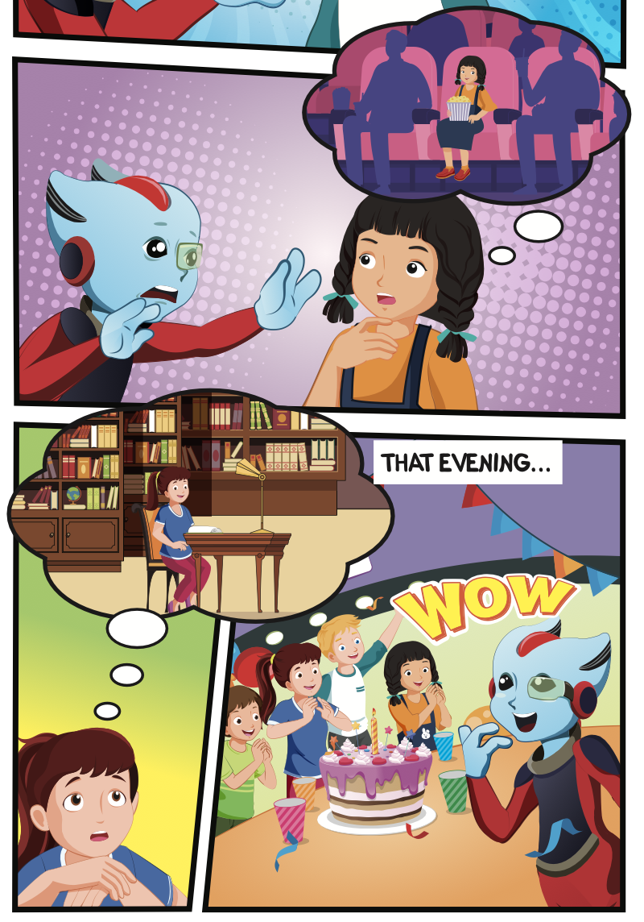
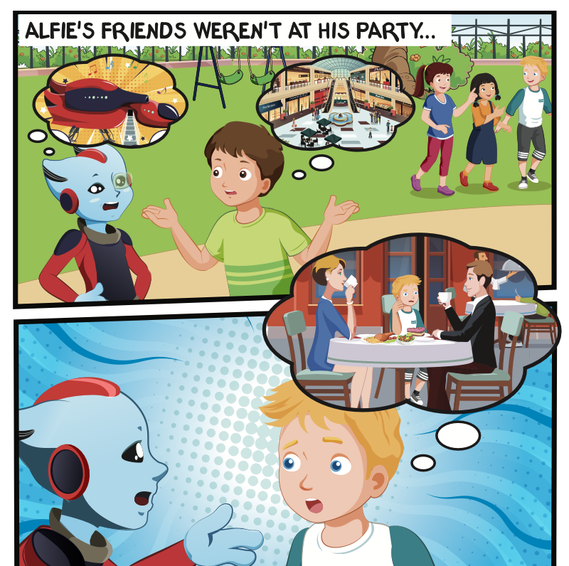
Who is talking?
Where are they?

Slide 13

Listening

Slide 14


Slide 15

Practice

Slide 16

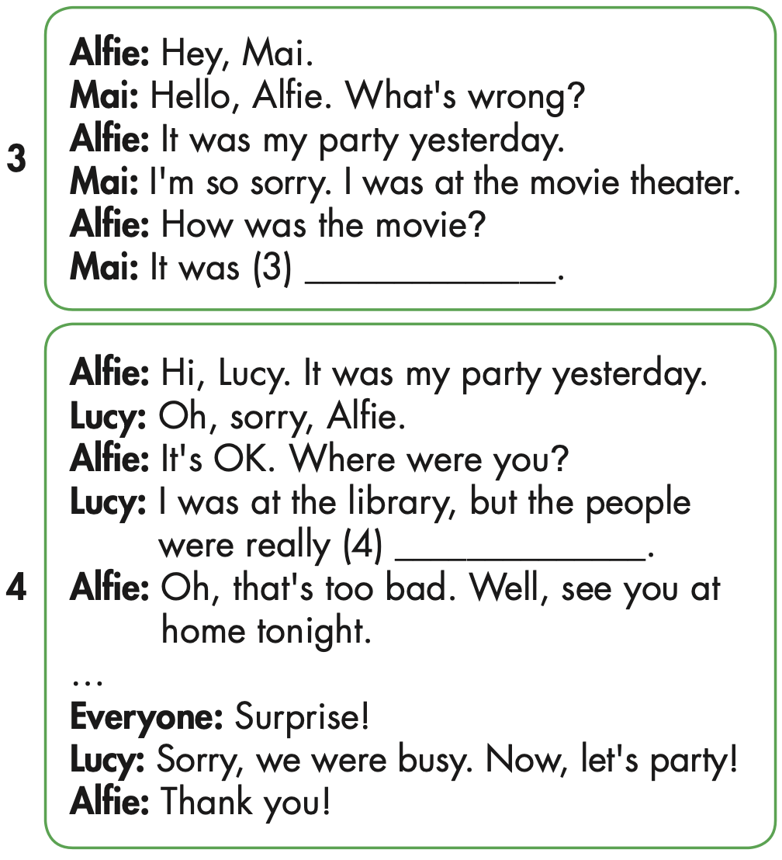
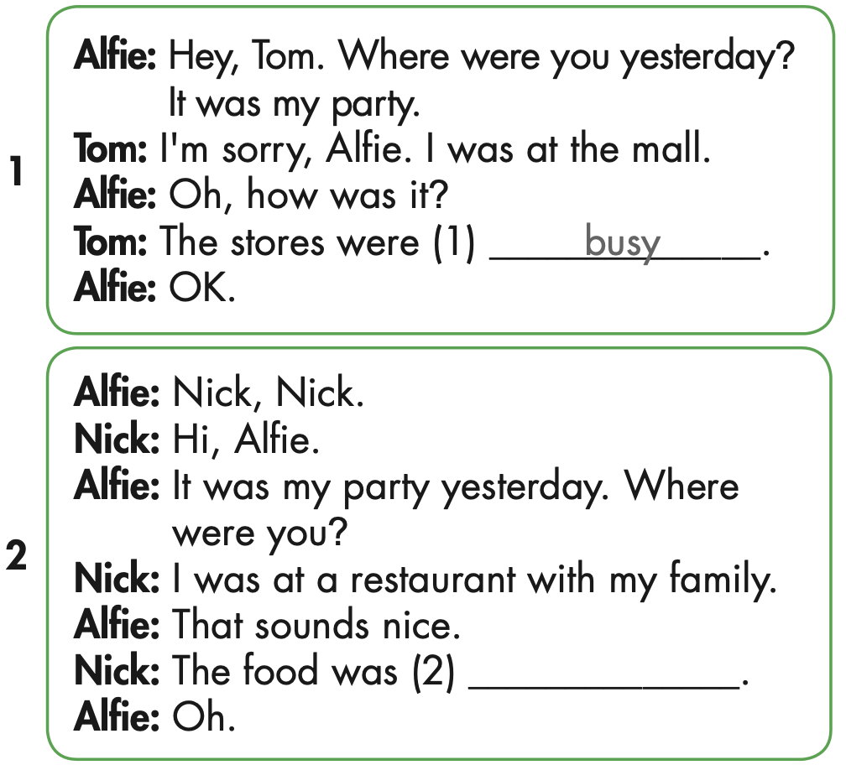

Slide 17

Speaking

Slide 18
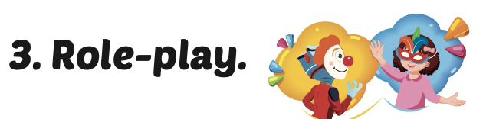
Role-play the conversations. Mind your intonation.

Slide 19

Production

Slide 20

Writing

Slide 21
MAKE YOUR OWN STORY

Slide 22
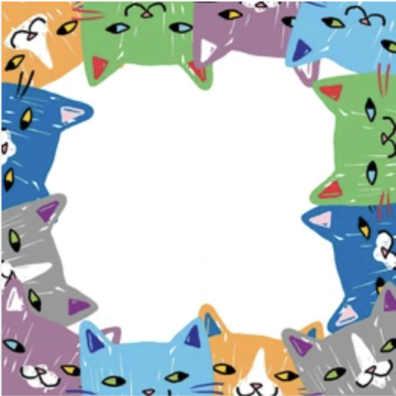

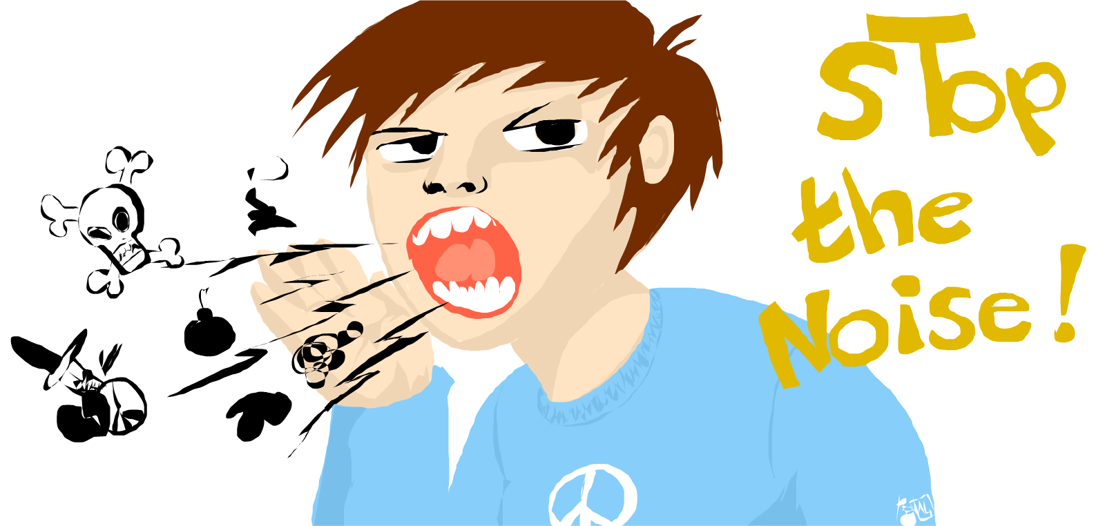
WAS
WERE
THE PEOPLE …………. NOISY.
WERE

Slide 23
Today’s lesson
Pronunciation
intonation for an affirmative sentence
Structures/ Sentence patterns
Where were you last night?
I was at the movie theater. The movie was scary.

Slide 24
Homework
Practice the vocabularies and structure, and make sentences using them.
Do the exercises in Tiếng Anh 5 i-Learn Smart Start WB (page 24).
Do the exercises in Tiếng Anh 5 i-Learn Smart Start Notebook.
Prepare the next lesson (page 39 SB).
Play the consolidation games in Tiếng Anh 5 i-Learn Smart Start DHA App on www.eduhome.com.vn

