Slide 1

Unit 3: MY FRIENDS AND I
Lesson 2.1
Page 37

Slide 2
Objectives
By the end of this lesson, students will be able to identify different adjectives.
Vocabulary: noisy, quiet, busy, delicious, yucky, scary.
Structure: Where were you last night?
I was at the movie theater. The movie was scary.

Slide 3

WARM-UP

Slide 4
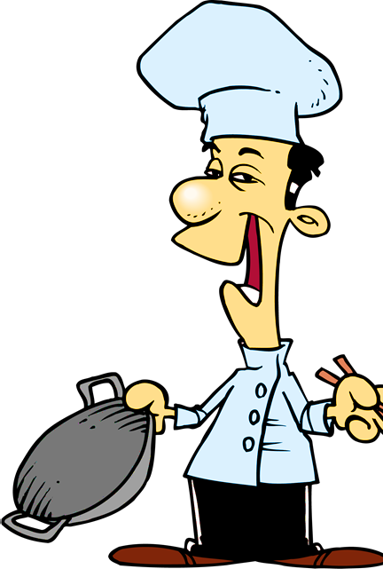


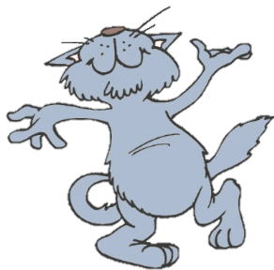
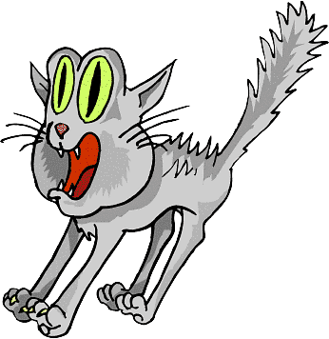

He sings ____________.
You got it!
badly
bad
NEXT
Notes:
4

Slide 5
She sings beautifully.
She is a _________ singer.
You got it!
good
well
NEXT

Slide 6
This bus is too _______ .
We will be late for school.
You got it!
slow
slowly
NEXT
Notes:
6

Slide 7
They are fantastic dancers.
They dance really _______.
You got it!
well
badly
NEXT
Notes:
7

Slide 8
I don’t want to go with him.
He drives too ________ .
You got it!
fast
slow
END

Slide 9

It’s time to learn …

Slide 10

New words
noisy,
quiet,
busy,
delicious,
yucky,
scary.

Slide 11

Presentation

Slide 12


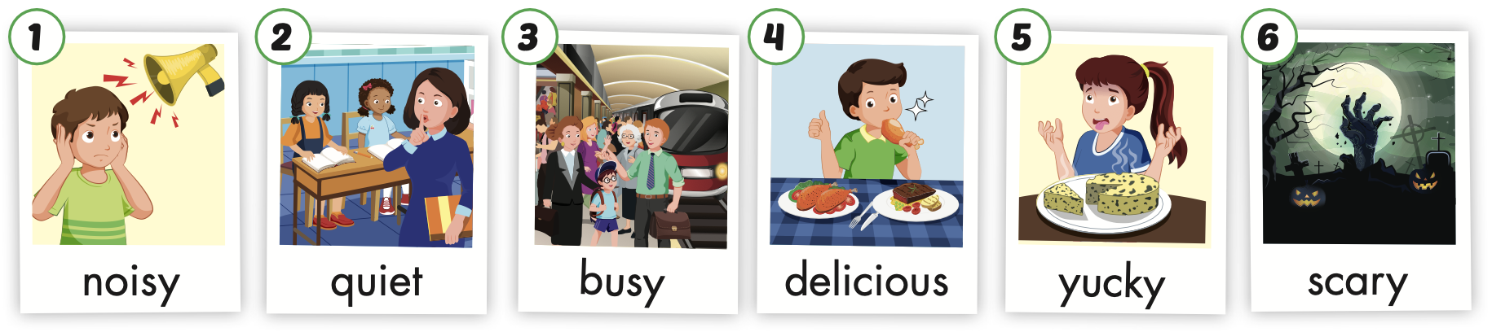
/ˈnɔɪzi/
ồn ào
/ˈkwaɪət/
yên lặng
/ˈbɪzi/
bận rộn,
nhộn nhịp
/dɪˈlɪʃəs/
ngon
/ˈjʌki/
dở, kinh tởm
/ˈskeri/
đáng sợ
Notes:
Click vào hình A. 1. Listen and point. Repeat để cho cả audio full chạy

Slide 13
Listen and choose. Then say.

Slide 14


A
B
C
Listen and choose. Then say.

Slide 15
A
B
C
Listen and choose. Then say.

Slide 16
A
B
C
Listen and choose. Then say.

Slide 17
C
A
B
Listen and choose. Then say.

Slide 18

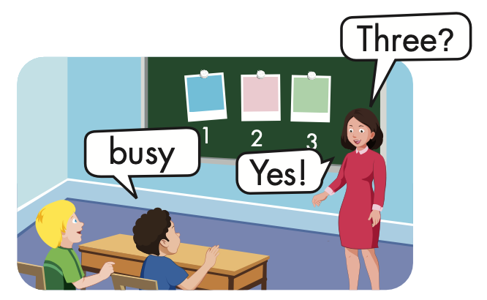
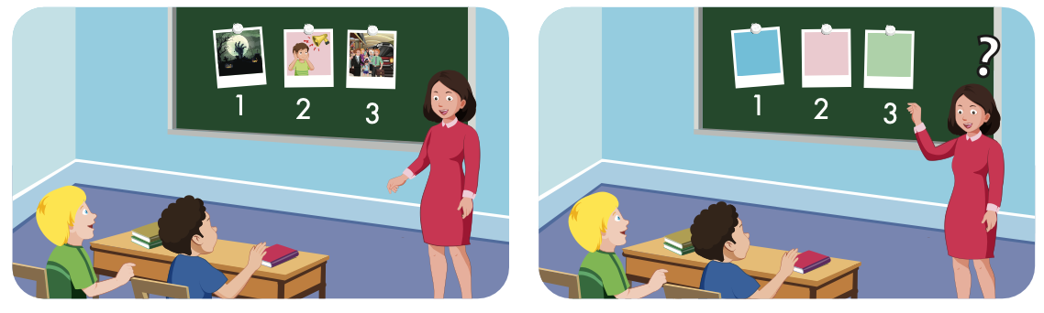

Slide 19
Structure
Where were you last night?
- I was at the movie theater.
The movie was scary.

Slide 20
Presentation

Slide 21
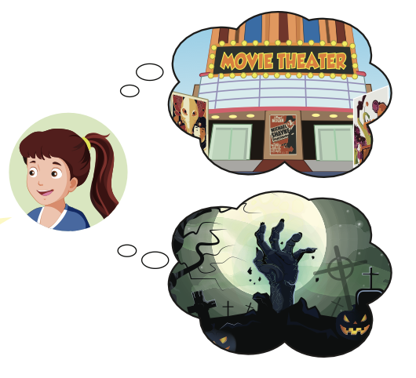
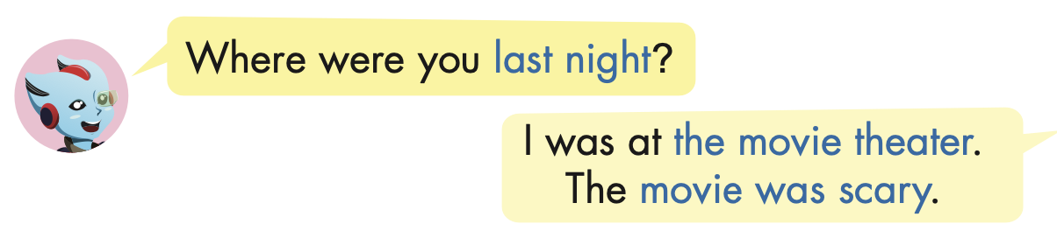
Structure

Slide 22

Practice

Slide 23



Slide 24

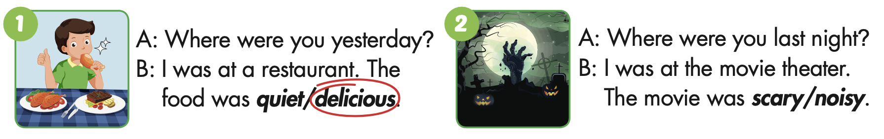

Slide 26
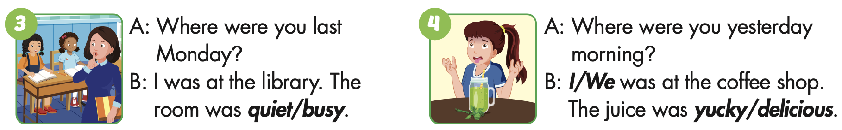

Slide 28
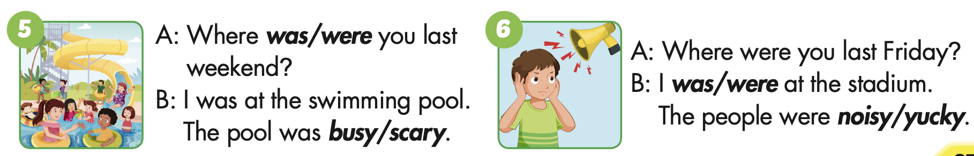

Slide 30

Production

Slide 31

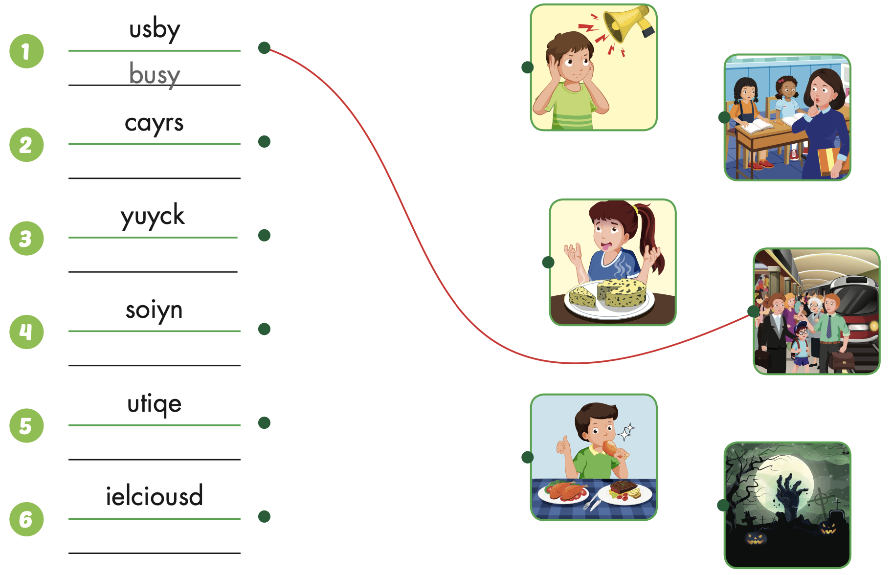
Extra Practice
WB, page 24
scary
yucky
noisy
quiet
delicious

Slide 32

CONSOLIDATION

Slide 33

WRAP-UP

Slide 34
Today’s lesson
Vocabularies
noisy,
quiet,
busy,
delicious,
yucky,
scary.
Structures/ Sentence patterns
Where were you last night?
I was at the movie theater. The movie was scary.

Slide 35
Homework
Practice the vocabularies and structure, and make sentences using them.
Do the exercises in Tiếng Anh 5 i-Learn Smart Start WB (page 24).
Do the exercises in Tiếng Anh 5 i-Learn Smart Start Notebook.
Prepare the next lesson (page 38 SB).
Play the consolidation games in Tiếng Anh 5 i-Learn Smart Start DHA App on www.eduhome.com.vn

