Slide 1

Unit 3: MY FRIENDS AND I
Lesson 1.3
Page 36

Slide 2
Objectives
By the end of this lesson, students will be able to to say how good people are at different activities.
Vocabulary: slowly, fast, badly, well, hard.
Structure: Tom kicks the ball hard.

Slide 3

WARM-UP

Slide 4

Practice

Slide 5

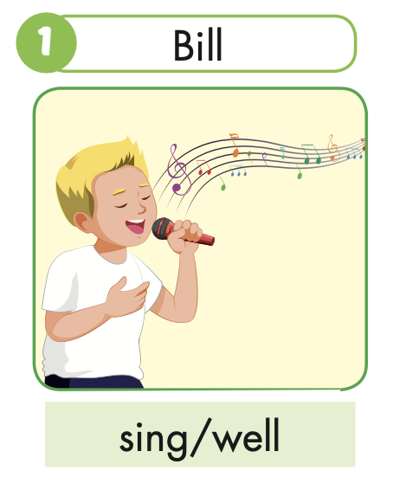


Slide 6
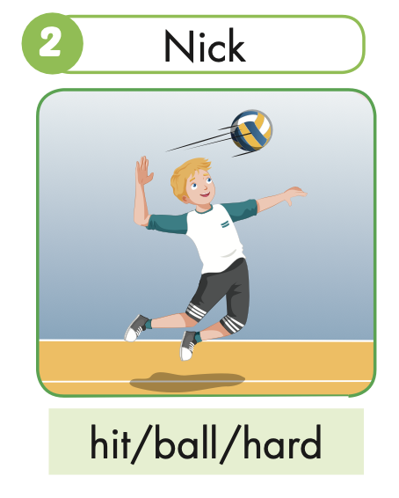
Nick hits the ball hard.

Slide 7
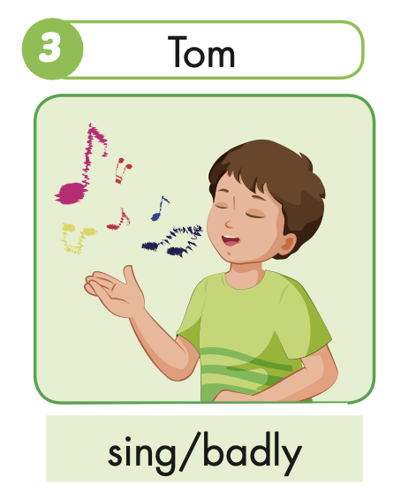
Tom sings badly.

Slide 8
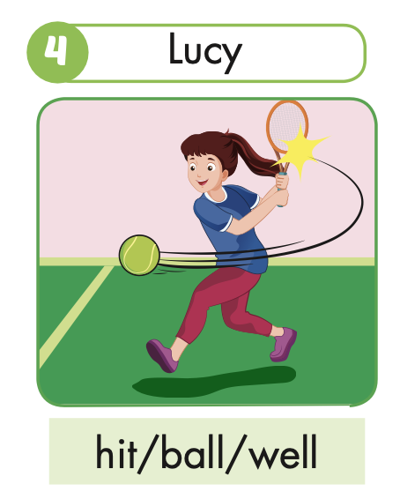
Lucy hits the ball well.

Slide 9
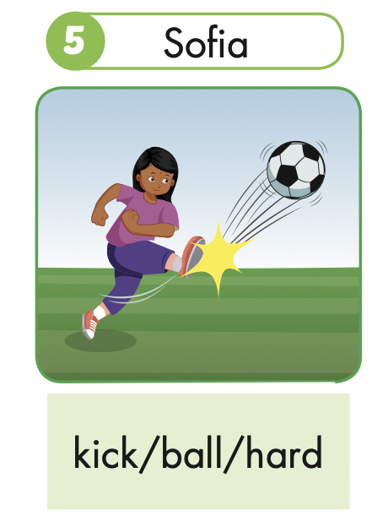
Sofia kicks the ball hard.

Slide 10
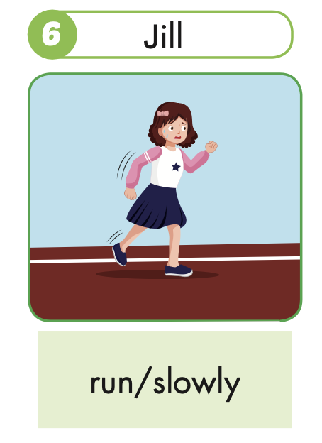
Jill runs slowly.

Slide 11
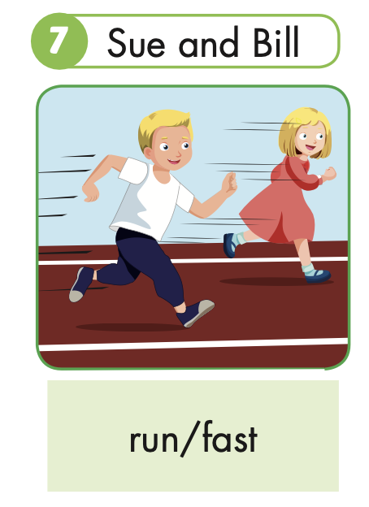
Sue and Bill run fast.

Slide 12
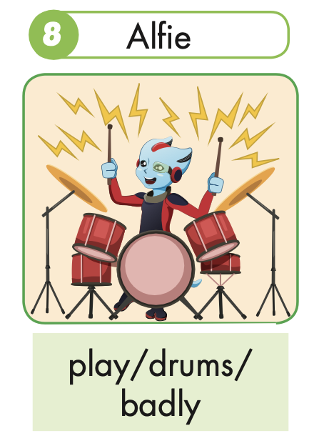
Alfie plays the drums badly.

Slide 13

Speaking

Slide 15

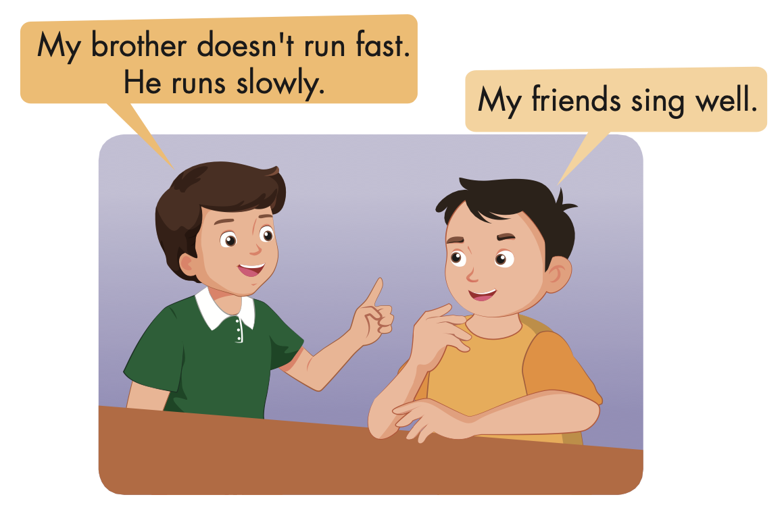

Slide 16

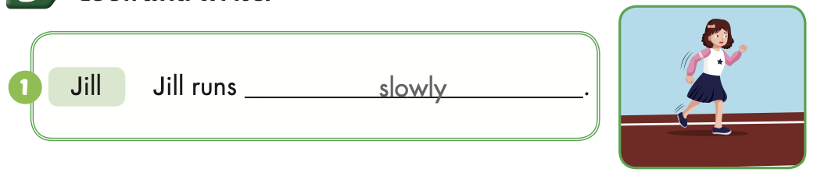
Extra Practice
WB, page 23

Slide 17
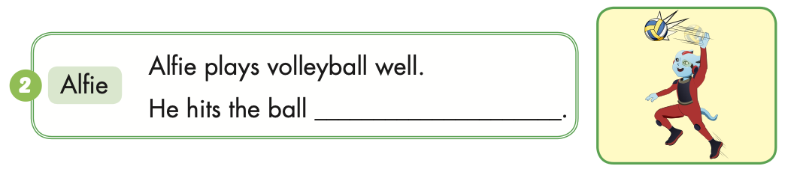
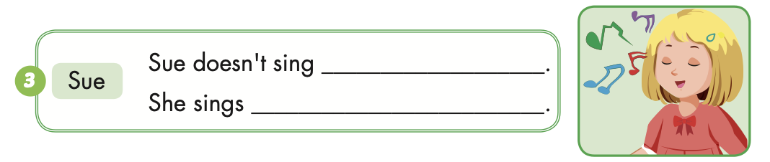
Extra Practice
WB, page 23
hard
well
badly

Slide 18
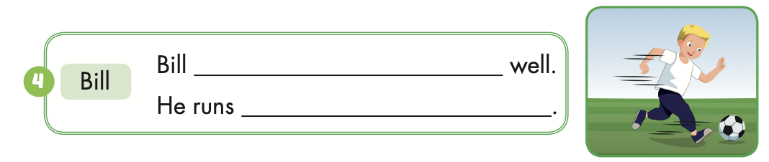
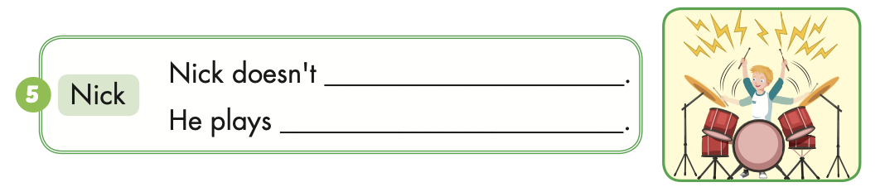
Extra Practice
WB, page 23
plays soccer
fast
play the drums well
the drums badly

Slide 19

CONSOLIDATION

Slide 20

Correct the mistakes!
GO!

Slide 21
play
Bill play the drums well.
NEXT

Slide 22
Bill plays the drums well.
NEXT

Slide 23
Sue runs slow.
slow
NEXT

Slide 24
Sue runs slowly.
NEXT

Slide 25
She doesn’t sing good.
She sing badly.
good
NEXT
sing

Slide 26
She doesn’t sing well.
She sings badly.
NEXT

Slide 27
Tom and Tim doesn’t kick the ball hard.
doesn’t
NEXT

Slide 28
Tom and Tim don’t kick the ball hard.
END

Slide 29

WRAP-UP

Slide 30
Today’s lesson
Vocabulary
slowly, fast, badly, well, hard.
Structures/ Sentence patterns
Tom kicks the ball hard.

Slide 31
Homework
Practice the vocabularies and structure, and make sentences using them.
Do the exercises in Tiếng Anh 5 i-Learn Smart Start WB (page 23).
Do the exercises in Tiếng Anh 5 i-Learn Smart Start Notebook.
Prepare the next lesson (page 37 SB).
Play the consolidation games in Tiếng Anh 5 i-Learn Smart Start DHA App on www.eduhome.com.vn

