Slide 1

Unit 3: MY FRIENDS AND I
Lesson 1.1
Page 34

Slide 2
Objectives
By the end of this lesson, students will be able to point out and say different adverbs.
Vocabulary: slowly, fast, badly, well, hard.
Structure: Tom kicks the ball hard.

Slide 3

WARM-UP

Slide 4
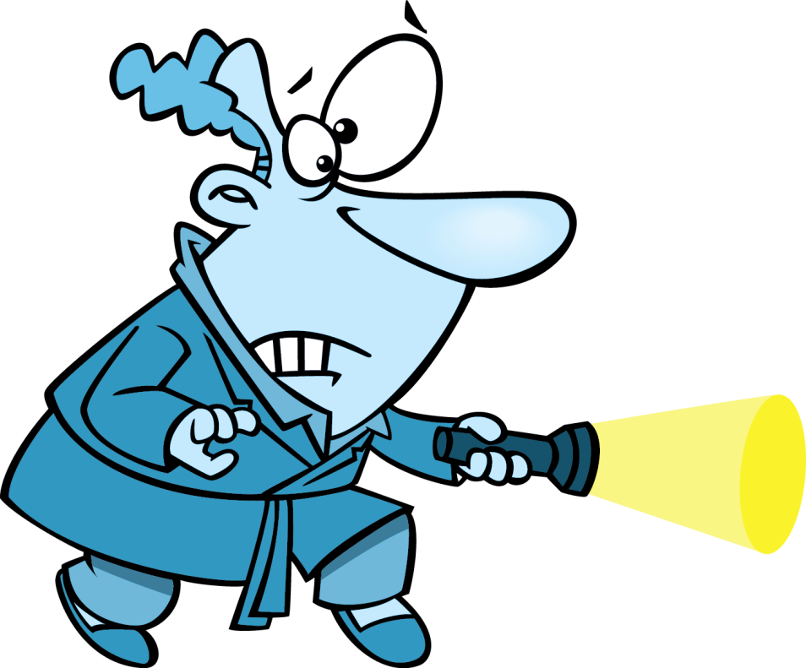

GUESS
AND
ACT

Slide 5
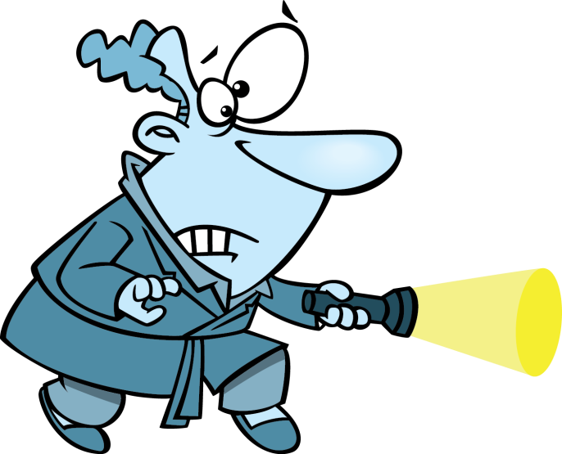
Click on the man with a torch and guess the hidden verb
walk
CHECK

Slide 6
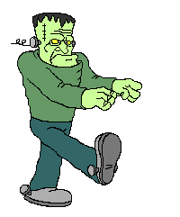

WALK
Walk like Frankenstein around the classroom.
CHECK

Slide 7
Click on the man with a torch and guess the hidden verb
cook
CHECK

Slide 8
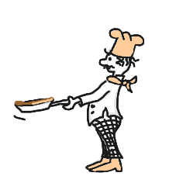
COOK
Act like cooking a pancake
CHECK

Slide 9
Click on the man with a torch and guess the hidden verb
smile
CHECK

Slide 10

SMILE
Smile to your classmates
CHECK

Slide 11
Click on the man with a torch and guess the hidden verb
drink
CHECK

Slide 12

DRINK
Mime the action
CHECK

Slide 13
Click on the man with a torch and guess the hidden verb
sing
CHECK

Slide 14
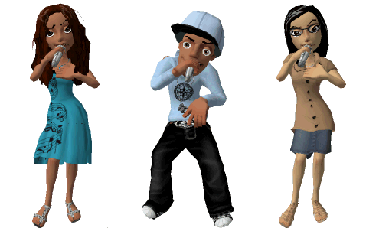
SING
Sing a song in English
EXIT
CHECK

Slide 15

It’s time to learn …

Slide 16

Presentation

Slide 17


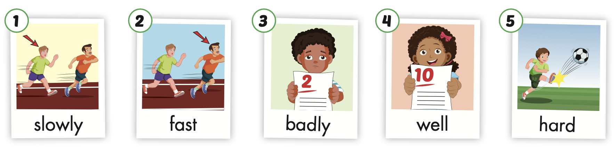
/ˈsloʊli/
chậm chạp
/fæst/
nhanh
/ˈbædli/
tồi, dở
/wel/
tốt, giỏi
/hɑːrd/
mạnh
Notes:
Click vào hình A. 1. Listen and point. Repeat để cho cả audio full chạy

Slide 18
Practice

Slide 19


Slide 20
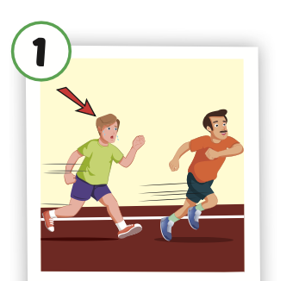
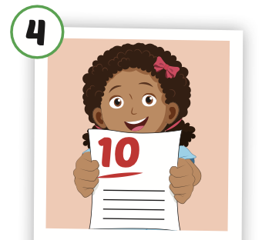
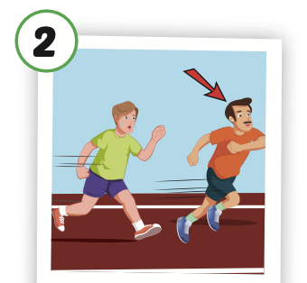
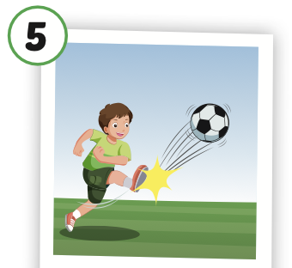
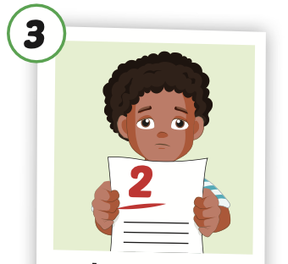
Look and say.

Slide 21

Structure
Tom kicks the ball hard.

Slide 22
Presentation

Slide 23
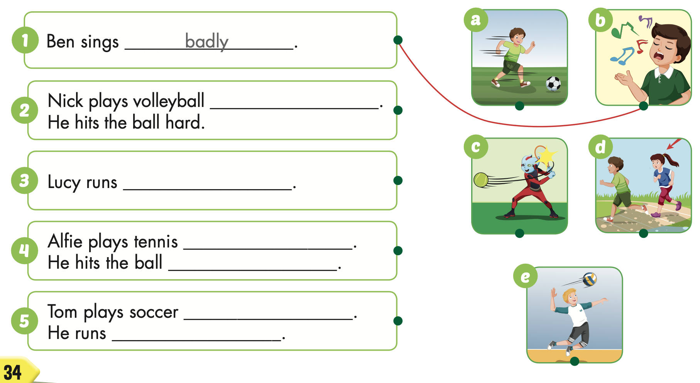

Structure
Ben sings badly.

Slide 24

Practice

Slide 25

well
slowly
well
hard
well
fast

Slide 26

Production

Slide 27

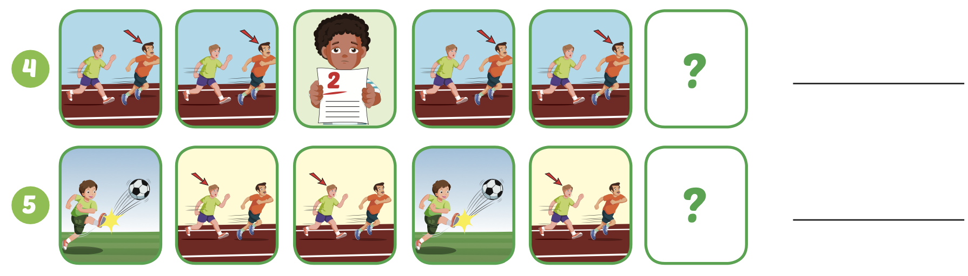
Extra Practice
WB, page 22
badly
slowly

Slide 28

WRAP-UP

Slide 29
Today’s lesson
Vocabularies
slowly,
fast,
badly,
well,
hard.
Structures/ Sentence patterns
Tom kicks the ball hard.

Slide 30
Homework
Practice the vocabularies and structure, and make sentences using them.
Do the exercises in Tiếng Anh 5 i-Learn Smart Start WB (page 22).
Do the exercises in Tiếng Anh 5 i-Learn Smart Start Notebook.
Prepare the next lesson (page 35 SB).
Play the consolidation games in Tiếng Anh 5 i-Learn Smart Start DHA App on www.eduhome.com.vn

