Slide 1
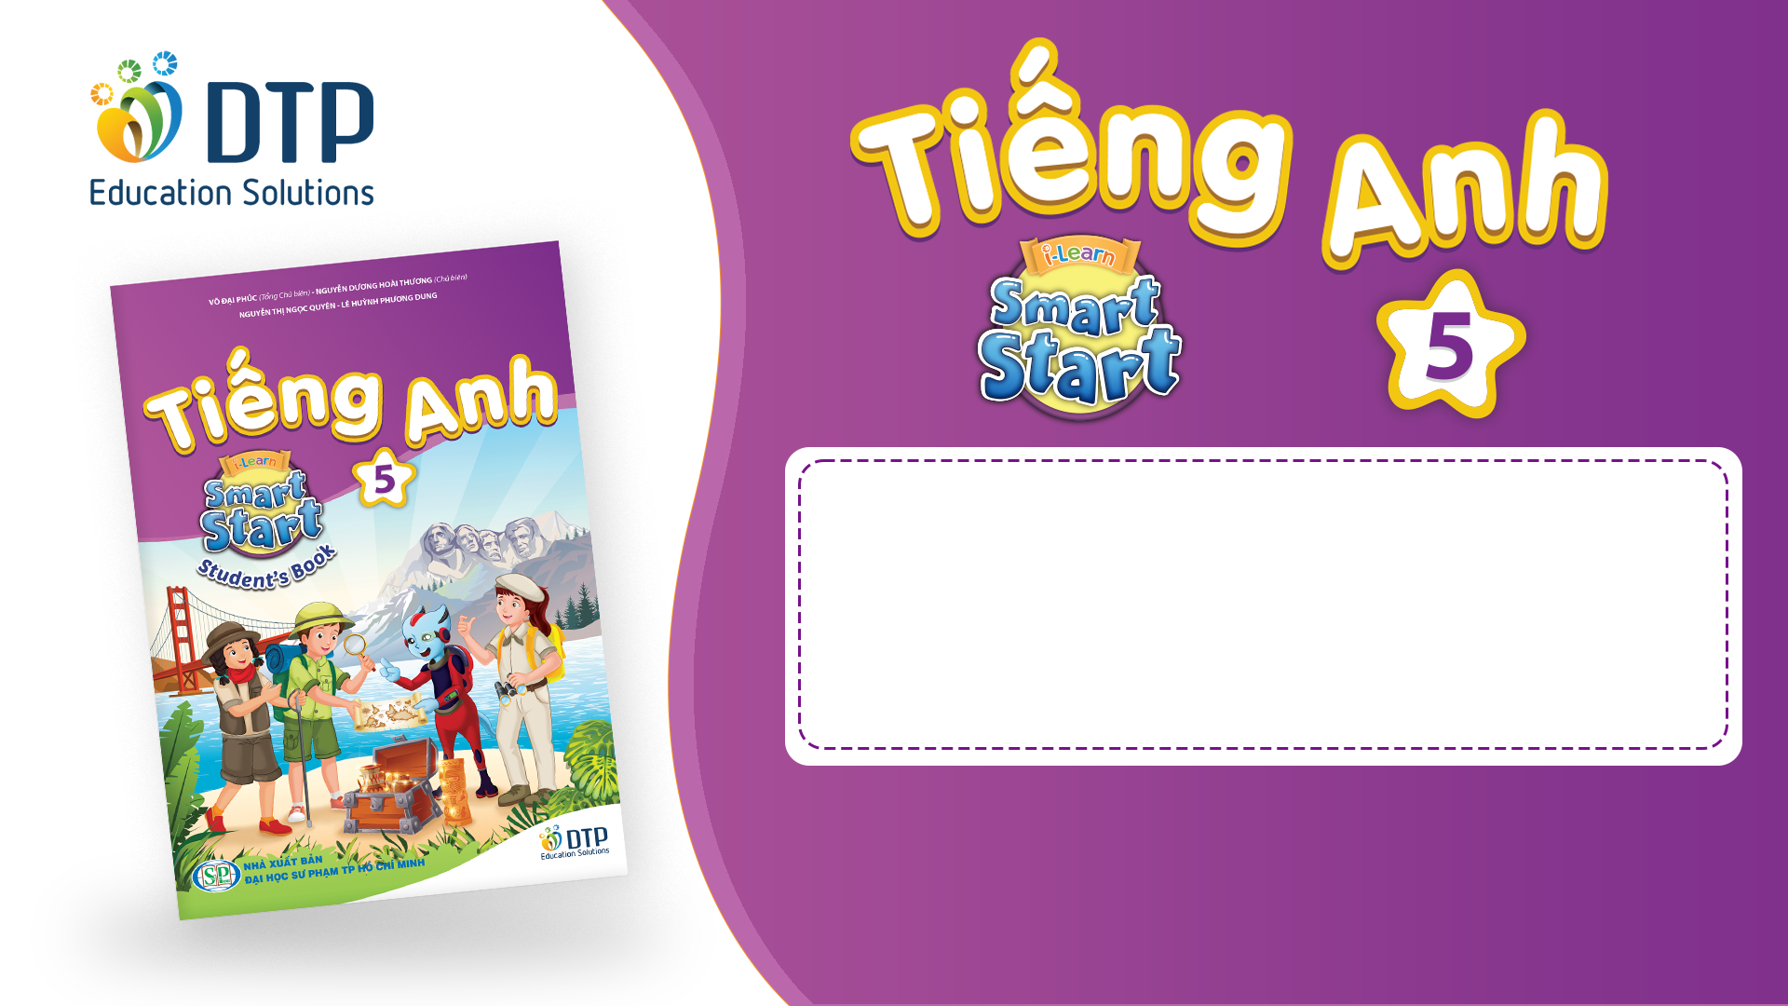
Unit 2: Holidays
Lesson 2.2
Page 24

Slide 2
Objectives
By the end of this lesson, students will be able to…
Word stress: Practice word stress - 'twenty-fifth, 'thirty-first
Structure: Practice asking and answering about dates
When's Christmas Day?
- It's on December twenty-fifth.

Slide 3

WARM-UP

Slide 4
CHECK-UP

Slide 5



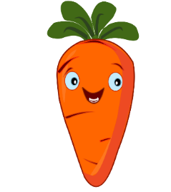



Listen and choose
A
B

Slide 6


Listen and choose
A
B

Slide 7

Listen and choose
A
B

Slide 8
Listen and choose
B
A

Slide 9
Listen and choose
A
B

Slide 10

It’s time to learn …

Slide 11

Stress
'twenty-fifth, 'thirty-first

Slide 12

Listening

Slide 13
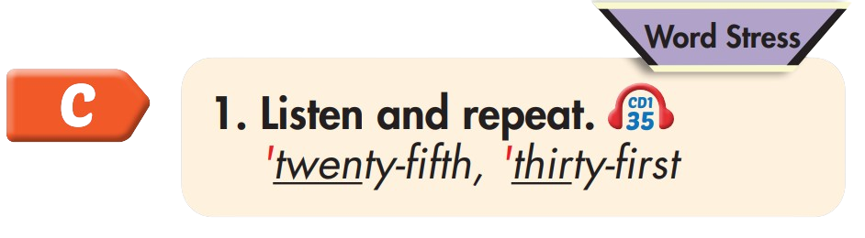
'twenty-fifth
'thirty-first

Slide 14
Practice

Slide 15



Slide 16
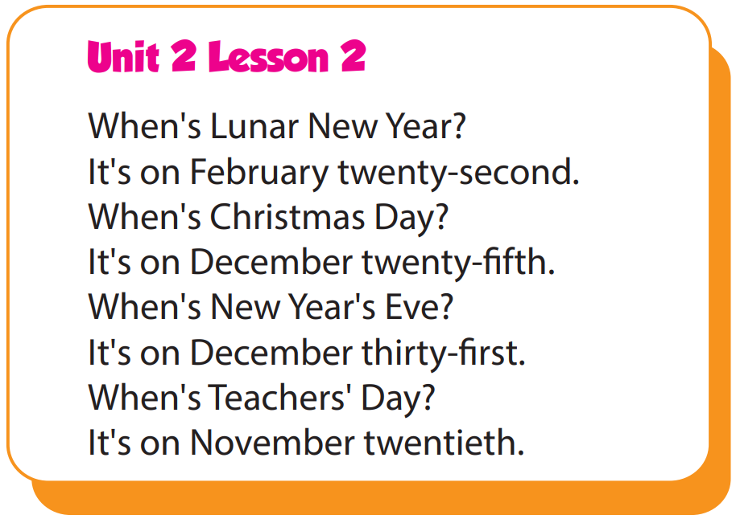

Slide 17
Structure
When's Christmas Day?
- It's on December twenty-fifth.

Slide 18
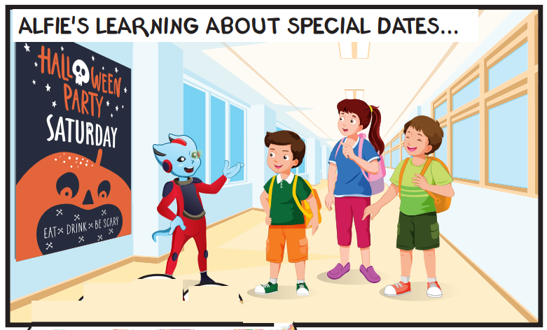
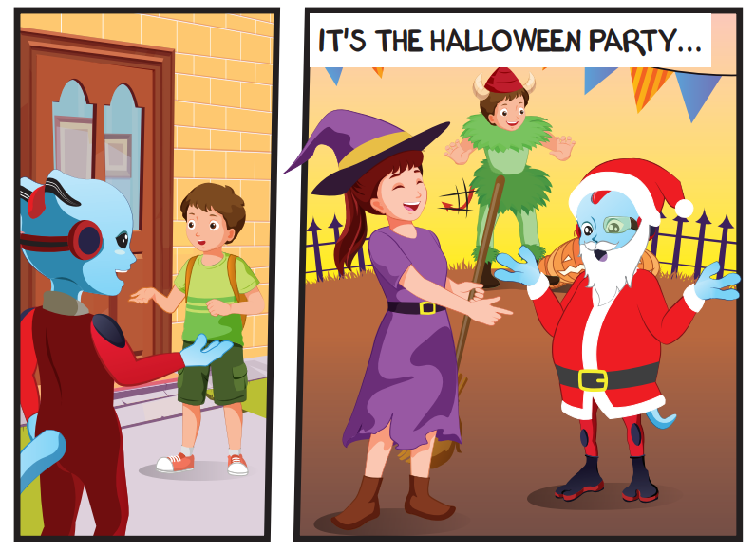
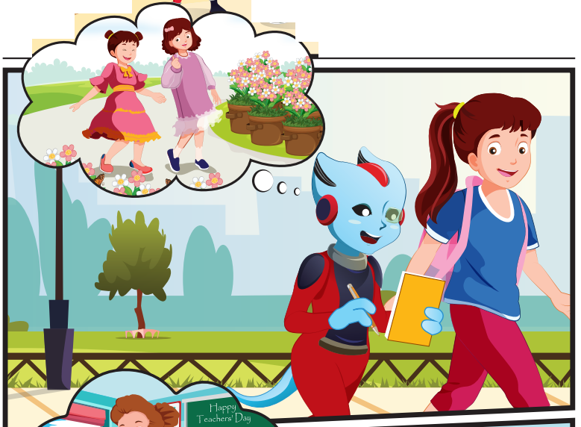
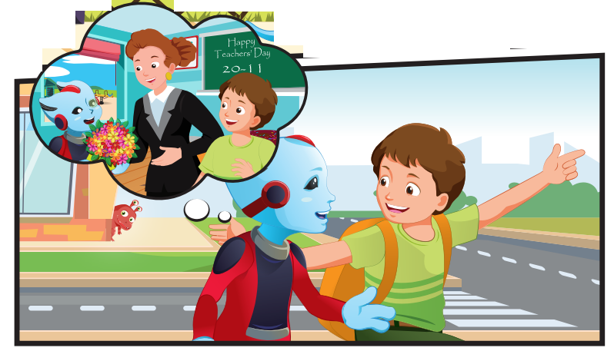
Who can you see?
Alfie, Tom, Lucy, Ben

Slide 19
Where are they?
They're outside.

Slide 20
What are they talking about?
They're talking about holidays.

Slide 21

Listening

Slide 22


Slide 23

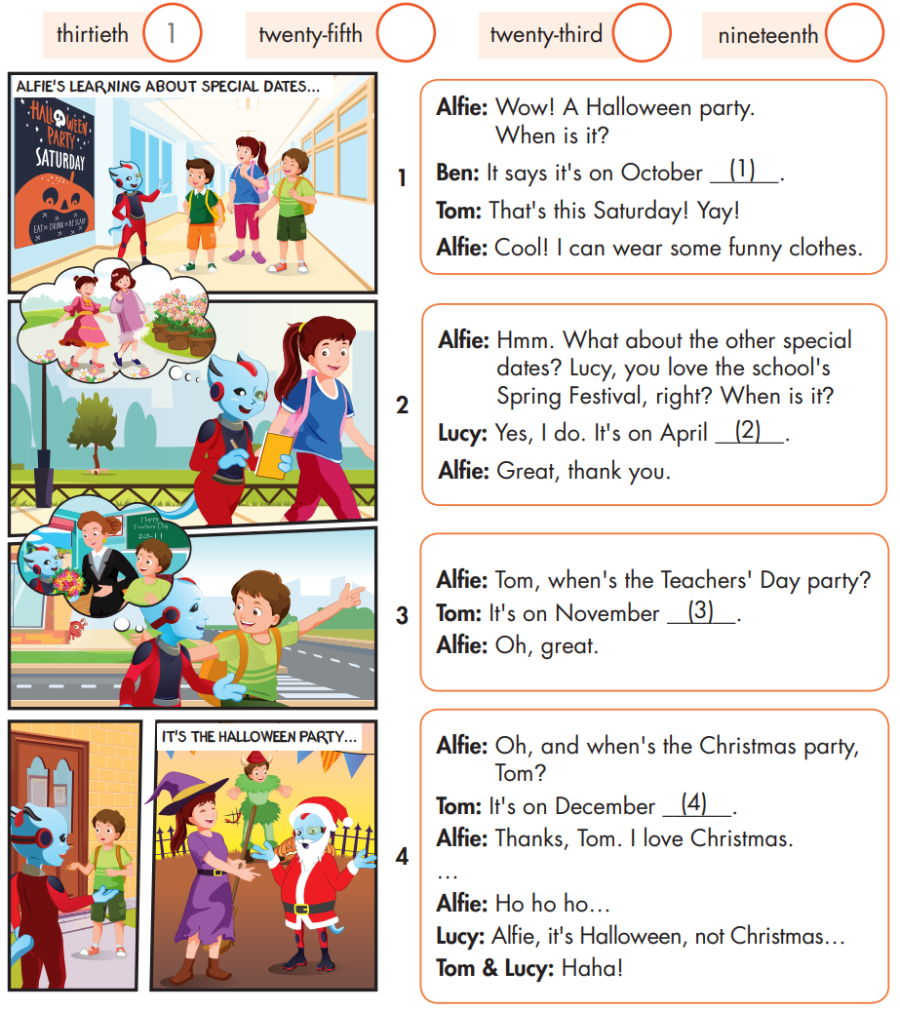

Slide 24

Speaking

Slide 25
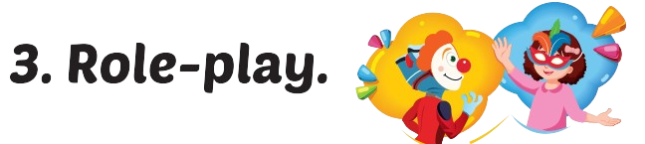
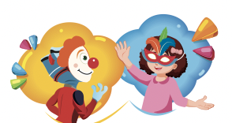

Slide 26

Writing

Slide 27
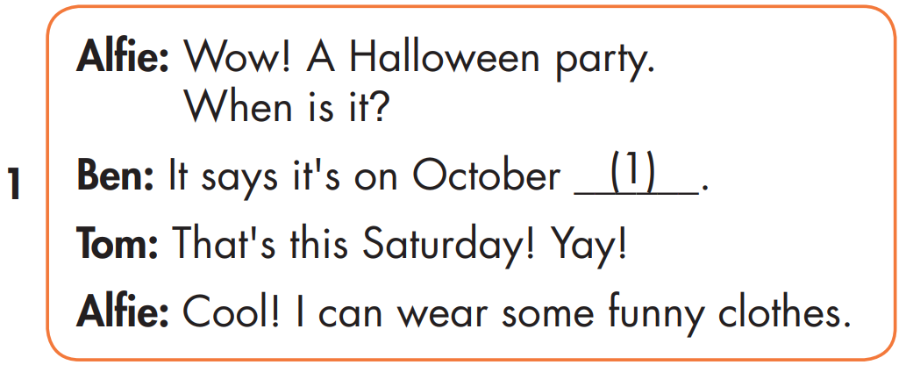
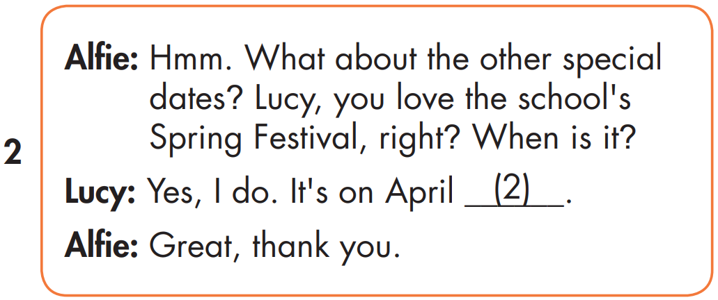
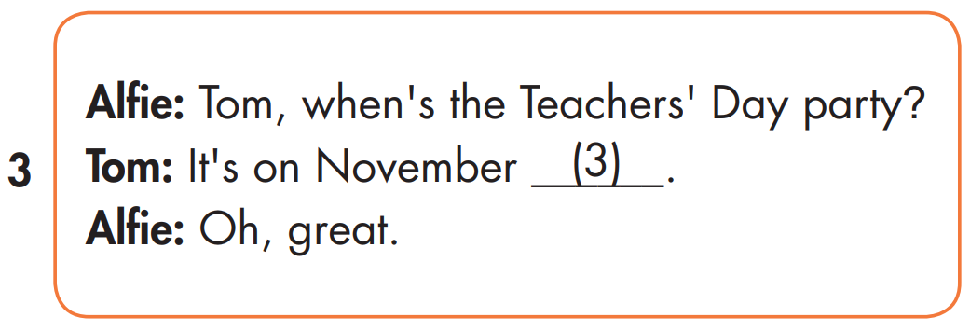
MAKE YOUR OWN STORY
twenty-fifth
nineteenth
twenty-third

Slide 28

Production

Slide 29

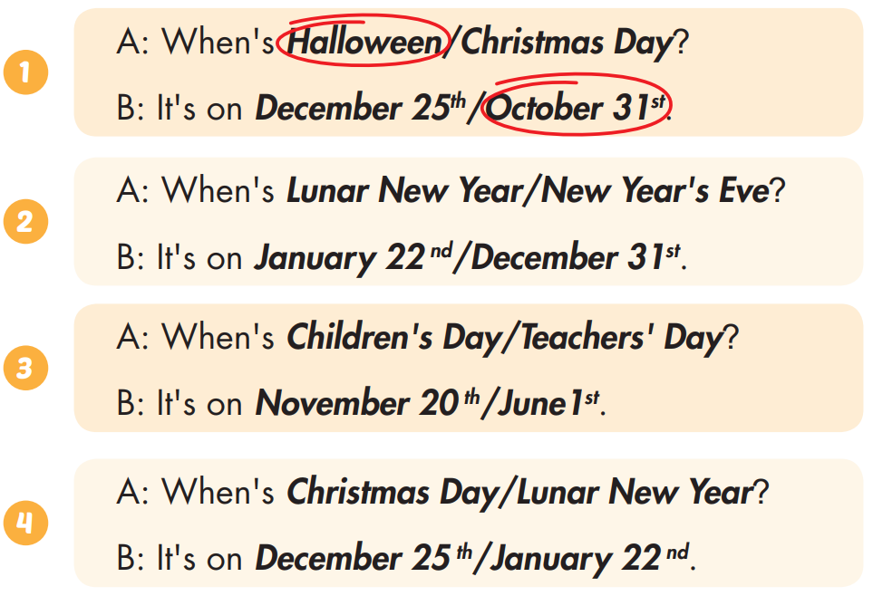
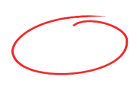
Extra Practice
WB, page 15

Slide 30

CONSOLIDATION

Slide 31

WRAP-UP

Slide 32
Today’s lesson
Stress
Word stress: 'twenty-fifth, 'thirty-first
Structures/ Sentence patterns
When's Christmas Day?
- It's on December twenty-fifth.

Slide 33
Homework
Practice the vocabularies and structure, and make sentences using them.
Do the exercises in Tiếng Anh 5 i-Learn Smart Start WB (page 15)
Do the exercises in Tiếng Anh 5 i-Learn Smart Start Notebook (page 11)
Prepare the next lesson (page 25 SB)
Play the consolidation games in Tiếng Anh 5 i-Learn Smart Start DHA App on www.eduhome.com.vn

