Slide 1

Unit 2: Holidays
Lesson 1.3
Page 22

Slide 2
Objectives
By the end of this lesson, students will be able to…
Vocabulary: Pronounce and use the words related to the topic properly: Halloween, New Year's Eve, Lunar New Year (Tết), Christmas, Teachers' Day, Children's Day.
Structure: Ask and answer about someone’s favorite holiday
What's your favorite holiday? - It's Halloween.
What's her favorite holiday? - It's Christmas

Slide 3

WARM-UP

Slide 4



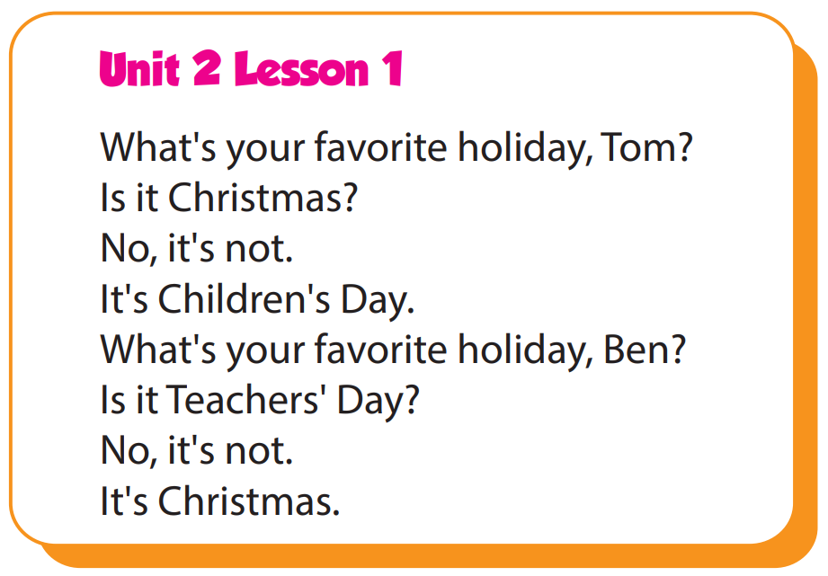

Slide 5

It’s time to learn …

Slide 6

Practice

Slide 7

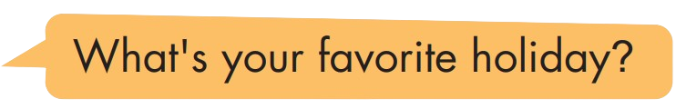
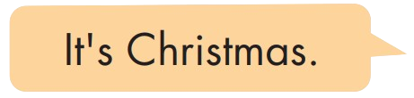
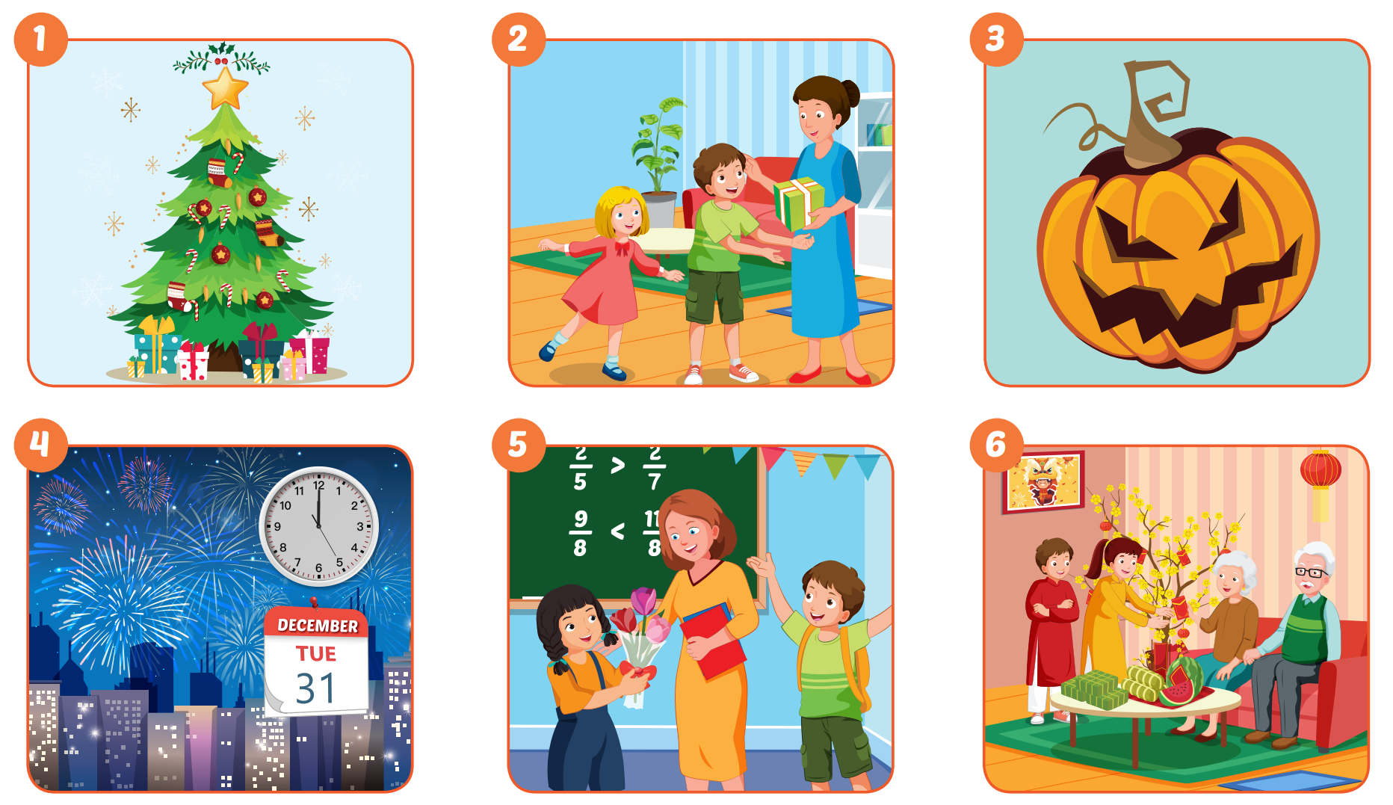

Slide 8

Production

Slide 9
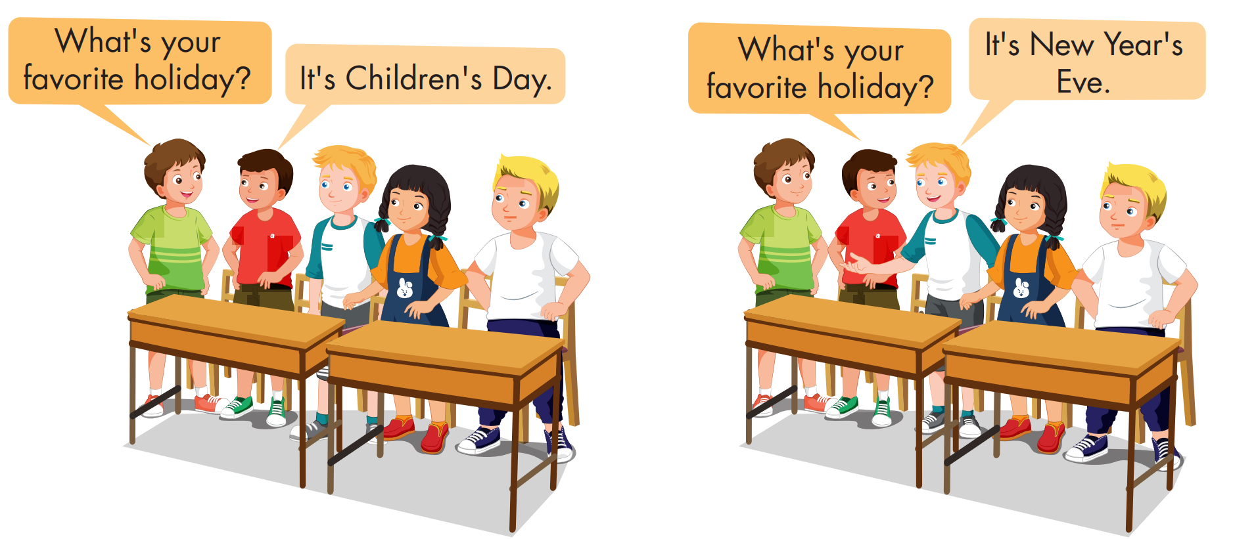

Slide 10

CONSOLIDATION

Slide 11

UNSCRAMBLE THE WORDS

Slide 12

WRAP-UP

Slide 13
Today’s lesson
Vocabularies
Halloween, NewYear's Eve, Lunar New Year (Tết), Christmas, Teachers' Day,
Children's Day
Structures/ Sentence patterns
What's your favorite holiday?
- It's Halloween.
What's her favorite holiday?
- It's Christmas.

Slide 14
Homework
Practice the vocabularies and structure, and make sentences using them.
Do the exercises in Tiếng Anh 5 i-Learn Smart Start WB (page 13)
Do the exercises in Tiếng Anh 5 i-Learn Smart Start Notebook (page 10)
Prepare the next lesson (page 23 SB)
Play the consolidation games in Tiếng Anh 5 i-Learn Smart Start DHA App on www.eduhome.com.vn

