Slide 1
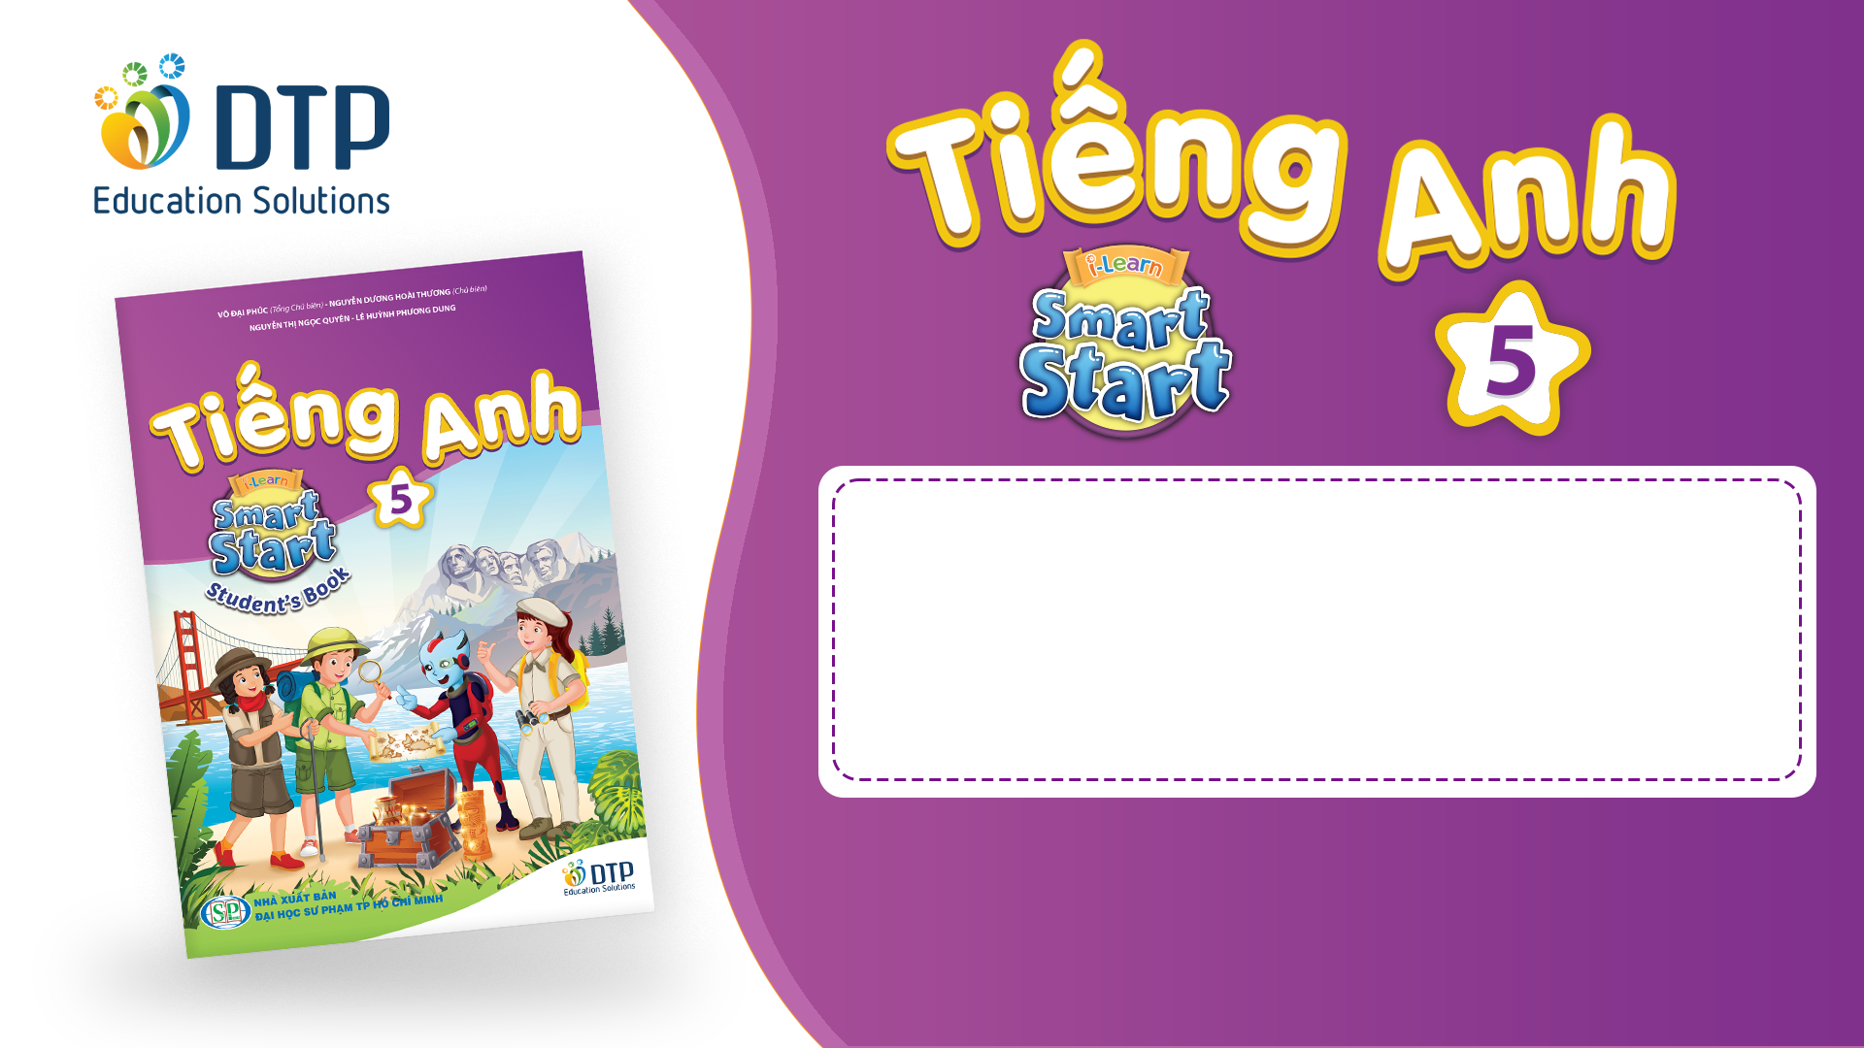
Unit 2: Holidays
Lesson 1.2
Page 21

Slide 2
Objectives
By the end of this lesson, students will be able to…
Stress: For most holidays, we usually stress the first syllable.
Structure: What's your favorite holiday? - It's Halloween.
What's her favorite holiday? - It's Christmas

Slide 3

WARM-UP

Slide 4
HIDDEN PICTURE

Slide 5


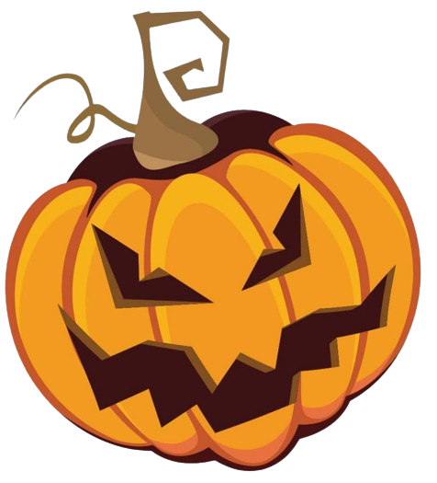
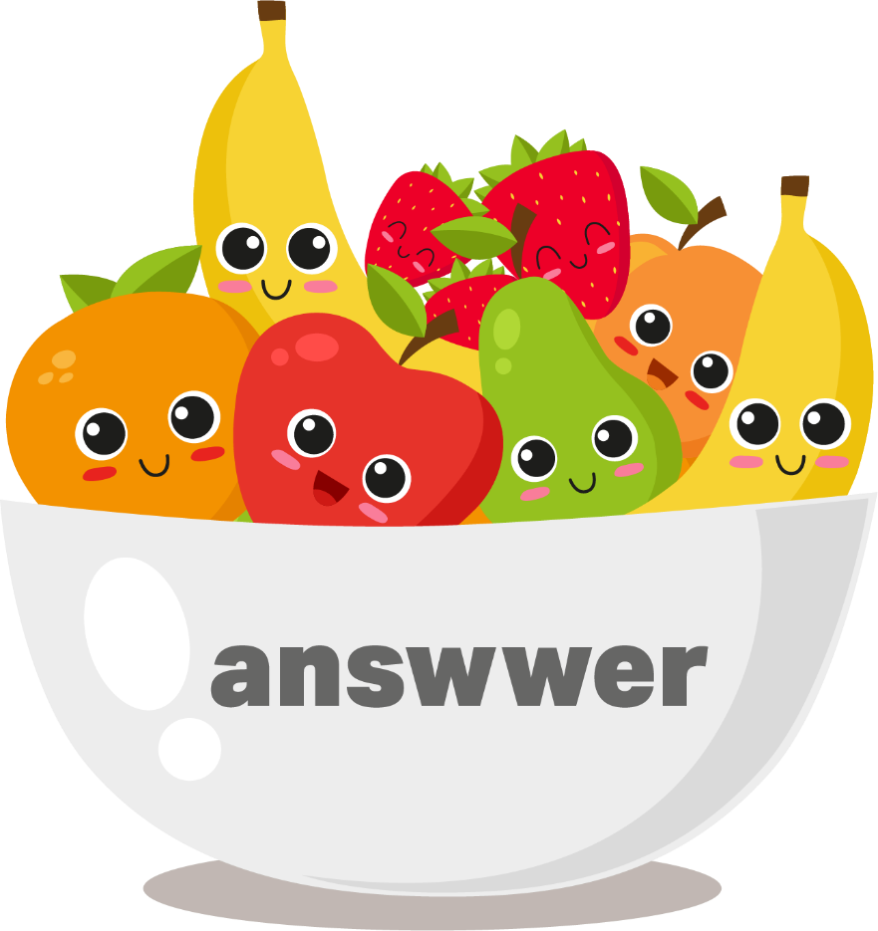

Halloween

Slide 6
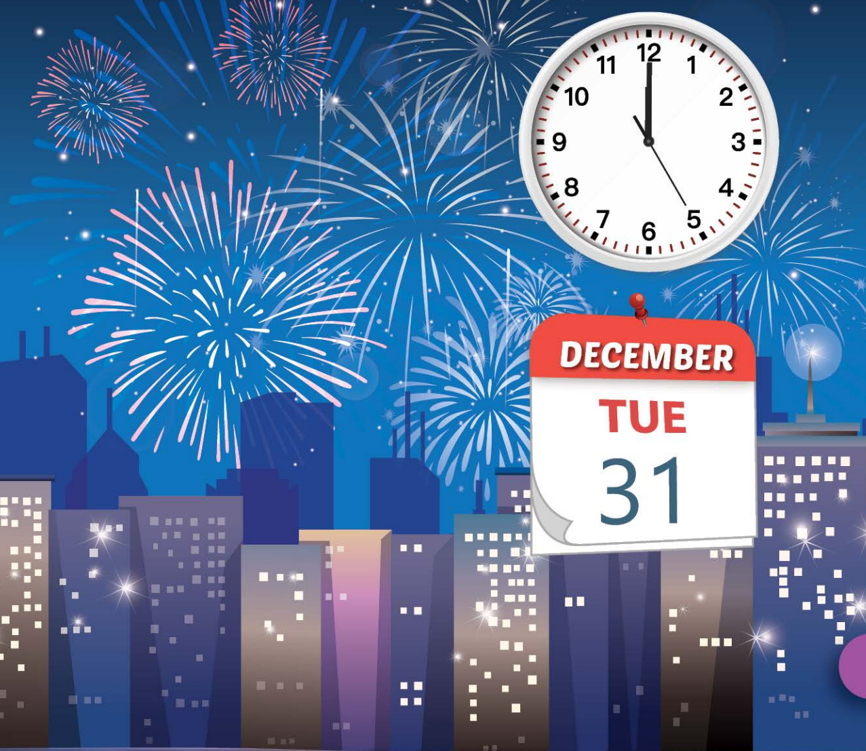
New Year's Eve

Slide 7
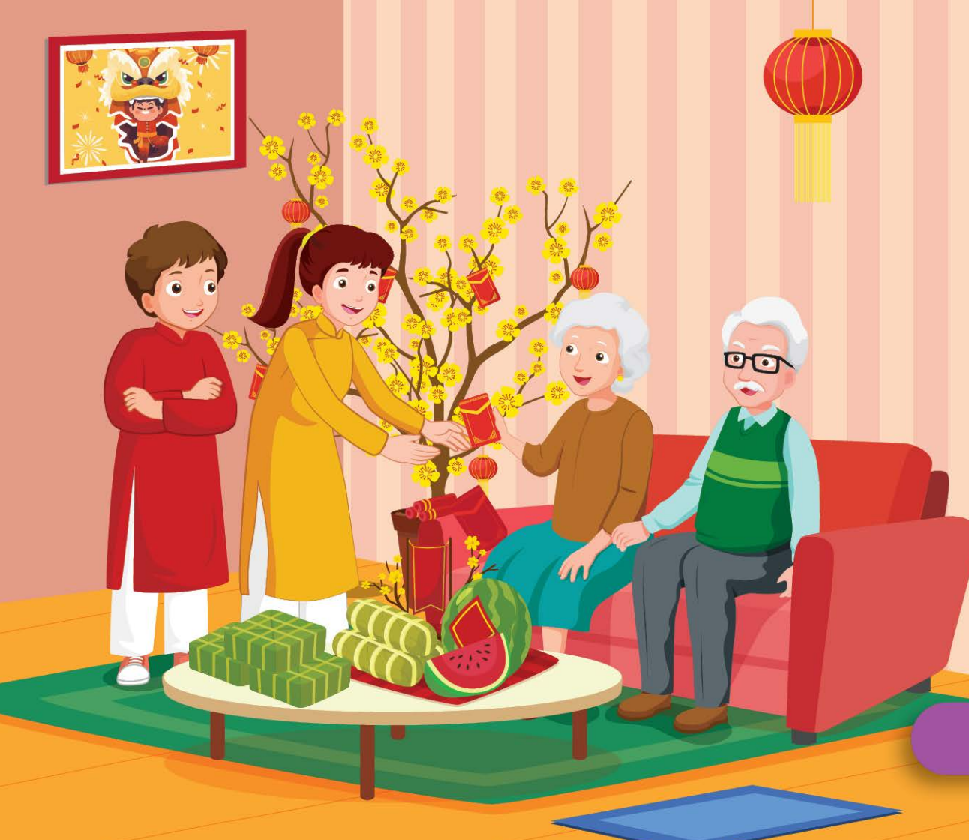
Lunar New Year (Tết)

Slide 8
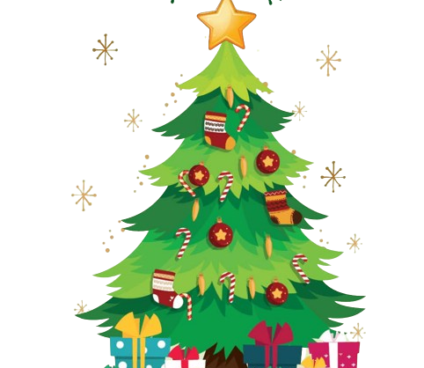
Christmas

Slide 9
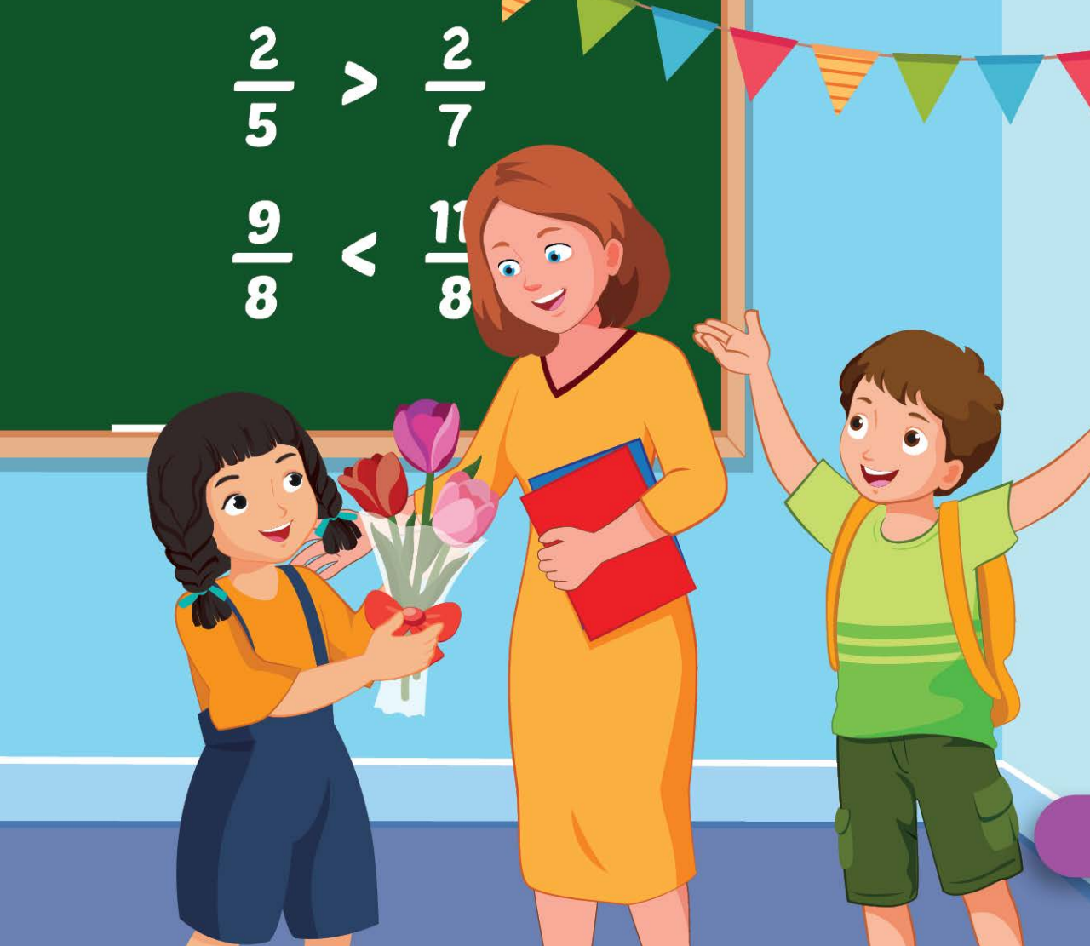
Teachers' Day

Slide 10
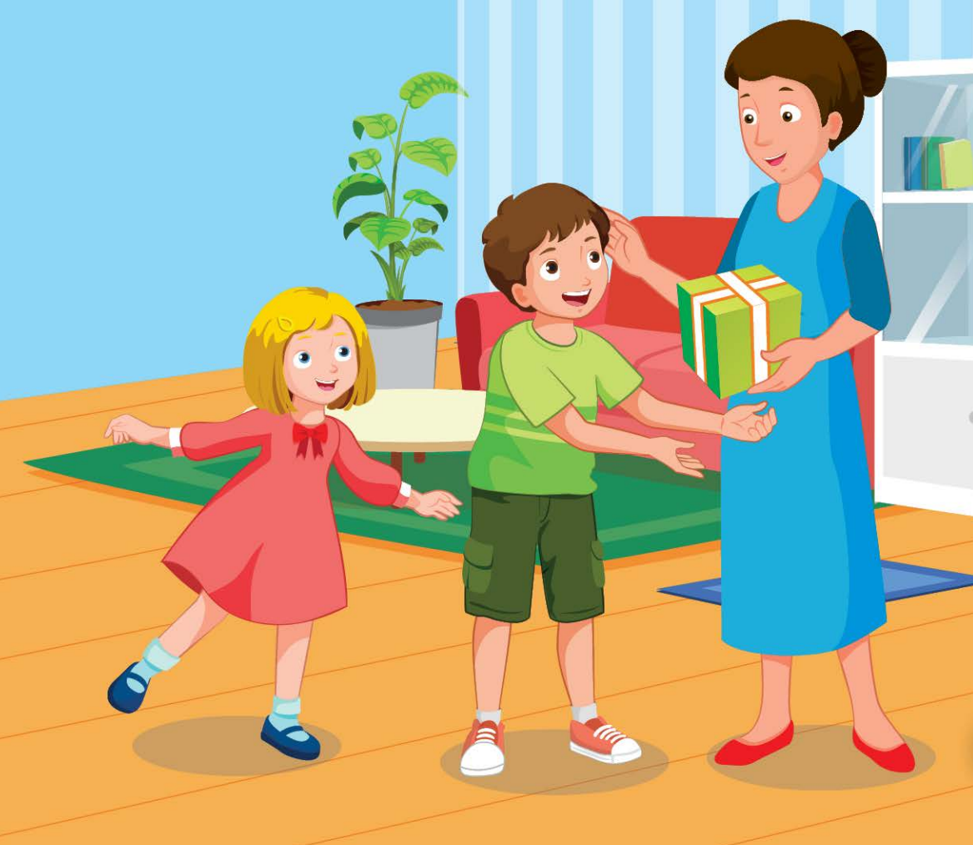
Children's Day

Slide 11

It’s time to learn …

Slide 12

Stress
'Christmas, 'Teachers' Day,
'Children's Day

Slide 13
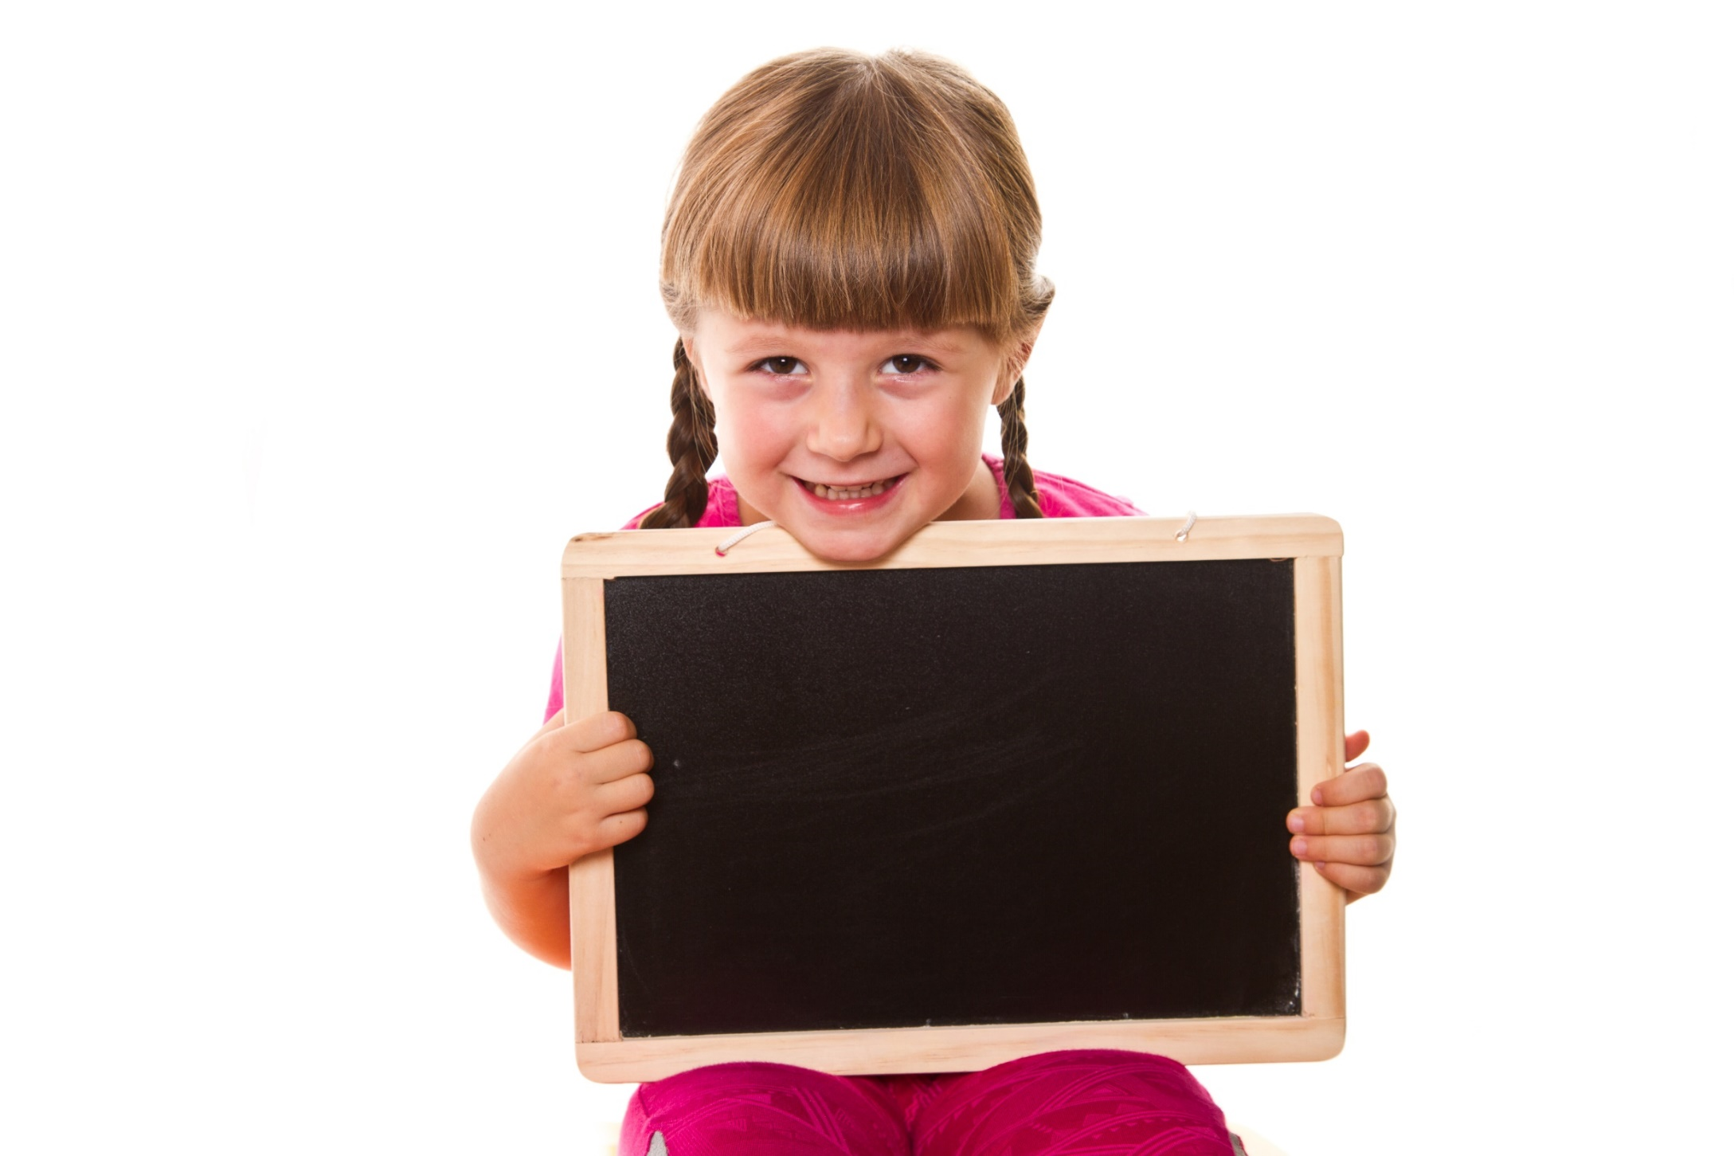
Listening

Slide 14
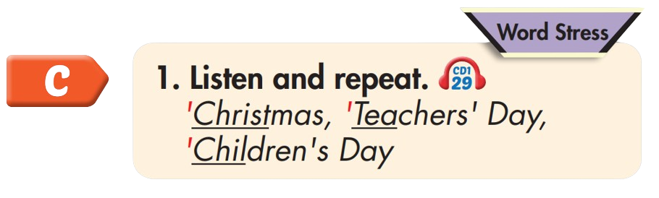

'Christmas
'Teachers' Day
'Children's Day

Slide 15
Practice

Slide 16

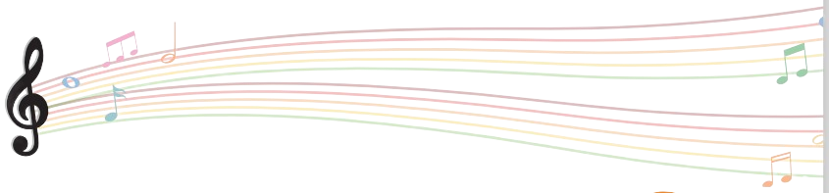

Slide 17
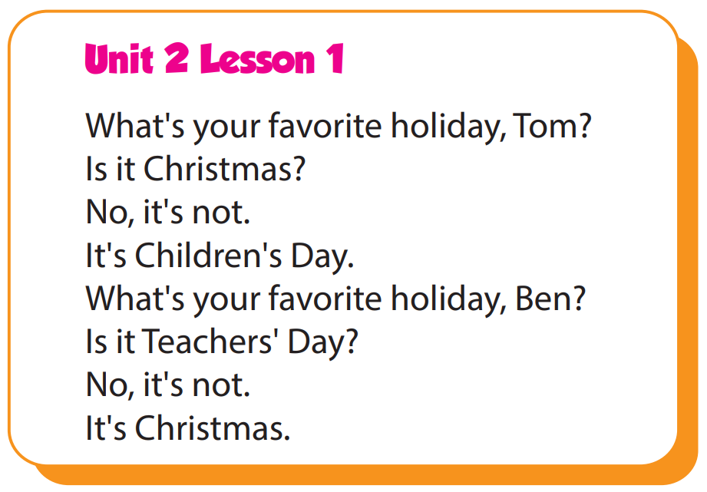

Slide 18
Structure
What's your favorite holiday?
- It's Halloween.
What's her favorite holiday?
- It's Christmas.

Slide 19
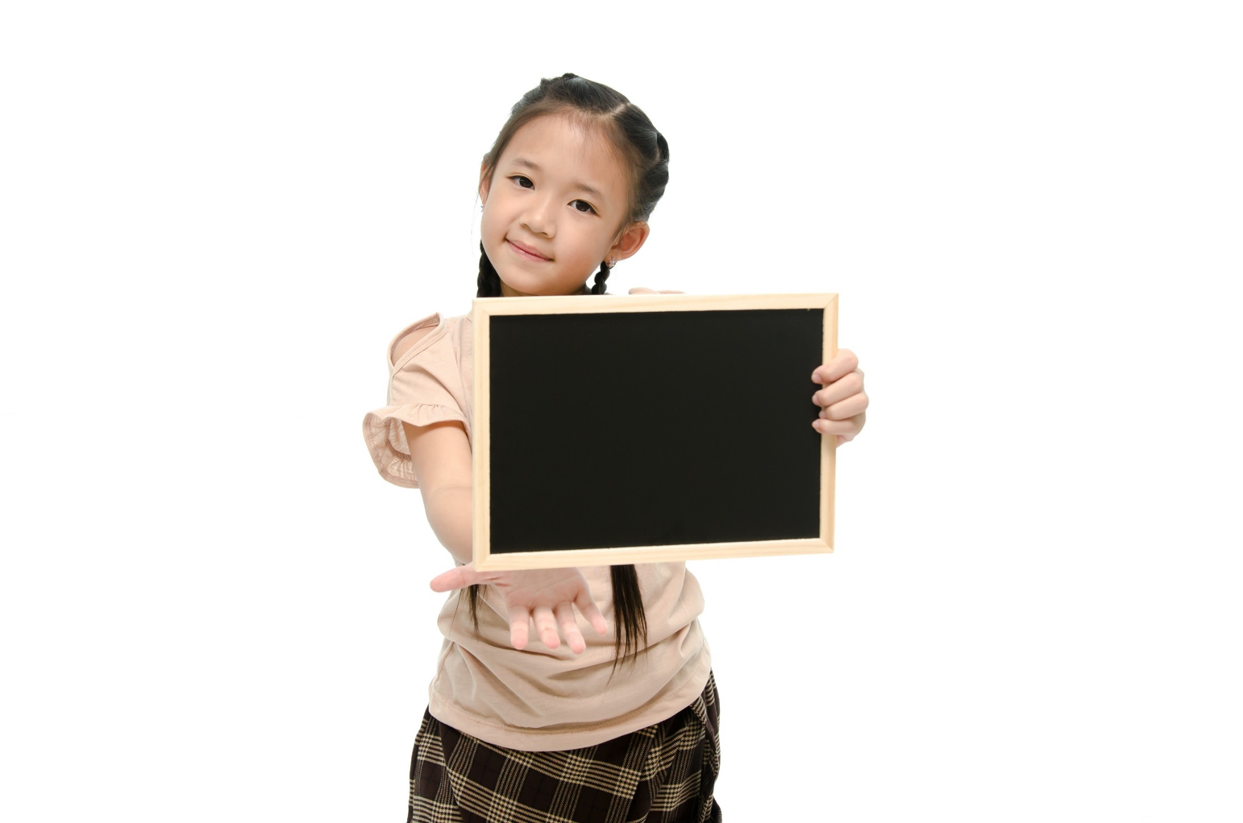
Speaking

Slide 20
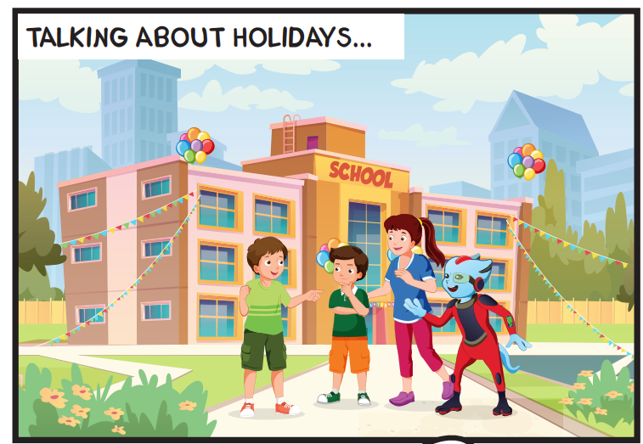
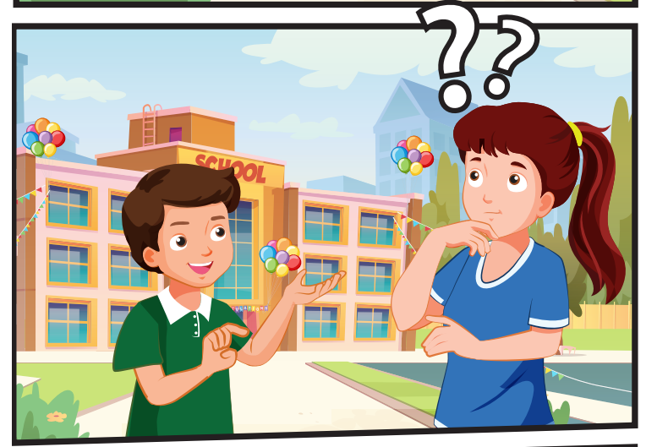
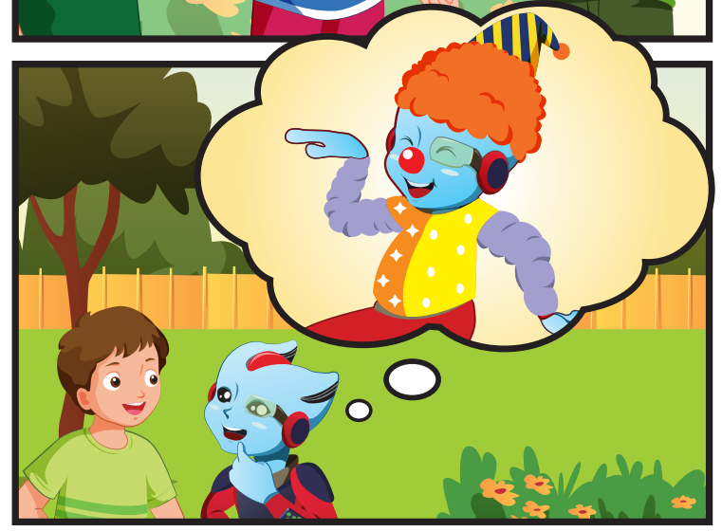
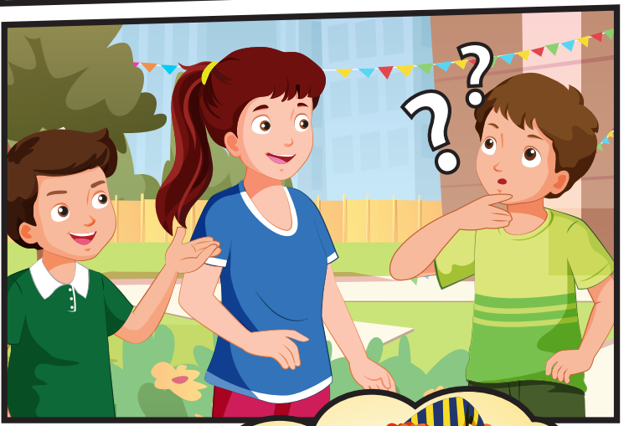
Who can you see?
(Tom, Ben, Lucy, Alfie

Slide 21
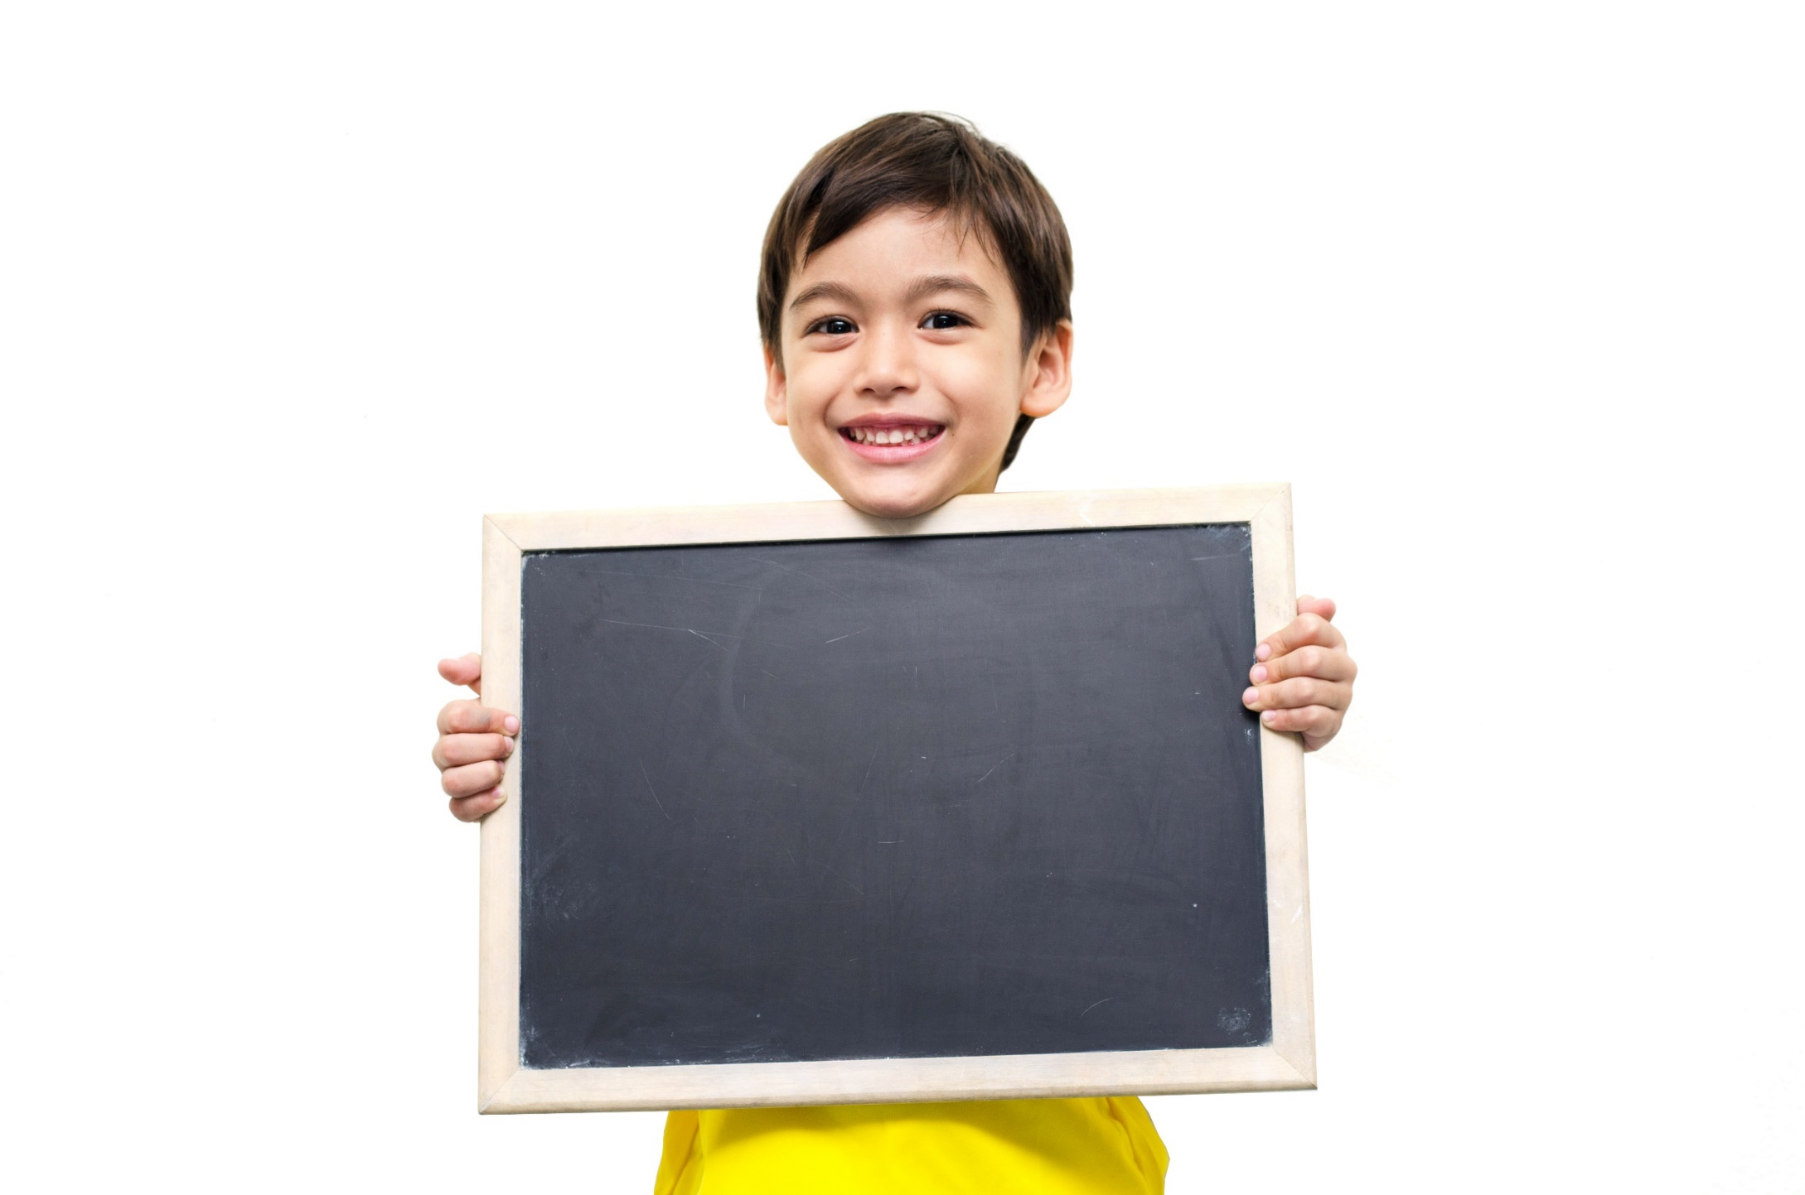
Listening

Slide 22
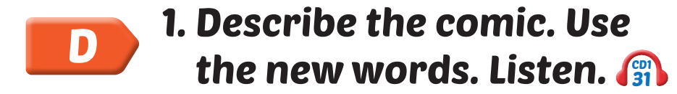

Slide 23

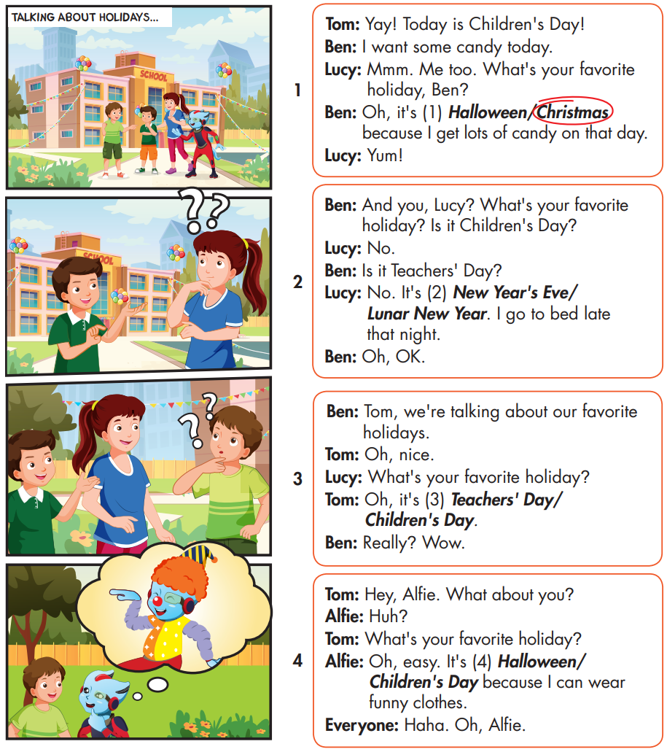

Slide 24
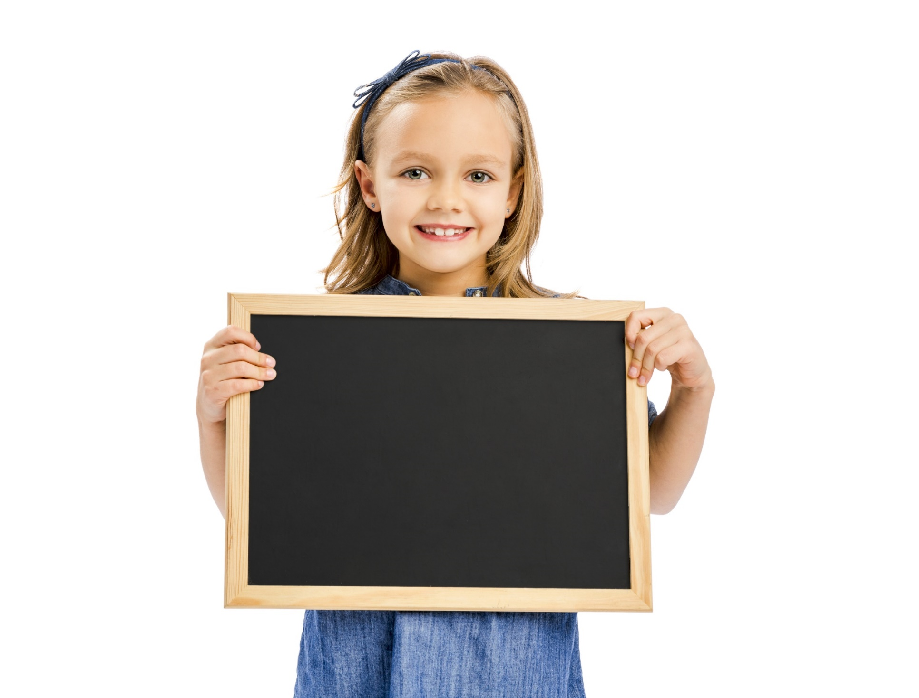
Speaking

Slide 25
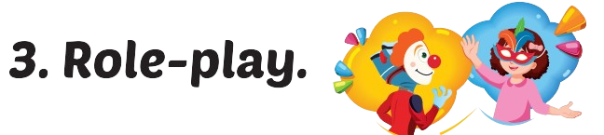
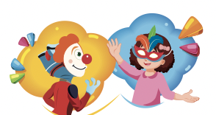

Slide 26
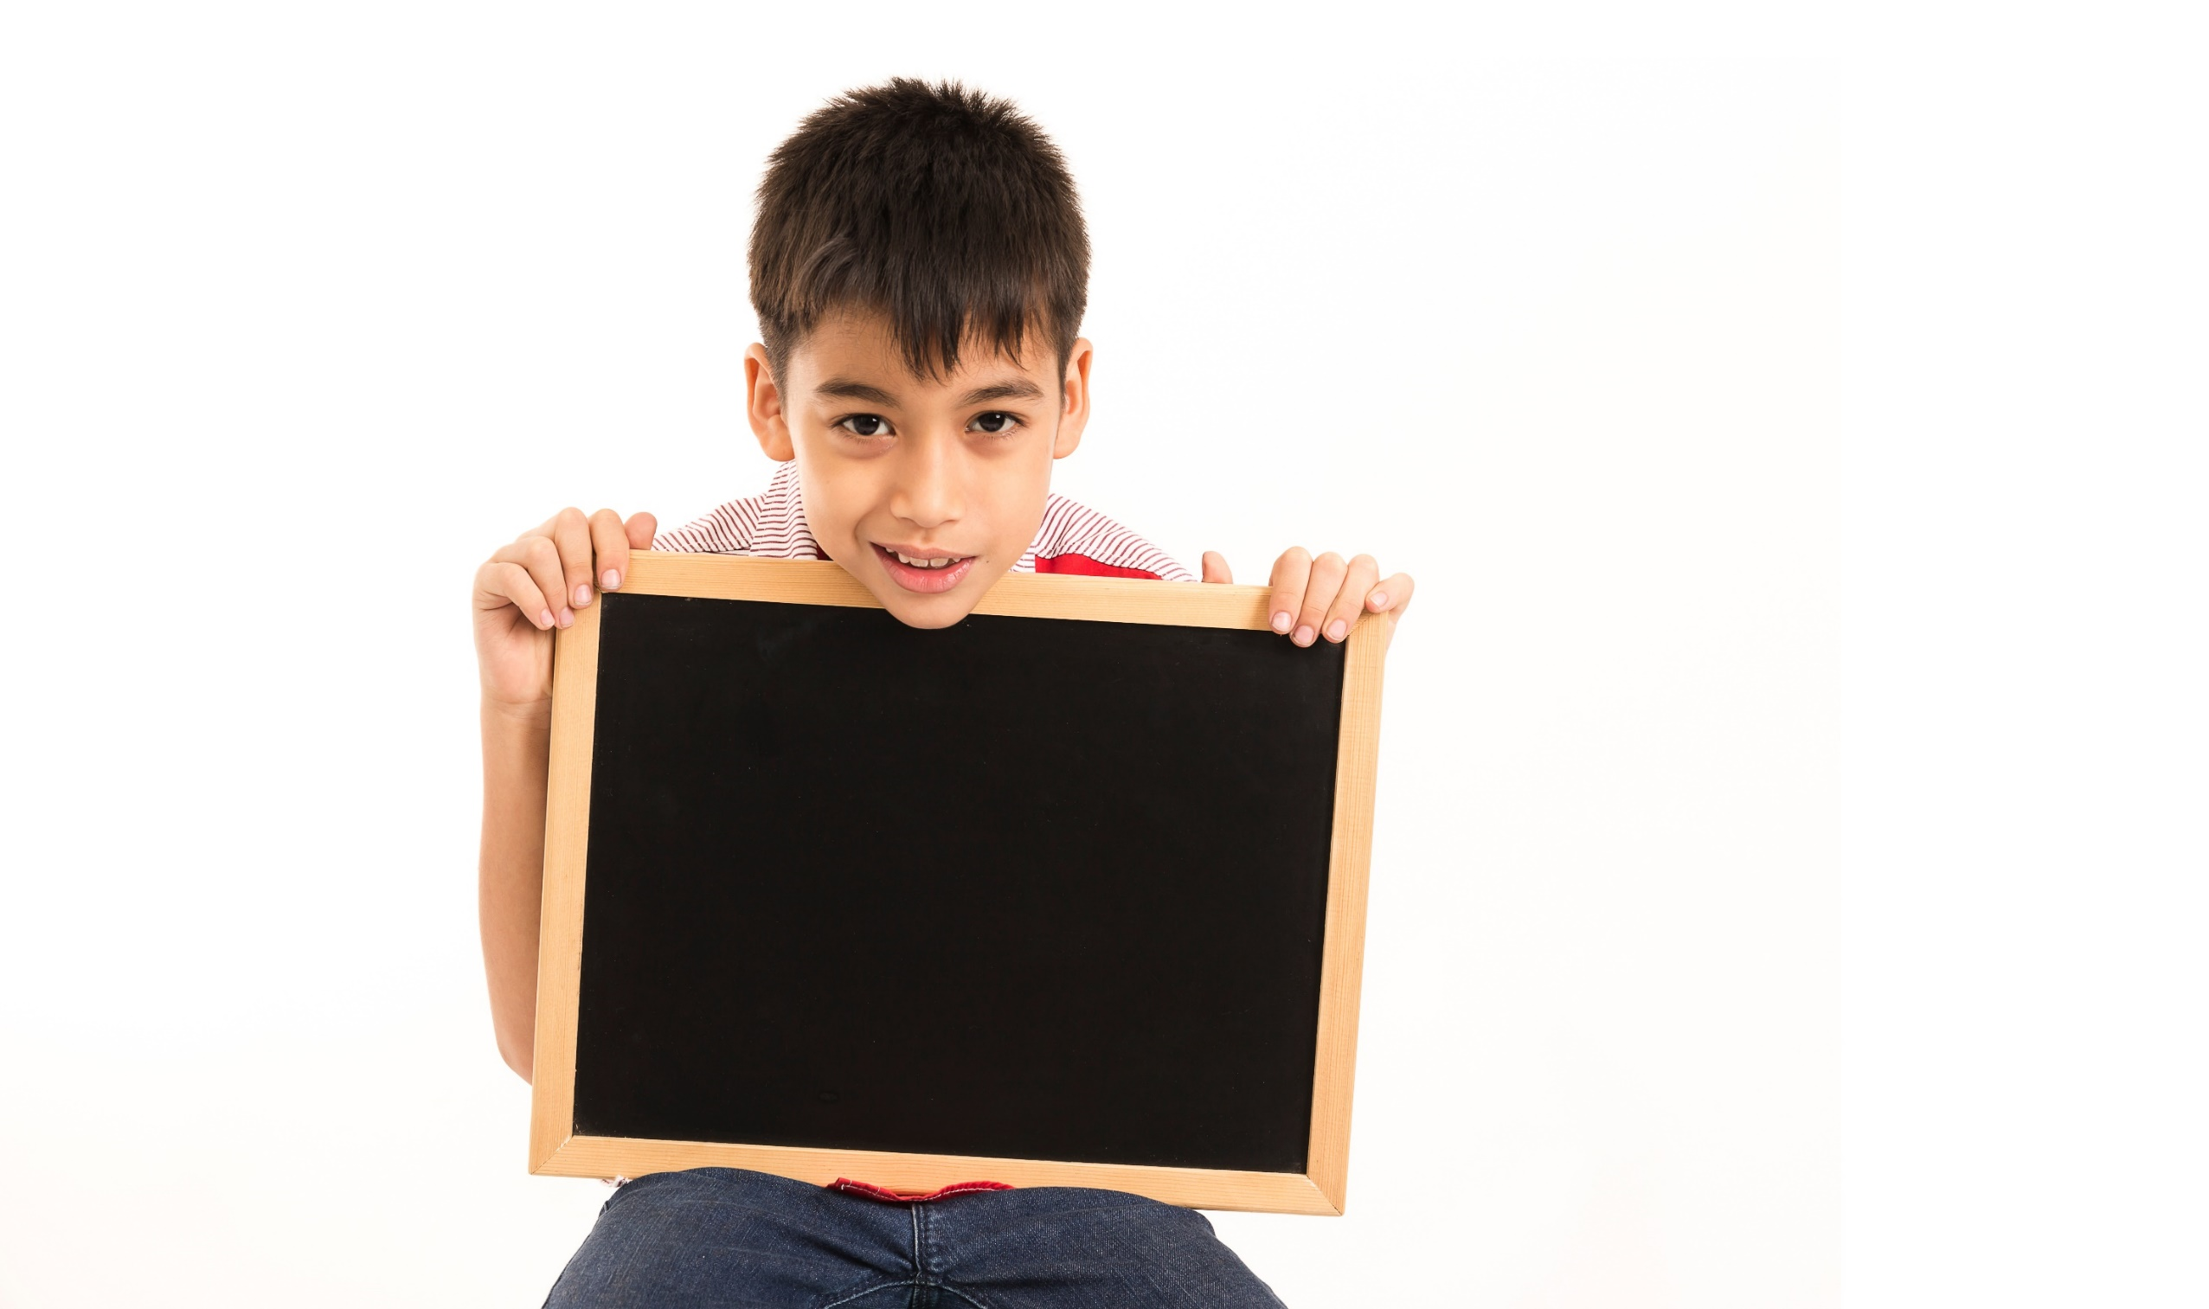
Writing

Slide 27
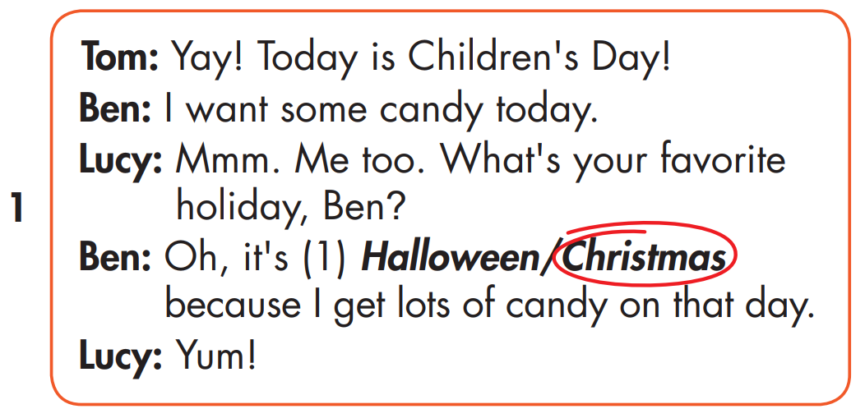
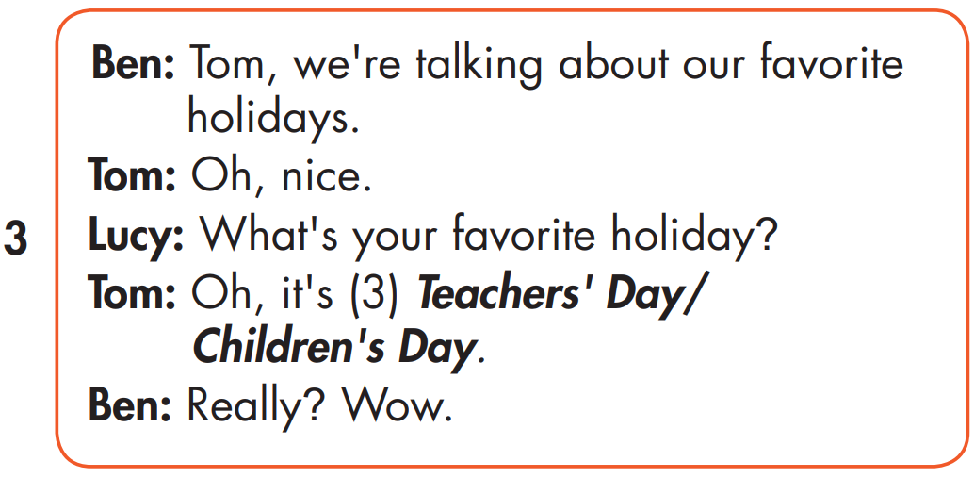
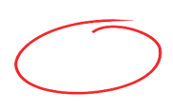
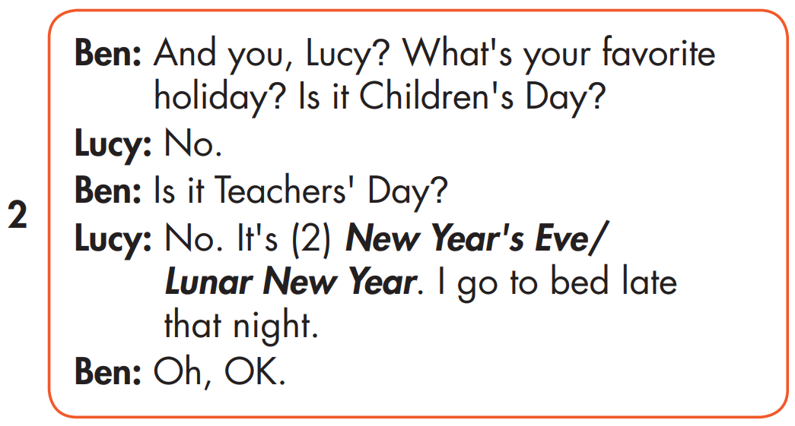
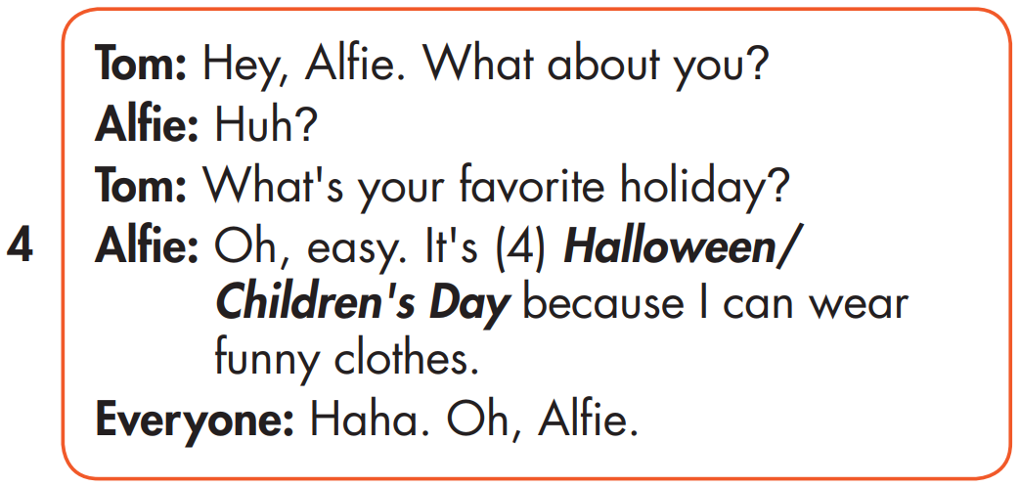
MAKE YOUR OWN STORY

Slide 28
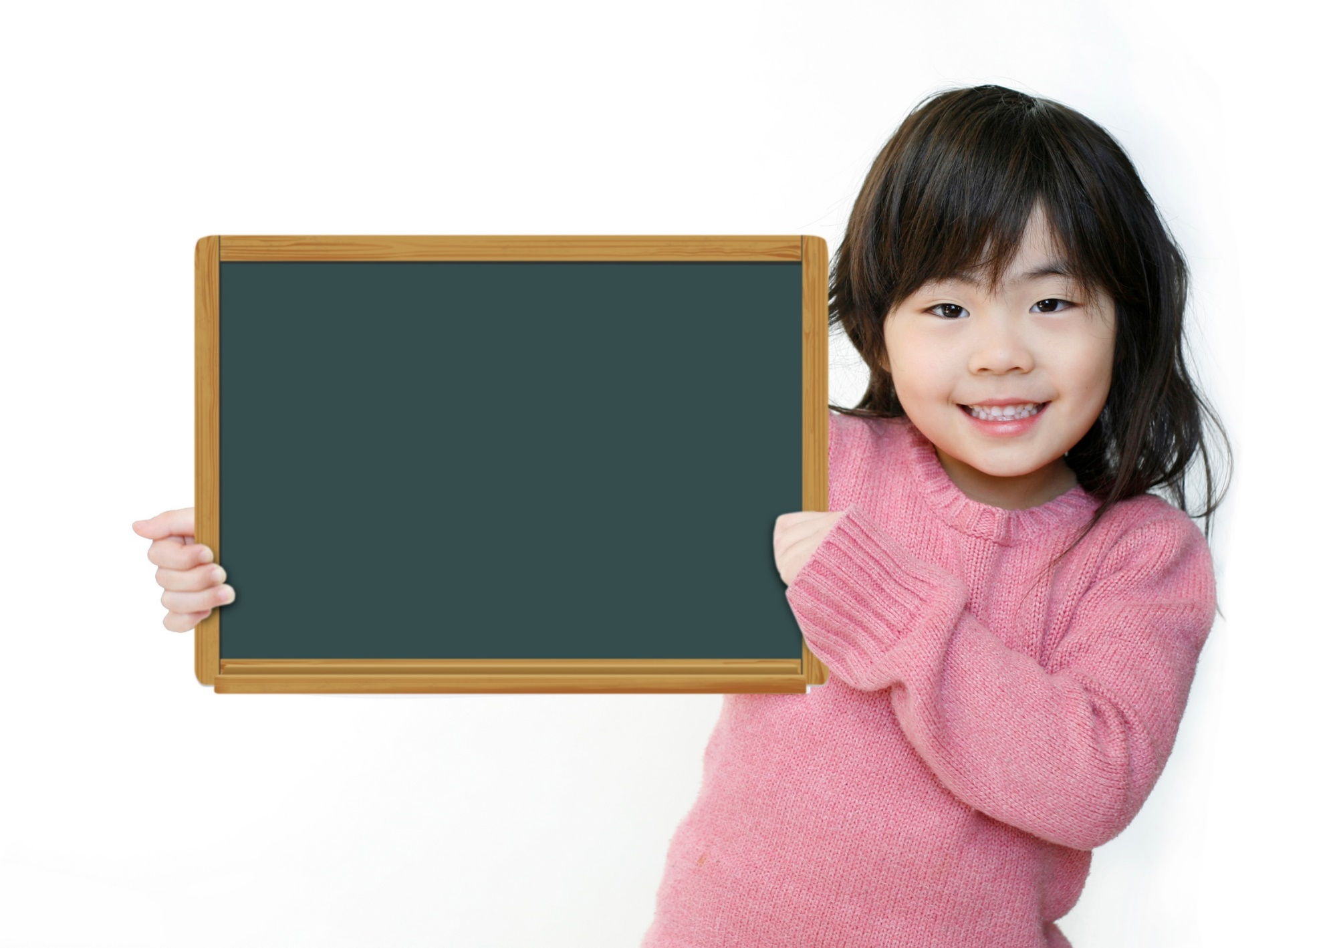
Production

Slide 29

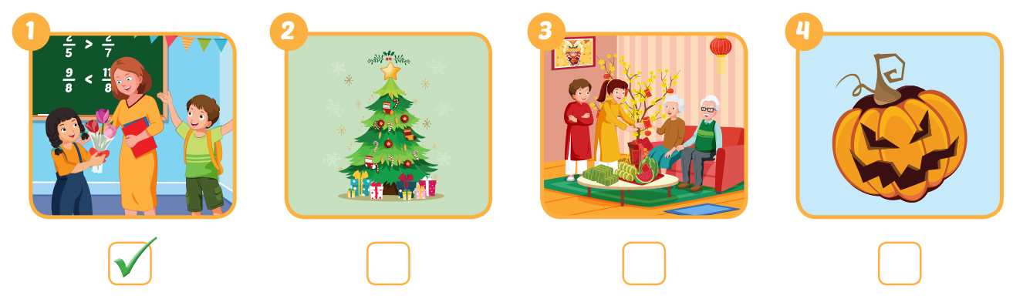


Extra Practice
WB, page 13

Slide 30

CONSOLIDATION

Slide 31
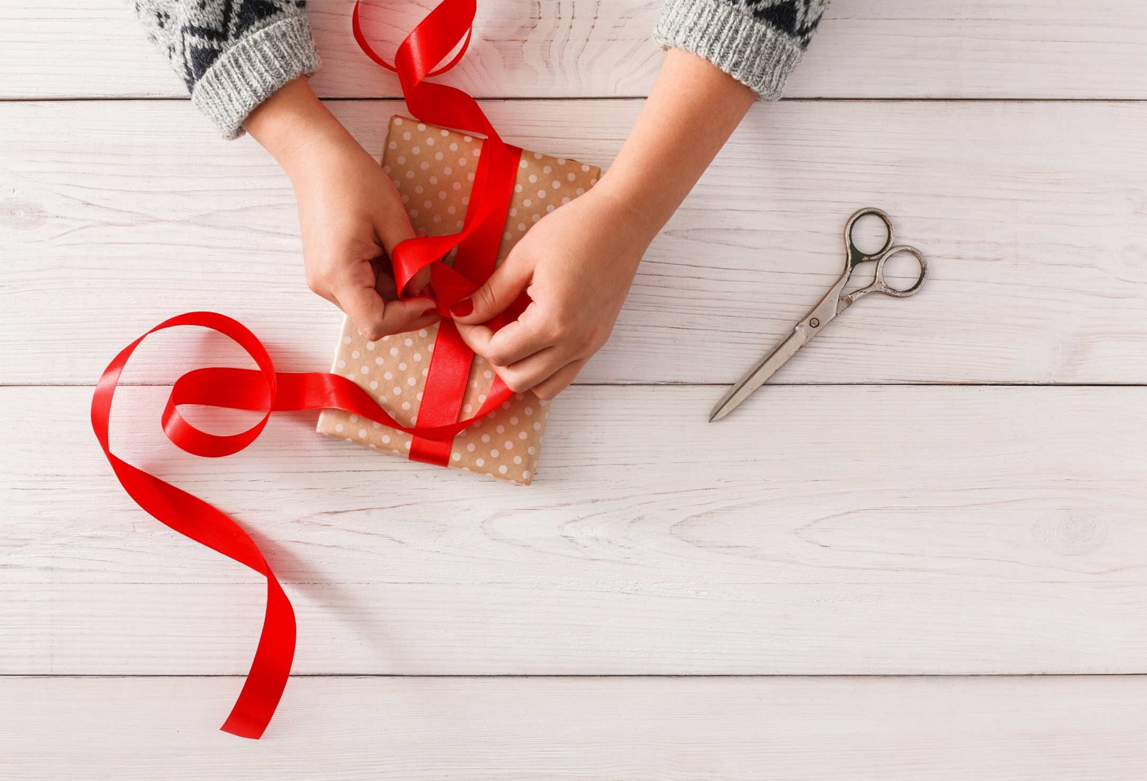
WRAP-UP

Slide 32
Today’s lesson
Stress
For most holidays, we usually stress the first syllable.
Structures/ Sentence patterns
What's your favorite holiday?
- It's Halloween.
What's her favorite holiday?
- It's Christmas.

Slide 33
Homework
Practice the vocabularies and structure, and make sentences using them.
Do the exercises in Tiếng Anh 5 i-Learn Smart Start WB (page 13)
Do the exercises in Tiếng Anh 5 i-Learn Smart Start Notebook (page 10)
Prepare the next lesson (page 22 SB)
Play the consolidation games in Tiếng Anh 5 i-Learn Smart Start DHA App on www.eduhome.com.vn

