Slide 1























Slide 2

Unit 1:
FAMILY AND FRIENDS
Lesson 2 – Part 1, 2, 3

Slide 3





Table of contents
01
02
Warm - up
Presentation
05
04
Wrap-up & Assessment
Production
03
Practice

Slide 4



01
Warm up

Slide 5

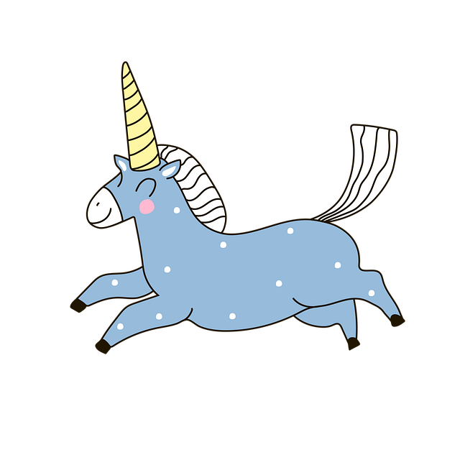
1
Choose an unicorn!
2
3
4
Next

Slide 6

Find the mistake in the sentence
Find the mistake in the sentence
Both Lucas or Noah are loud.
=> Both Lucas and Noah are loud.
Back

Slide 7


Find the mistake in the sentence
Both Becky is quiet, but Emma is loud.
=> Becky is quiet, but Emma is loud.
Back

Slide 8

Find the mistake in the sentence
Penguins can’t fly, both they can swim well.
=> Penguins can’t fly, but they can swim well.
Back

Slide 9

Find the mistake in the sentence
Both Anna and Tom loves dogs.
=> Both Anna and Tom love dogs.
Back

Slide 10
02
Presentation

Slide 11

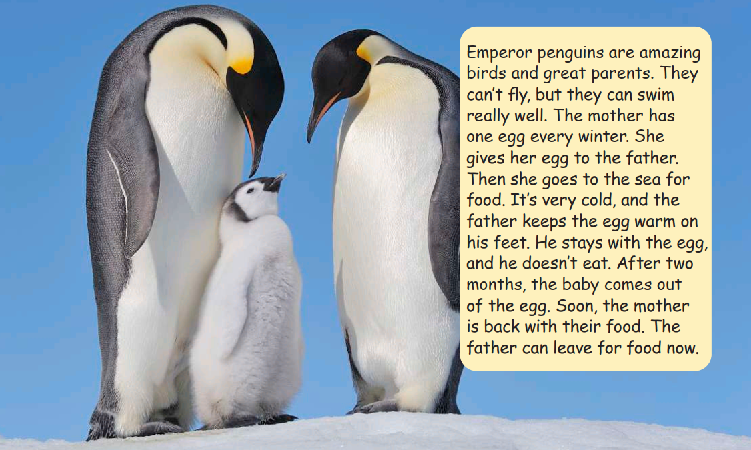
Emperor penguins are amazing birds and great parents. They can’t fly, but they can swim very well. The mother has one egg every winter. She gives her egg to the father. Then she goes to the sea for food. It’s very cold, and the father keep the egg warm on his feet. He stays with the egg, and he doesn’t eat. After two months, the baby comes out of the egg. Soon, the mother is back with their food. The father can leave for food now.

Slide 12


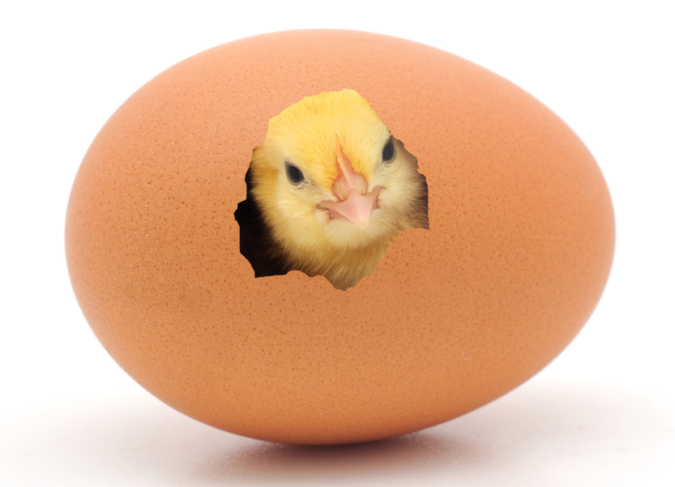

come out of

Slide 13

keep warm

Slide 14

leave

Slide 15


parents

Slide 16
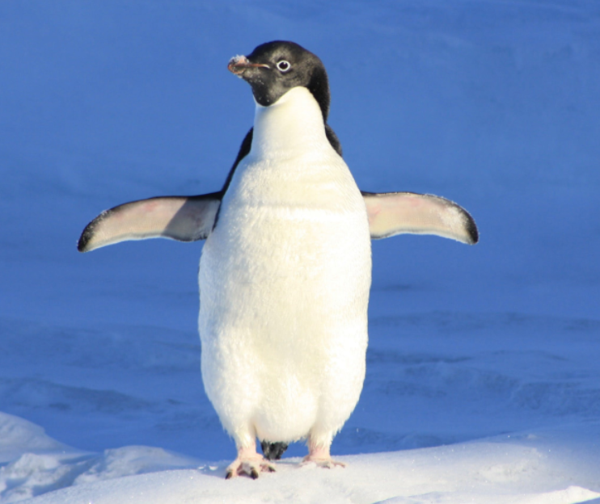
penguin

Slide 17

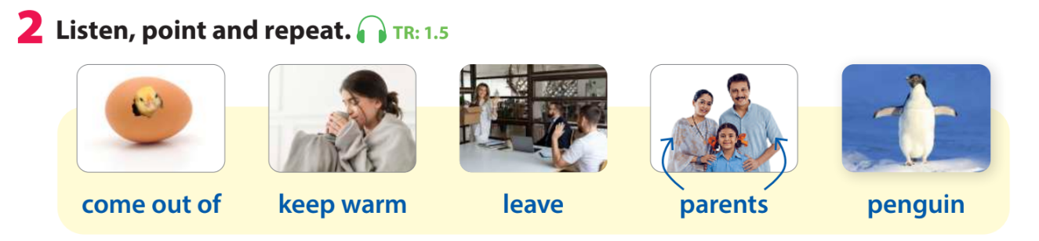


Slide 18


Let’s play a game!
Look and say the word

Slide 19
Look and say the word
leave

Slide 20
Look and say the word
parents

Slide 21
Look and say the word
Keep warm

Slide 22
Look and say the word
penguin

Slide 23
Look and say the word
come out of

Slide 24
03
Practice

Slide 25


Listen again. Then read.
Emperor penguins are amazing birds and great parents. They can’t fly, but they can swim very well. The mother has one egg every winter. She gives her egg to the father. Then she goes to the sea for food. It’s very cold, and the father keep the egg warm on his feet. He stays with the egg, and he doesn’t eat. After two months, the baby comes out of the egg. Soon, the mother is back with their food. The father can leave for food now.
How do emperor penguins keep their eggs warm?

Slide 26
Rearrange the sentences
?
The father can leave for food now.
?
The mother has one egg every winter.
?
He stays with the egg and he doesn’t eat.
?
The father keeps the egg warm on his feet.
?
After two months, the baby comes out of the egg.
?
She gives her egg to the father.

Slide 27
Rearrange the sentences
6
The father can leave for food now.
1
The mother has one egg every winter.
4
He stays with the egg and he doesn’t eat.
3
The father keeps the egg warm on his feet.
5
After two months, the baby comes out of the egg.
2
She gives her egg to the father.

Slide 28
Rearrange the sentences
1
The mother has one egg every winter.
2
She gives her egg to the father.
3
The father keeps the egg warm on his feet.
4
He stays with the egg and he doesn’t eat.
5
After two months, the baby comes out of the egg.
6
The father can leave for food now.

Slide 29
04
Production

Slide 30
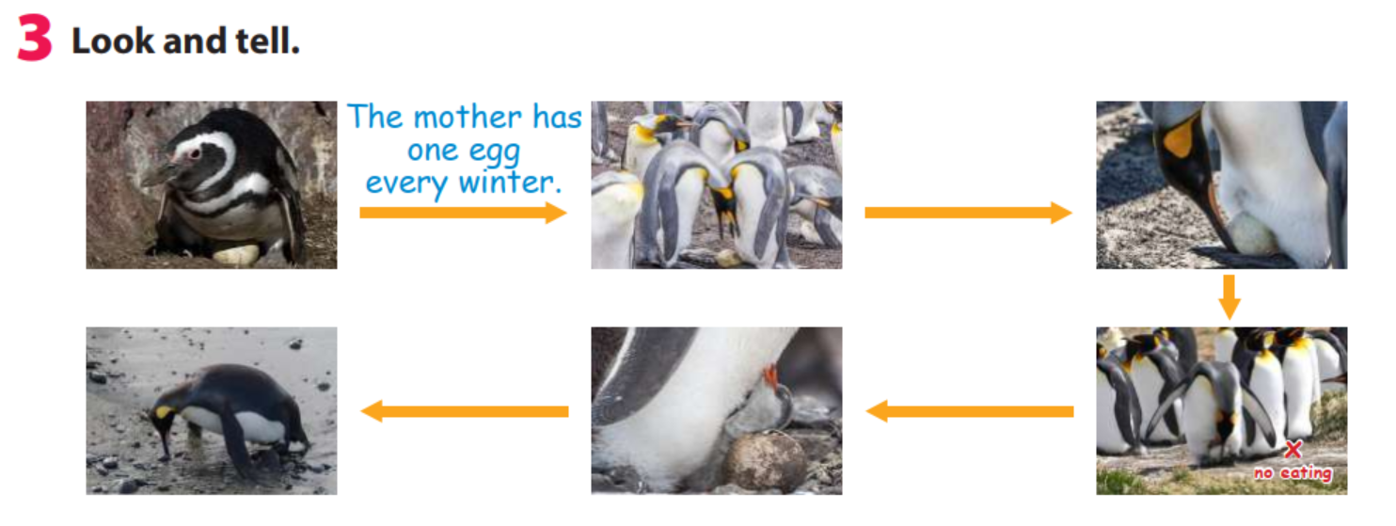

The mother has one egg every winter.
She gives her egg to the father.
?
The father keeps the egg warm on his feet.
The baby comes out of the egg.
?
?
The father can leave for food now.
He stays with the egg and he doesn’t eat.
?
?

Slide 31
05
Wrap-up &
Assessment

Slide 32
Write
warm
leave
parents
Penguins
comes out of
Emperor penguins are great _________.
_______ can’t fly, but they can swim very well.
The father keeps the egg ____ on his feet.
After two months, the baby _________ the egg.
The father can _____ for food when the mother is back.

Slide 33
Wrap up
Unit 1: Family and friends Lesson 2 – Part 1,2,3
What have we learnt today?
New words: come out of, keep warm, leave, parents, penguin
Show and tell: A story about the penguin’s family

Slide 34


Thank you
& goodbye!

