Slide 1









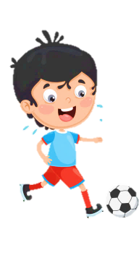













Slide 2
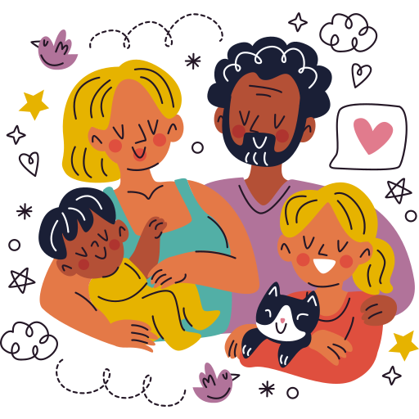
Unit 1:
FAMILY AND FRIENDS
Lesson 1 – Part 4, 5, 6

Slide 3





Table of contents
01
02
Warm - up
Presentation
05
04
Wrap-up &
Assessment
Production
03
Practice

Slide 4


01
Warm up

Slide 5

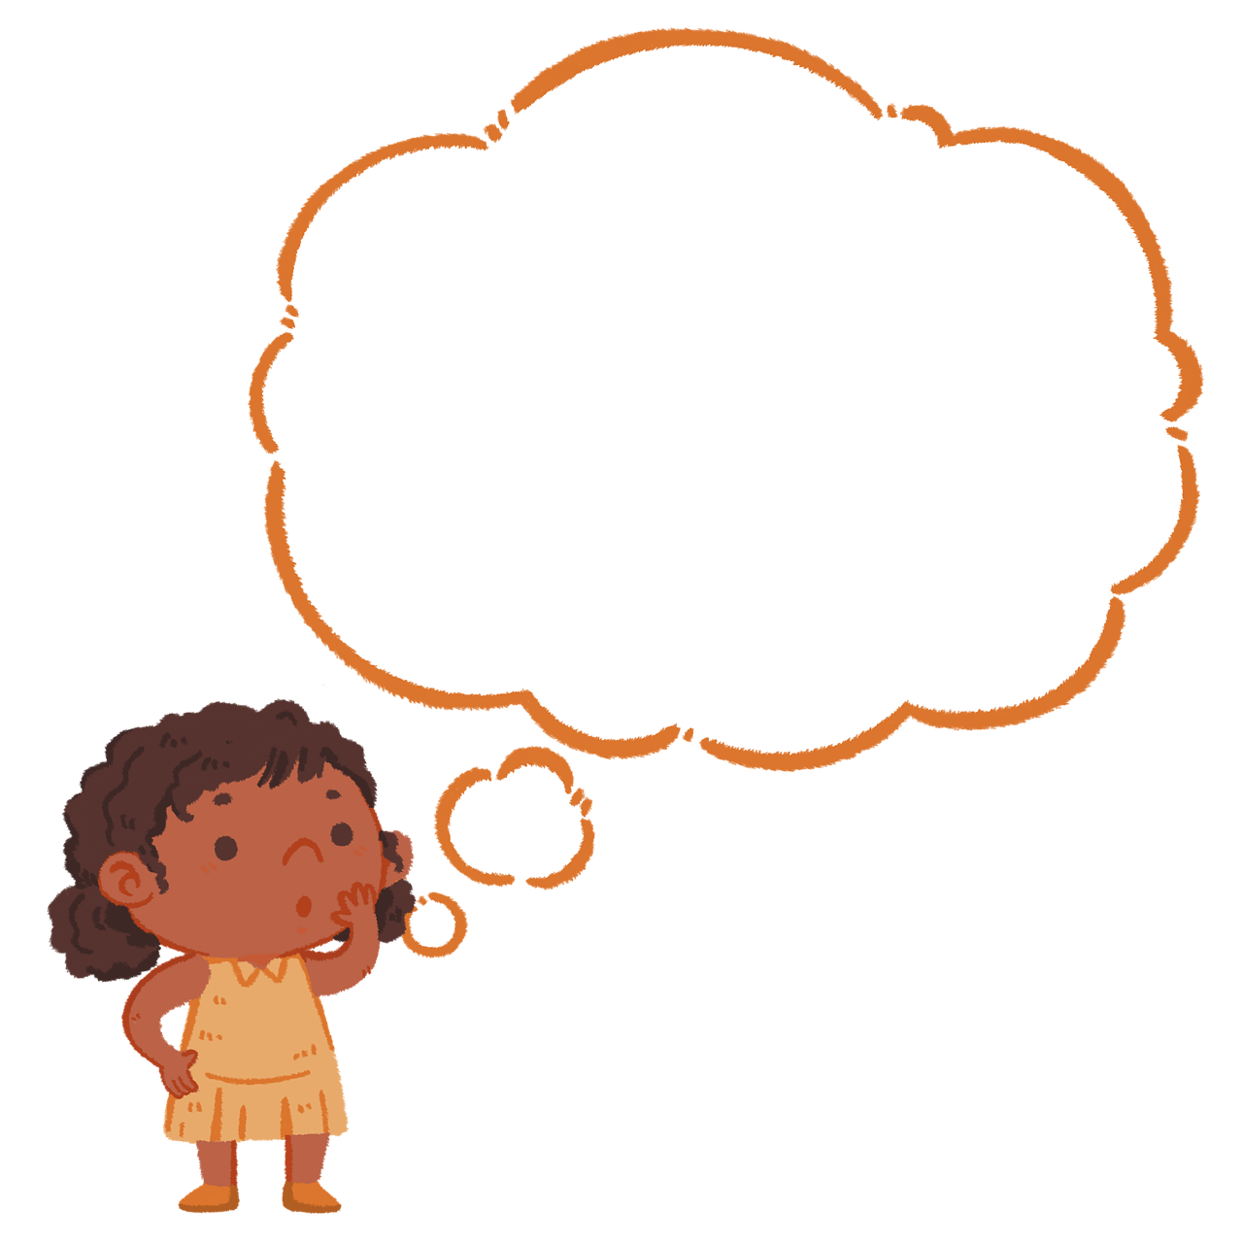
Look and answer
“What letters are missing?”

Slide 6


What letters are missing?
_am_
c_eve_
s
e

Slide 7

What letters are missing?
c_eve_
c_eve_
l
r

Slide 8
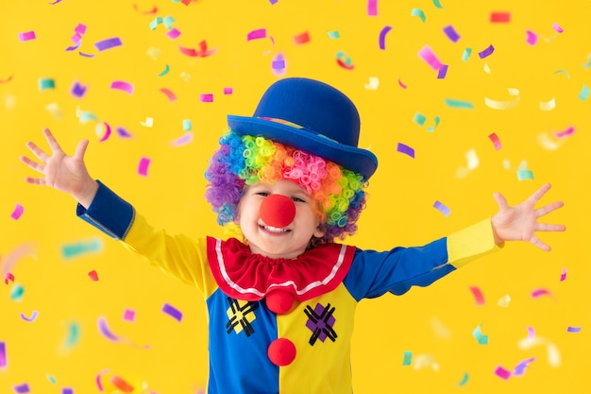
What letters are missing?
f
_ _nny
c_eve_
u

Slide 9

What letters are missing?
d
lo_ _
c_eve_
u

Slide 10

What letters are missing?
a
y
cr_z_ a_out
c_eve_
b

Slide 11

What letters are missing?
q
t
_uie_
c_eve_

Slide 12
What letters are missing?
dif_e_en_
c_eve_
f
r
t

Slide 13
02
Presentation

Slide 14

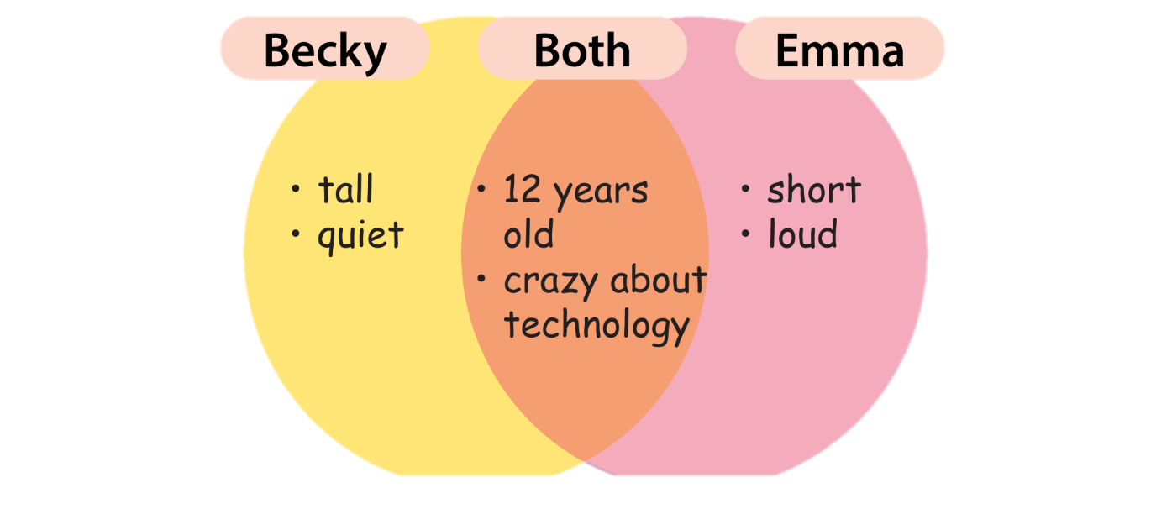


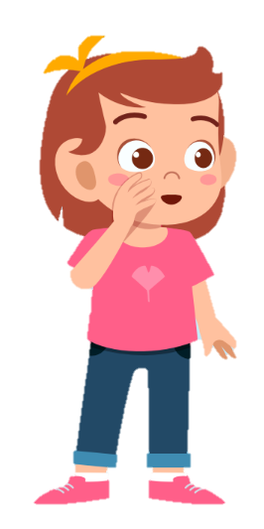
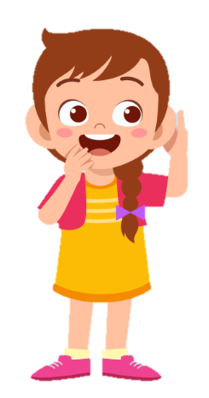

Slide 15
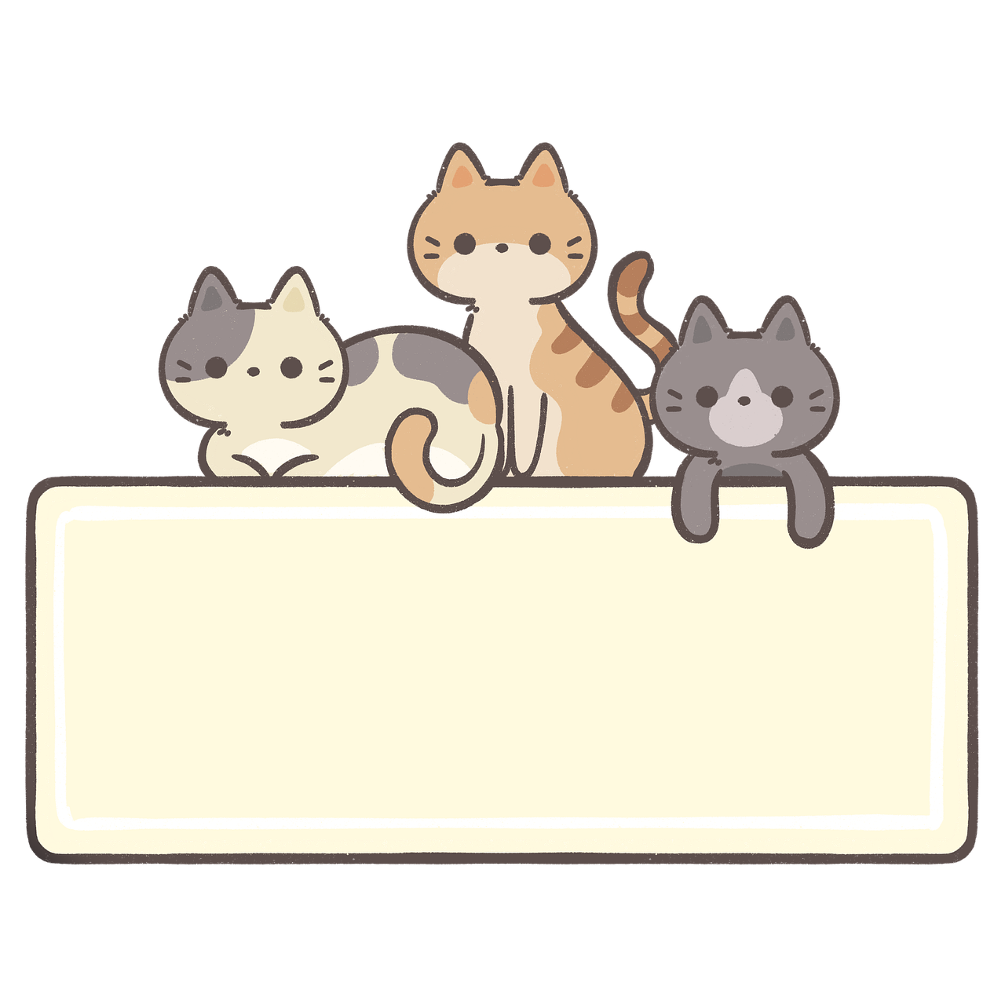
Both ….. and

Slide 16

Both Becky and Emma are crazy about technology.

Slide 17
Make a sentence, using “both”!
Both Becky and Emma are 12 years old.

Slide 18
but

Slide 19
Becky is quiet, but Emma is loud.

Slide 20
Make a sentence, using “but”!
Becky is tall, but Emma is short.

Slide 21
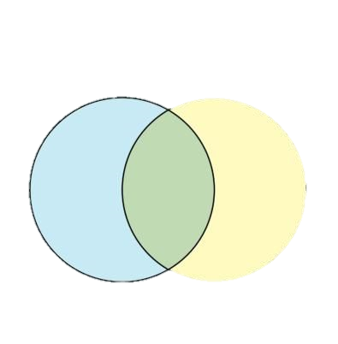
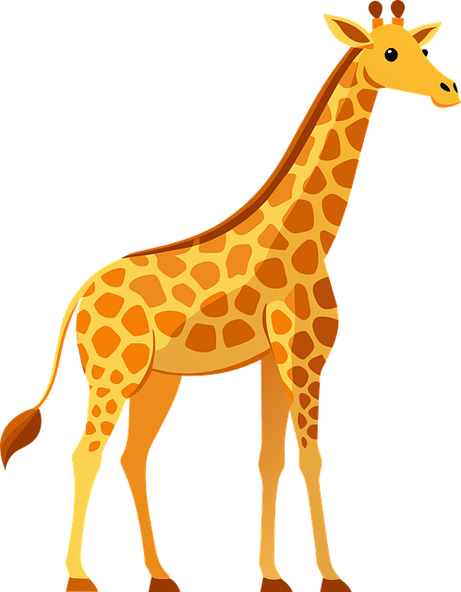

Look and write
big ears
small ears
live on land
but
The giraffe has small ears, _____ the elephant has big ears.
Both
_____ the giraffe and the elephant live on land.

Slide 22
03
Practice

Slide 23

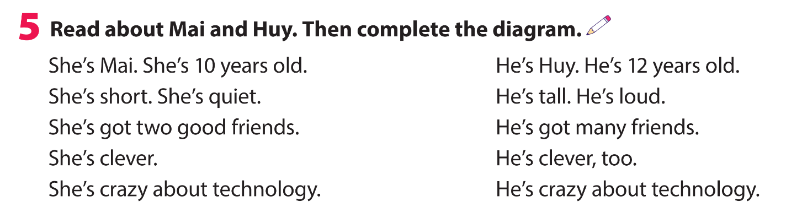
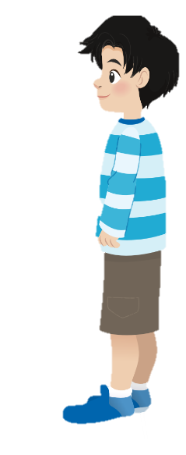
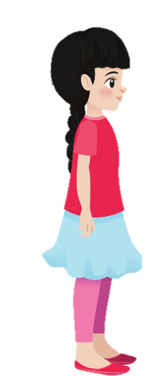
She’s Mai. She’s 10 years old.
He’s Huy. He’s 12 years old.
She’s short. She’s quiet.
He’s tall. He’s loud.
She’s got two good friends.
He’s got many friends.
She’s clever.
He’s clever, too.
She’s crazy about technology.
He’s crazy about technology.

Slide 24
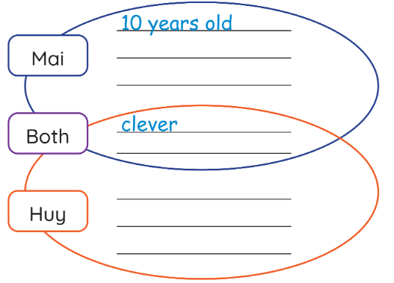
short
quiet
crazy about technology.
12 years old
tall
loud

Slide 25
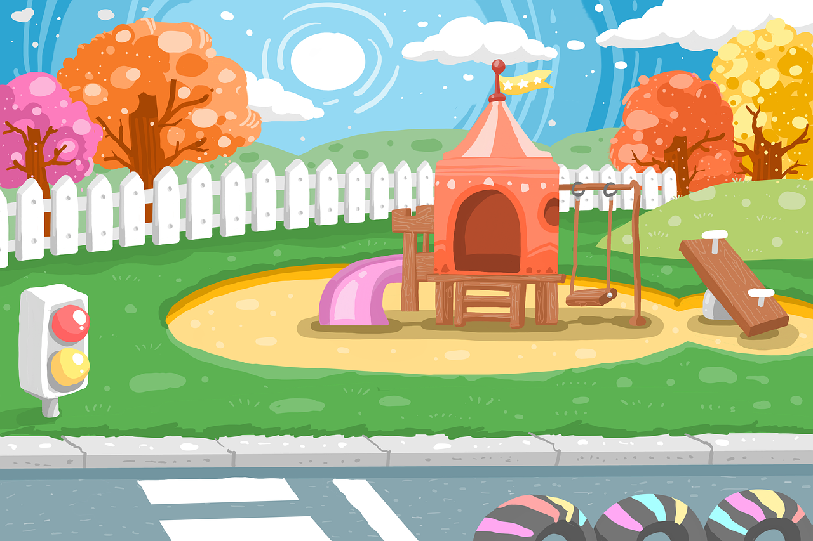



Read and write
“Both” - ”But”
crazy about technology
crazy about technology
Both Mai and Huy are crazy about technology.

Slide 26
Read and write
“Both” - ”But”
tall
short
Mai’s short, but Huy’s tall.

Slide 27
Read and write
“Both” - ”But”
clever
clever
Both Mai and Huy are clever.

Slide 28
Read and write
“Both” - ”But”
12 years old
10 years old
Mai’s 10 years old, but Huy’s 12 years old.

Slide 29
04
Production

Slide 30


sister
Both my mum and my sister are tall.
quiet
tall
loud
mum
My mum is quiet, but my sister is loud.

Slide 31
05
Wrap-up &
Assessment

Slide 32

Reorder the words to make a sentence
funny/ Billy/ are/ Both/ Bee/ and/.
Both Billy and Bee are funny.
Both Bee and Billy are funny.

Slide 33
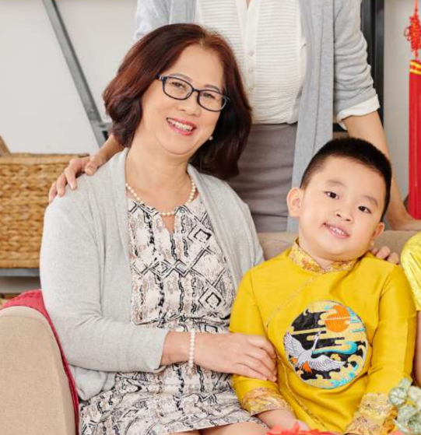
Reorder the words to make a sentence
my brother/ is/, but/ old/ young/ My grandma/ is.
My grandma is old, but my brother is young.

Slide 34

Reorder the words to make a sentence
about/ Bella/ Tim/ crazy/ science/ and/Both.
Both Bella and Tim are crazy about science.
Both Tim and Bella are crazy about science.

Slide 35
Wrap up
Unit 1: Family and friends
Lesson 1 – Part 4,5,6
What have we learnt today?
Structures:
Both Becky and Emma are 12 years old.
Becky is quiet, but Emma is loud.

Slide 36

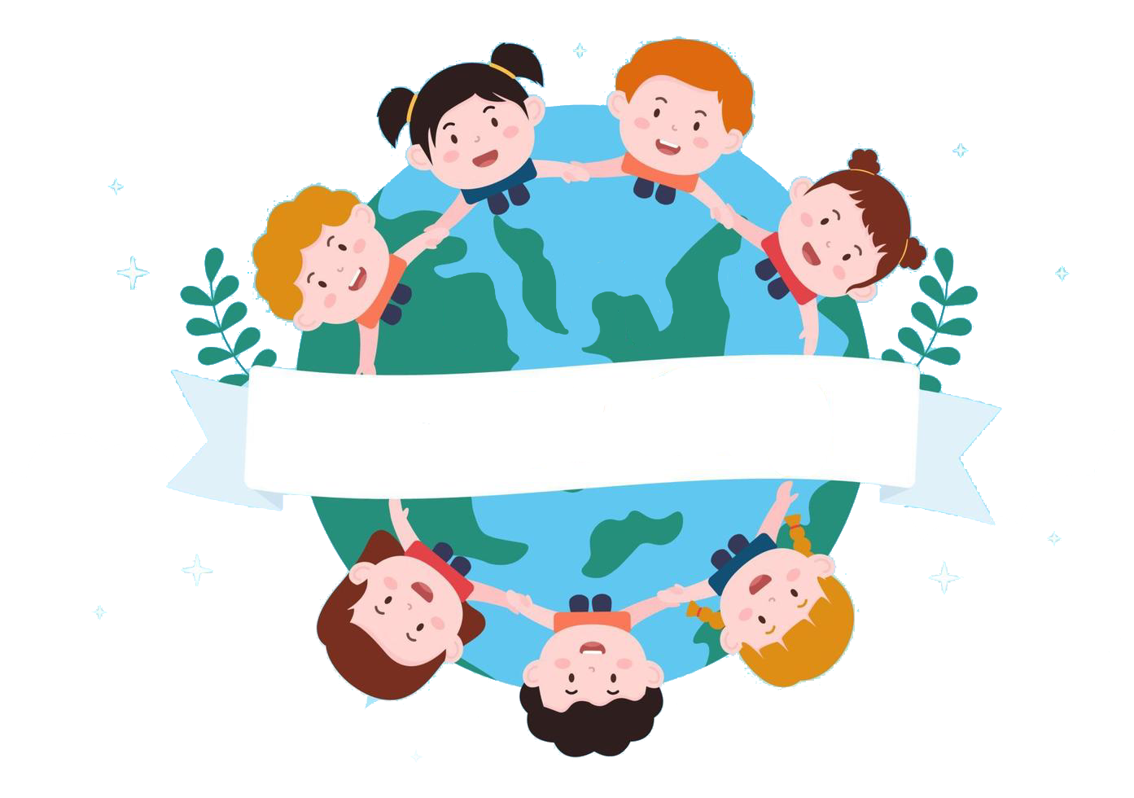
Thank you
& goodbye!

