Slide 1




















Review 6
Part 1

Slide 2










1.Warm up

Slide 3

Odd one out
sunny
spring
rainy

Slide 4
Odd one out
wet
get up
climb

Slide 5
Odd one out
Monday
Friday
April

Slide 6
Odd one out
autumn
summer
bus

Slide 7
2.Review

Slide 8



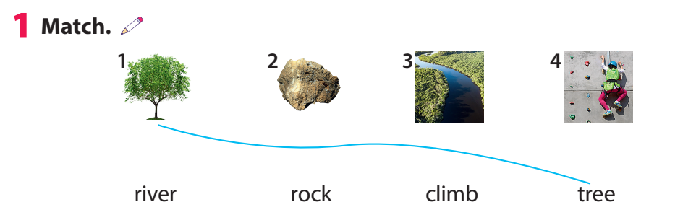

Slide 9
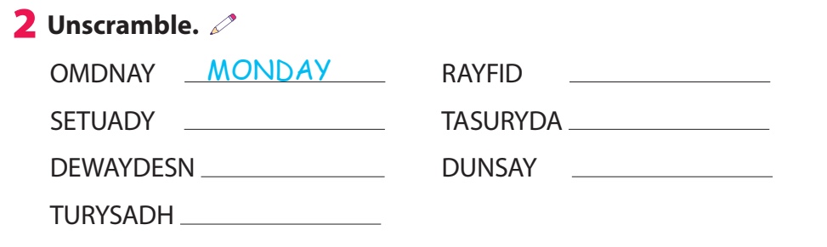
FRIDAY
TUESDAY
SATURDAY
WEDNESDAY
SUNDAY
THURSDAY

Slide 10
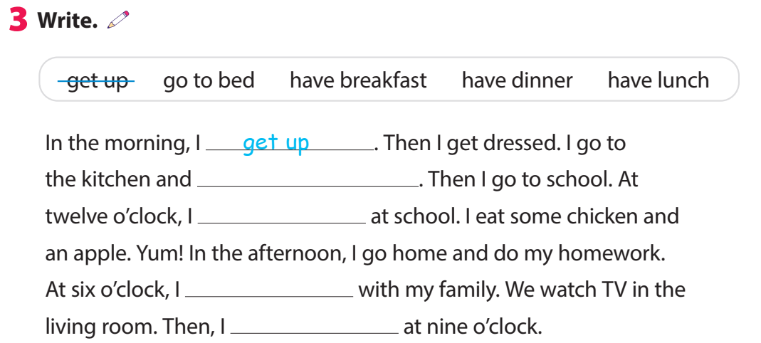
have breakfast
have lunch
have dinner
go to bed

Slide 11
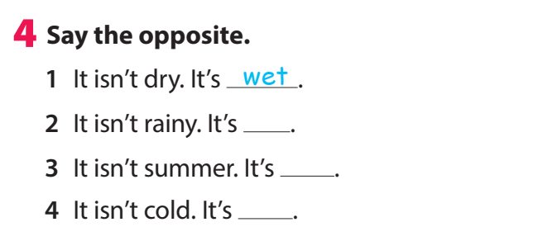
sunny
winter
hot

Slide 12
3.Extra activity

Slide 13



Task 1:Write .
Who find more words will be the winner!
Nature | Activities | Weather | Days | Transport
tree
hot
hot
tree

Slide 14
Task 2: Odd the letter out and say.
.
Let’s find the word
It’s Sunday.
Example:
Sunaday

Slide 15


Odd the letter out and say.
It’s rainy.
rainey

Slide 16

Odd letter out and say.
It’s motorbike.
mfotobike

Slide 17
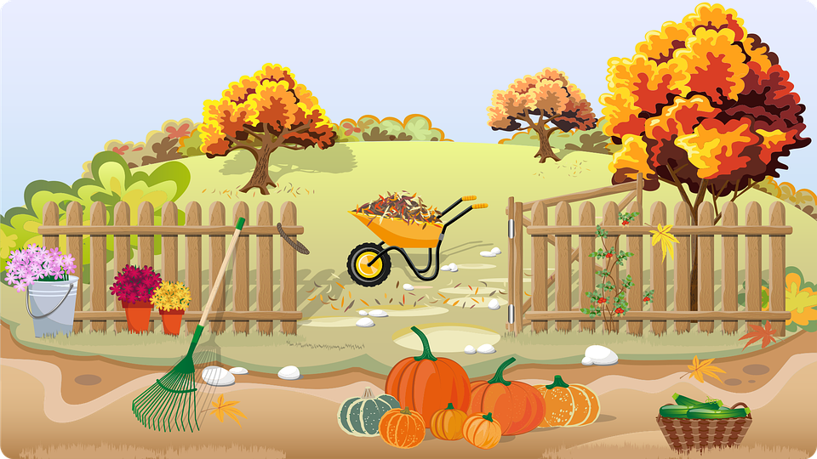
Odd the letter out and say.
It’s autumn.
autunmn

Slide 18



Thank you & goodbye!

