Slide 1








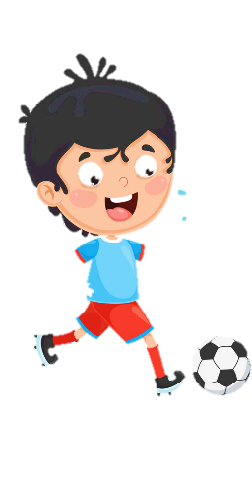











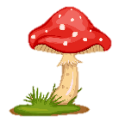
Unit 11
My day
Funtime & project

Slide 2





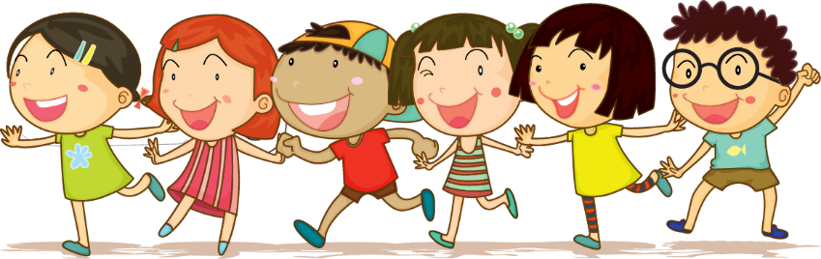



1 Warm up Cross river

Slide 3

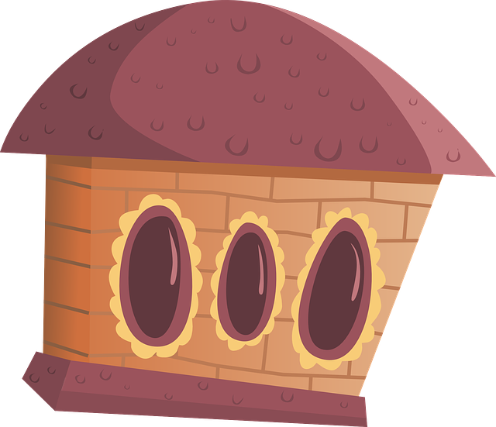
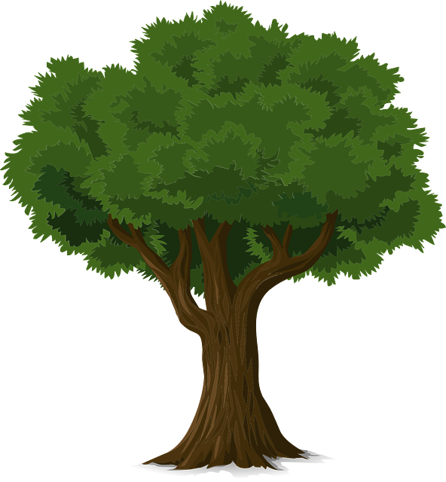
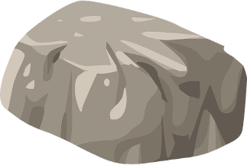
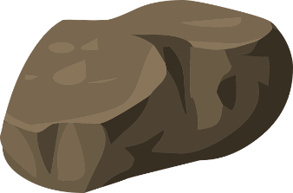
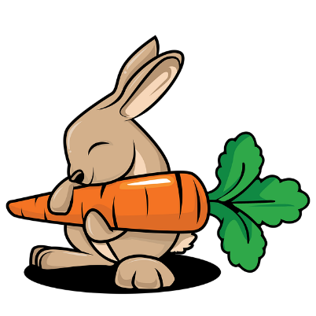

1
2
3
4
5
6
7
8
Practice
Notes:
T clicks numbers to show the questions, click the rabbit to make it move.

Slide 4
What day is it?
WDENESDYA
=> It’s Wednesday.
Back

Slide 5
Fill in the blanks
S_T_RDAY
A
U
Back

Slide 6
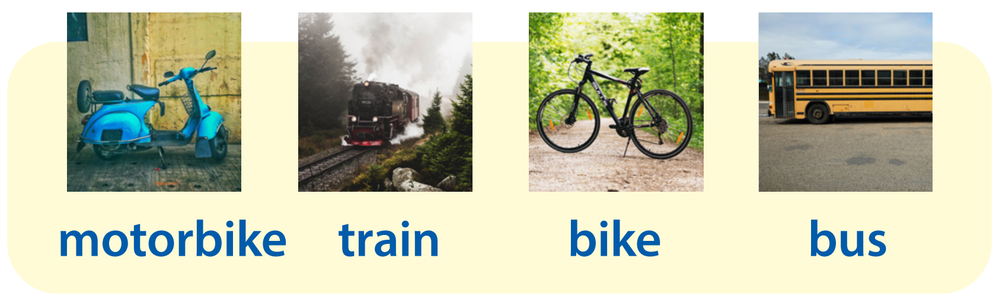
What is it?
=> It’s a motorbike.
Back

Slide 7
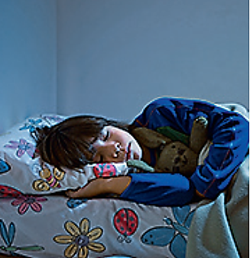
What action is it?
=> It’s “go to bed”.
Back

Slide 8
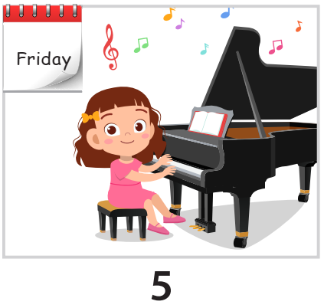
What do you do on Fridays?
=> I play the piano on Fridays.
Back

Slide 9


Fill in the blank
___________________?
By bus
How do you go to school
Back

Slide 10
Make the sentence
with/go/my sister/swimming/I
=> I go swimming with my sister.
Back

Slide 11
Fill in the blank.
- ____________________?
- I go to the park with my family.
=> Who do you go to the park with?
Back

Slide 12

2 Practice writing

Slide 13

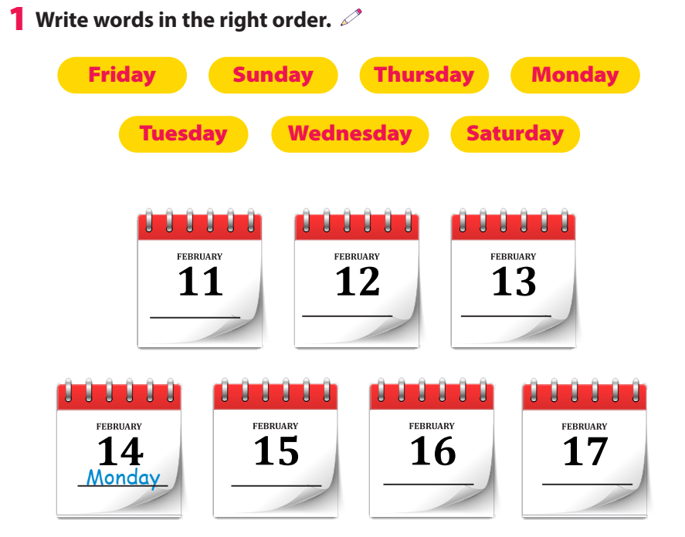
Friday
Saturday
Sunday
Tuesday
Wednesday
Thursday

Slide 14
3 Project
My week

Slide 15

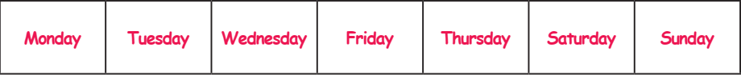
Write.
What do you do on ______?

Slide 16
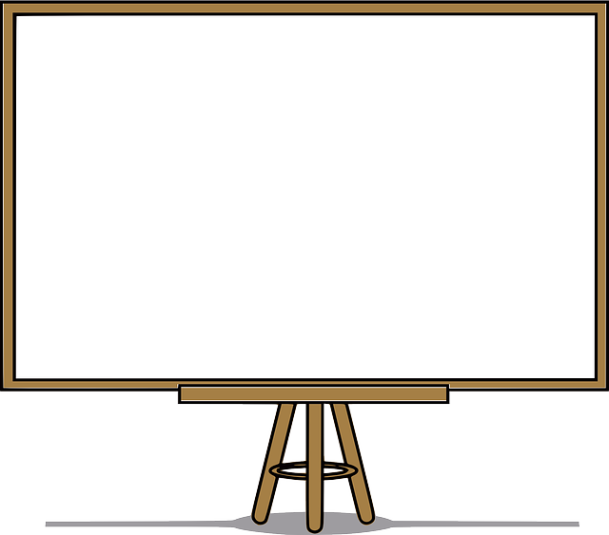
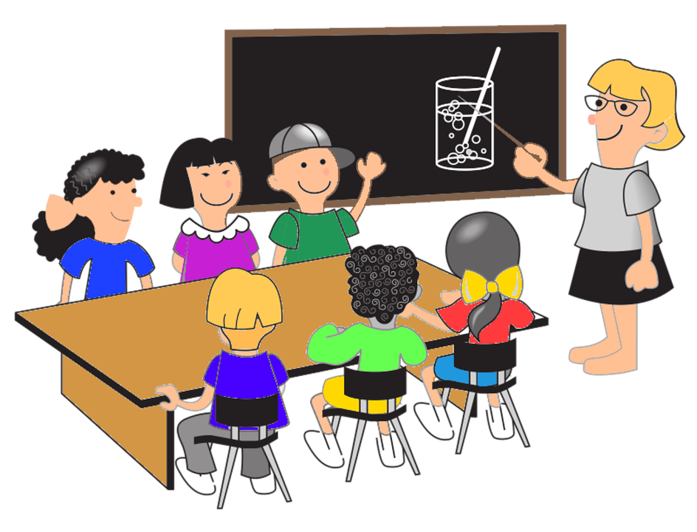
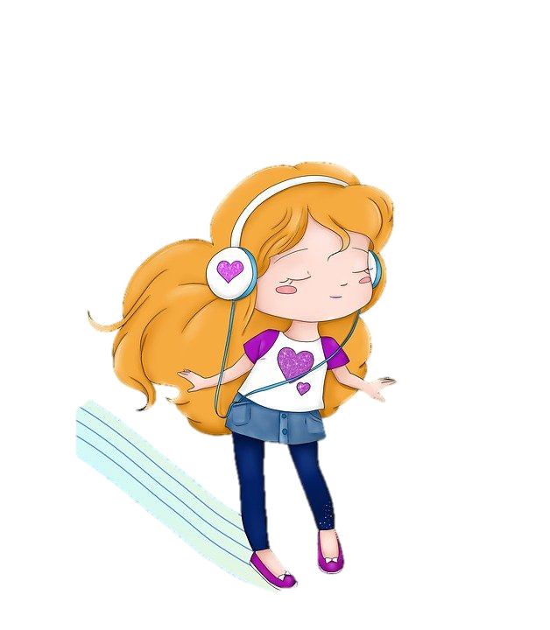

Draw. Then say!
I go to school with my friends on Mondays. I sing and dance on Sundays.
Monday
Sunday

Slide 17
4 Assessment

Slide 18
Write
What do you do on ______?
1 I ____________ on Sunday.
2 I ____________ with my family on Friday.
3 I ____________ on Saturday.
4 I _____________ on Tuesdays and Wednesdays.
5 I _____________ on Monday morning.
Notes:
It’s a free-answer question. Ss can show they opinions in their own words.

Slide 19




Thank you & goodbye!

