Slide 1








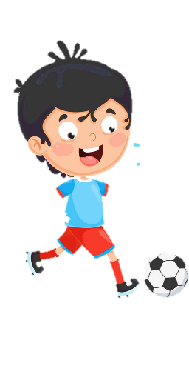












Unit 11
My day
Lesson 3 – Task 7,8,9

Slide 2








1 Warm up
What letter is missing?

Slide 3



r_ce
i
a
u
1
2
3

Slide 4
_ellow
k
y
s
1
2
3

Slide 5

2 Presentation

Slide 6

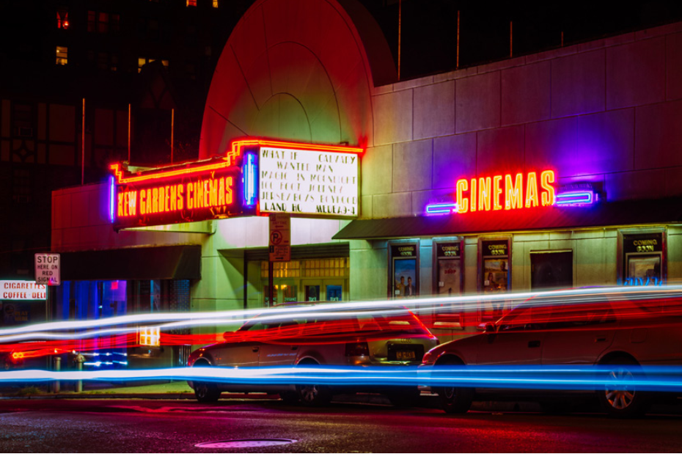
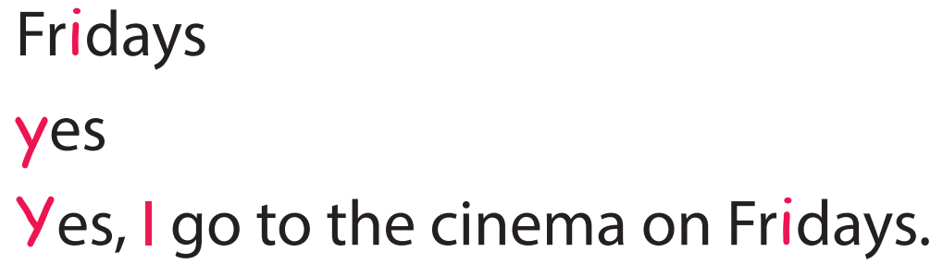
Task 7 Listen and repeat.

Slide 7

3 Practice

Slide 8

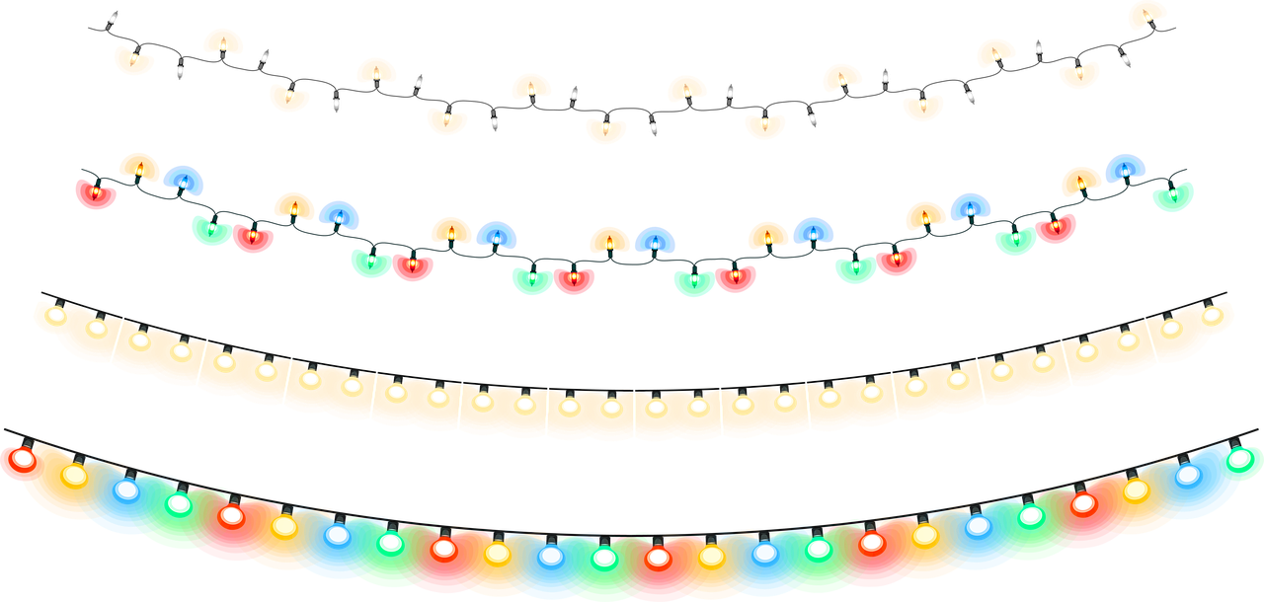
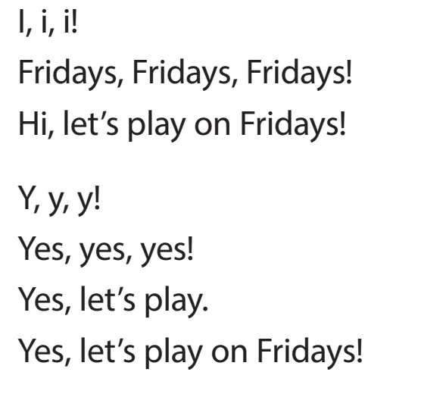

Task 8 Listen and chant.

Slide 9
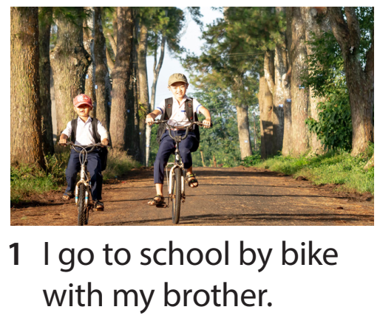
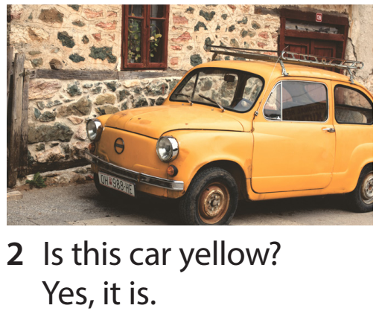
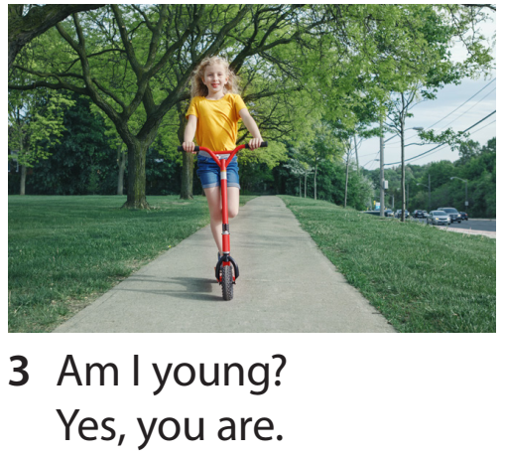
Task 9 Say it!

Slide 10
4 Production

Slide 11

Find and write!
i
y
bike | yes
… | …

Slide 12
5 Assessment

Slide 13

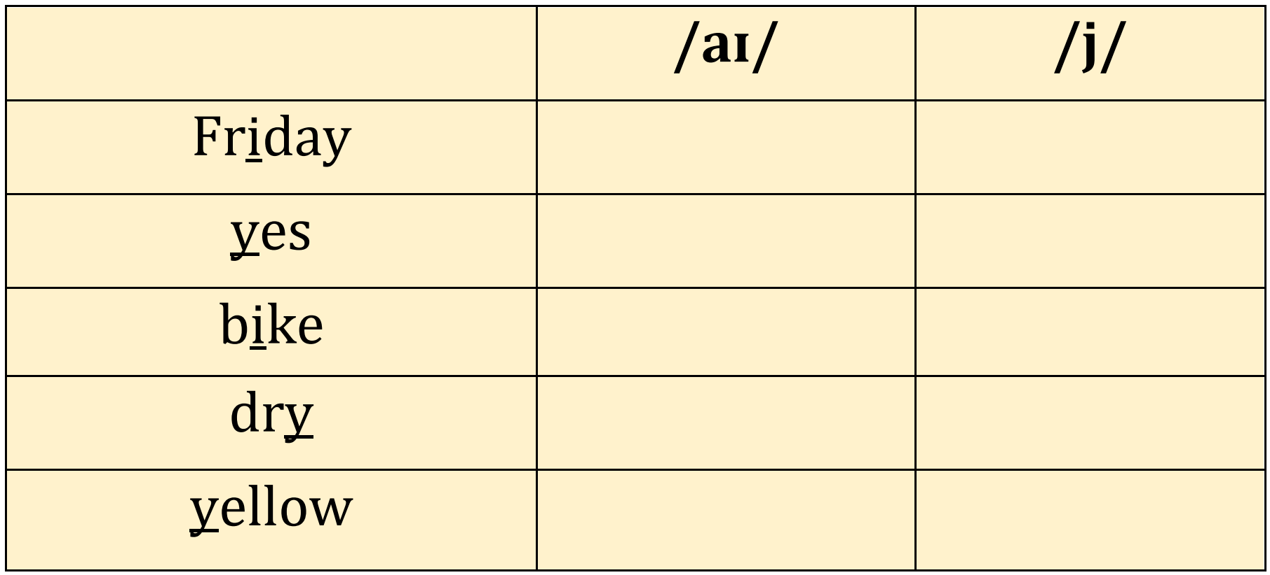
Listen and tick
✓
i
y
✓
✓
✓
✓
✓

Slide 14



Thank you & goodbye!

