Slide 1























Slide 2






Unit 10
Our World
Lesson 1 – Task 1,2,3

Slide 3

1
Warm Up
Listen to the song
https://www.youtube.com/watch?v=2UcZWXvgMZE

Slide 4
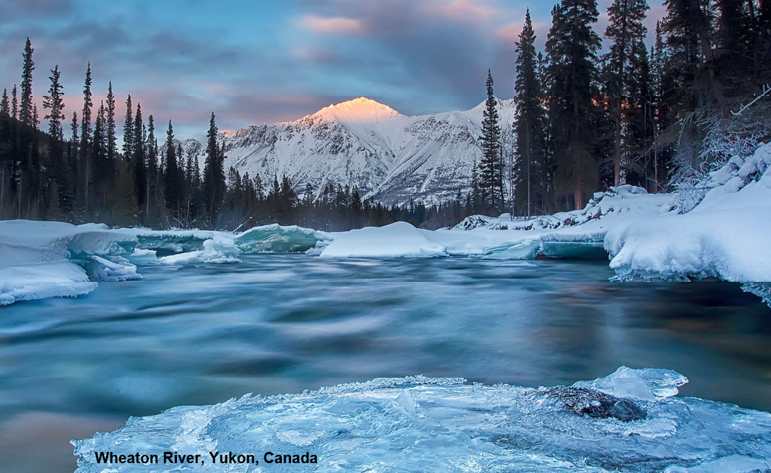
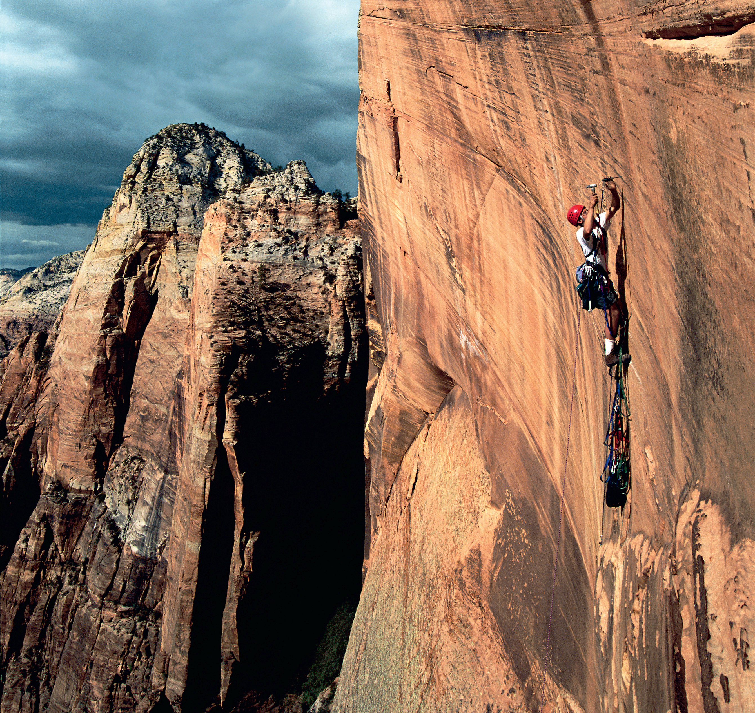
I love skiing. So, where can I go ?
Can you see them in the song ?
river
mountain

Slide 5


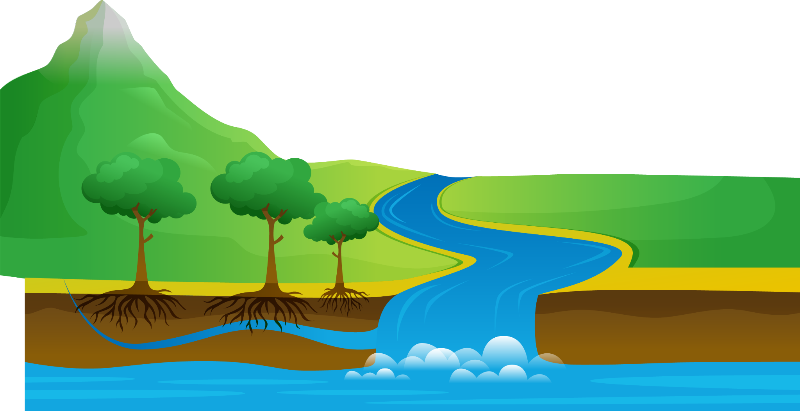

Presentation
2
1
Listen and point. Repeat.

Slide 6

Look at the photo. Tick
✓
nice
ugly
funny
great
Wheaton River , Yukon, Canada

Slide 7


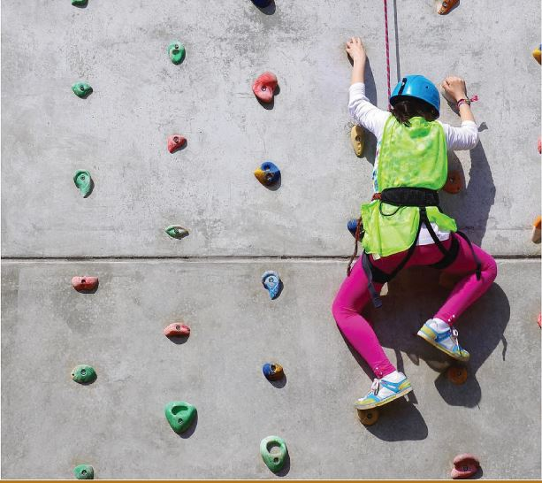
1
Listen and point. Repeat.
climb

Slide 8
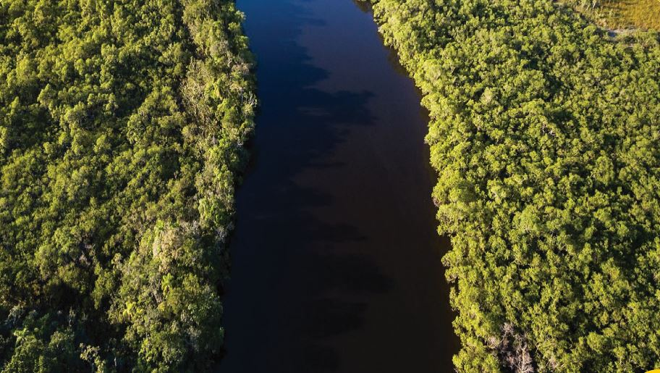
river

Slide 9
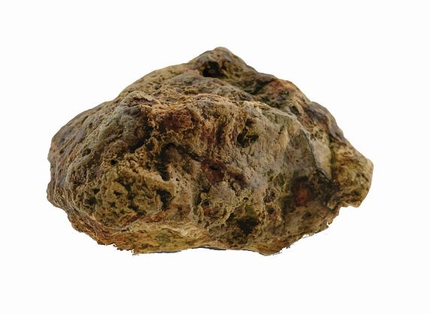
rock

Slide 10
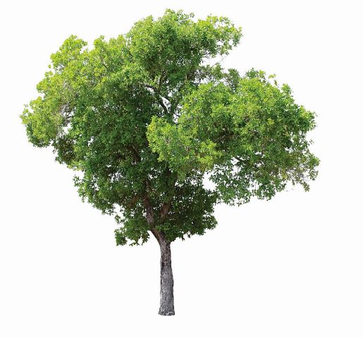
tree

Slide 11

water

Slide 12
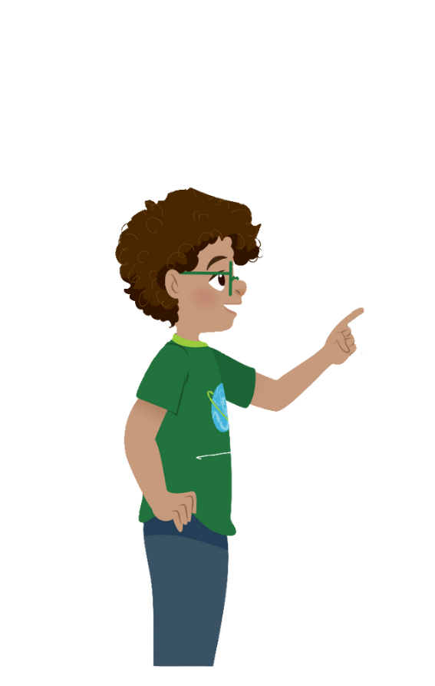
climb
river
rock
tree
water

Slide 13


VOCABULARY CHECKING
PASS THE BALL GAME
Notes:
Pass the ball. When the music stops – whoever has the ball must answer the question

Slide 14


Pass the BALL!

Slide 15
It’s a rock.

Slide 16
Pass the BALL!

Slide 17
tree

Slide 18
Pass the BALL!

Slide 19
water

Slide 20
Pass the BALL!

Slide 21
river

Slide 22
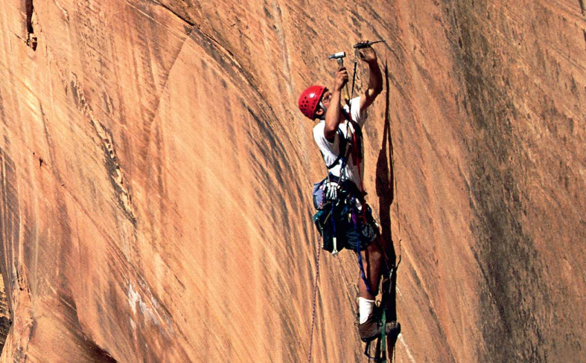

1. Listen and point. Repeat.
nature
climb
river
rock
tree
water

Slide 23


3
Practice
2
Listen and tick

Slide 24
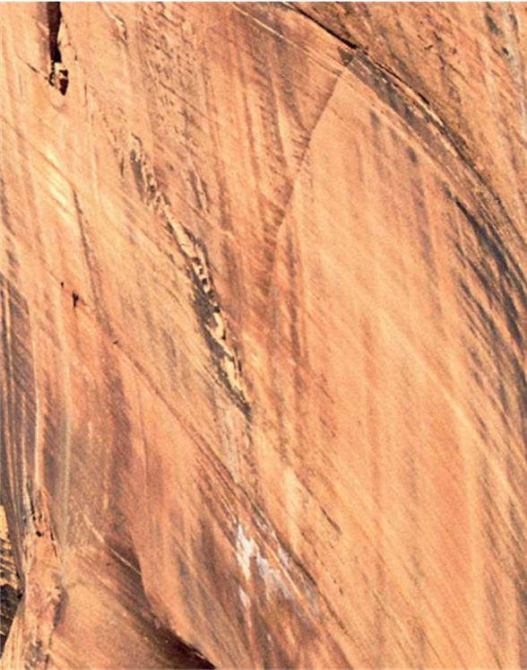


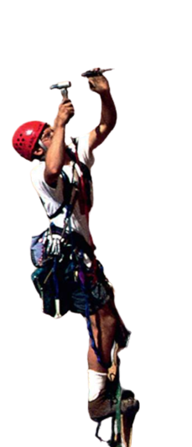
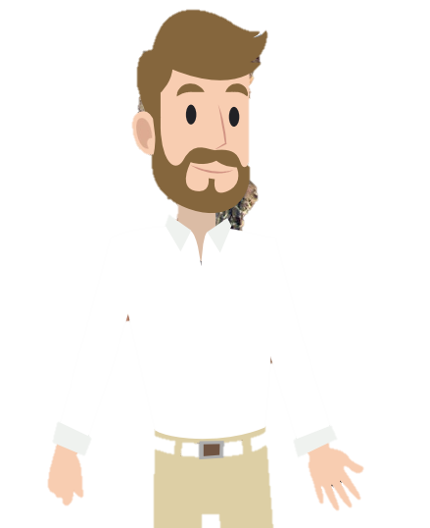
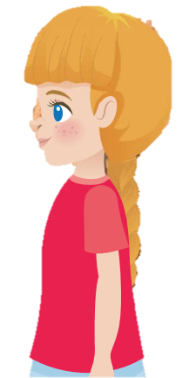
2. Listen and tick.

Slide 25
2. Listen and tick.

Slide 26
2. Listen and tick.
Yes, Uncle John.
Wow! You can climb
the rock!
Look! Can you see
me in the photo?
Yes. And I climb
big rocks with my friends!

Slide 27
2. Listen and tick.
Yes, Uncle John.
Wow! You can climb
the rock!
Look! Can you see
me in the photo?
Yes. And I climb
big rocks with my friends!
Can Uncle John climb the rock?
✓
Yes, he can.
No, he can’t.

Slide 28
Look and Match

Slide 29

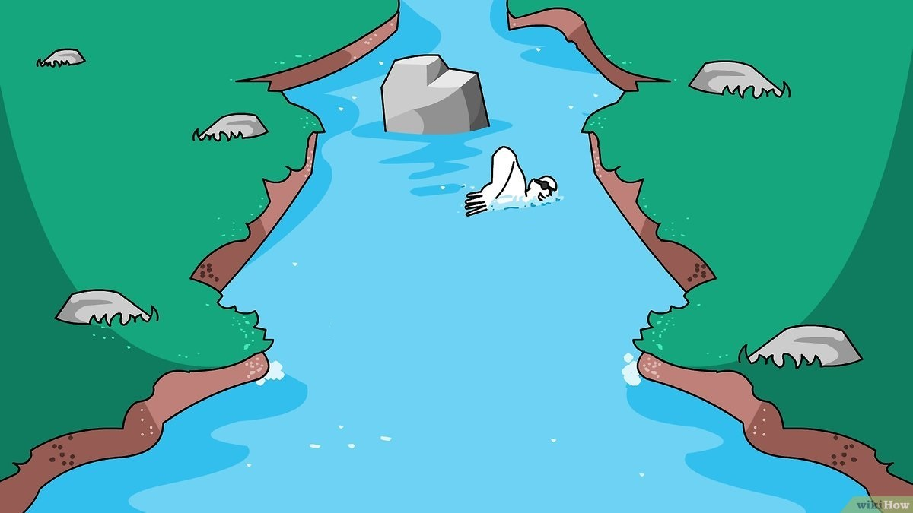
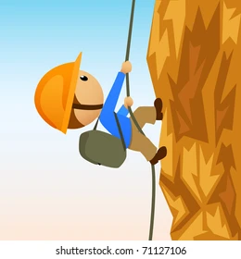
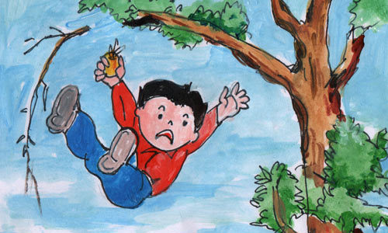
a. Yes, I can.
1.
b. Yes, I can.
2.
c. No, I can’t.
3.
d. No, I can’t.
4.

Slide 30
Can you drink cold water?

Slide 31
Can you swim in the river?

Slide 32
Can you climb the rock?

Slide 33
Can you climb the tree?

Slide 34
4
Production
3
Ask and answer. Tick.

Slide 35
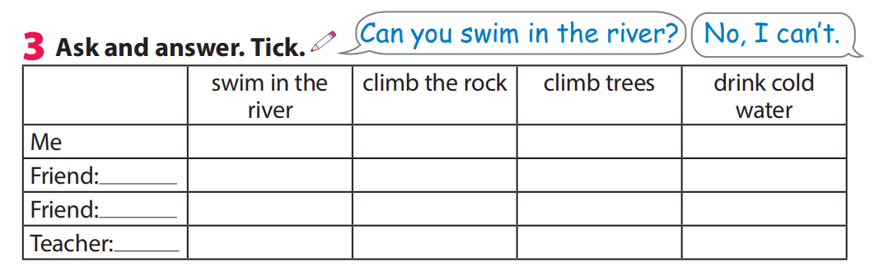

3 Ask and answer. Tick .

Slide 36



5
Assessment
Match

Slide 37
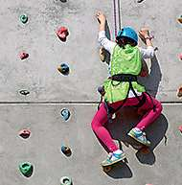
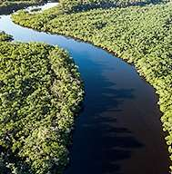
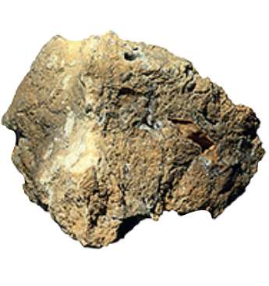


Match
1.climb
2.rock
a
b
3.river
4.tree
c
d
e
5.water
Notes:
HOẠT ĐỘNG TƯƠNG TÁC

Slide 38



See you next time!

