Slide 1








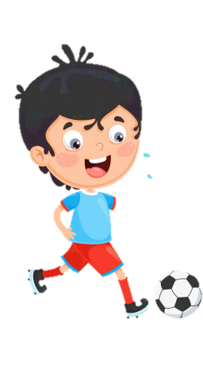
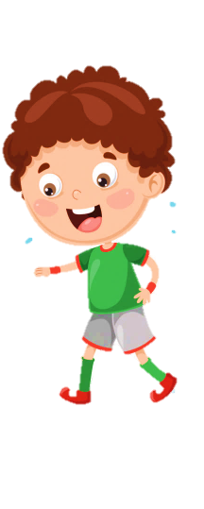












Slide 2
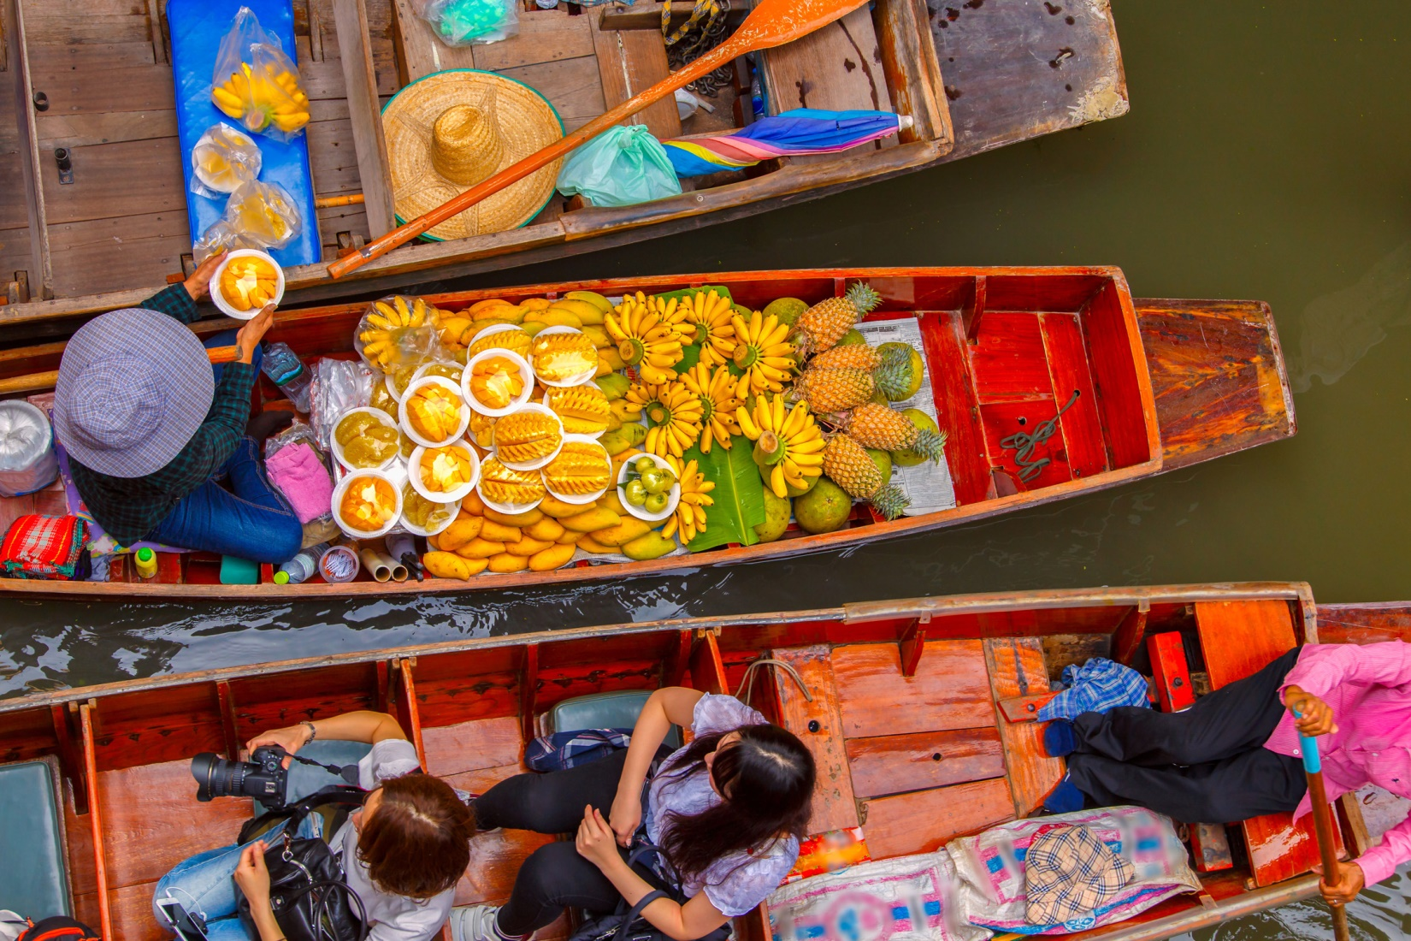

Unit 9:
My Favourite Food
Lesson 1 – Task 1, 2, 3

Slide 3
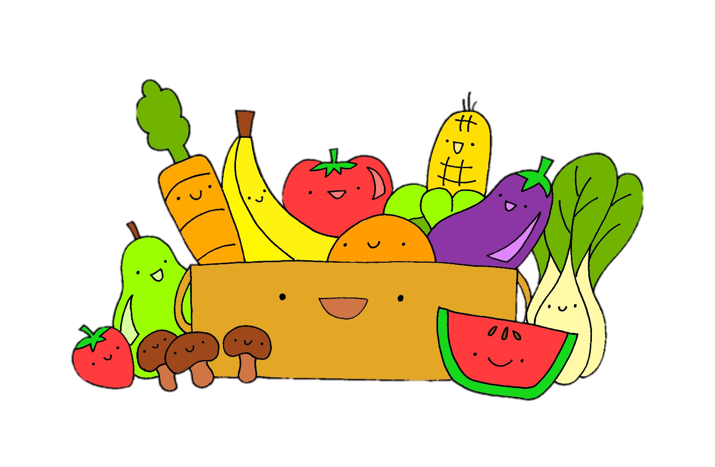
1 WARM UP
Movement Game.

Slide 4
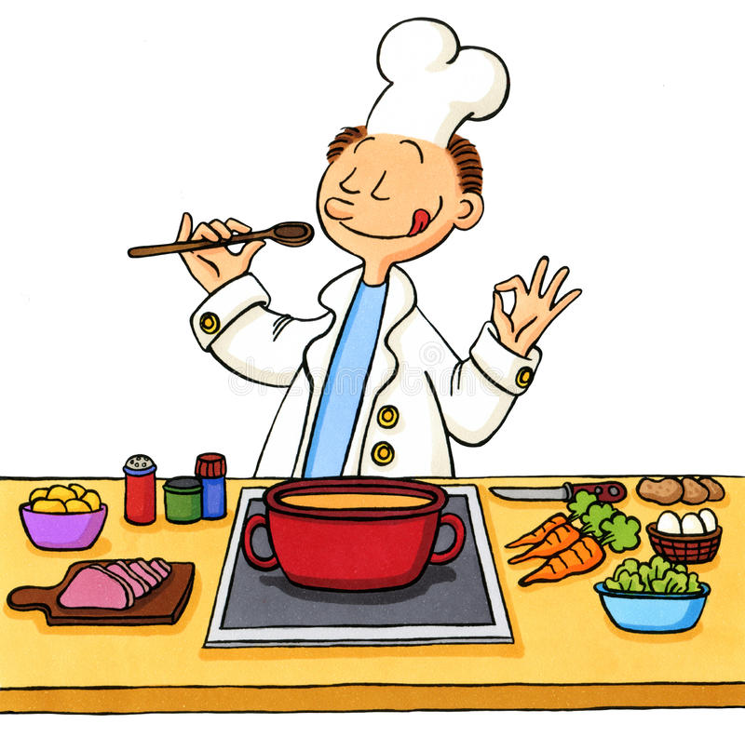
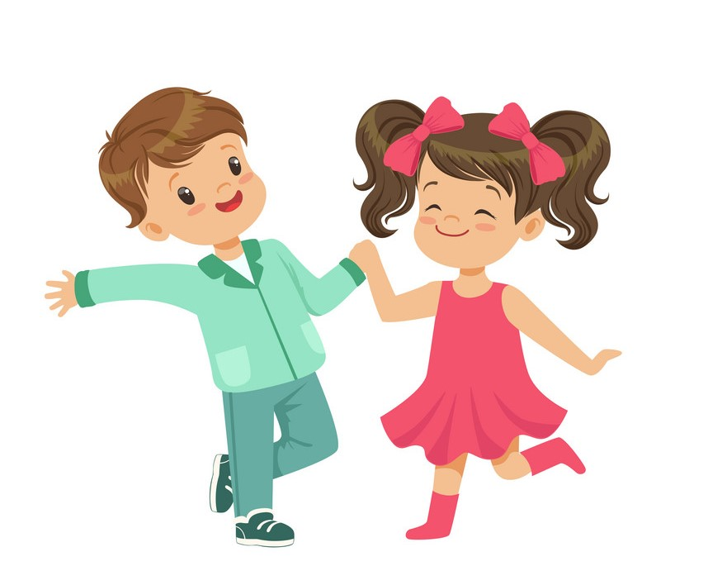
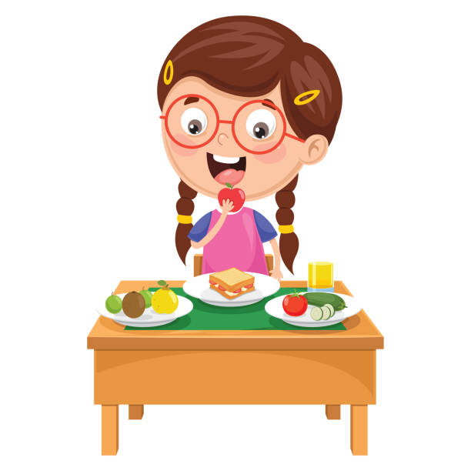

eat
read
cook
dance

Slide 5



Matching
A
B
C
D
book
food
kitchen
music
1
2
3
4
Notes:
Bấm vào tranh để nối

Slide 6
Look. What can you do with these things. Tick.
eat
cook
read
dance
Food market, Bangkok, Thailand

Slide 7




2 PRESENTATION
Task 1 Listen and point. Repeat.

Slide 8
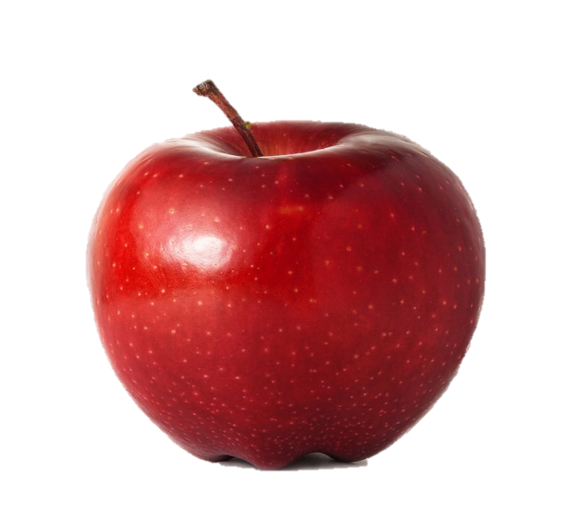
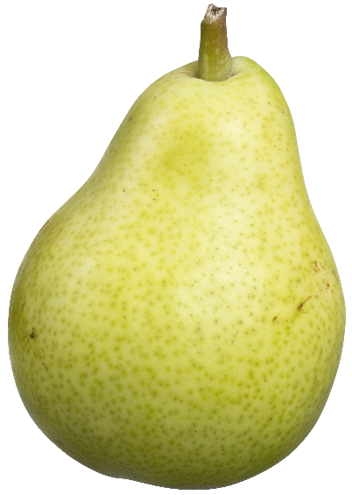

Listen and point. Repeat.
apple
pear
banana
tomato

Slide 9

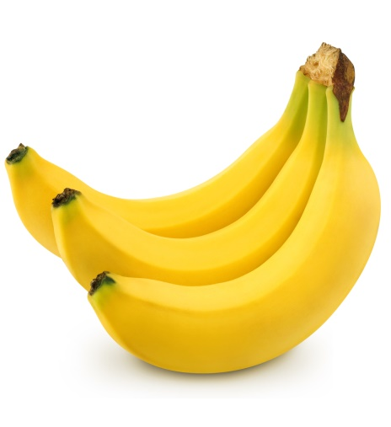
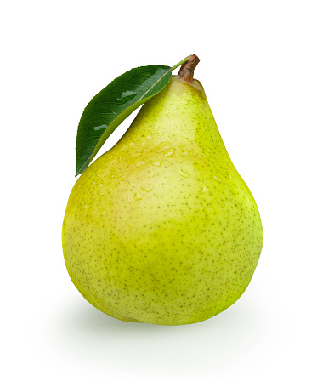

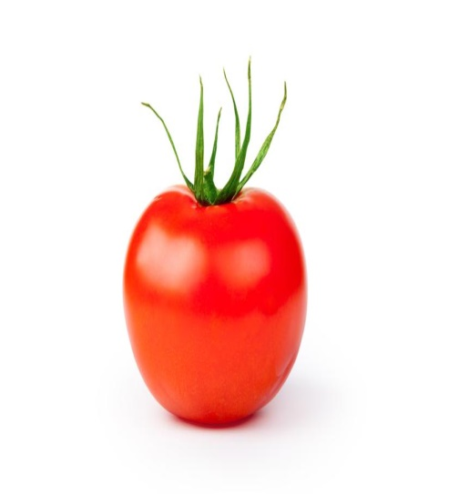
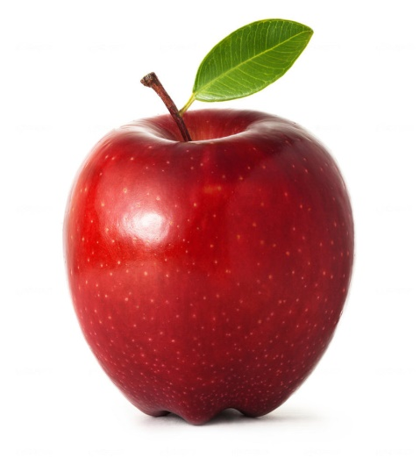
Memory game
Let’s check
1
2
3
4
apple
tomato
5
6
7
8
pear
banana
Notes:
Bấm vào số để mở các mảnh ghép
Bấm vào biểu tượng tròn đỏ để đóng các mảnh ghép nếu mở sai
Bấm vào biểu tượng V để biến mất 2 mảnh ghép đã chọn đúng

Slide 10
3 PRACTICE
Task 2 Listen and write.

Slide 11
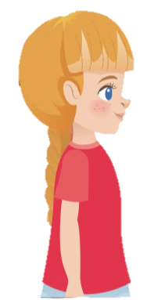

Listen and write.
Yes! There are many tomatoes! And look at that man over there. What’s he doing ?
Look! A lot of tomatoes !
He is throwing a tomato!
That man is throwing a __________.
tomato

Slide 12

4.PRODUCTION
Task 3 Look at 1. Draw and guess.
Notes:
(Divide class into 6 groups. A student in each group chooses an action and acts out it for the rest of the group to guess. The rest of group have to say a full sentence He/she can…. )
- Introduce and set game rules
- Do a demo
- Play several rounds.

Slide 13
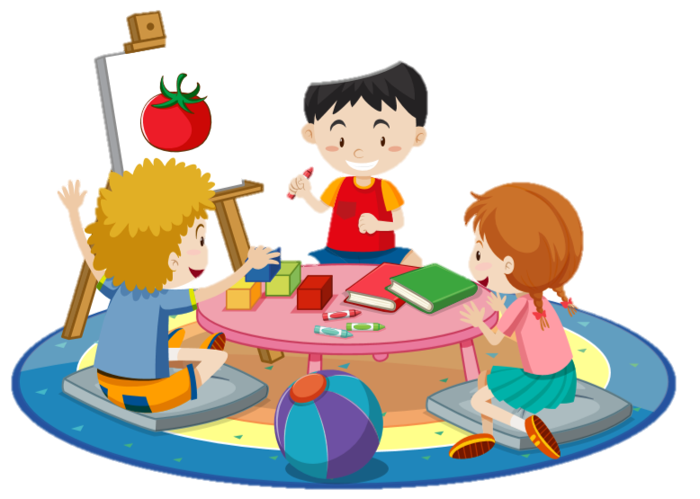
No, I’m not.
Yes, I am.
Are you drawing an apple?
Are you drawing a tomato ?

Slide 14

5.ASSESSMENT

Slide 15




I
T
S
H
P
E
A
R
T
P
E
A
R
M
O
K
U
V
S
P
U
O
X
M
F
O
O
T
A
L
M
A
B
A
N
A
N
A
P
E
B
A
P
A
N
A
N
A
FIND AND CIRCLE
E
T
O
P
A
P
R
T
M
P
A
O
L
O
H
P
O
S
L
S
R
V
N
M
F
E
K
E
E
T
O
M
E
T
O
M
A
Notes:
Teacher click on the first letter of the word to make it change color.

Slide 16




Thank you & goodbye!

