Slide 1





















Notes:
Để nguyên trang bìa như này, chỉ thay đổi tên bài trong quá trình làm. Logo của sách Wonderful World

Slide 2
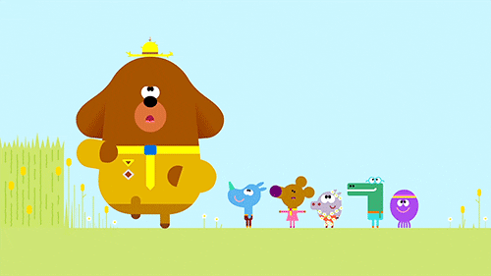
Unit 6:
Outdoor activities
Lesson 2
Task 1, 2, 3

Slide 3

1. WARM UP
Catch the word
Notes:
Catch the words game
Each team will stand in lines. The first SS will be given a word and they must draw a picture according to that word.
After finishing, the picture will be passed down to the next one to re-draw. The last SS will write down the answer on the paper. Each turn will last for 1’30s.

Slide 4

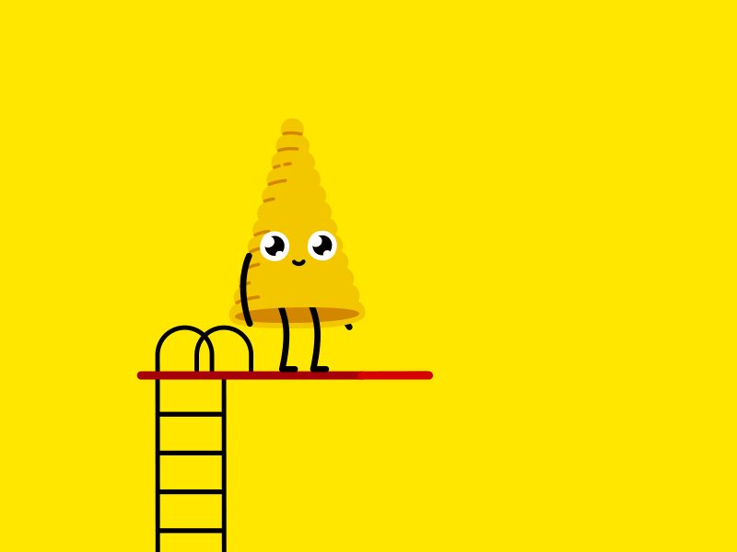
Notes:
Catch the words game
Each team will stand in lines. The first SS will be given a word and they must draw a picture according to that word.
After finishing, the picture will be passed down to the next one to re-draw. The last SS will write down the answer on the paper. Each turn will last for 1’30s.

Slide 5
2. PRESENTATION

Slide 6

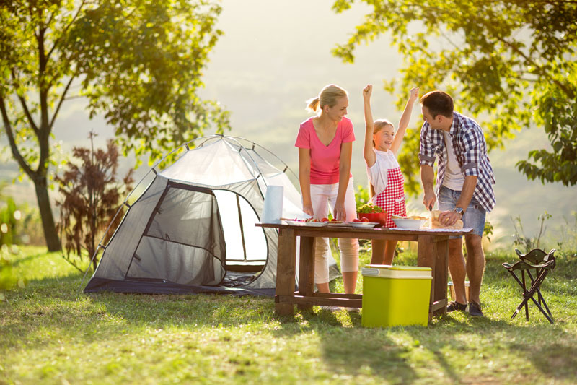
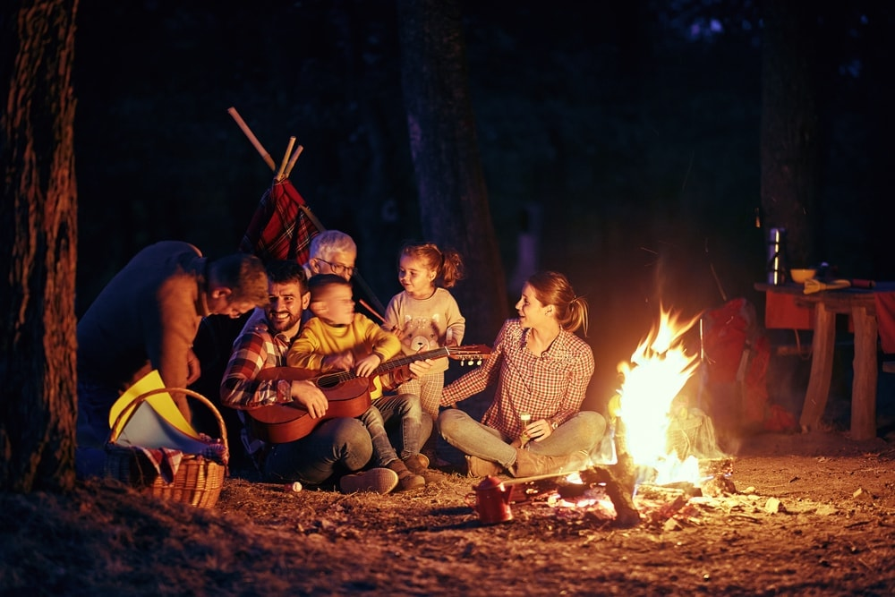
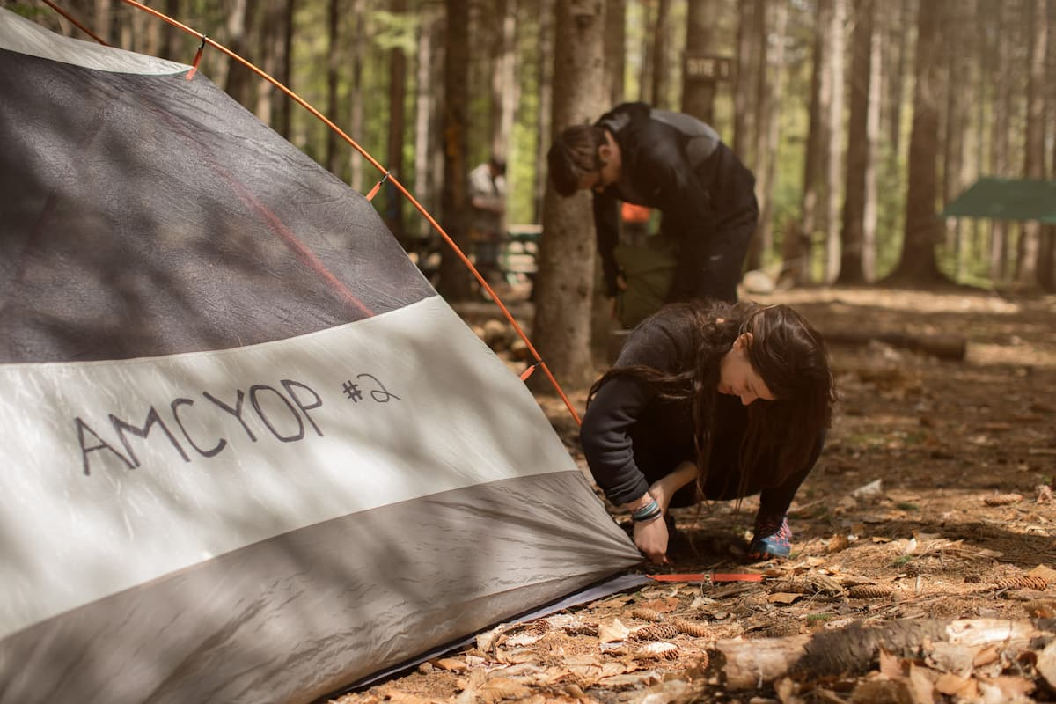
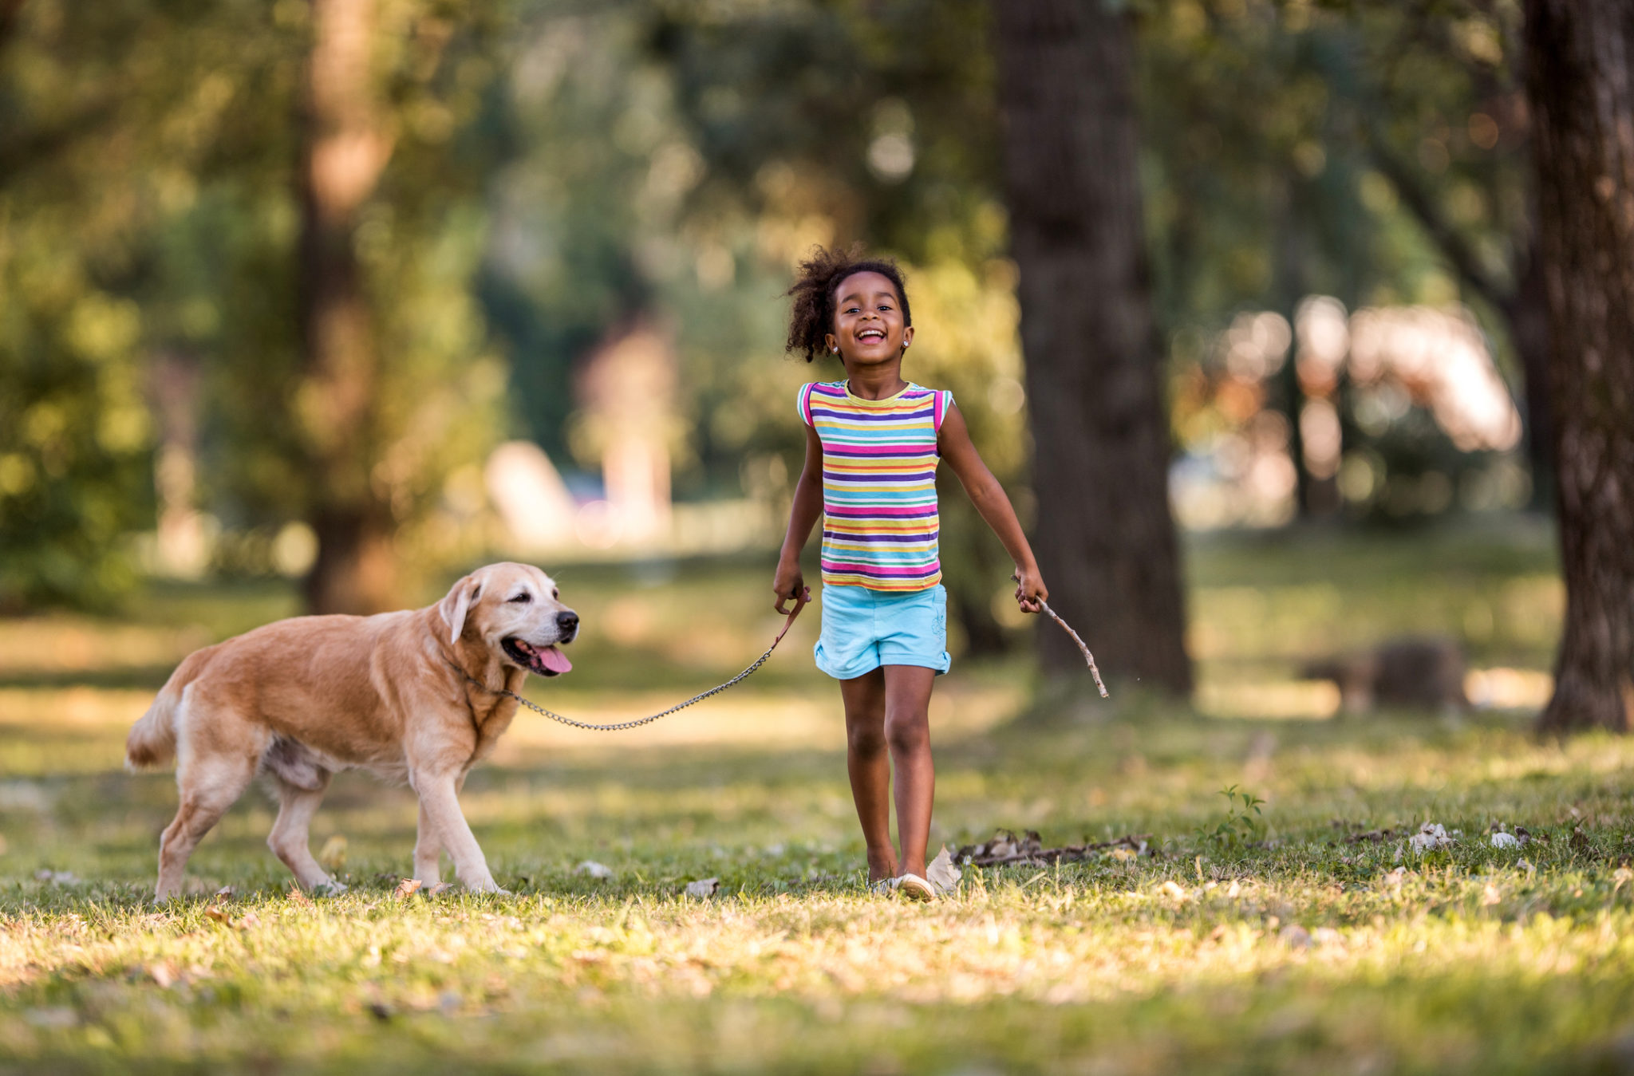
pitch a tent
make a campfire
walk the dog
go camping

Slide 7
3. PRACTICE

Slide 8
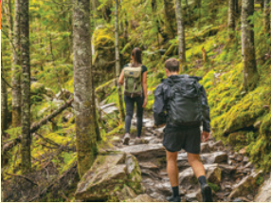
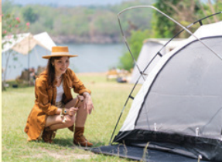
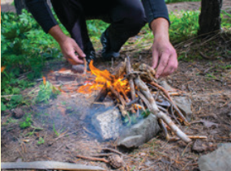
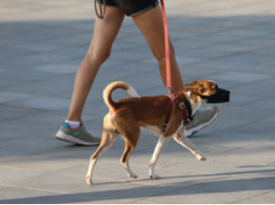
1. Listen and point. Repeat.
go camping
pitch a tent
make a campfire
walk the dog

Slide 9
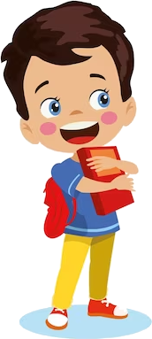
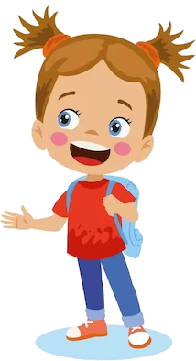

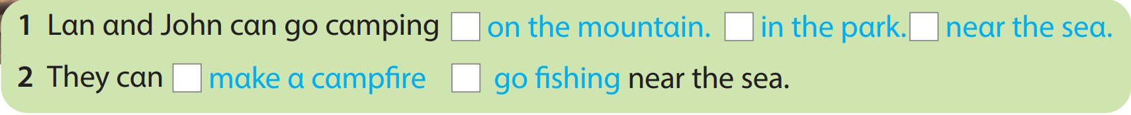
2. Listen and read. Tick.
Lan: Where can we go camping, John?
John: We can go camping on the mountain or near the sea.
Lan: I like the sea. We can go camping on the mountain, but we can’t go swimming.
John: That’s right. Let’s go to the sea. We can go swimming and make a campfire near the sea.
Lan: That sounds fun!

Slide 10
4. PRODUCTION

Slide 11
3. Let’s play!
Work in pairs. Look and match. Ask and answer questions.
What can we do on the mountain?
We can go camping on the mountain.
go camping
pitch a tent
make a campfire
walk the dog
go fishing
ice-skate
on the mountain
in the park
near the lake
near the sea

Slide 12
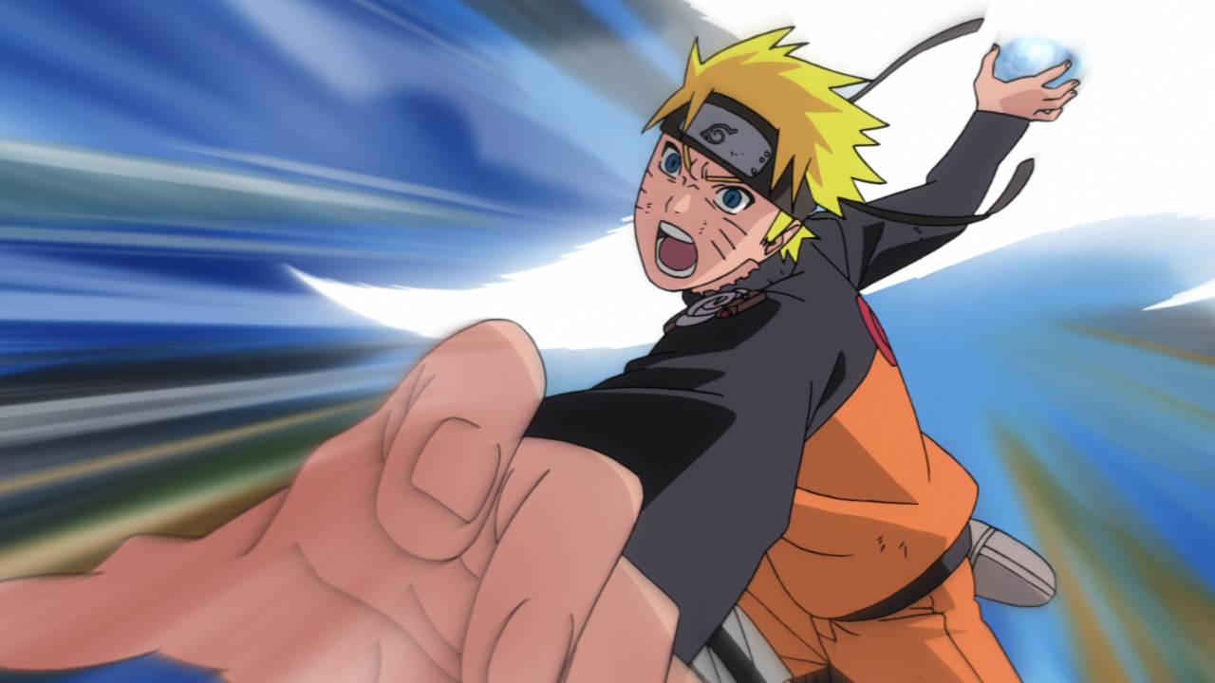


Slide 13
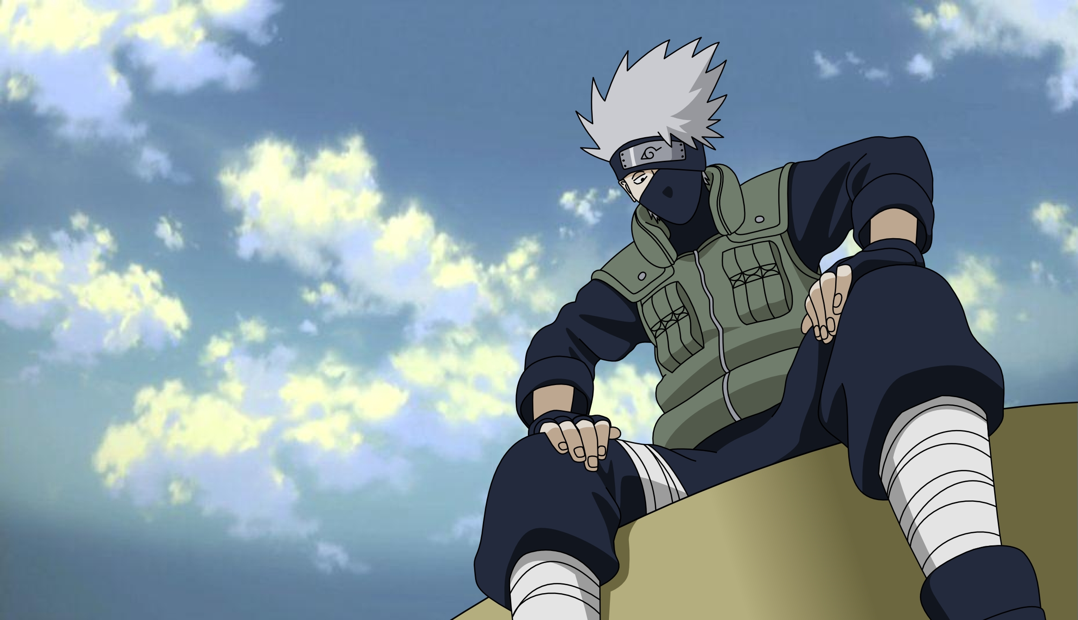

A
B
C
STOP
F
G
H
Notes:
Click on the respective letter box to go to the question page.
DO NOT CLICK on the dog. Nothing will happen!
Click STOP to move to the next part

Slide 14



go camping
What is it?
go swimming
go shopping
walk the dog
Notes:
Click / Press the Right arrow button -> to show the answer.
If the students answer correctly, +2 points and then press the right arrow button again ->
Only click the Naruto Icon on the right hand side IF the team answered wrong.
It will hyperlink back to the question page.

Slide 15

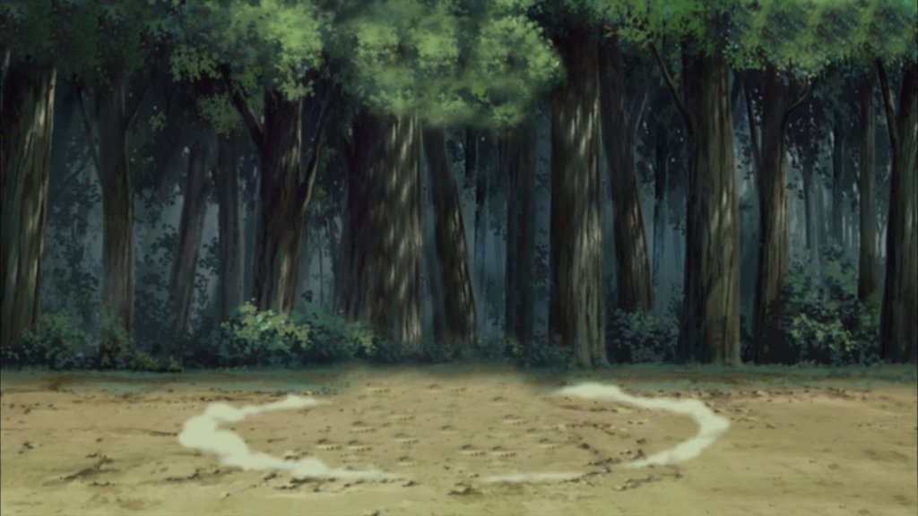


+4
+1
Bomb!
+3
Open the mystery box?
Notes:
-There is a set of mystery boxes set on this bonus game.
Học sinh có thể chọn số lần click để mở mystery box, số lần <5
-Students can choose how many they want to open. They DON’T have to open if they are happy with their points.
-Eventually there will be a bomb at the end, so students should keep in mind that they will get a bomb if they go too far!
-Students can stop anytime.
-Click the icon in the right hand corner to return to the question selection page.

Slide 16
walk the dog
Listen.
What can you hear?
go hiking
run
pitch a tent
Notes:
Click / Press the Right arrow button -> to show the answer.
If the students answer correctly, +2 points and then press the right arrow button again ->
Only click the Naruto Icon on the right hand side IF the team answered wrong.
It will hyperlink back to the question page.

Slide 17
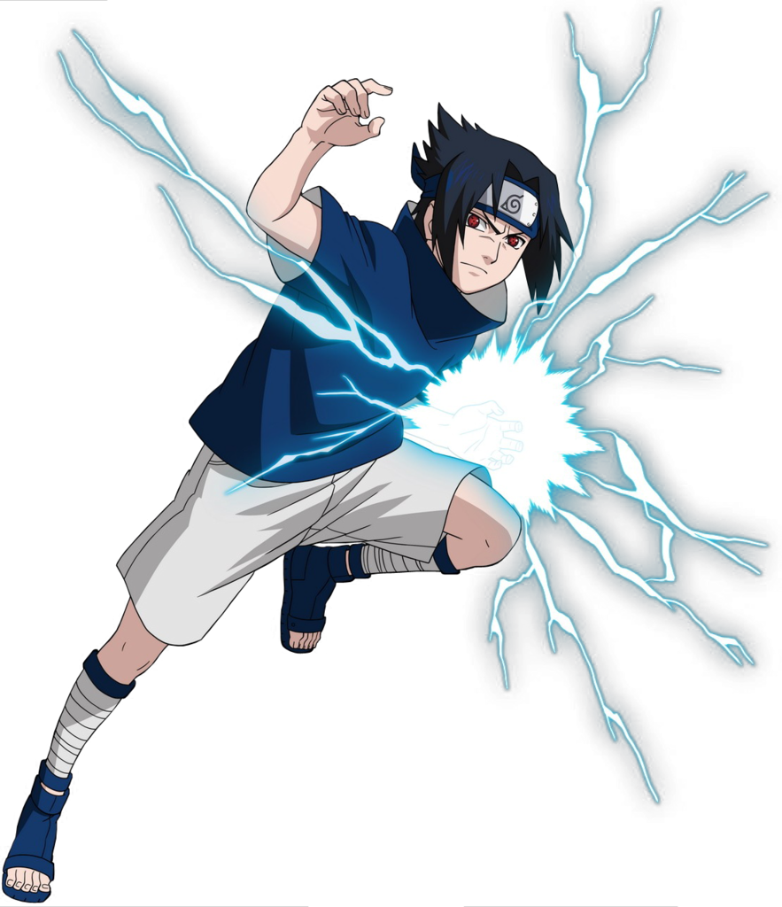
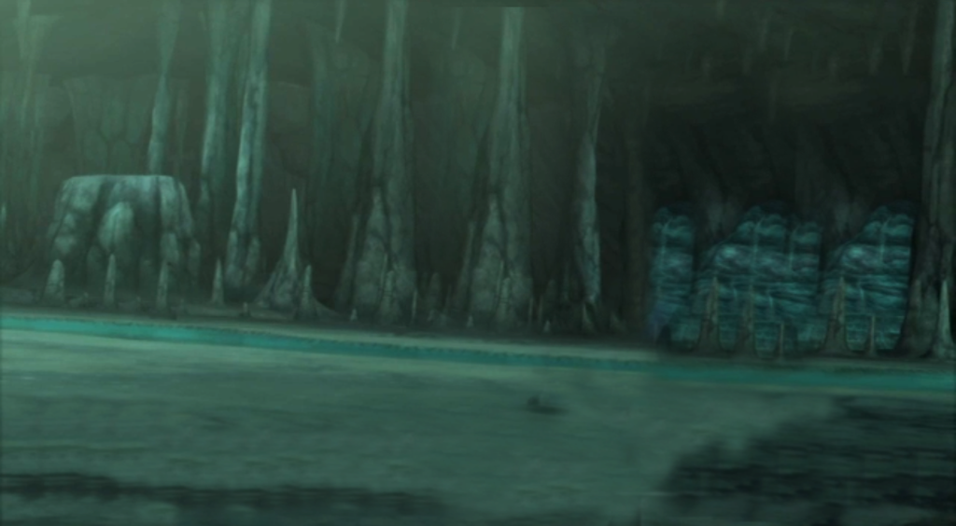
+1
BOMB!
+3
+1
+2
Open the mystery box?
Notes:
-Students can choose how many they want to open. They DON’T have to open if they are happy with their points.
-Eventually there will be a bomb at the end, so students should keep in mind that they will get a bomb if they go too far!
-Students can stop anytime.
-Click the icon in the right hand corner to return to the question selection page.

Slide 18
We can go swimming.
Listen and answer:
What can we do on the mountain?
We can draw a picture.
We can go camping.
We can play the guitar.
Notes:
Click / Press the Right arrow button -> to show the answer.
If the students answer correctly, +2 points and then press the right arrow button again ->
Only click the Naruto Icon on the right hand side IF the team answered wrong.
It will hyperlink back to the question page.

Slide 19
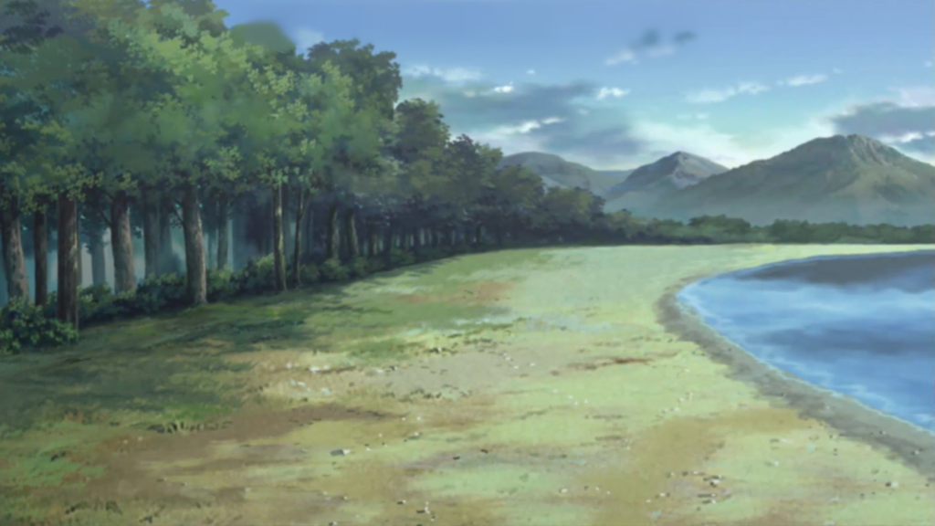
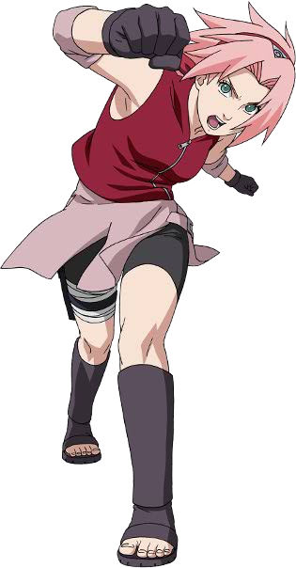
Bomb!
+2
+3
Open the mystery box?
Notes:
-Students can choose how many they want to open. They DON’T have to open if they are happy with their points.
-Eventually there will be a bomb at the end, so students should keep in mind that they will get a bomb if they go too far!
-Students can stop anytime.
-Click the icon in the right hand corner to return to the question selection page.

Slide 20
put
Fill in the blank:
We can ____ a campfire near the sea.
bring
have
make
Notes:
Click / Press the Right arrow button -> to show the answer.
If the students answer correctly, +2 points and then press the right arrow button again ->
Only click the Naruto Icon on the right hand side IF the team answered wrong.
It will hyperlink back to the question page.

Slide 21
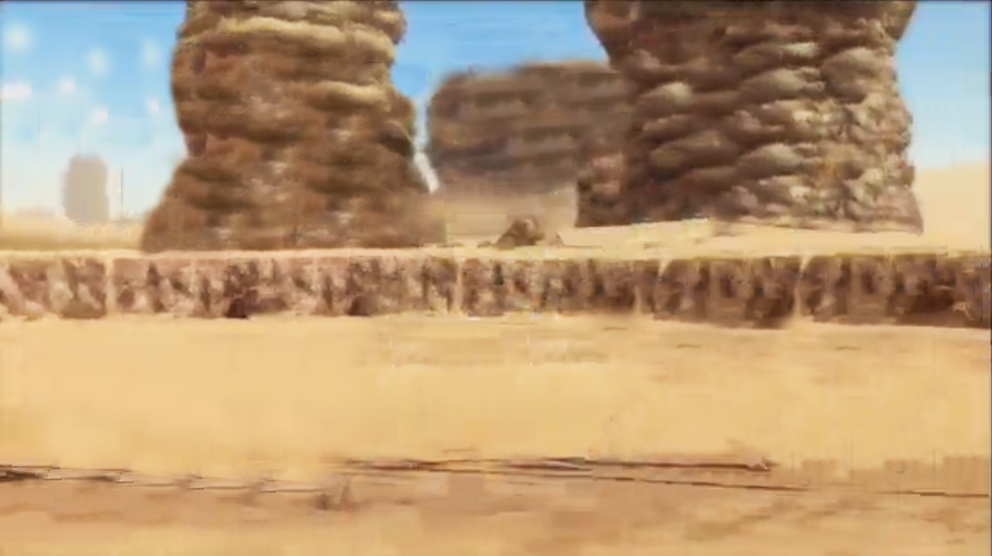
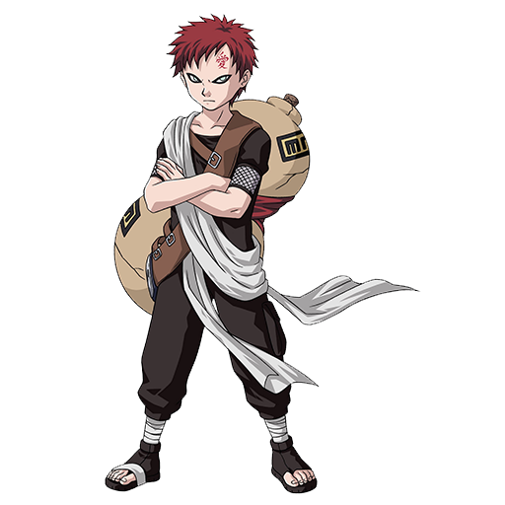
+2
Bomb!
+1
+1
+5
+1
Notes:
-Students can choose how many they want to open. They DON’T have to open if they are happy with their points.
-Eventually there will be a bomb at the end, so students should keep in mind that they will get a bomb if they go too far!
-Students can stop anytime.
-Click the icon in the right hand corner to return to the question selection page.

Slide 22
in the store
We can walk the dog _____.
in the park
in the school
on the table
Notes:
Click / Press the Right arrow button -> to show the answer.
If the students answer correctly, +2 points and then press the right arrow button again ->
Only click the Naruto Icon on the right hand side IF the team answered wrong.
It will hyperlink back to the question page.

Slide 23
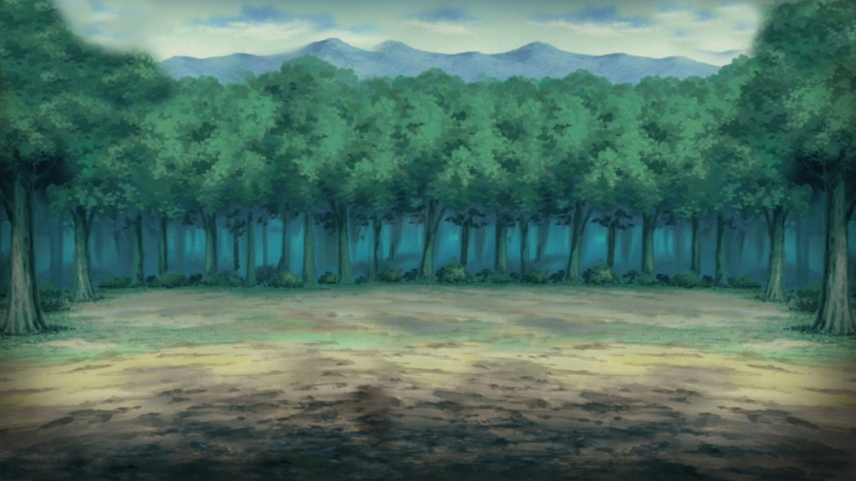
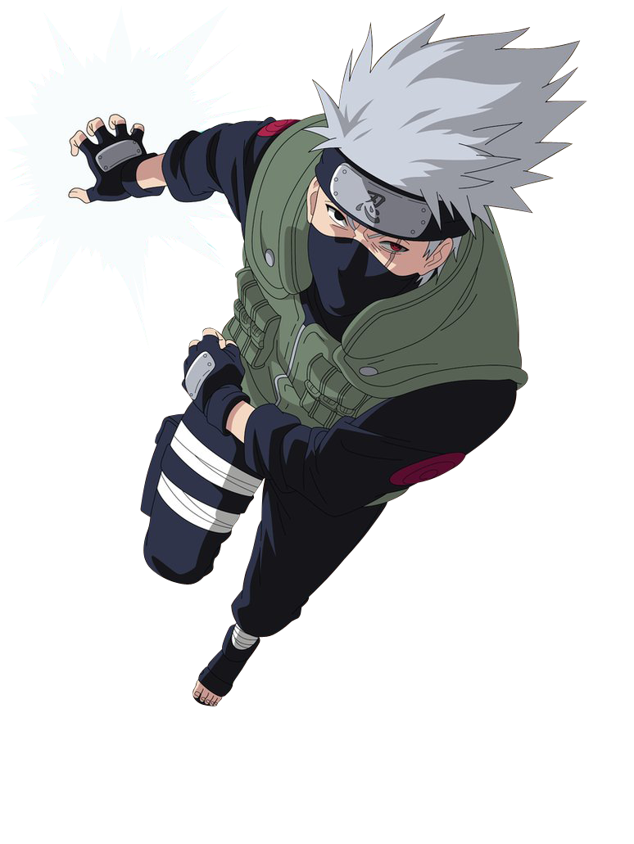
Change
Points!!
Notes:
No bomb bonus here.
To keep it interesting I have some bonuses where students must destroy or change points.

Slide 24
near the lake
on the mountain
They can go ice-skating _____.
in the park
near the forest
Notes:
Click / Press the Right arrow button -> to show the answer.
If the students answer correctly, +2 points and then press the right arrow button again ->
Only click the Naruto Icon on the right hand side IF the team answered wrong.
It will hyperlink back to the question page.

Slide 25
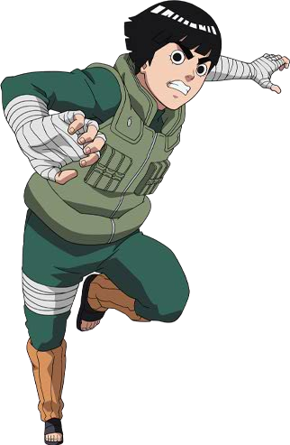
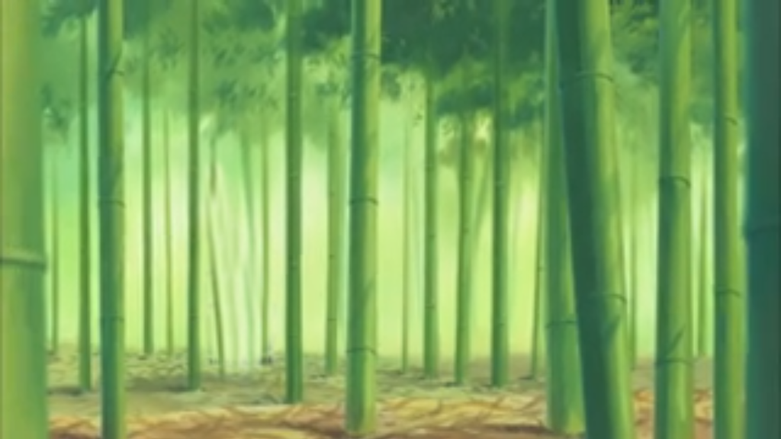
+2
+5
+2
+3
BOMB!
Open the mystery box?
Notes:
-Students can choose how many they want to open. They DON’T have to open if they are happy with their points.
-Eventually there will be a bomb at the end, so students should keep in mind that they will get a bomb if they go too far!
-Students can stop anytime.
-Click the icon in the right hand corner to return to the question selection page.

Slide 26
5. ASSESSMENT

Slide 27
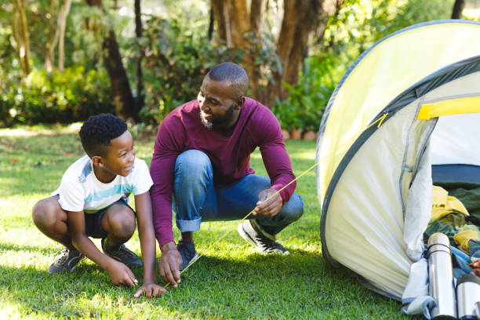
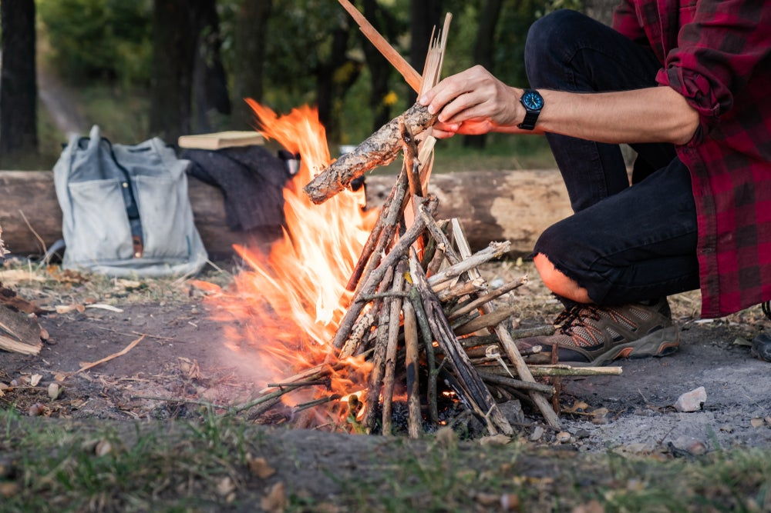
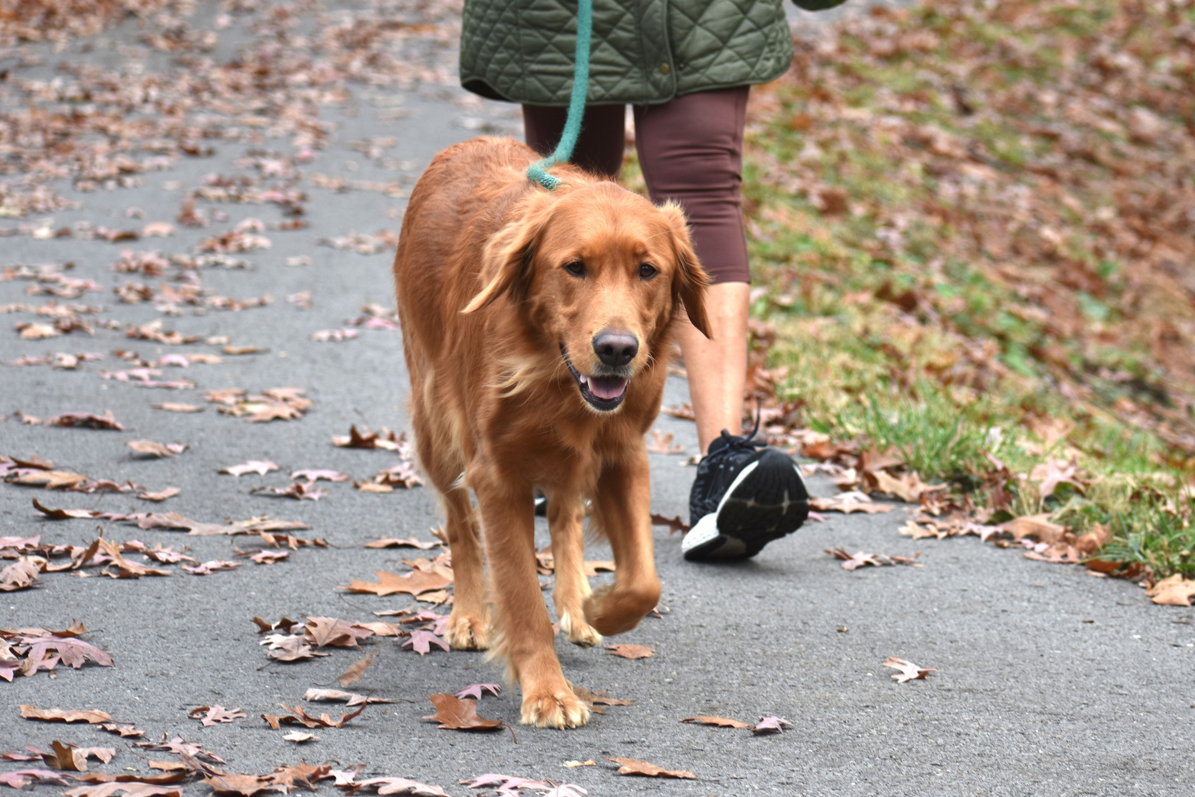
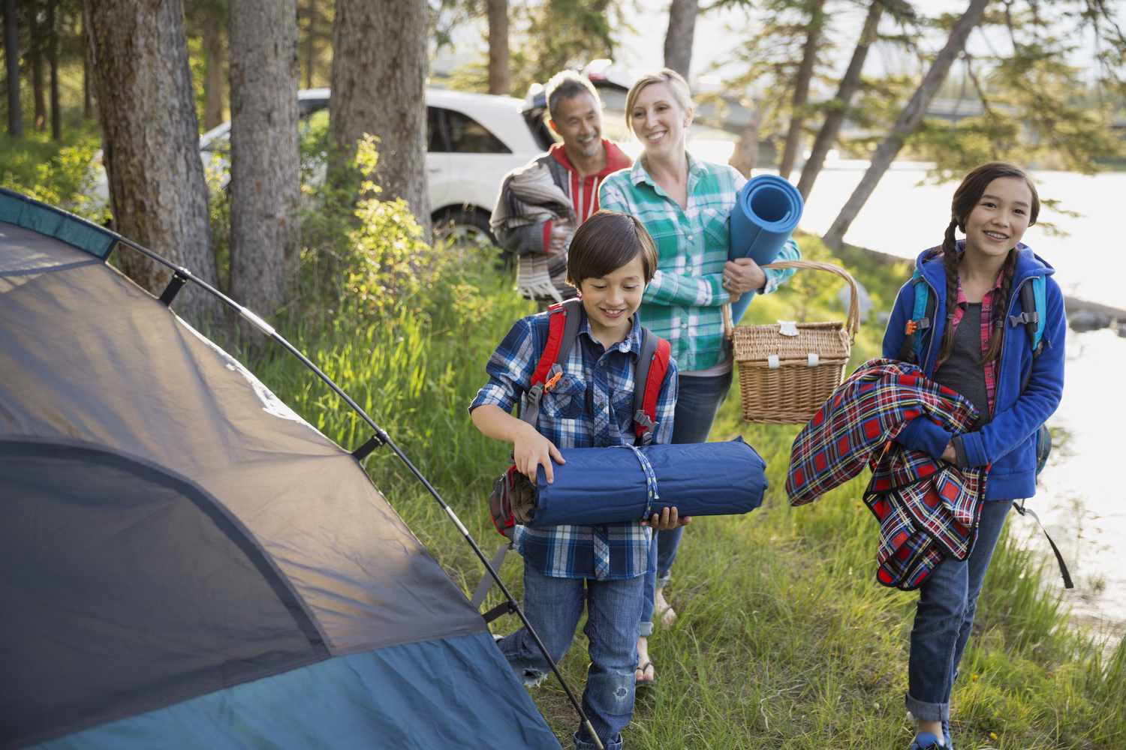
Look and tick.
pitch a tent
make a campfire
walk the dog
make a campfire
walk a dog
pitch a tent
go camping
make a campfire

Slide 28




Thank you & goodbye!

