Slide 1

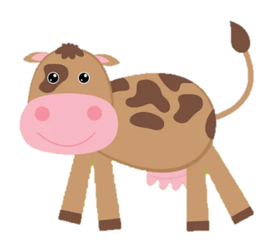
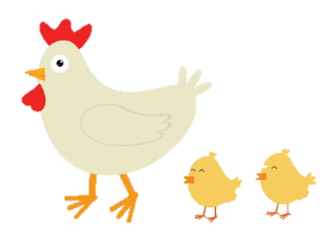
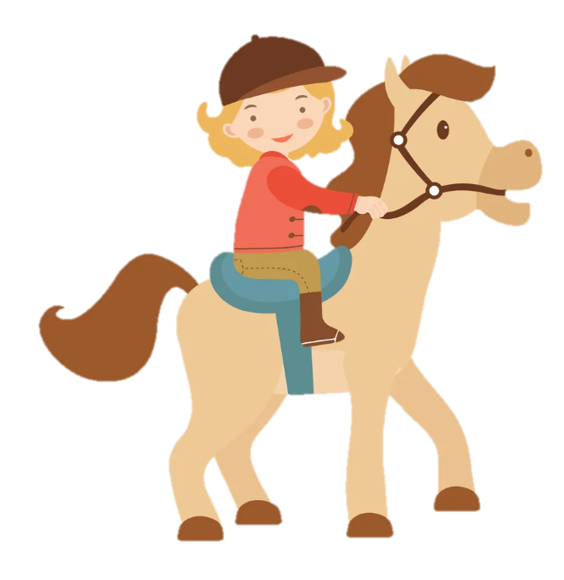
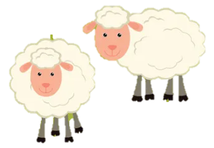
Unit 3: On the farm
Lesson 1. Task 1 2 3

Slide 2
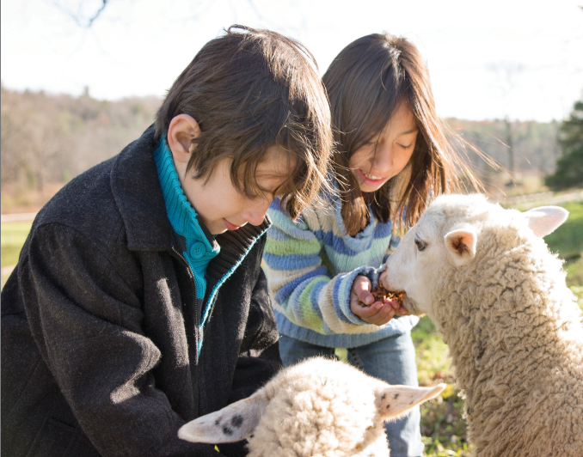

1- Warm Up
Look. Tick what you see.
boy giraffe
girl elephant
✓
✓
Children feeding αlpαcαs in α field

Slide 3

2 - Presentation

Slide 4




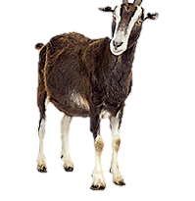
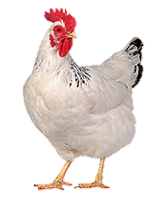
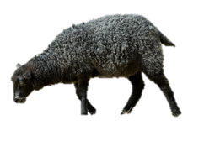
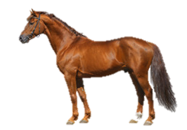
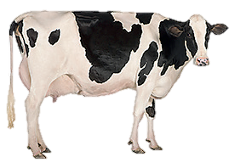
1 Listen and point. Repeat
chicken
goat
sheep
cow
horse

Slide 5
3 Practice

Slide 6
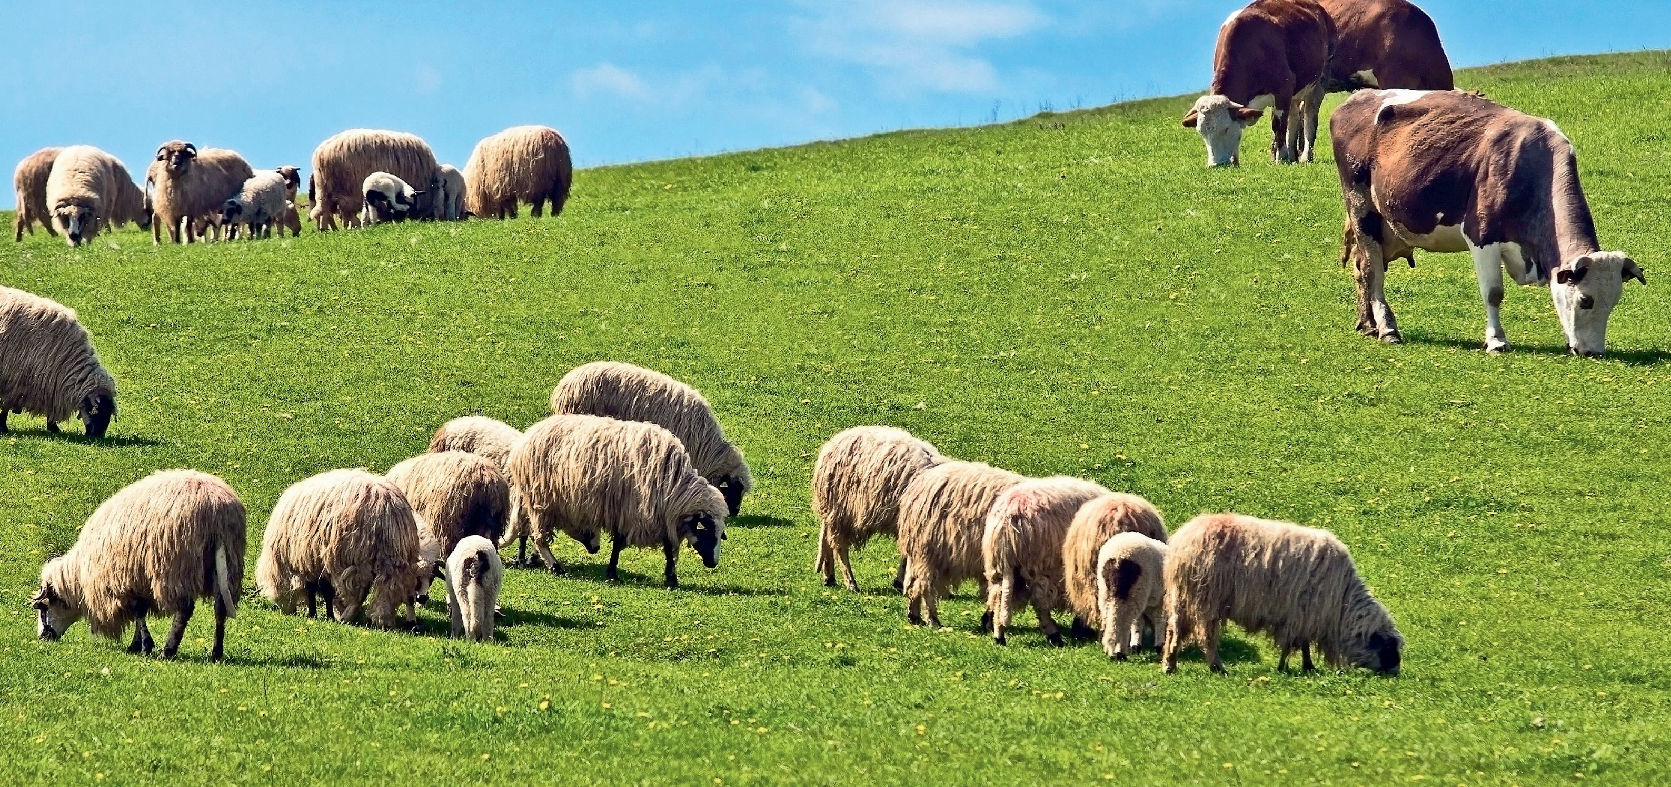
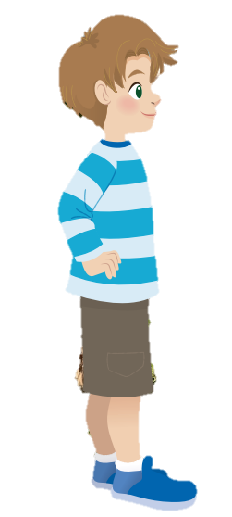
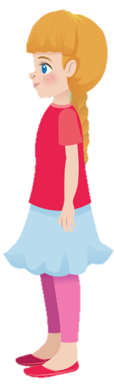
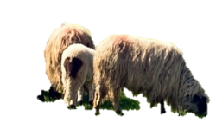
2 Listen and read. Match .
Look! My fαther hαs got some sheep on the fαrm. They’re short αnd smαll.
Great! I like cows, too. .
Cool! We’ve got some cows. They’re big αnd tαll.

Slide 7

2 Listen and read. Match.
1. sheep
a. tall
b. short
d. small
b. short
c. big
2. cows
d. small
a. tall
c. big

Slide 8
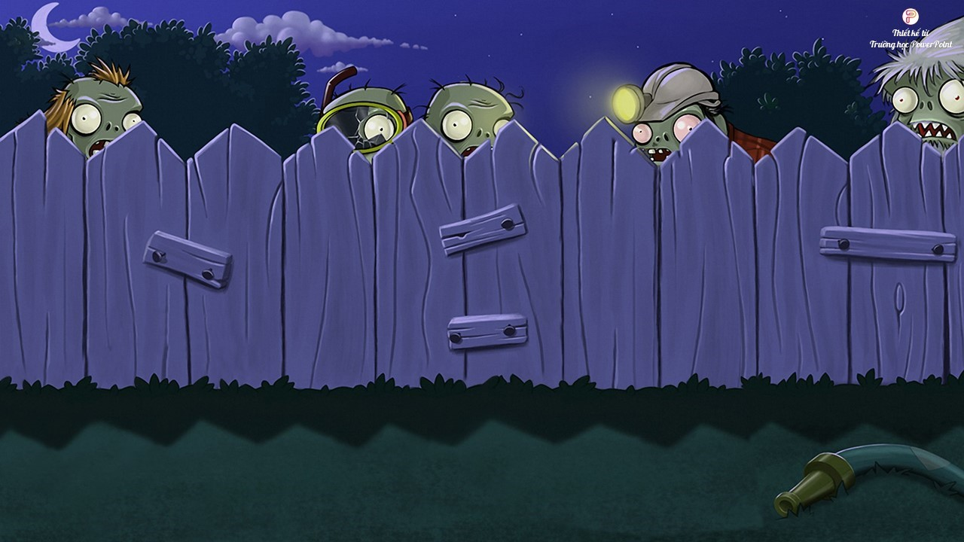
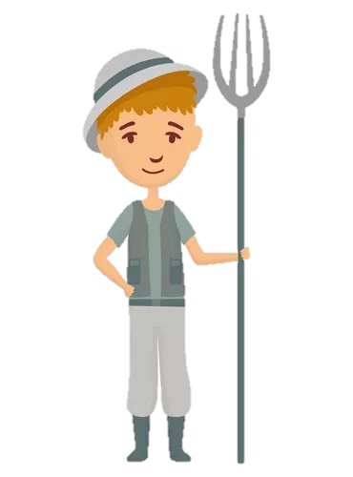
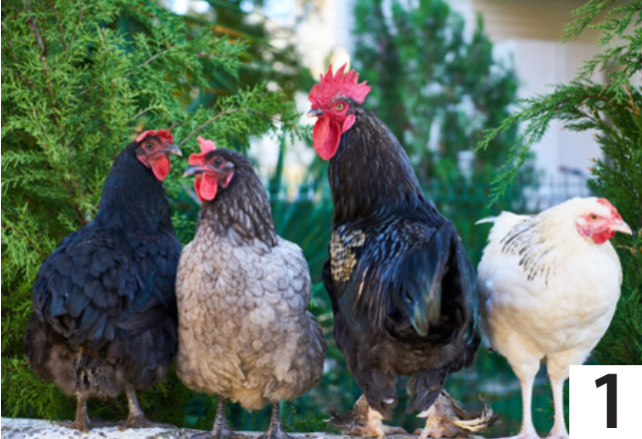
3 Look and say.
1. I’ve got........................….
some chickens.

Slide 9
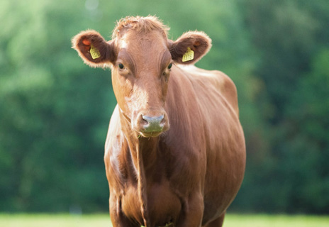
3 Look and say.
2. I’ve got........................….
a cow

Slide 10
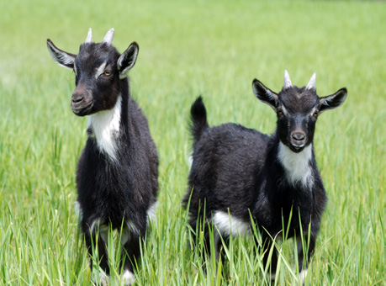
3 Look and say.
3. I’ve got........................….
some goats.

Slide 11
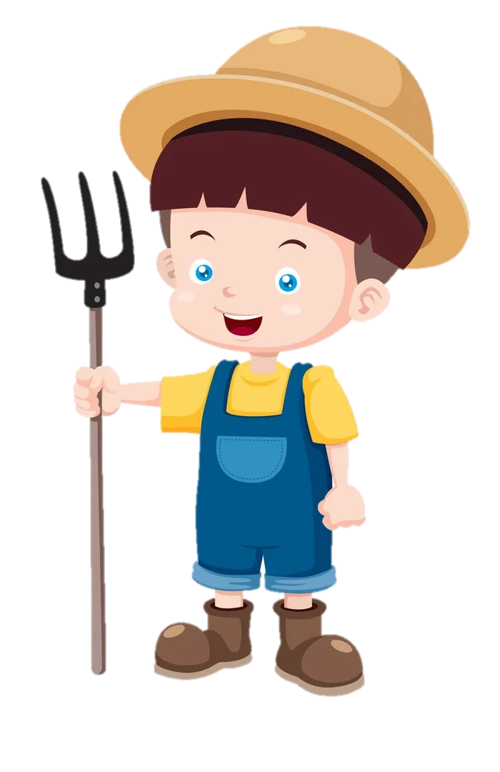
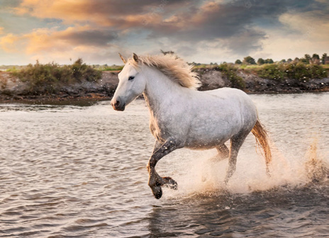
3 Look and say.
4. I’ve got.....................
a horse.

Slide 12
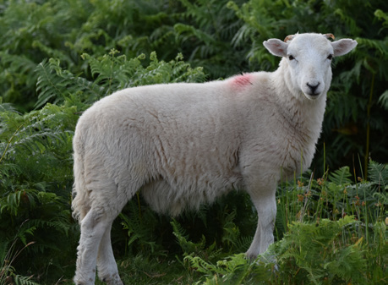
3 Look and say.
5. I’ve got........................….
a sheep.

Slide 13
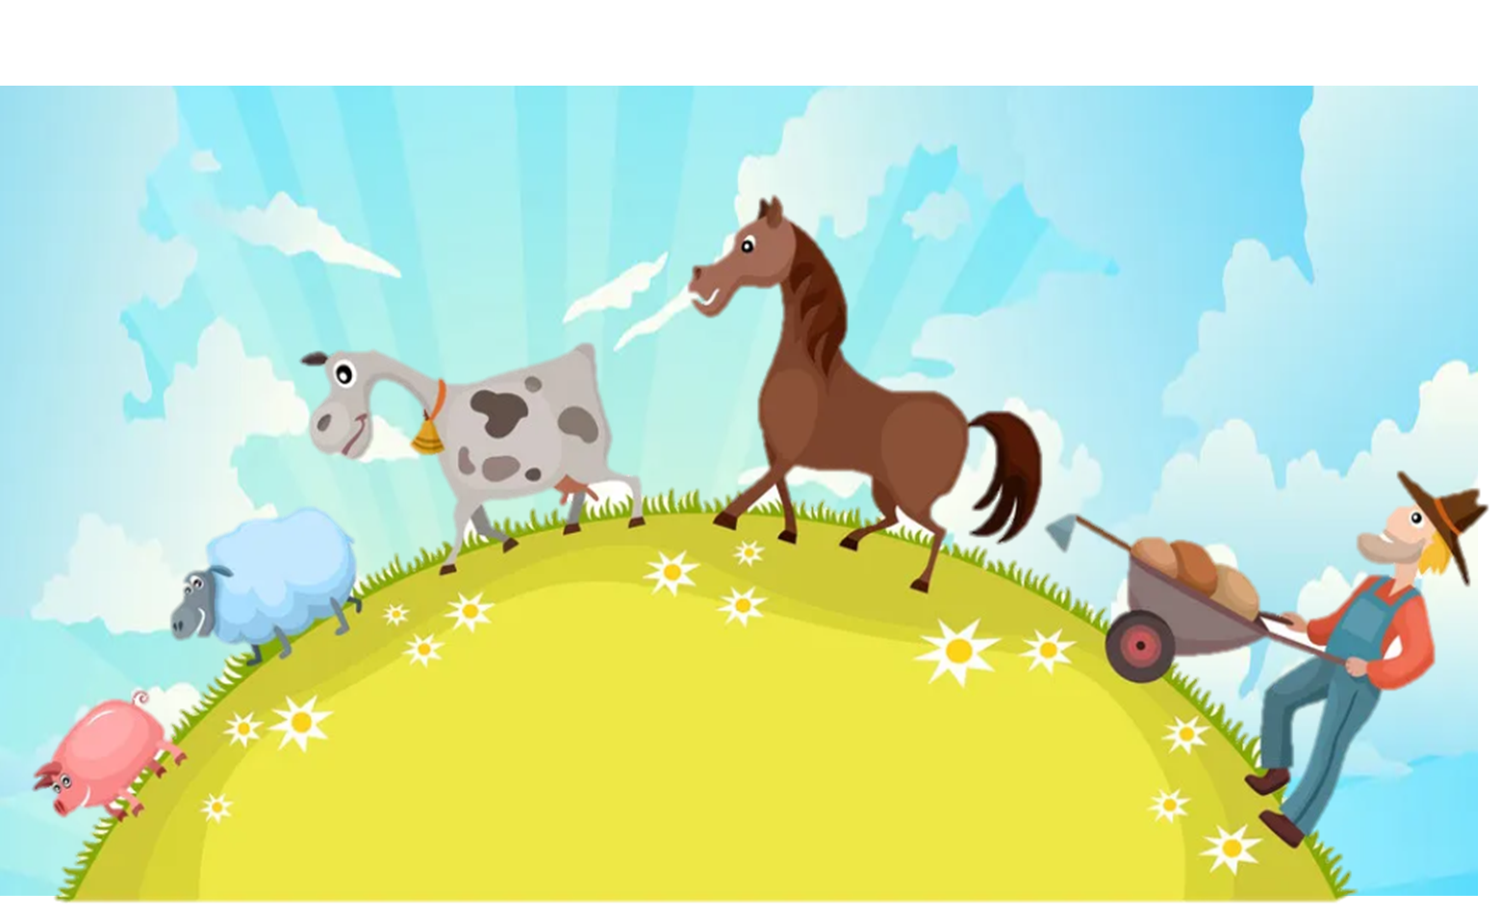
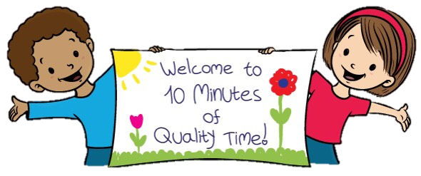
4 Production

Slide 14
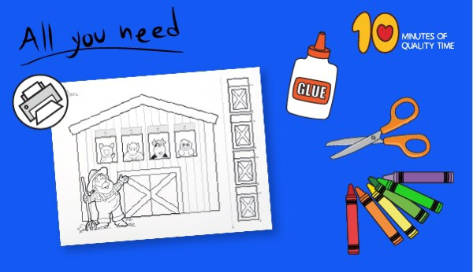
Old Macdonald had a farm craft

Slide 15
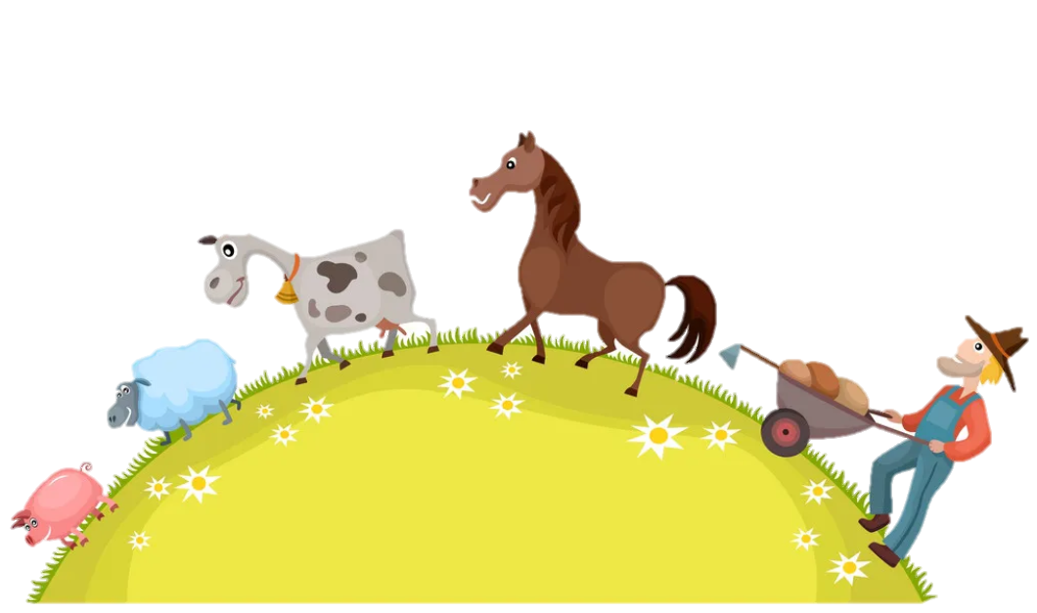
5 Assessment

Slide 16
Look and number
WORD LIST
Cow
Chicken
Sheep
Goat
Horse
2
4
3
1
5

Slide 17

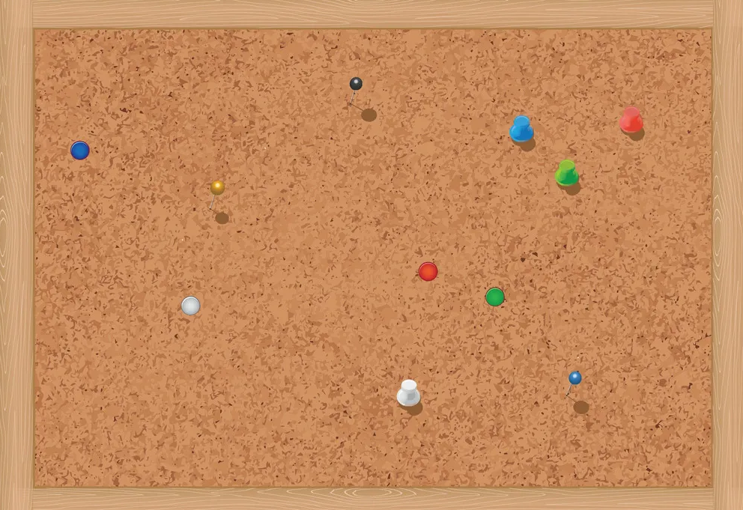



REMEMBER
Vocabulary
Chicken
Cow
Goat
Horse
Sheep
Structures
I’ve got some chickens.

Slide 18

Thank you
& goodbye!

